Slide 1

Towinly
It takes two To Win.
Help and company for elders, from younger helpers nearby who earn trust step by step.
Investor overview · August 2026 · towinly.com

Slide 2
THE PROBLEM
Elders are alone. Helpers are willing.
No one has built the bridge.
15 cigarettes a day
“Mom doesn’t want a stranger in her house. But she also won’t call us every time she needs help. So she goes without.”
the health toll of chronic loneliness (Surgeon General, 2023)
27% live alone
Daughter of an 82-year-old, Toronto
of US adults 60+ (Pew Research). Asking a stranger for help is still a gamble.
Elders go without. Families worry. Willing helpers never find them.
Towinly · It takes two To Win.
02

Slide 3
THE SOLUTION
A trust app, on the phone elders already carry.
Elders
Helpers
Families
Ask for help or company. The elder leads every step.
Give time, earn money, and build a Trust Score that travels with you.
Up to five relatives stay close: they see each friendship grow and hear when something needs attention.
Strangers at first. Trust earned step by step, and the elder always leads.
Towinly · It takes two To Win.
03

Slide 4
HOW IT WORKS
Seven steps. Both people must say yes.
7
6
Fully Trusted
5
Ready to Meet
4
Social Media
3
Video Ready
2
Phone Ready
1
Messaging
Just Connected
Both people must agree to every step. Slow is the point.
Towinly · It takes two To Win.
04

Slide 5
THE TRUST SCORE
Trust, made visible.
Each connection is worth 15 points
Score tiers
Profile
+3
90+
Community Champion
ID, phone and photo on file
Trust Ladder
+7
45+
Highly Trusted
one point per step climbed together
15+
Reliable
Review
+5
one point per star from that person
1+
Getting Started
Summed across every real friendship.
0
New Member
Elders open a helper’s profile and read the Trust Score before they say yes.
Towinly · It takes two To Win.
05

Slide 6
WHY NOW
A first in history: elders online,
and more of them than ever.
6×
7 in 10
73 yrs
1 in 6
smartphone growth among US seniors in a decade (Pew)
urban Indian 60+ payments are digital (Kearney)
life expectancy, up from 47 in 1950 (UN)
people will be 60+ by 2030 (WHO)
The biggest elder generation ever, and the first that pays online.
Towinly · It takes two To Win.
06

Slide 7
WHY IT MATTERS
More elders every year. Company keeps them well.
50%
US$6.7B
2.1B
HEALTH
MONEY
THE FUTURE
better odds of survival for people with strong social ties (148 studies, PLOS Medicine)
extra Medicare spending each year on socially isolated older adults (AARP, Stanford)
people aged 60+ by 2050, double 2020. India alone: 347M (WHO, UNFPA)
Company isn’t a luxury. Company is healthcare.
Towinly · It takes two To Win.
07

Slide 8
WHY TOWINLY
Both sides win.
Today’s elders use phones, shop online, and pay online. Tomorrow there will be many more. But the hardest parts of growing older haven’t changed: feeling lonely, and not having enough energy for everyday things.
Elders
Helpers
HAVE
Time, money, and life lessons to share
HAVE
Energy, time, and good company
NEED
Energy and company
NEED
Money, care, and life advice
Towinly is where they meet and share, and both win.
Towinly · It takes two To Win.
08

Slide 9
THE MARKET
India and North America first. Then the world.
US$1.6T+
220M+
2M elders
TAM
SAM
SOM
the global elder-care economy by 2030 (industry forecasts)
seniors in our home markets: India (150M+) plus the US and Canada (70M+)
our first three years, about 1% of home markets, city by city
Only 1% of India’s senior care is organized today. The trust layer is wide open.
Towinly · It takes two To Win.
09

Slide 10
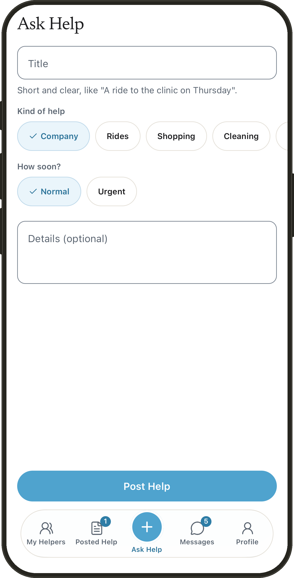
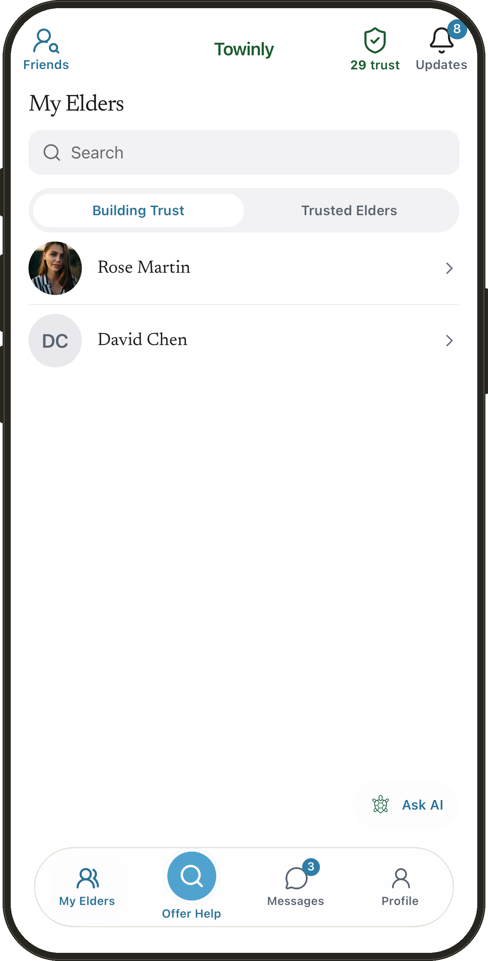
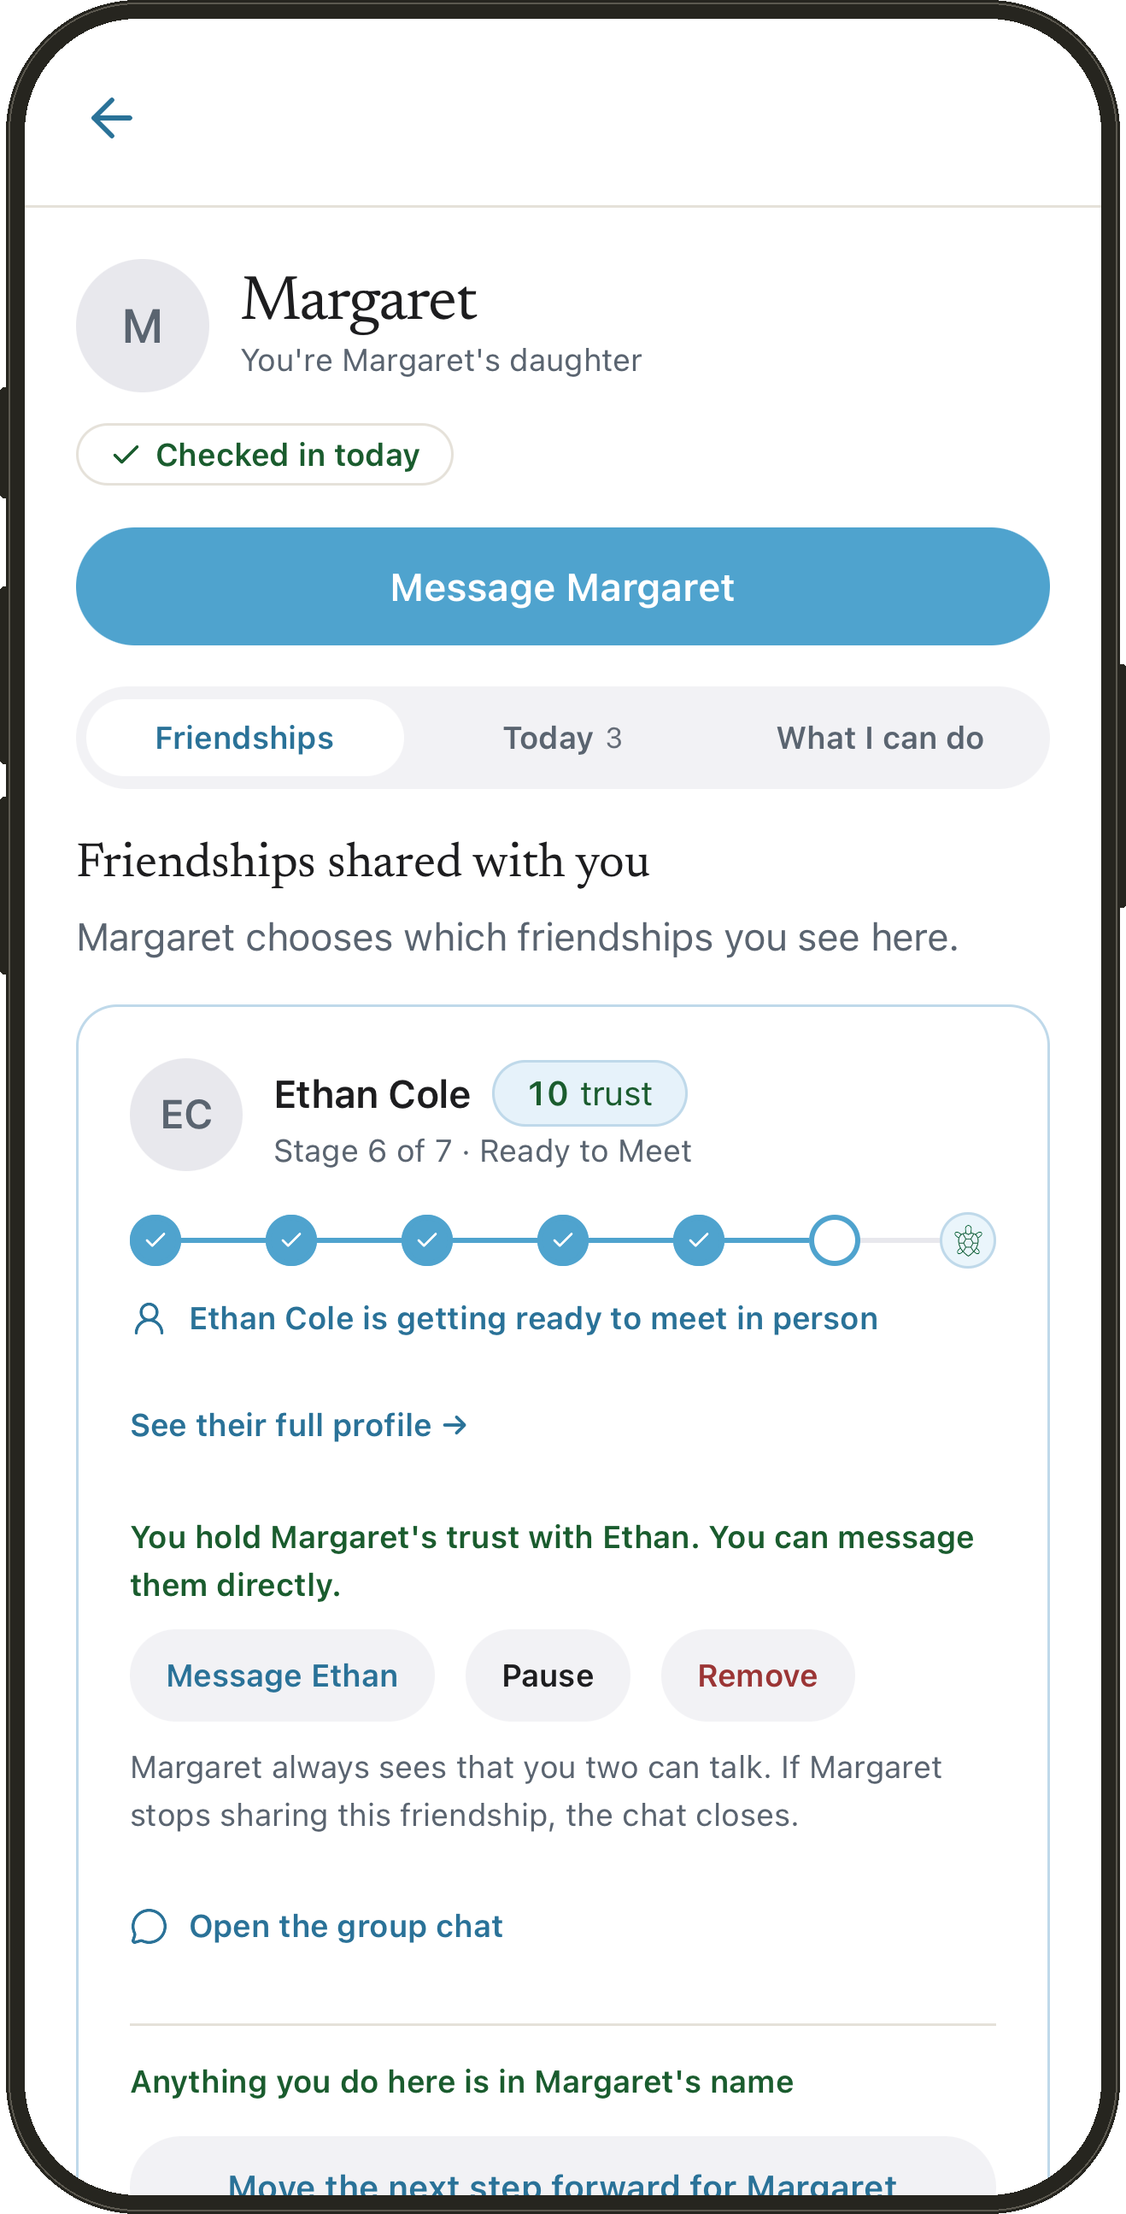
THE PRODUCT
The app is built. One seat each.
ELDER
HELPER
FAMILY
Ask for a ride, shopping,
cleaning or company.
The elders you help,
and your trust score.
See your parent is well,
and message them.
iOS on TestFlight · Android build ready · towinly.com/app on any phone
Towinly · It takes two To Win.
10

Slide 11
THE PRODUCT
What ships in version 1.
Help nearby
Chat inside the app
Family watch
A ride, shopping, cleaning or company. Helpers nearby see it, 25 km by default, and offer a hand. The elder chooses.
Messages stay in Towinly. Phone numbers are shared only when both people agree.
Up to five family members see each friendship climb, get alerts, and can step in when asked.
Daily check-in
My boxes
Safety
One tap a day. If the elder goes quiet, linked family is told.
Stories, letters, and a sealed box that opens only after a person at Towinly has checked a death certificate and waited thirty days.
SOS reaches emergency contacts. A block holds on every phone you sign in on, and push alerts never carry message text.
Help is easy to find. Trust takes time.
Towinly · It takes two To Win.
11

Slide 12
EXECUTION
The product risk is behind us.
TestFlight
Live
1,401
1 person
iOS 1.1.0 in testers’ hands; the Android build is ready for Play
on towinly.com with one-tap demo accounts, and in any phone browser
automated tests across 173 suites, all green
designed, built and shipped it all
Next: the store launch and the first pilot community. That is what we are asking for.
Towinly · It takes two To Win.
12

Slide 13
BUSINESS MODEL
Free for the first months.
Revenue is ready when we are.
Service commission
a small share of paid tasks such as rides and errands; companionship stays free
Elder Plus
optional subscription: priority matching, premium support
Helper Pro
optional subscription: more visibility, more applications
Family Dashboard
optional extras for adult children; the family view itself is free today
Partnerships
insurers, elder-care brands, hospitals
Everything is free at launch. We earn trust first. And always free for elders who cannot pay.
Towinly · It takes two To Win.
13

Slide 14
WHY WE WIN
Everyone else matches. Towinly builds trust.
Most apps
Towinly
Match instantly with strangers
Seven trust steps, both say yes
Built for the young
Designed for a 75-year-old
The elder is a customer
Elders give back: skills, stories
Family is locked out
Family watch, SOS, daily check-in
Elder cybercrime in India rose 86% in two years. Matching without trust is dangerous.
Towinly · It takes two To Win.
14

Slide 15
ROADMAP
From first pilots to a platform for living well.
Live now
Next 12 months
Big bets
iOS, Android and web
Trust Ladder and Trust Score
Help requests near you
Family watch, five seats
Check-in, SOS, blocks, alerts
My boxes: what I pass on
App Store and Play launch
In-app voice and video
Background checks
Neighbourhood groups
Skill exchange
Hindi and Tamil
Digital Soul
Phone-line onboarding
The post-work world
The big bets wait until the trust layer has earned them.
Towinly · It takes two To Win.
15

Slide 16
TEAM
One founder. The whole platform.
Harshavardhan Anbu Gowri
$0
Founder · Full-Stack Engineer
Master’s in Computer Science, Concordia University, Canada.
Built Towinly end to end: React Native app, React web, Spring Boot backend, security, deployment.
AI-native engineer and entrepreneur: ships with AI at every step, from code to design to this deck.
raised so far. Everything in this deck already exists, built by one person.
portfolioharsha.vercel.app
Every dollar raised goes to trust, safety and reach. The product is already built.
Towinly · It takes two To Win.
16

Slide 17
THE ASK
Join the first mile.
Pilot communities
First-wave helpers
senior centres, retirement residences, neighbourhood associations
students, Gen Z volunteers, and retirees giving back
Family champions
Partners and funders
adult children who bring Towinly home to a parent
insurers, elder-care brands, funders of safety
Trust, built one connection at a time.
agharsha.anbu@gmail.com · help@towinly.com · towinly.com
Towinly · It takes two To Win.
17

Slide 18
APPENDIX
The numbers behind this deck.
Loneliness = 15 cigarettes a day
US Surgeon General advisory (2023)
27% of US adults 60+ live alone
Pew Research Center (2020)
78% of US 65+ own smartphones; 48% shop by phone
Pew Research Center (2025; 2022)
50% better survival with strong social ties
Holt-Lunstad et al., PLOS Medicine (2010), 148 studies
US$6.7B a year extra Medicare spend on isolation
AARP Public Policy Institute with Stanford (2017)
60+: 1 in 6 by 2030, 2.1B by 2050 · 80+ to 426M
WHO, “Ageing and Health” fact sheet
Life expectancy 47 → 73 years since 1950
United Nations, World Population Prospects
India: 150M+ seniors today → 347M by 2050
UNFPA India Ageing Report (2023)
7 in 10 urban 60+ payments digital · cybercrime +86%
Kearney × Amazon Pay (2024); NCRB via Safer Internet India
US$1.6T+ global elder-care market by 2030
Industry forecasts (Research & Markets; Brainy Insights)
Towinly · It takes two To Win.
18

