Slide 1
🍽️
ForkLine
Restaurant Management System
AI-Powered Full Stack Web Application
TEAM DETAILS
M. Harshavardhan Rao
Full Stack Developer
Backend Developer
UI/UX Designer
Database Engineer

Slide 2
Introduction
02
ForkLine is a comprehensive, AI-prompt-generated full stack web application designed to modernize restaurant operations. Built entirely using conversational AI prompts with Claude AI, it demonstrates how modern software can be created through intelligent prompt engineering without writing a single line of code manually.
Built With Claude AI
Prompts Used: 12+
Files Generated:
44
Lines of Code:
3,500+
🤖
🌐
📱
AI-Generated
Full Stack
Responsive
100% built using Claude AI prompts — no manual coding
Express.js + MongoDB + EJS with session authentication
Works on desktop, tablet and mobile devices

Slide 3
Objectives
03
01
02
Demonstrate the power of AI prompt engineering to build real-world production applications
Build a secure, role-based restaurant management system with Admin and Customer roles
03
04
Implement full CRUD operations for food menu, orders, and user management
Provide interactive dashboards with real-time charts using Chart.js
05
06
Enable food image uploads, session-based auth, and order tracking
Deploy the application online for access from any device worldwide

Slide 4
Stakeholders
04
👨‍💼
Restaurant Admin
👤
Customer
Manage full food menu
View & update all orders
Manage user accounts
View dashboard analytics
Browse available menu
Add items to cart
Place & track orders
View order history
🏢
Restaurant Owner
💻
Developer / AI
Monitor business KPIs
View revenue charts
Oversee operations
Scale the system
Built via AI prompts
Claude AI generated code
Zero manual coding
44 files, 3500+ lines

Slide 5
Programming Languages, Tools & Software
05
⚙️
🚂
🍃
🔷
📄
Node.js
Express.js
MongoDB
Mongoose
EJS
Runtime
Framework
Database
ODM
Template Engine
🔐
🍪
📁
📊
🤖
bcryptjs
express-session
Multer
Chart.js
Claude AI
Auth / Hashing
Session Mgmt
File Upload
Charts
AI Prompt Tool

Slide 6
AI Prompts Used to Generate Code (Part 1 / 2)
06
Prompt 1
Create a responsive restaurant website using HTML, CSS, and JavaScript with sections like Home, Menu, and Contact.
Prompt 2
Continue — generate the remaining views: profile/index.ejs, public/css/style.css with full responsive design using CSS variables, and public/js/main.js with sidebar toggle, password visibility, alert auto-dismiss and file drag-and-drop.
Prompt 3
Develop a Node.js Express backend with MongoDB connection for storing user and order data.
Prompt 4
Implement user authentication with login and registration using bcrypt and session management.

Slide 7
AI Prompts Used to Generate Code (Part 2 / 2)
06
Prompt 5
Design role-based access control with Admin and Customer functionalities.
Create CRUD operations for managing food items including add, edit, delete, and display.
Prompt 6
Build an order management system where customers can place orders and admins can view them.
Integrate frontend with backend using fetch API for sending and receiving data.
Design a responsive dashboard interface with navigation and user-specific features.
Prompt 7
Implement image upload functionality for food items using multer.
Store and retrieve data efficiently using MongoDB and Mongoose schemas.

Slide 8
Application Workflow
07
User Visits Site
Login / Register
Stores all data
MongoDB Database
Session Created
Role Check
Admin Dashboard
Customer
Customer Dashboard
Admin
Manage Menu / Orders / Users
Browse Menu & Place Order
Auth Layer
Logic Layer
Data Layer
Customer

Slide 9
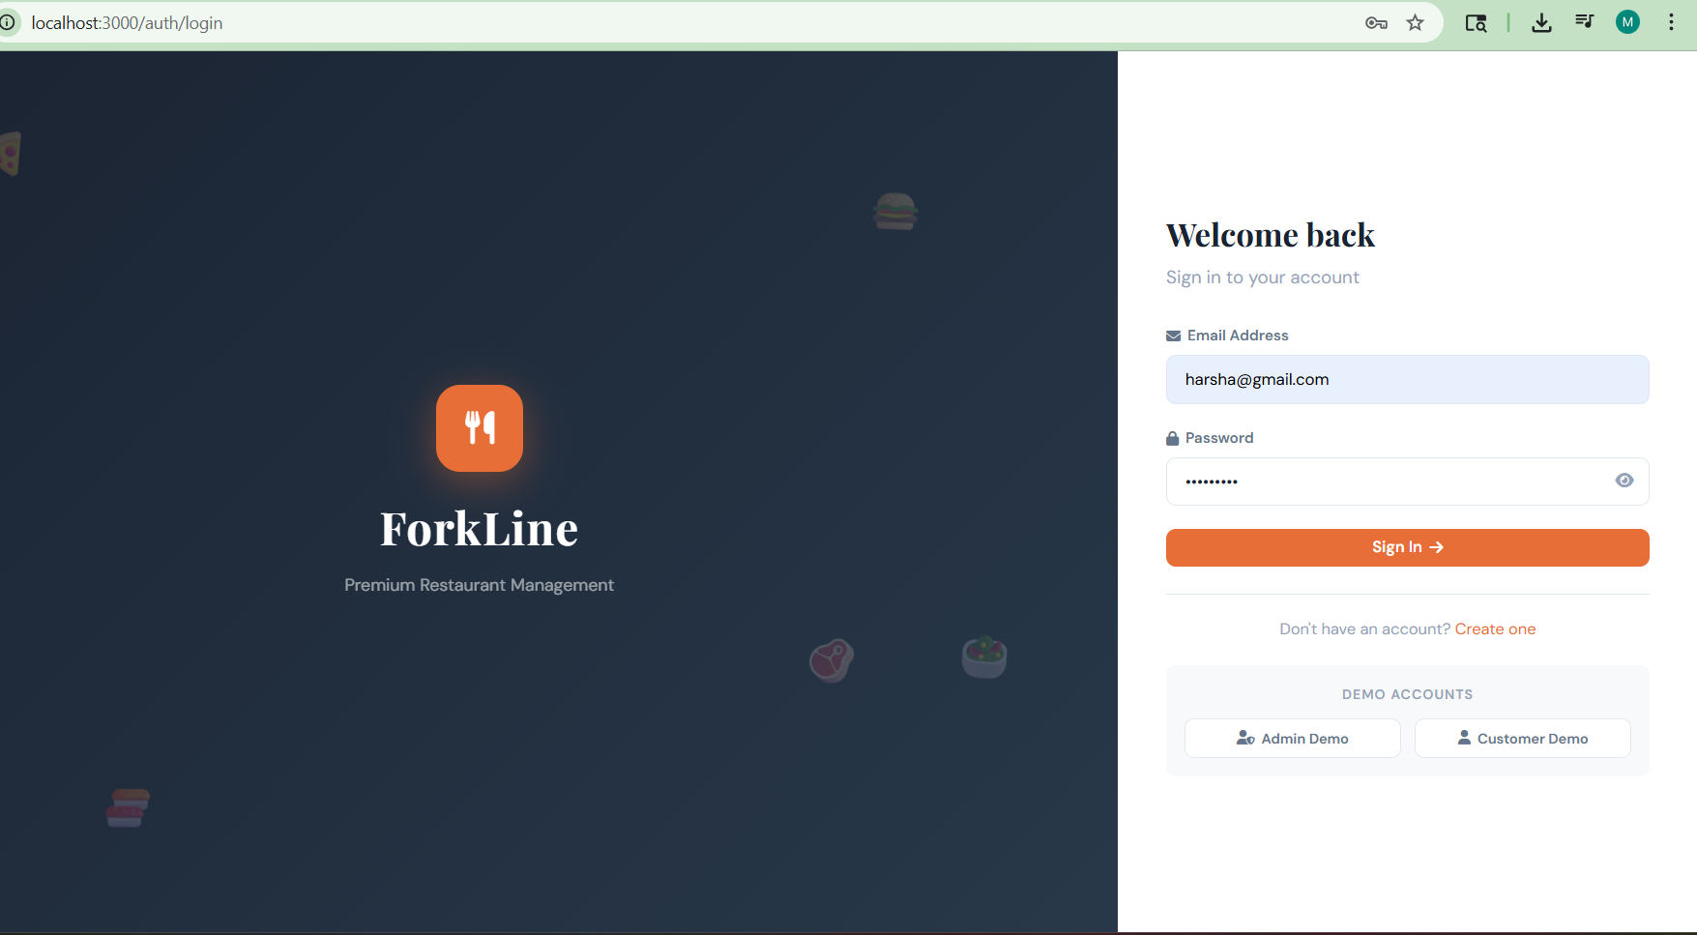
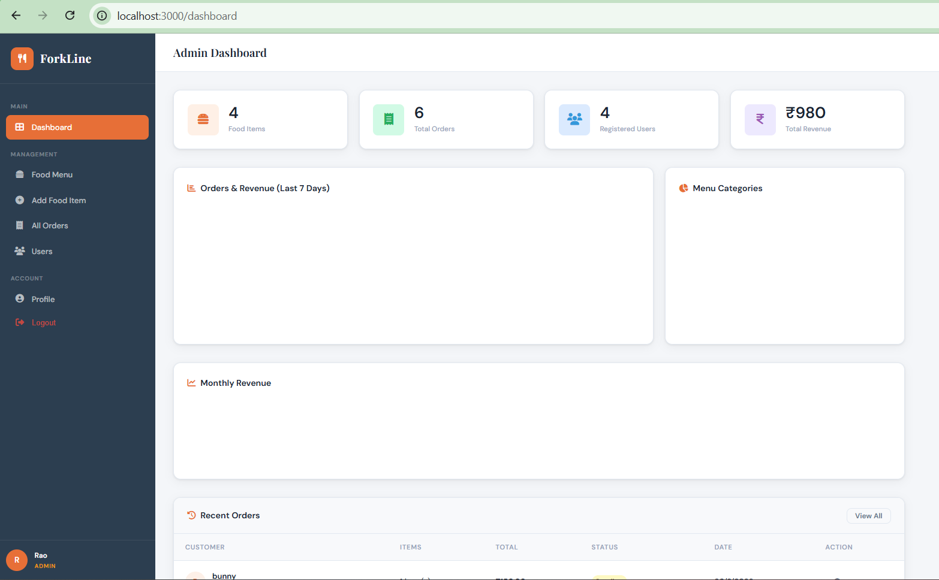
Front-End Views
08
Login Page
Admin Dashboard
Email & password login with demo account buttons and animated food icons
Stats cards (foods/orders/users/revenue), Bar chart, Doughnut chart, recent orders table

Slide 10
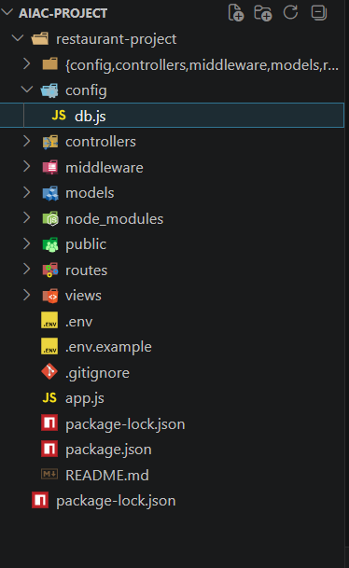
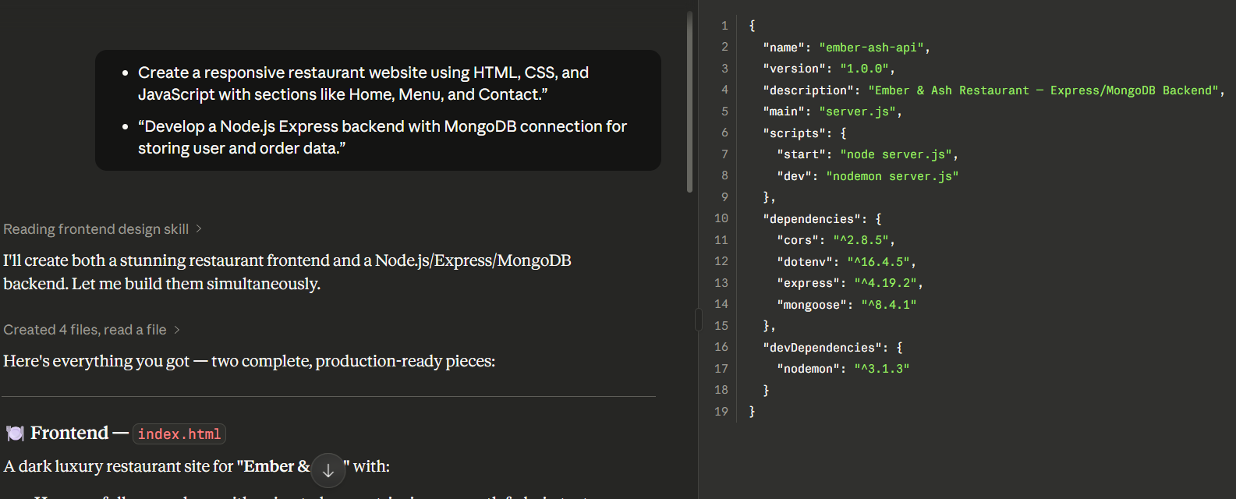
Proof of Prompts Generating Code
09

Slide 11
References
10
[1] Claude AI by Anthropic
[2] Express.js Official Docs
https://claude.ai
https://expressjs.com
Primary AI tool used to generate all source code via prompt engineering
Web framework for Node.js — routing, middleware, and server setup
[3] MongoDB Official Docs
[4] Mongoose Documentation
https://www.mongodb.com/docs
https://mongoosejs.com/docs
NoSQL database documentation — queries, schemas, and Atlas setup
ODM for MongoDB — model definitions, validation, and methods
[5] EJS Template Engine
[6] Chart.js Documentation
https://ejs.co
https://www.chartjs.org/docs
Embedded JavaScript templating used for all server-side rendered views
JavaScript charting library used for dashboard analytics and graphs
[7] Multer — File Upload Middleware
[8] Railway — Cloud Deployment
https://github.com/expressjs/multer
https://railway.app
Handles multipart/form-data for image uploads in the food management module
Platform used to deploy the application online with a public URL

Slide 12
🍽️
Thank You!
ForkLine — Restaurant Management System
Built entirely using AI Prompt Engineering with Claude AI

