Slide 1
STOCK MARKET PREDICTION
Siva,Ruthvika,Yeshash,Pamar

Slide 2
ABSTRACT
Invested time in understanding the concept of stocks and how stock prediction is done
Started with trying linear regression on some sample data
Noted that linear regression doesn’t help time series data, since it doesn’t store any memory
Breakthrough: Usage of RNNs is the key to move forward
Experimented different kind of ideas with various stock samples ,like
->long short term memory(LSTM model)
Single layer
Multiple layers
->Gated Recurrent Units(GRU model)
Analysed and compared the performance of each experiment
Drawed the advantages and disadvantages of each idea
Conclusions

Slide 3
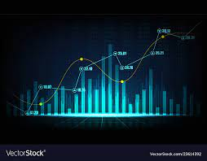
INTRODUCTION
As financial institutions begin to embrace artificial intelligence, machine learning is increasingly utilized to help make trading decisions.
We would like to model stock prices correctly, so as a stock buyer you can reasonably decide when to buy stocks and when to sell them to make a profit.
This is where time series modelling comes in.
We need good machine learning models that can look at the history of a sequence of data and correctly predict what the future elements of the sequence are going to be.

Slide 4
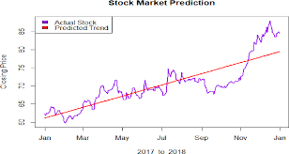
Linear Regression to Start with

Slide 5
Observed poor performance,why??
Linear regression analyzes two separate variables in order to define a single relationship
The future is shown as a linear increase which is not true as if you observe the actual values you see a jump up and a fall down in the prices. There is a lot of variability in the actual data but a standard increase in the forecasted values.
The line goes only one way which means if the past has been of an average increase over a period of time then the future will also show the average increase over the next period. In reality, there is always a danger of trend reversal which the linear forecast can never reveal.
The values by and of itself differ from the actual by large percentages in excess of 10% which shows it is not such an accurate predictor

Slide 6
Solution? Recurrent Networks!!
Recurrent Neural Networks are a type of neural network where the output from previous step are fed as input to the current step.
In traditional neural networks, all the inputs and outputs are independent of each other, but in cases like when it is required to predict the next word of a sentence, the previous words are required and hence there is a need to remember the previous words.
Thus RNN came into existence, which solved this issue with the help of a Hidden Layer.
The main and most important feature of RNN is Hidden state, which remembers some information about a sequence

Slide 7
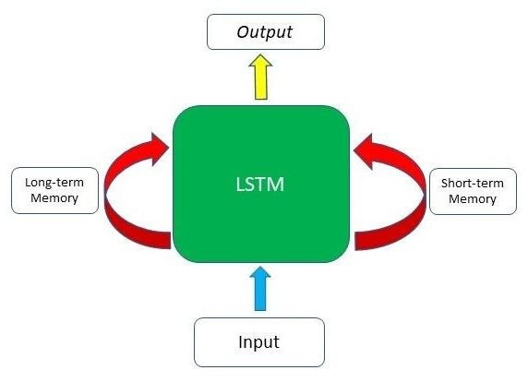
LSTMS
LSTMs are an improved version of recurrent neural networks (RNNs).
RNNs can only connect recent previous information and cannot connect information as the time gap grows.
This is where LSTMs come into play; LSTMs are a type of RNN that remember information over long periods of time, making them better suited for predicting stock prices.

Slide 8
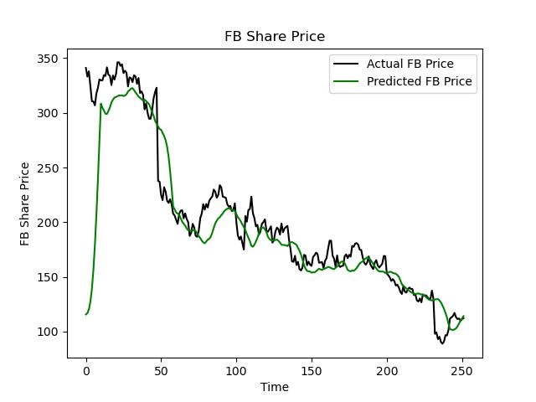
Applied LSTM on FB share prices

Slide 9
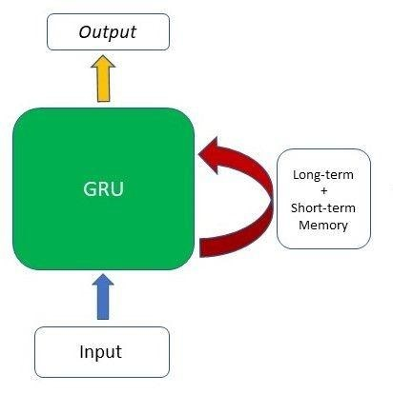
GRUs
GRUss are an improved version of LSTM neural networks .
GRU does not possess any internal memory, they don’t have an output gate that is present in LSTM.
Reset Gate in GRU substitutes the input and target gates of LSTM combinedly.

Slide 10
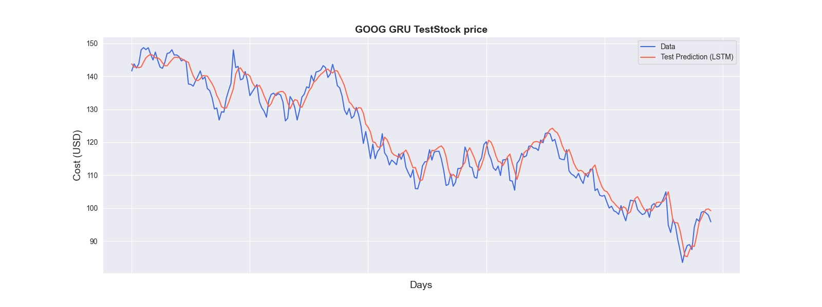
Applied GRU on GOOGLE share prices

Slide 11
LSTM vs GRU
In GRU memory operates only and directly via hidden state.
GRU uses less training parameters and therefore uses less memory and executes faster than LSTM whereas LSTM is more accurate on a larger dataset.
One can choose LSTM if you are dealing with large sequences and accuracy is concerned, GRU is used when you have less memory consumption and want faster results.

Slide 12
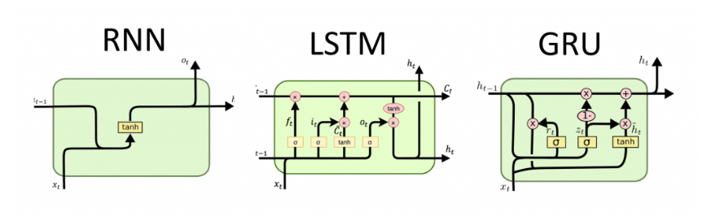
LSTM vs GRU

Slide 13
Conclusions
Although there is an abundance of stock data for machine learning models to train on, a high noise to signal ratio and the multitude of factors that affect stock prices are among the several reasons that predicting the market difficult.
At the same time, these models don’t need to reach high levels of accuracy because even 60% accuracy can deliver solid returns.
LSTMs,GRUs are used in different scenarios ,as per the requirement.

Slide 14
ACKNOWLEDGEMENTS
https://www.youtube.com/watch?v=pI-3TreYU18&list=PLEAYkSg4uSQ1r-2XrJ_GBzzS6I-f8yfRU&index=109
https://towardsdatascience.com/predicting-stock-prices-using-a-keras-lstm-model-4225457f0233#:~:text=Utilizing%20a%20Keras%20LSTM%20model%20to%20forecast%20stock%20trends&text=At%20the%20same%20time%2C%20these,LSTM)%20for%20times%20series%20forecasting.
https://www.kaggle.com/code/faressayah/stock-market-analysis-prediction-using-lstm
https://medium.datadriveninvestor.com/stock-price-prediction-using-recurrent-neural-network-artificial-intelligence-ffe6ac1bd344
https://www.sciencedirect.com/science/article/pii/S1877050920304865
https://github.com/RodolfoLSS/stock-prediction-pytorch/blob/master/stock-prediction-pytorch.ipynb

Slide 15


