Slide 1

MOVIE RATING ANALYSIS

Slide 2

PROJECT
This study seeks to examine and characterize the obstacles faced by the top-rated 1000 movies on IMDb. IMDb's list of the highest-rated films serves as a benchmark for cinematic excellence, and comprehending the particular challenges these movies encounter can offer valuable insights into filmmaking techniques, artistic development, and the ever-evolving landscape of the film industry.
1. Problem Domain: The problem domain here revolves around the world of movies, specifically the top-rated films on IMDb. It involves analyzing a dataset related to the top 1000 rated movies on IMDb, with the aim of extracting insights and knowledge from the data.
2. Dataset: The dataset comprises detailed information about these movies, including titles, directors, release years, user ratings, genres, and more.
3. Objective: The objective is to perform exploratory data analysis (EDA) on the dataset to gain a deeper understanding of the top-rated movies' characteristics and performances. This analysis can provide valuable insights for movie enthusiasts, filmmakers, and industry professionals.

Slide 3
4. Exploratory Data Analysis (EDA): EDA for the top 1000 IMDb-rated movies involves analyzing statistical trends and patterns in various movie attributes, such as ratings, genres, and directors. Visualizations like bar charts, scatter plots, and word clouds can help identify popular genres, directors with the highest-rated films, and trends in movie ratings over the years.
5. Problem Statement:
Descriptive Analysis
Trend Analysis
Comparative Analysis
Predictive Analysis
User Engagement Analysis
6. Challenges: Challenges in analyzing the top 1000 IMDb-rated movies dataset may include data inconsistencies, missing information, variations in user ratings, and changes in the rankings over time as new movies are released and reviewed.

Slide 4
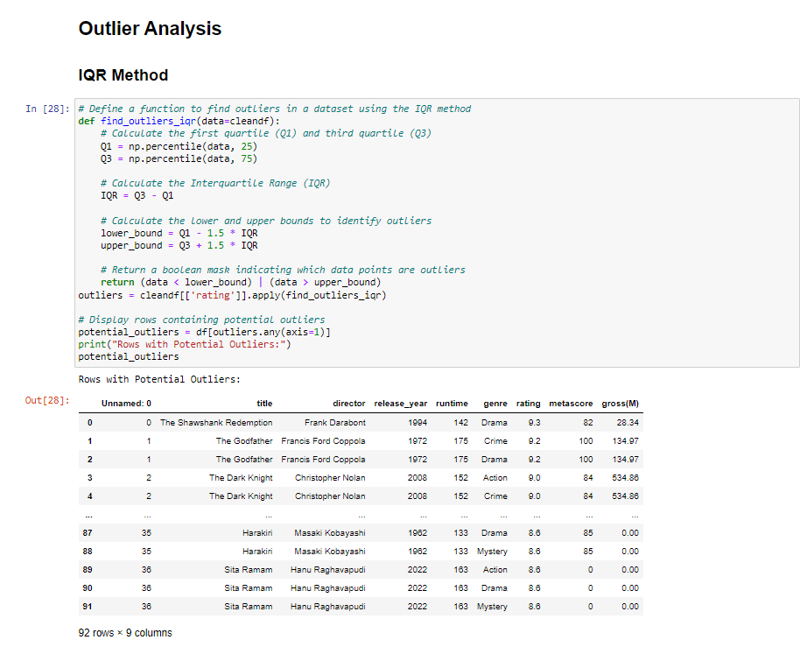
Outlier Analysis

Slide 5
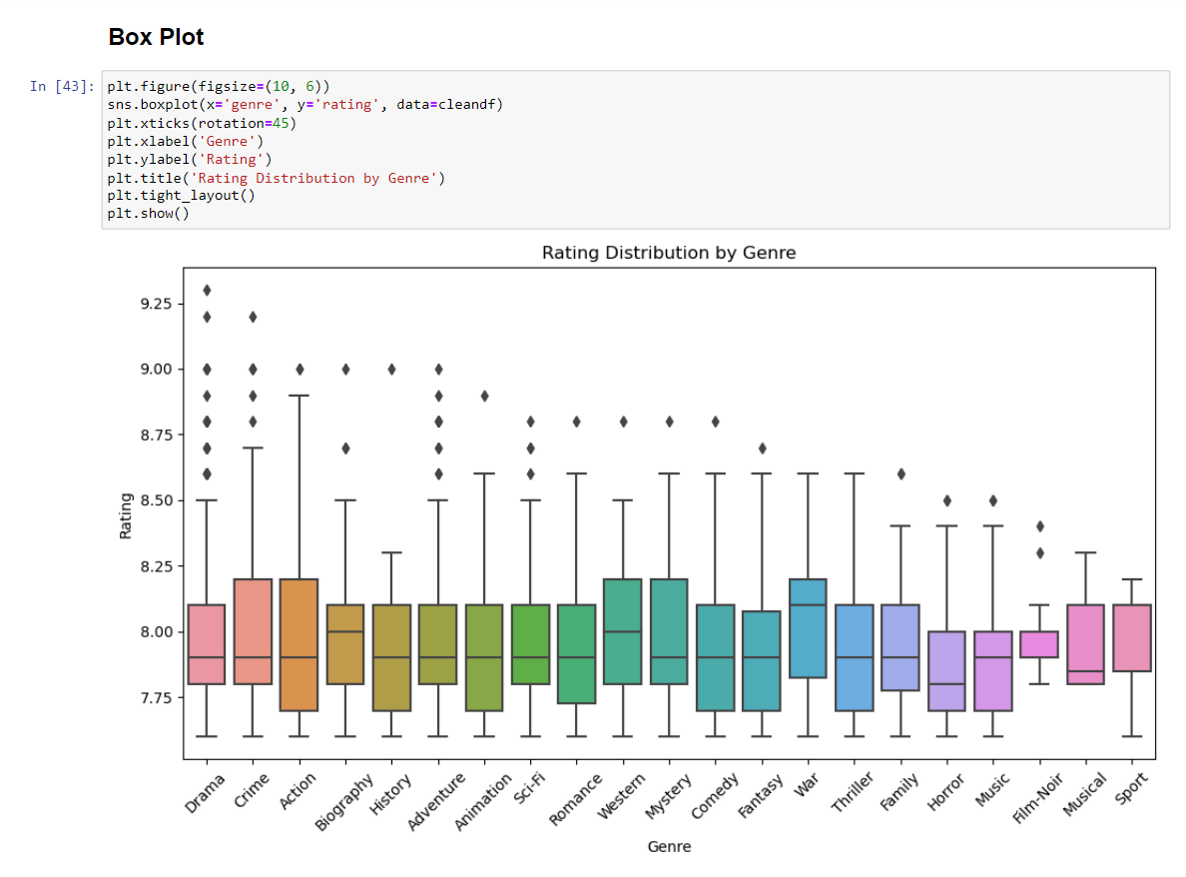
Box Plot

Slide 6
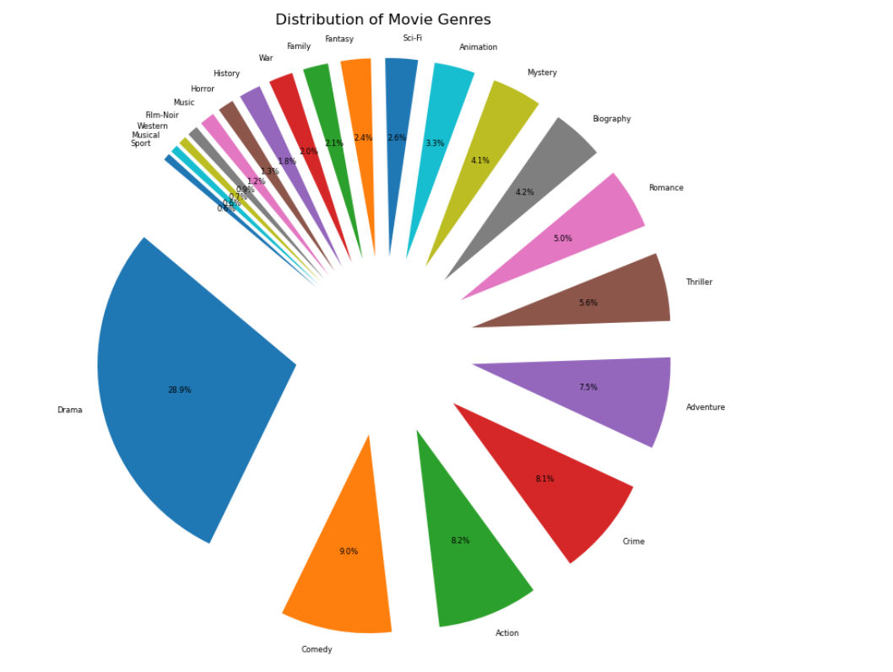
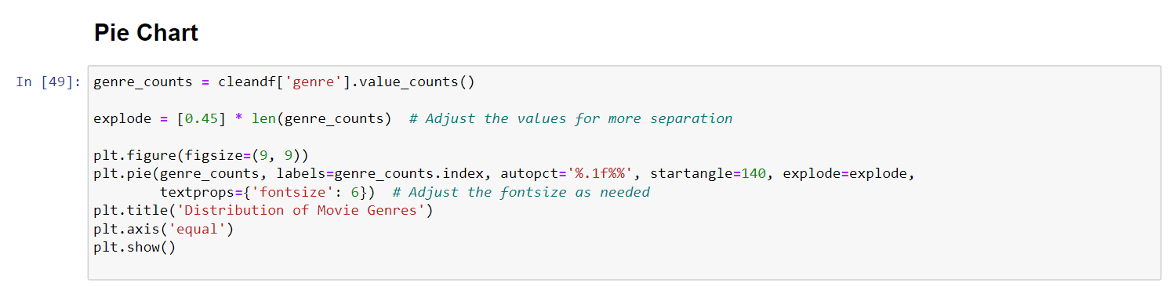

Slide 7
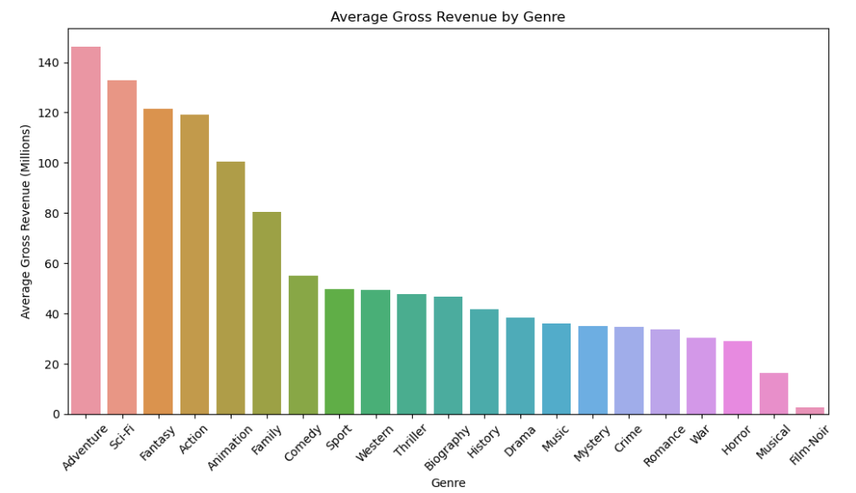
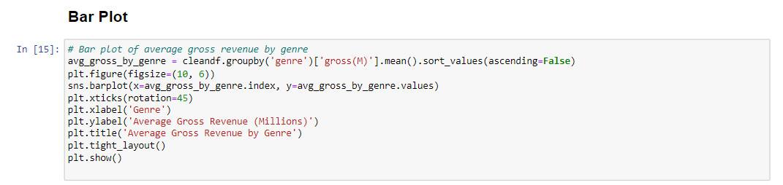
Bivariate Analysis

Slide 8
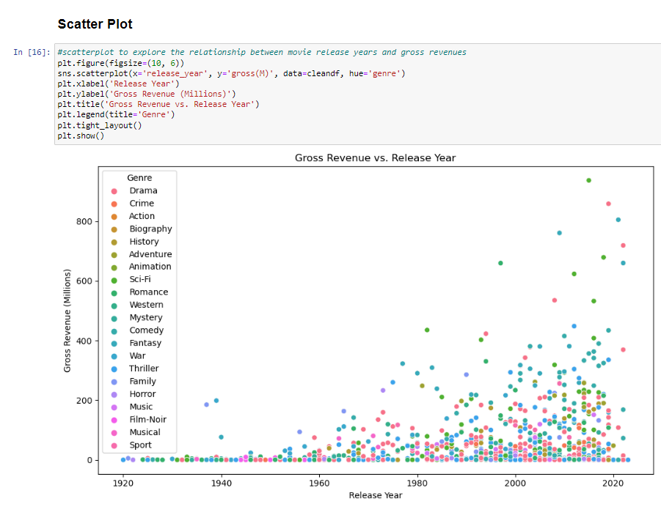
Scatter Plot

Slide 9
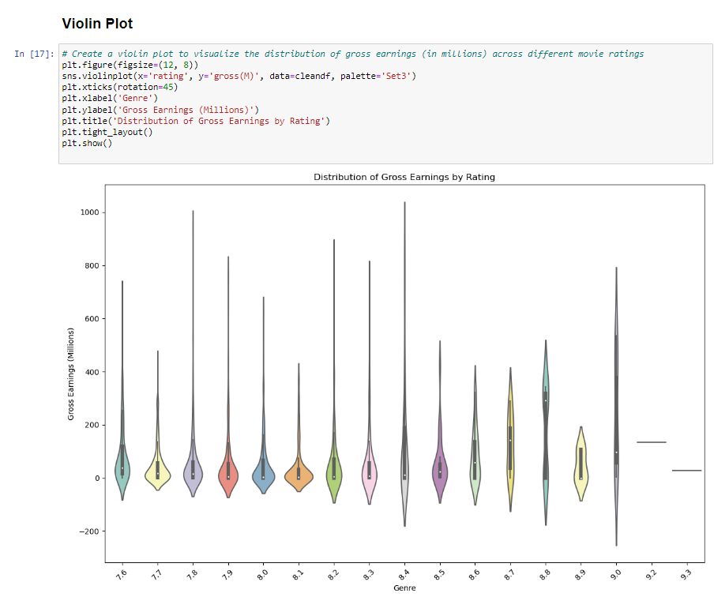
Violin Plot

Slide 10
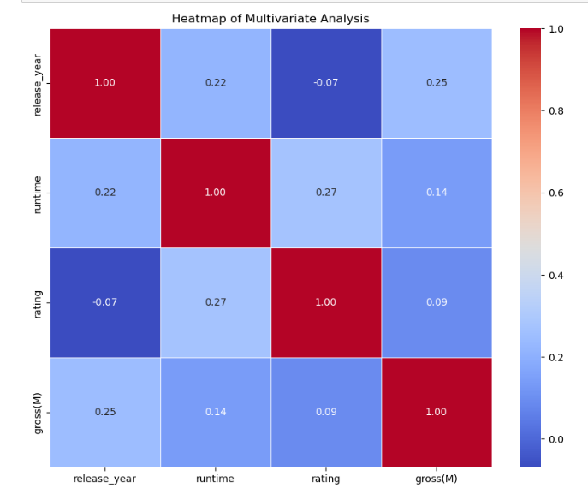
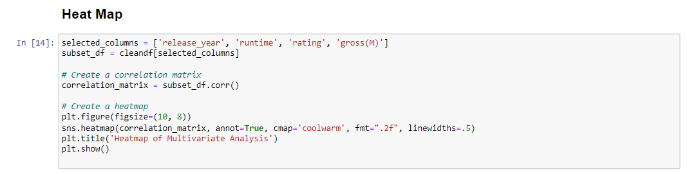
Multivariate Analysis

Slide 11
Limitations
Genre Classification Challenges: Classifying movies into specific genres may be subjective or ambiguous. Some movies may belong to multiple genres, and inconsistencies in genre classification can impact genre-based analyses.
Outliers and Anomalies: Outliers or anomalies in the data, such as extreme gross revenue values or unusually long runtimes, may disproportionately influence analyses and predictions. Identifying and handling these outliers appropriately is crucial.
Data Collection Bias: IMDb ratings and gross revenue figures may be biased towards movies that are more popular or well-promoted. This bias can impact the generalizability of findings to less publicized or independent films.
Data Quality and Reliability: The dataset's overall quality and reliability depend on the accuracy of the data sources and the completeness of information. Inaccuracies or inconsistencies can affect the validity of conclusions drawn from the data.

Slide 12
Recommendations:
Genre Insights:
Conduct a detailed genre analysis. Determine the most prevalent genres, analyze their average ratings and gross earnings, and identify any emerging or declining trends in genre popularity over the years.
Directorial Impact: Investigate the influence of directors on movie success. Identify top directors based on factors like average ratings, gross earnings, or the number of movies in the top 1000. Explore patterns in the performance of movies directed by specific individuals.
Runtime Exploration: Analyze the distribution of movie runtimes. Identify the average runtime, explore trends in movie lengths over the years, and examine whether there's a correlation between runtime and ratings or gross earnings.
Rating and Revenue Relationship: Investigate the correlation between movie ratings and gross earnings. Create visualizations, such as scatter plots, to better understand the relationship. Check if higher-rated movies tend to have higher gross earnings.

Slide 13
Outlier Detection: Identify and explore outliers in the dataset. Examine movies with exceptionally high or low ratings compared to their gross earnings. Investigate the characteristics of these outliers for potential insights.
Correlation Matrix: Generate a correlation matrix to quantify relationships between different variables. Examine which factors (e.g., release year, genre) are most strongly correlated with ratings and gross earnings.
Budget and Profitability: If available, consider incorporating data on movie budgets. Analyze the relationship between budget, profitability, and success to understand the cost-effectiveness of filmmaking.
Market Trends: Investigate broader market trends that might impact movie success, such as changes in consumer behavior, advancements in technology, or shifts in genre preferences.

Slide 14
Conclusion
Ratings Distribution: The distribution of movie ratings spans a wide range, showcasing the diversity in audience preferences for these top-rated films.
Director Impact: Certain directors consistently produce movies with high ratings, indicating the influence of directorial styles on audience reception.
Financial Success: The gross revenue column provides insights into the financial success of these top-rated movies. Exploring correlations with ratings and genre could reveal trends in audience expectations and box office performance.
In summary, this analysis of the top 1000 movies rated by IMDb provides a holistic understanding of the factors influencing audience ratings, genre preferences, and financial success. The insights gained contribute valuable information for stakeholders in the film industry to make informed decisions for future movie productions.

Slide 15


