Slide 1

22AIE301 – Probabilistic Reasoning
Amazon Review Analysis Using HMM
Presented To: Mr. Nagesh Koudinya Subbana
Team Members:
B SAI VIVEK– BL.EN.U4AIE22107
HARSHA VARDHAN T– BL.EN.U4AIE22159
SRI RAM K– BL.EN.U4AIE22124
ABHISHEK KUMAR K – BL.EN.U4AIE22120

Slide 2

Abstract
The goal of this work is on using Hidden Markov Models to categorize the sentiments of the reviews collected from Amazon into three categories of positive, negative and neutral.
It uses Viterbi algorithmic for decoding of the highest probable sentiment sequences and is therefore a hybrid of probabilistic modelling and natural language processing.
Amazon Gift Card ratings and textual reviews are used, where the ratings, textual reviews in particular, are feature preprocessed through tokenization, stop-word removal and lemmatization in order to extract features.
Illustrates the ability of combining probabilistic approaches with NLP for customer sentiment analysis and providing better understanding and thus, various tips for improving customer satisfaction.

Slide 3
Introduction
Consequently, product Amazon reviews act as an important source through which a business can gather important feedback about product quality and customers’ satisfaction.
Sentiment analysis is currently crucial for studying people’s attitudes and enhancing solutions across numerous fields.
The classification of reviews based on the Hidden Markov Models (HMMs) differs from traditional learning mechanisms as they use Markov chains with the existence of hidden states which represent some sentiment.
Therefore, the Viterbi algorithm is used to find the best path of hidden states allowing proper sentiment classification.
This project is concerned with using HMM with the aid of the Viterbi algorithm to classify sentiments in Amazon Gift Card as positive, neutral or negative and these are well interpretable models.

Slide 4
Problem Statement
Since the number of reviews submitted by users is increasing dramatically, businesses are in possession of two main issues: the ability to collect information from distributed sources and the capacity of identifying user sentiment in the avalanche of information.
Comparing to DSS, traditional methods of analysis does not always allow us to identify emotions properly and take into consideration dependencies between texts and their sequence.
This project mitigates these challenges by adopting Hidden Markov Models (HMMs) and the Viterbi Paths for the classification of the identified features in Amazon Gift card reviews data into positive, neutral or negative sentiments.
This approach taken to model the probabilistic dependencies between latent sentiment states, stands to offer a flexible and comprehensible framework for modern sentiment analysis.

Slide 5
Data Set Overview
Category: Comments are from the Gift Cards.
Size: Comprises 147194 customer ratings.
Attributes: It consists of the review text, an aggregated rating across all reviews (overall), the ID of the reviewer, product identification number (ASIN), votes for helpfulness, time stamp.
Sentiment Labels: Ratings are transformed into negative, neutral and positive due to the rating(overall).
Review Diversity: Reviews can also be short or lengthy, positive or negative or even detailed.
Labeled Dataset: Designed in a supervised learning way for building sentiment analysis.

Slide 6
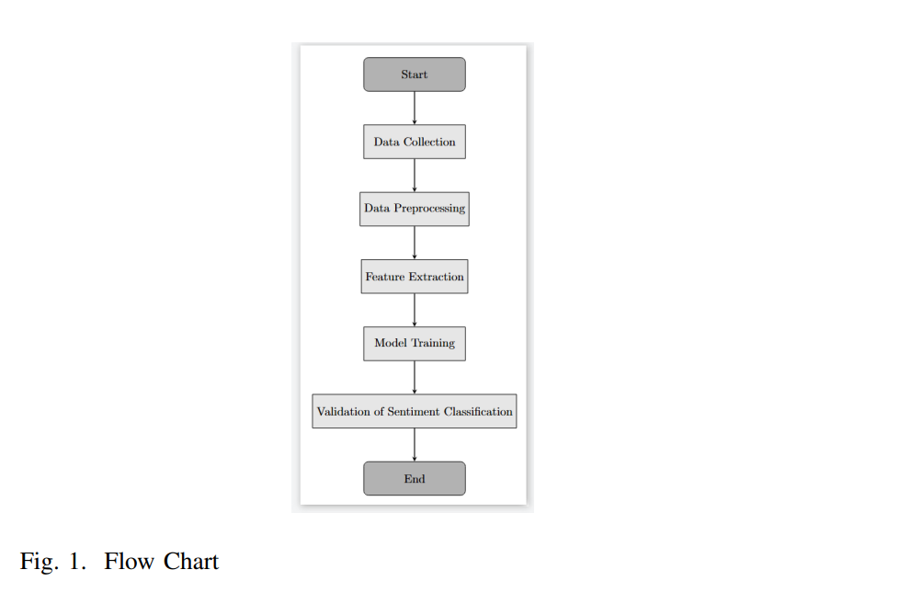
Methodology
Data Collection
Reviews extracted from Amazon Gift Card containing the review text (as an unstructured data) and the overall rating (as a structured data).
This is a table that gives ratings various aspects and maps them to positive, neutral and negative sentiments.
Some tables have been modified to make them fit the context of Organization with certain rows completely eliminated.
Data Preprocessing
Text pre-processing carried out included: Lower casing, Punctuation removal, Negative word handling.
They then splitted the given text into words and eliminated the stop words.
Lemmatization was also performed in order to get the same word represented in the same form.
Feature Extraction
Established dictionary where every token has been assigned its own index.
HMM produced input from encoded token sequences.
Treated out_of_vocabulary words also with a unique index different from any other index.

Slide 7
Methodology
Model Training
Further, trained HMM with Sentiment States such as positive, neutral and negative.
related, class imbalance was managed with the help of balancing techniques.
Recurrent patterns in sentiment classification validation
Applied Viterbi algorithm to the decoding of sentiment sequences.
The results for the evaluated model were accuracy, precision, recall, and F1 score.

Slide 8
RESULTS AND CONCLUSION
The Hidden Markov Model given an accuracy of about 76% effectively classified Amazon review into positive, neutral and negative sentiment, the precision defined at 67 % and recall at 64% are viable.
It was observed that while the intended sentiment classes were well captured, there remained a few false positives in which a review which might have been neutral or negative was classified as positive. This shows directions for further development for example in emission probabilities or in better capturing nuances in sentiment.
NLP preprocessing and feature extraction approaches including tokenization, lemmatization, and stop word removal were fundamental in Arranging the textual data into form that can be analyzed using HMM.
Through the decoding process of sentiment sequences, the Viterbi algorithm was demonstrated to tackle the interpretation and rigorous performances of HMMs in the sentiment classification problem.
Possible enhancements in the future might include more complex language capabilities, better class balance, integration of the best features of multiple methods to increase the efficiency of models, and to overcome the limitations of the methods used that include handling with complex sentiment expressions.

Slide 9
THANK YOU

