Slide 1
DOG BREED PREDICTION
DATA 603 Platforms for Big Data Processing
PROF: Melih Gunay
By:
Madhiri Sri Harsha Vardhan
Raja Pavan Kalyan

Slide 2
CONTENTS
Description Of The Project
Problem Statement
Project Implementation
Technologies Used
Project Workflow Diagram
Dataset
Data Collection
Visualizations And Results
Observations
Conclusion & Lesson’s Learnt
References

Slide 3
PROJECT DISCRIPTION
- Aim: The project aims to develop a machine learning model for predicting dog breeds from images.
- Method: Utilizing convolutional neural networks (CNNs), a deep learning technique known for its effectiveness in image classification tasks.
- Goal: The primary objective is to contribute to conservation efforts by providing a reliable tool for accurately identifying dog breeds. This aids in preserving genetic diversity within dog populations, which is crucial for breed conservation and management.

Slide 4
PROBLEM STATEMENT
Problem:
Complexity: Accurately identifying dog breeds from images is challenging due to the diverse appearance of different breeds and variations within breeds.
Manual Effort: Traditional methods rely on manual identification by experts, which is time-consuming and subjective.
Objective:
Machine Learning Solution: Develop a machine learning model capable of automatically predicting dog breeds from images.
Applications: The model will have applications in various fields such as pet adoption, veterinary care, and breed conservation efforts, where accurate breed identification is essential.

Slide 5
PROJECT IMPLEMENTATION
Data Sourcing: Obtained image data from Kaggle, a comprehensive platform for datasets, ensuring a diverse and extensive collection of dog breed images.
Data Storage: Leveraged MongoDB, a NoSQL database, to store the sourced image data, providing robust and scalable data handling capabilities.
Data Handling: Utilized PySpark, a powerful analytics engine for large-scale data processing, to preprocess and clean the image data effectively.
Image Processing: Employed OpenCV, an open-source computer vision library, for initial image processing tasks such as resizing and format standardization, ensuring consistency in image inputs.
Data Preprocessing: Conducted further data cleaning and preprocessing using PySpark, optimizing the data for model training by handling missing values and standardizing features.

Slide 6
PROJECT IMPLEMENTATION
Model Development: Developed a Convolutional Neural Network (CNN) tailored for high accuracy in image classification tasks, designed to effectively learn from thousands of images across numerous dog breeds.
Model Training: Trained the CNN model on a large dataset of 100,000 images, progressively validating and tuning it to improve accuracy and reduce overfitting, ensuring robust performance in breed prediction.
Machine Learning Enhancement: Utilized Spark's MLlib, a scalable machine learning library, for additional machine learning tasks, enhancing the model's learning capabilities and optimizing its performance.

Slide 7
TECHNOLOGIES UTILIZED
- PySpark: Leveraged for scalable and distributed data processing, allowing efficient handling of large-scale image datasets.
- MongoDB: Utilized as a NoSQL database for storing and managing the image data, providing flexibility and scalability in data storage.
- OpenCV: Employed for initial image processing tasks such as resizing and format standardization, ensuring consistency in image inputs for model training.
- Convolutional Neural Network (CNN): Developed a CNN architecture optimized for image classification tasks, capable of learning complex patterns and features from dog breed images.
- Spark's MLlib: Utilized for additional machine learning tasks, enhancing the model's learning capabilities and optimizing its performance through scalable algorithms and tools.
- Kaggle: Sourced image data from Kaggle, a renowned platform for datasets and competitions, ensuring a diverse and extensive collection of dog breed images for model training.

Slide 8
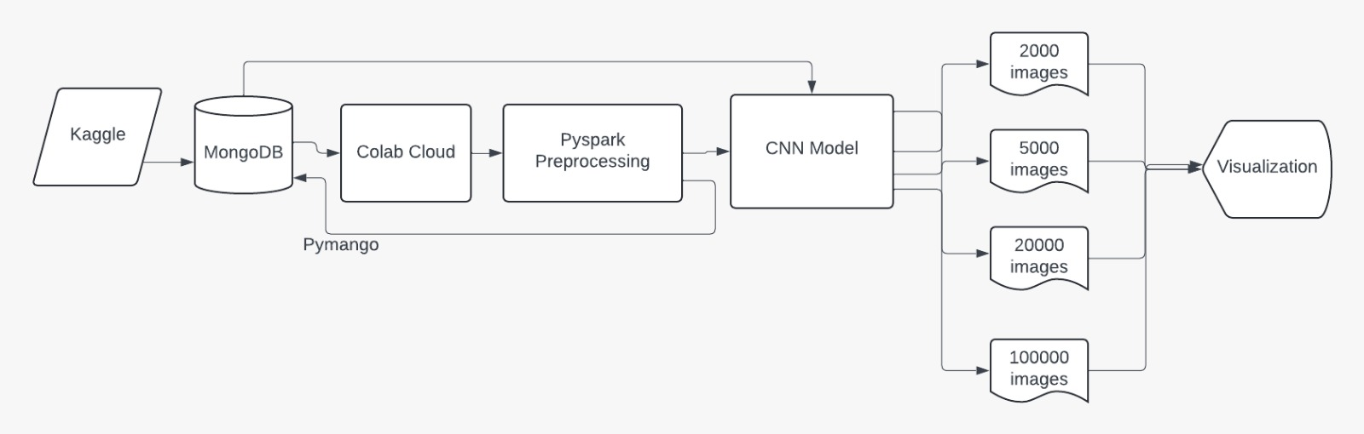
PROJECT WORK FLOW DIAGRAM

Slide 9
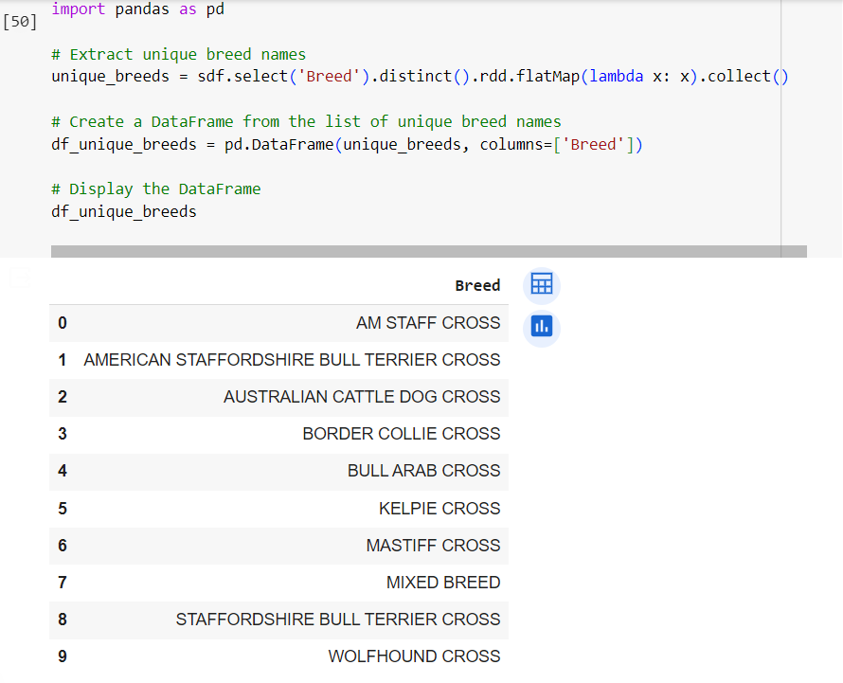
DATA SET
Obtained the dataset from Kaggle of size 20GB.
The dataset comprises images of dogs labelled by their respective breeds of 10 classes.
The dataset includes both a CSV file and a folder containing JPEG image files.
ATTRIBUTES
DogId: A unique identifier for each dog. Multiple rows may share the same DogId.
Breed: The breed name or label as advertised on the website.
Image: File name of the JPEG image stored in the accompanying folder.
Image number: An attribute ranging from 1 to 10, denoting the sequence number of the image associated with a particular DogId

Slide 10
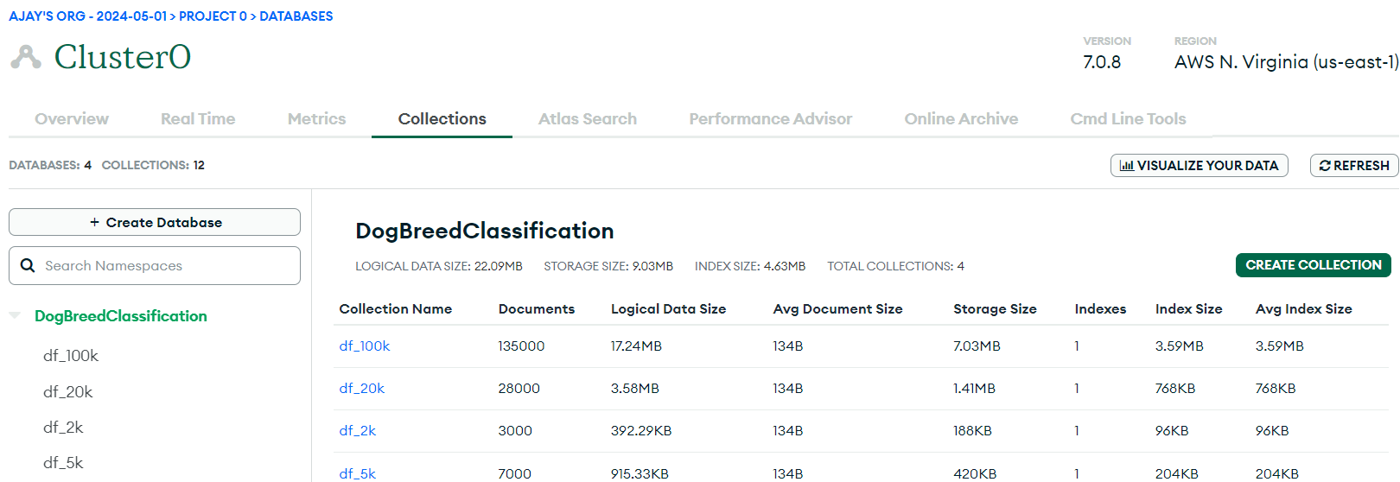
DATA COLLECTION
Loaded the image data (from Kaggle) into the "DogBreedClassification" collection within the MongoDB database.
Created a MongoDB Database housing datasets of varying sizes: 2000, 5000, 20000, and 100000 rows of image data.
Established a connection to the MongoDB cluster utilizing the pymongo library.

Slide 11
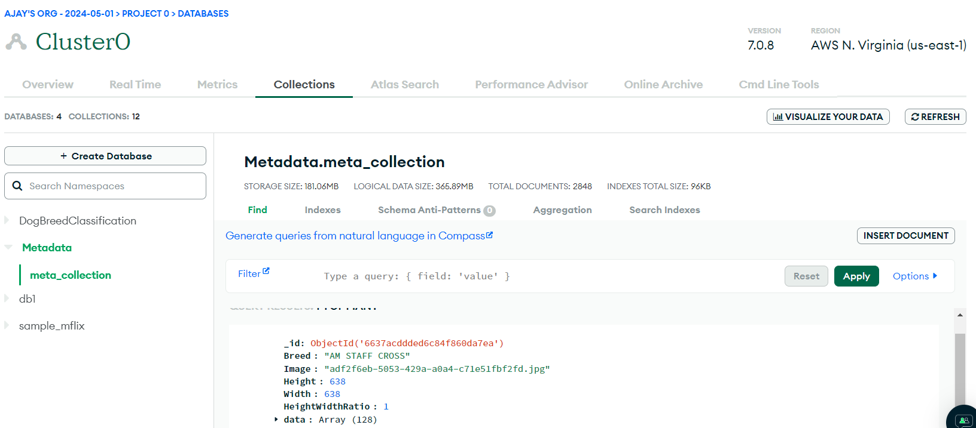
METADATA (PROCESSED DATA) TO MONGODB
The data which is preprocessed has been stored in the MongoDB

Slide 12
SAMPLING DATASET FOR TESTING AND TRAINING
Why Sample the Dataset?
To accommodate computational constraints and optimize resource usage.
To explore model performance across different dataset sizes.
To test the scalability of the model as dataset sizes increase.
Rationale:
Sampling enables efficient model development by reducing computational overhead.
Facilitates experimentation and iteration on model development more effectively.
Allows for testing model scalability and performance under varying dataset sizes.

Slide 13
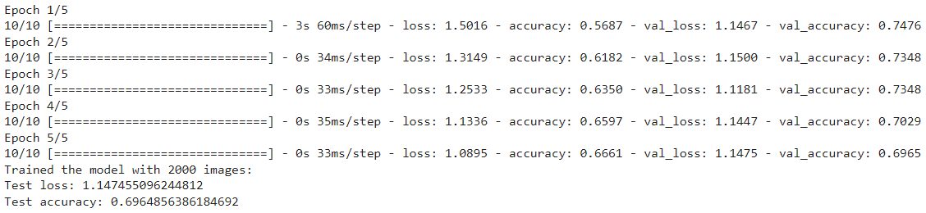
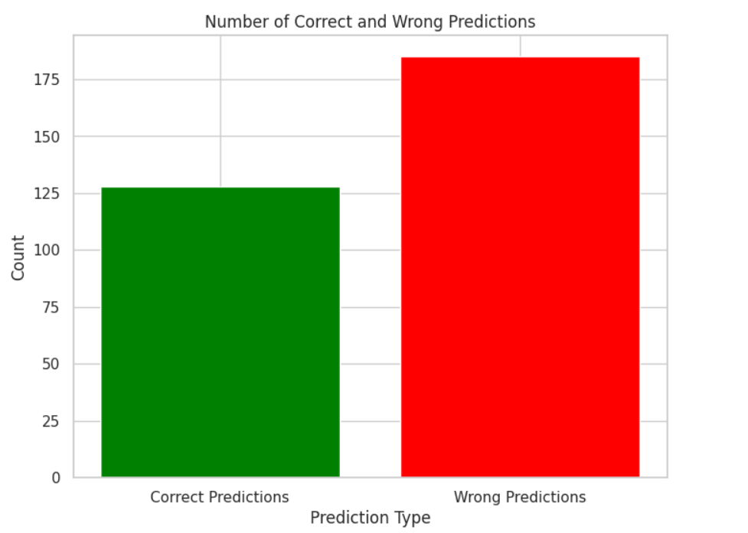
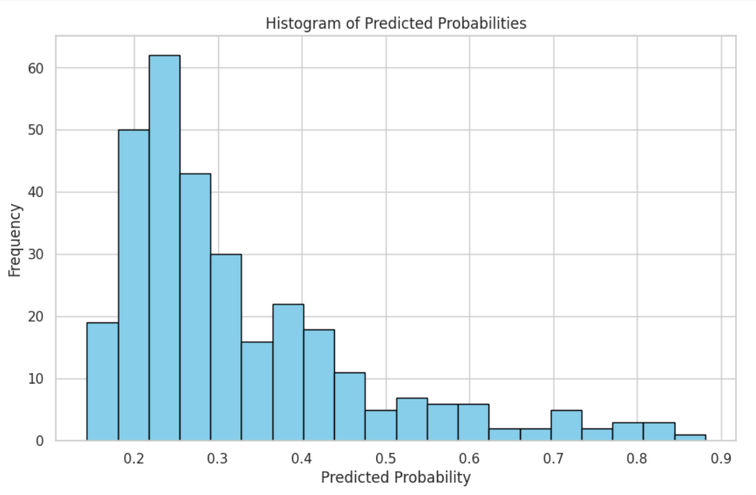
VISUALIZATIONS & RESULTS FOR EACH SUBSET
FOR 2000 SAMPLE

Slide 14
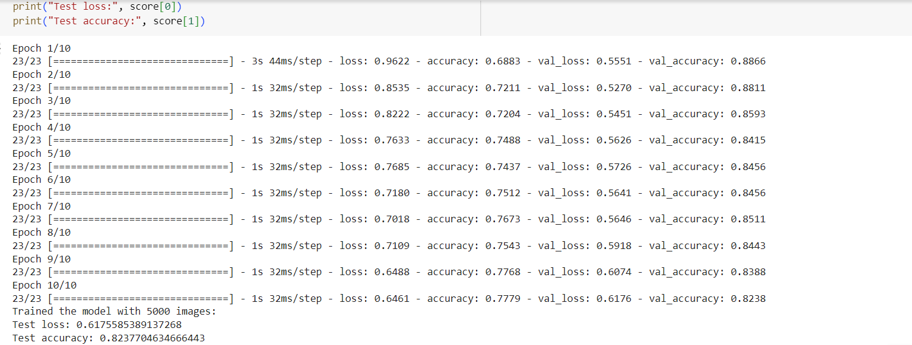
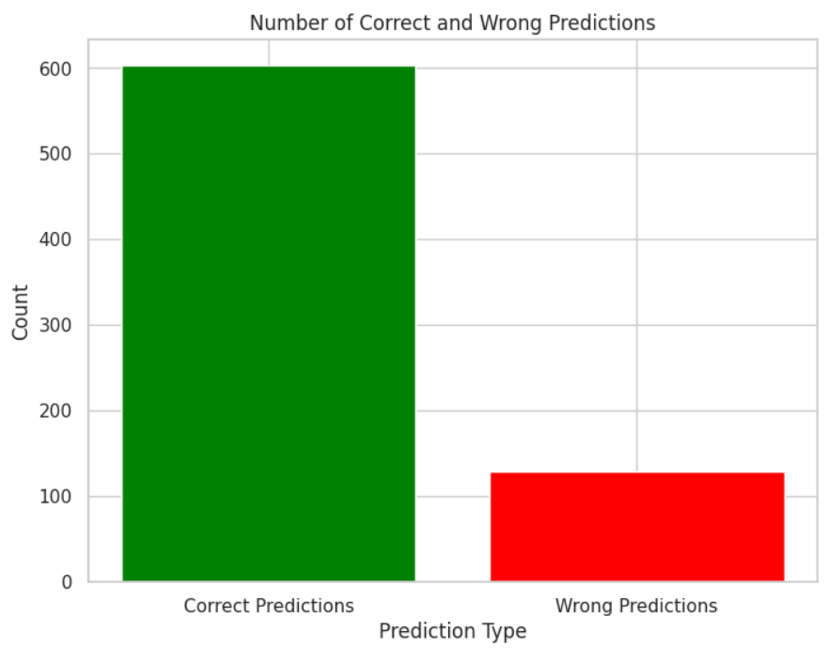
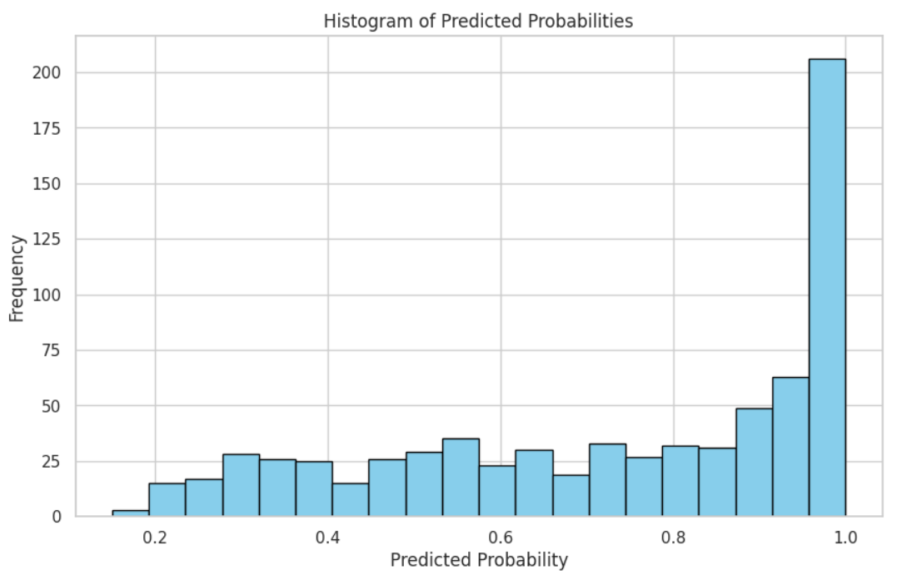
VISUALIZATIONS & RESULTS FOR EACH SUBSET
FOR 5000 SAMPLE

Slide 15
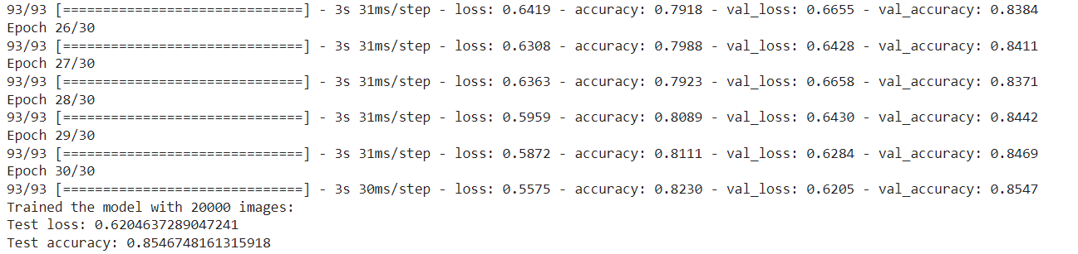
VISUALIZATIONS & RESULTS FOR EACH SUBSET
FOR 20000 SAMPLE

Slide 16
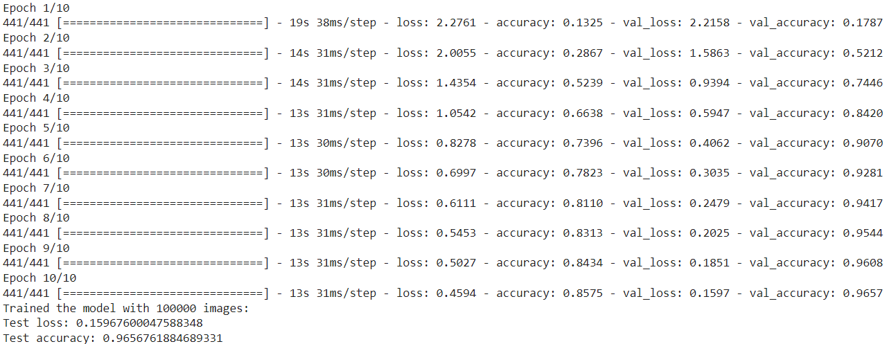
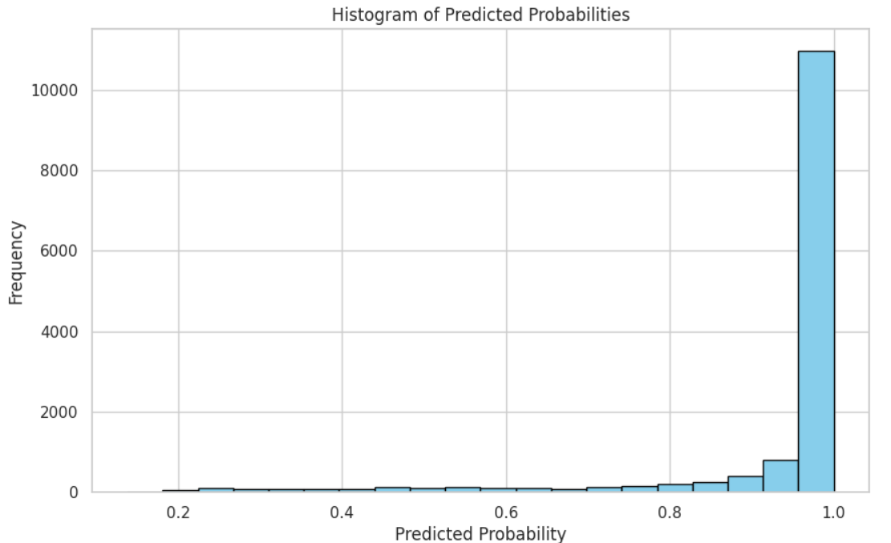
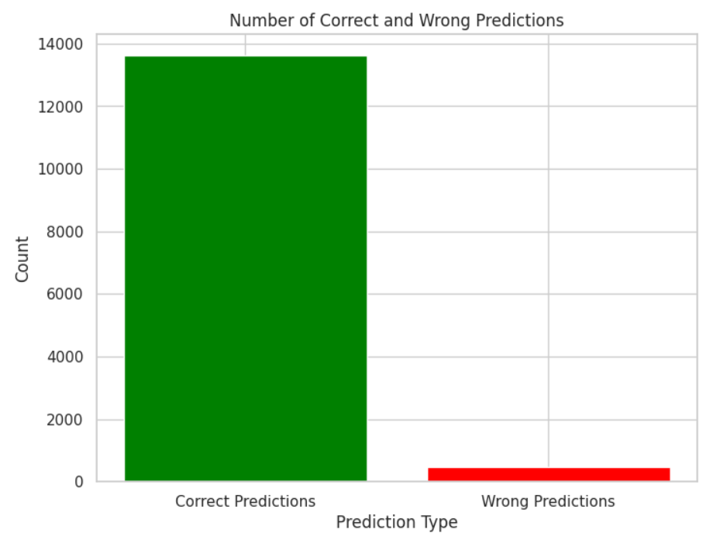
VISUALIZATIONS & RESULTS FOR EACH SUBSET
FOR 100000 SAMPLE

Slide 17
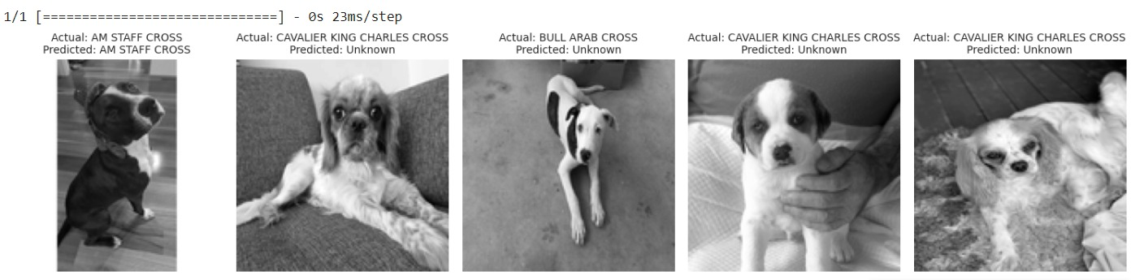
OBSERVATIONS
2000 Samples: 69% Accuracy — Initial performance baseline.
5000 Samples: 82% Accuracy — Noticeable improvements.
20000 Samples: 85% Accuracy — Consistent gains.
100000 Samples: 96% Accuracy — Achieved optimal performance.
We have also tried to run the model on unknown dataset which consists images of different breeds that are not used for any training.

Slide 18
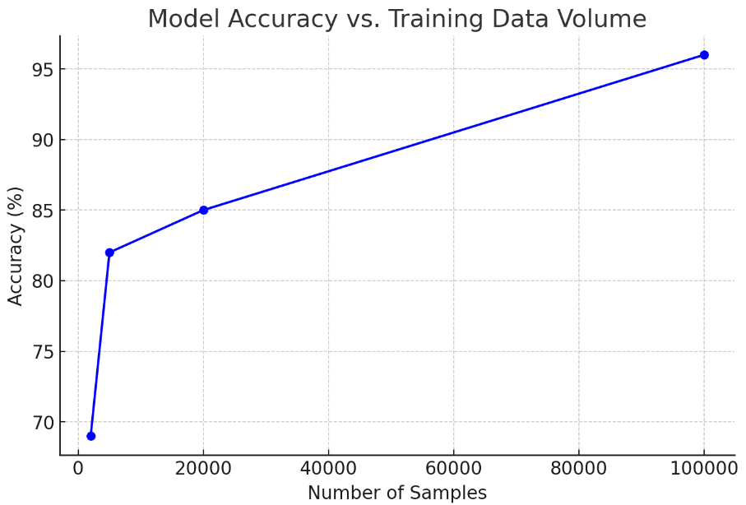

GRAPHICAL INSIGHT:
A line graph depicting a clear positive trend in accuracy as training data volume increases, emphasizing the model’s scalability.
Accuracy of 100000 samples: 96%

Slide 19
CONCLUSION
Successfully engineered a high-performance dog breed classification system using Apache Spark and MongoDB, achieving peak accuracy of 96% with extensive training data.
Conservation and Preservation
Our model contributes to genetic diversity conservation within dog populations.
It aids in maintaining healthy breeding programs and preserving unique breed traits.
Practical Application
The model has real-world applications in animal shelters, veterinary clinics, and wildlife conservation centers.
It assists professionals in accurately identifying dog breeds, facilitating animal care, and aiding research efforts.

Slide 20
CONCLUSION
Technological Advancement
Development of machine learning models for image classification showcases the potential of artificial intelligence.
Continuous refinement and optimization of models unlock new possibilities for innovation and discovery.
Collaborative Efforts
Project success attributed to collaborative efforts of team members and support from the open-source community.
Collaboration fosters creativity, diversity of thought, and collective problem-solving.
Future Directions
Future research aims to enhance model accuracy and efficiency.
Exploration of additional features for breed recognition and extension to other species beyond dogs.

Slide 21
Lessons Learnt
Integration Mastery : Navigated complexities of integrating Spark, MongoDB, and Python, overcoming setbacks through persistence and strategic problem-solving.
Data Handling Proficiency: Mastered complex data extraction and management with MongoDB, emphasizing precision and planning for large dataset handling.
Versatile Environment Adaptation : Worked on a 20GB dataset across Cloudera and Databricks, gaining versatile experience in different big data environments.
Efficient Spark Programming : Developed proficiency in Spark programming, enhancing productivity and performance in big data processing tasks.
Effective CNN Implementation : Implemented Convolutional Neural Networks (CNNs) effectively, optimizing model training for accurate predictions in image classification.

Slide 22
REFERENCES
Apache Spark https://spark.apache.org/docs/latest/
(2) Mongodb https://www.mongodb.com/docs/
(3) CNN for Deep Learning https://towardsdatascience.com/a-comprehensive-guide-to-convolutional-neural-networks-the-eli5-way-3bd2b1164a53

Slide 23


