Slide 1
Project Title: TIDAL ENERGY
Subject C ode: ENA0105
Subject N ame: Renew able Energy Sources for Domestic Applications
Student Name : D. Vijay Sai Kumar
Stud ent Reg No: Department : Mech
Faculty Name: Dr. Deepak Joel John son
Date : 22.01.202 1

Slide 2
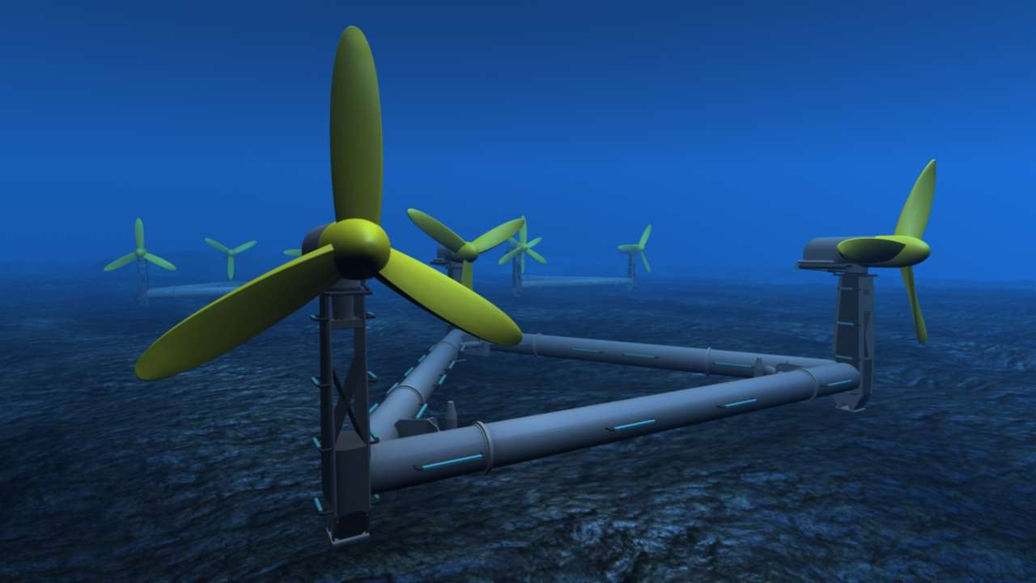


Slide 3

TIDAL ENERGY :
TIDAL ENERGY IS A FORM OF HYDROPOWER THAT CONVERTS THE ENERGY OF TIDES INTO USEFUL FORMS OF POWER.

Slide 4
INTRODUCTION TO TIDAL ENERGY
Demand of electricity is increasing and global warming also threaten human life. It’s time to move away from fossil fuel and other source.
The tides contain energy that can be harnessed to produce electricity. Two types of tidal energy can be extracted. Kinetic energy can be harnessed from the ebbing and surging tides. Potential energy can be harnessed from differences in the high and low tides. Using tidal currents remains the primary method of generating electricity.
Tidal power has huge potential due to the size of the
oceans and predictability of the tides.

Slide 5
BASIC PHYSICS OF TIDES:
Gravitational pull of the sun and moon.
The pull of the centrifugal force of rotation of the earth-moon system.
There are two high tides and low tides during each period of rotation of the earth.

Slide 6

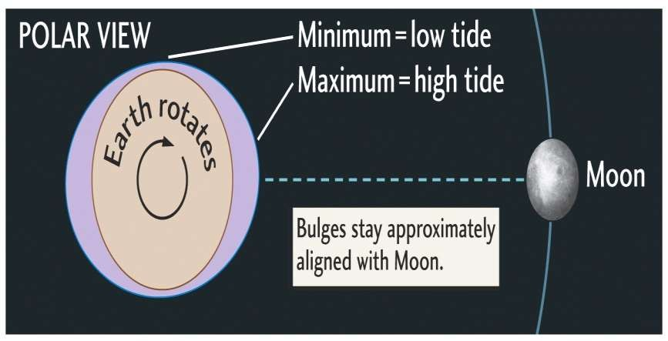
HOW THE TIDES COME AND GO ?
The gravitational force of the moon causes the oceans to bulge along an axis pointing directly at the moon. The magnitude of this attraction depends on the mass of the object and its distance away .

Slide 7

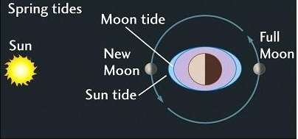
SPRING TIDES:
When the sun and moon are in a line their gravitational attraction on the earth combine and cause a “spring” tides.

Slide 8

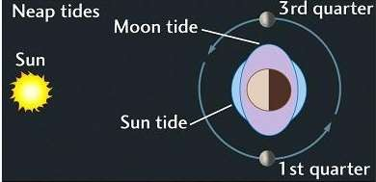
NEAP TIDES
When they are as positioned in 90° from each other, their gravitational attraction each pulls water in different directions, causing a “neap” tides.

Slide 9
ENERGY FROM THE MOON
Tides generated by the combination of the moon and sun’s gravitational forces.
Greatest affect in spring when moon and sun combine forces.
for energy production, the height difference needs to be at least 5 meters.
Overall potential of 3000 GW from movement of tides.

Slide 10
Two types of tidal plant facilities.
ELECTRICITY GENERATION THROUGH TIDAL ENERGY
Tidal barrages
Tidal currents turbine

Slide 11

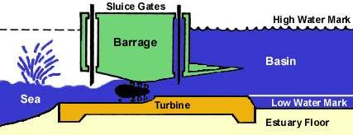
TIDAL BARRAGES :
Utilize potential energy.
Tidal barrages are typically dams built across an bay.
Consist of turbines, sluicegates, and Ship locks.

Slide 12
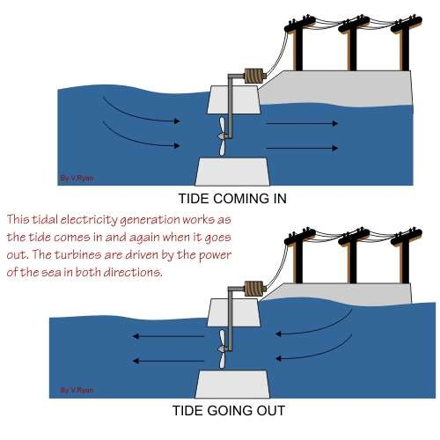

Slide 13
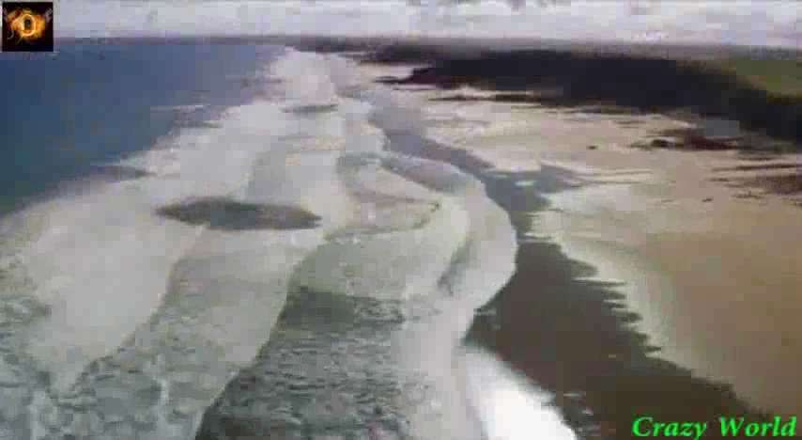

Slide 14
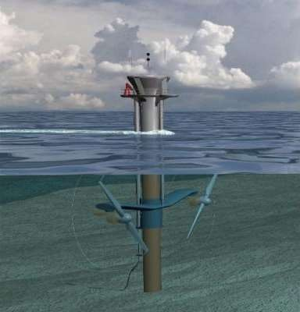
TIDAL CURRENT TURBINES
Make use of kinetic energy of moving water to power turbines, in a similar way to wind turbines that use wind to power turbines.
Operate during Flood and Ebb
tides.
Consists of a rotor, gearbox, and a generator. These three parts are mounted onto a support structure.
There are three main types structure:
Gravity structure
Piled Structure
Floating structure

Slide 15
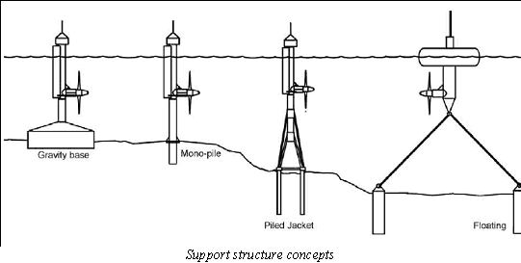

Slide 16
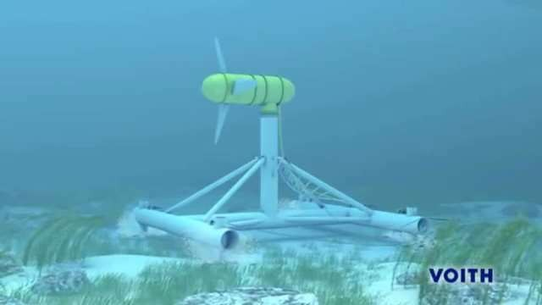

Slide 17
Tidal Barrages
PROS AND CONS OF BOTH TIDAL POWER FACILITIES
Tidal Current Turbine
Mature technology that has been around for nearly 50years.
Reliable energy source.
BUT
High costs of construction
Environmental on marine life
Low power output in. comparison to other energy source like coal and nuclear power plants.
Able to utilize both Ebb
and Flood tides.
Tidal current turbines are not large massive dam structure.
BUT
Tidal current turbine technology is young in its development.
Installation and maintenance challenges.

Slide 18
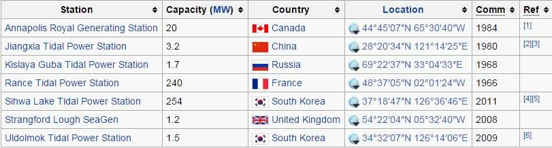
MAJOR TIDAL PLANTS IN THE WORLD

Slide 19
ADVANTAGES OF TIDAL ENERGY
Once you've built it, tidal power is free.
It produces no green-house gases or other waste.
It needs no fuel.
Not expensive to maintain.
Permits the simultaneous use of the dam for a road or rail road.
Provides a non-polluting and inexhaustible supply of energy.

Slide 20
DISADVANTAGES OF TIDAL ENERGY
Building of barrage is expensive
Needs a wide area
Few suitable sites available

Slide 21

CONCLUSION
Tidal power is a proven technology and has the potential to generate significant amounts of electricity at certain sites around the world.
Although, our entire electricity needs could never be met by tidal power alone, it can be invaluable source of renewable energy.

Slide 22


