Slide 1
It's-a Me! Nintendo!
Harsha Kankanamge

Slide 2
This code pulls all stock data from Yahoo Finance

Slide 3
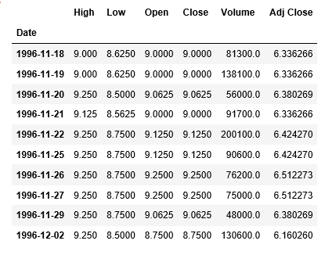
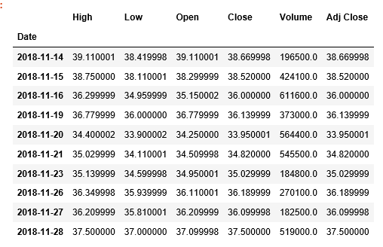
dataset
First 10 Rows:
Last 10 Rows:

Slide 4
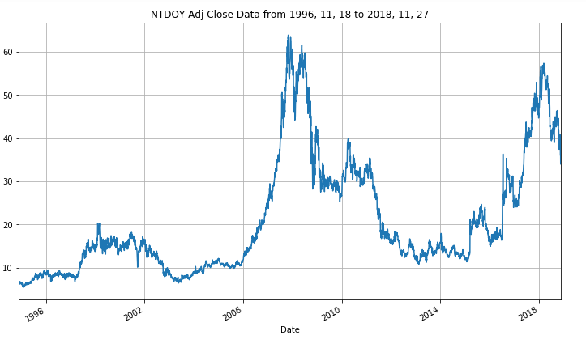
nintendo adjusted Close: Data vs years

Slide 5
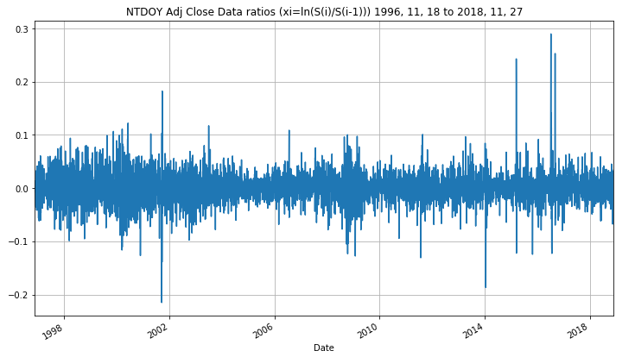
nintendo adjusted Close Data ratios

Slide 6
Volatility Calculation
Volatility = 0.43905915864868805

Slide 7
Cox-Ross-Rubinstein tree
58.95
50.47
43.21
43.21
37.00
37.00
31.68
31.68
27.13
23.22

Slide 8
Building the Cox-Ross-Rubinstein tree

Slide 9
put option prices using Cox-Ross-Rubinstein
5.550985732987845
3.912526904981438
4.8074254771544185
4.155890706828922
4.654228769685962
4.243637755686113
4.588847540998152
4.288644450868489
4.552686527038348
4.427562475493936
4.4275849231754885
4.427562475728777
4.427584922662847
4.427562476047598
4.427584922537167
4.427562476022619
4.427584922495112
4.427562476532915
4.427584922184095

Slide 10
call option prices using Cox-Ross-Rubinstein
5.75015329548223
4.111694467475819
5.006593039648809
4.355058269323318
4.853396332180331
4.442805318180507
4.788015103492518
4.487812013362878
4.751854089532722
4.6267300380144585
4.6267524852964295
4.626730038228505
4.6267524855004325
4.626730038366811
4.626752485113659
4.626730038816596
4.626752484651023
4.626730038829164
4.626752484577381

Slide 11
Put vs Call for 500 period for Cox-Ross-Rubinstein tree

Slide 12
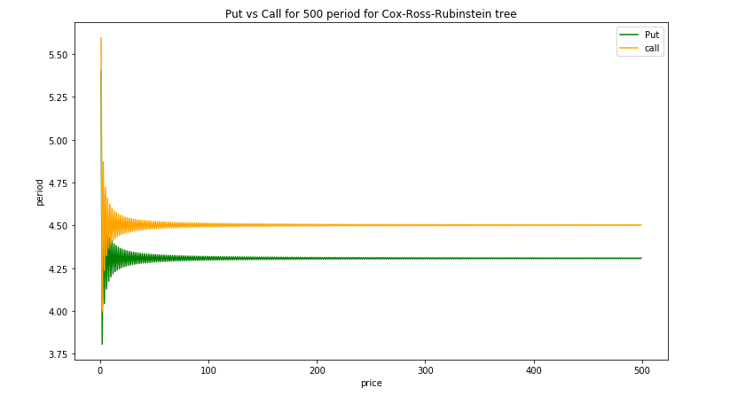

Slide 13
Building the Log normal tree
65.96
57.08
49.40
48.36
42.75
41.85
37.00
36.22
35.45
31.34
30.68
26.55
25.99
22.49
19.05

Slide 14
Price tree for put and call (Log normal)

Slide 15
put option prices using Log normal tree
5.4311071819904395
4.25760415424375
4.742222911588577
4.403133730123513
4.598560494055691
4.442254621233452
4.537110552681642
4.456954521878634
4.503092720593405
4.4275773968652965
4.427580074757706
4.427577385880092
4.427580082922271
4.427577374946007
4.427580091538743
4.42757736366065
4.427580100155761
4.427577352876826
4.427580108519727

Slide 16
call option prices using Log normal tree
4.6267449593851735
4.62674763687875
4.626744948379529
4.626747645759001
4.626744937265348
4.626747654116349
4.62674492645451
4.62674766231179
4.626744915172341
4.626747670913005
5.630274744484825
4.456771716738132
4.9413904740829695
4.602301292617906
4.797728056550064
4.641422183727843
4.736278115176005
4.656122084373023
4.702260283087781

Slide 17
Put vs Call for 500 period for Log normal tree

Slide 18
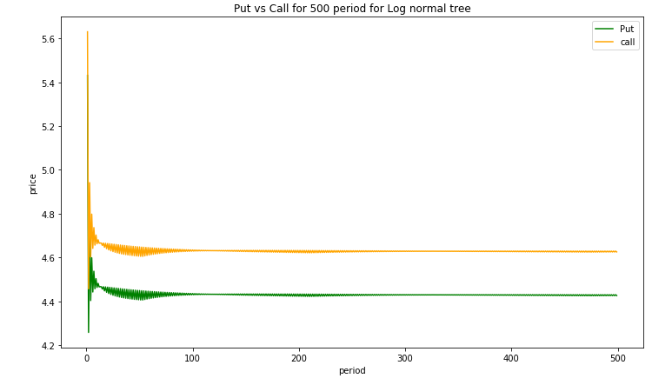

Slide 19
Put vs Call for 500 period for Cox-Ross-Rubinstein and Log normal

Slide 20
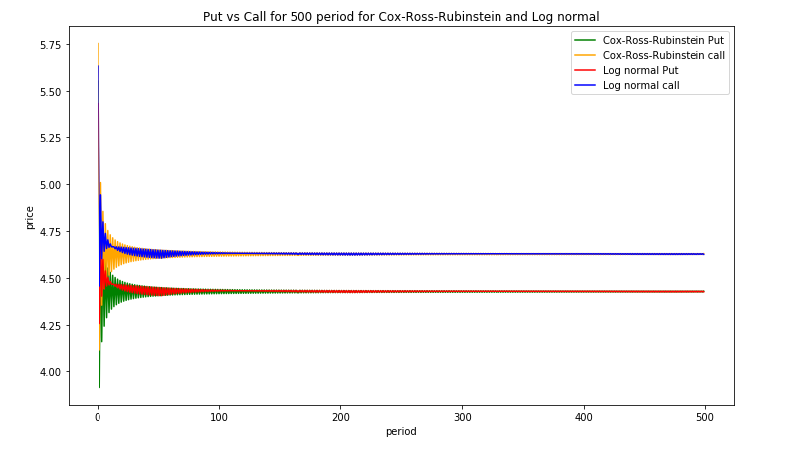

Slide 21
Thank you

