Slide 1
Presidential Election Data Analysis Using SAS 2008 –2016
Final Project ACM 614
Harsha Kankanamge

Slide 2
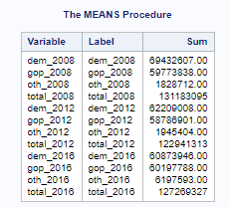
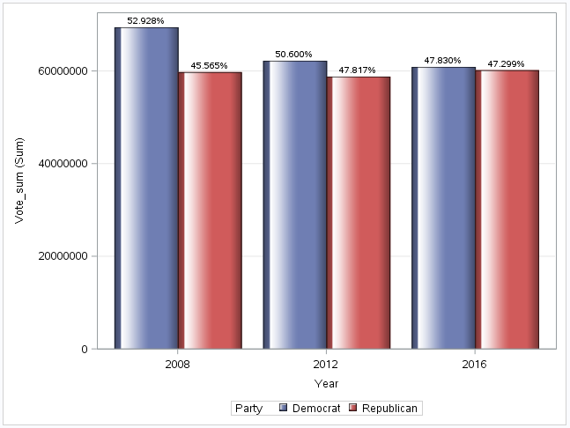
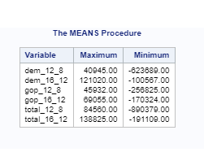
The Change of Voting Trends between 2008 - 2016

Slide 3
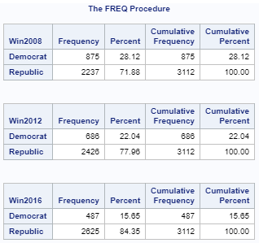
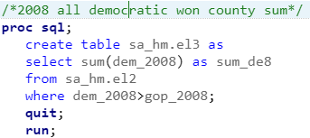
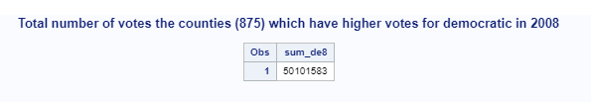

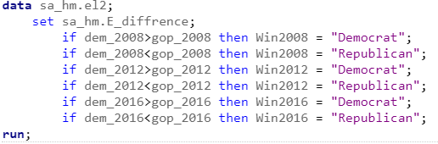

Frequency of Lead Counties by Party
The difference = 50101583-29850269 = 20251314

Slide 4
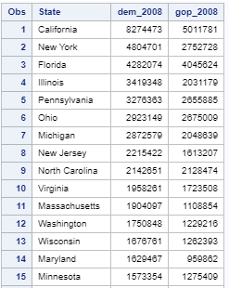
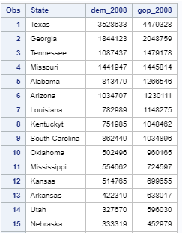

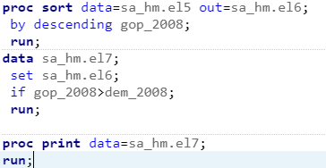
Top 15 States Lead by Democrats and Republicans 2008
Democrats’ Top 15 (Won 28 State + DC)
Republicans' Top 15 (Won 21 State)

Slide 5
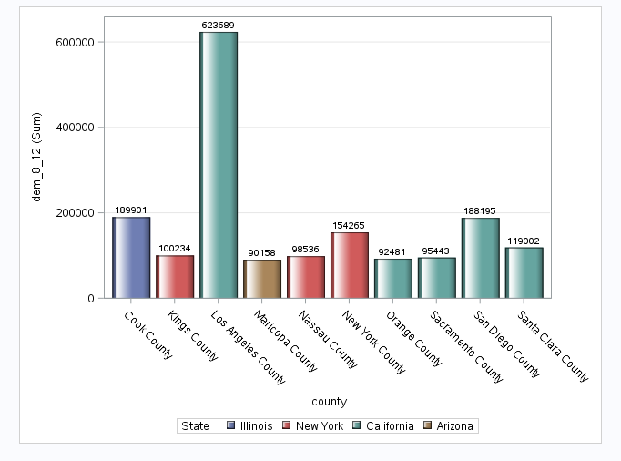
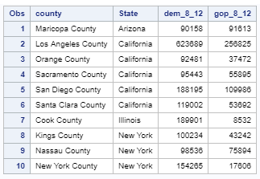
Top Ten Counties Democrats’ Largest Voting Change (2008 – 2012)

Slide 6
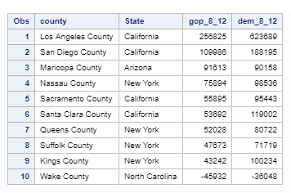
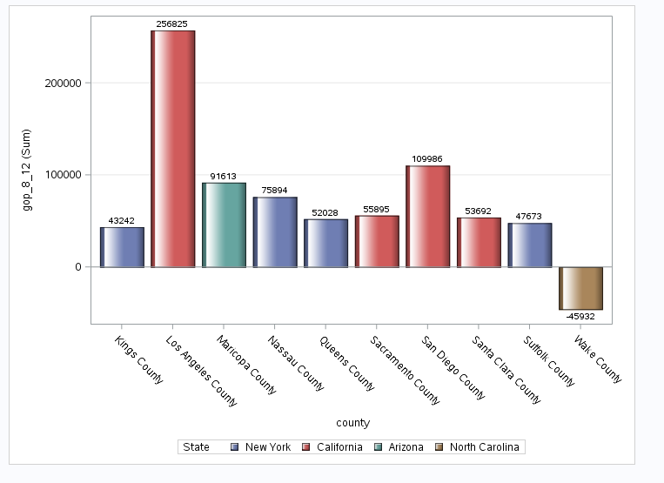

Top Ten Counties Republicans’ Largest Voting Change (2008 – 2012)

Slide 7
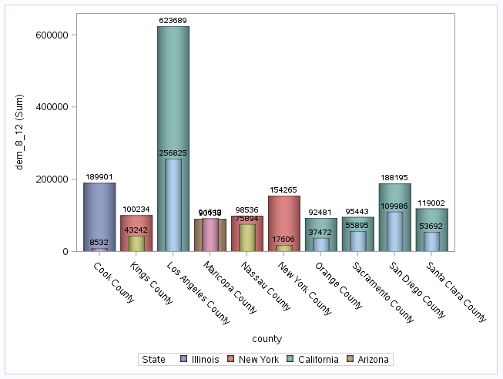
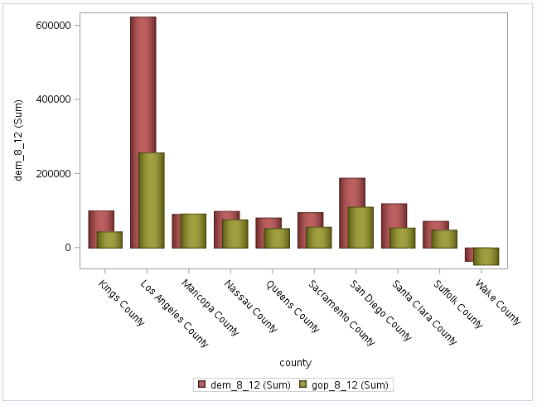
Democrats’ and Republicans’ Largest Voting Change (2008 – 2012) Counties Comparison
Democrats’ Top 10
Republicans' Top 10

Slide 8
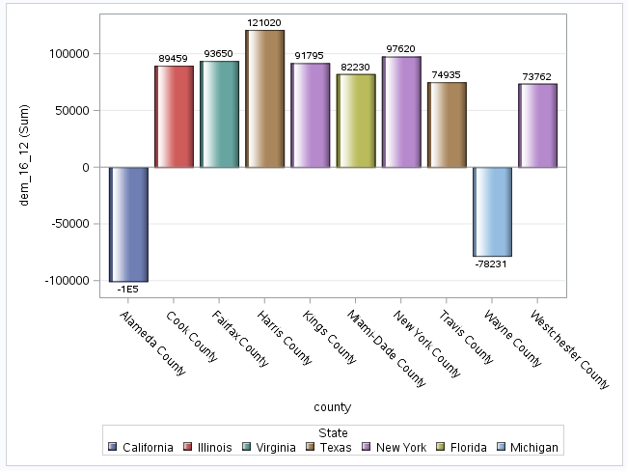
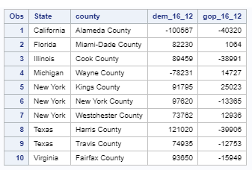
Top Ten Counties Democrats’ Largest Voting Change (2016 – 2012)

Slide 9
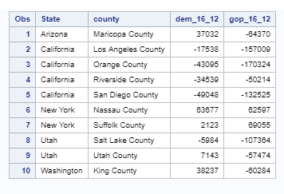
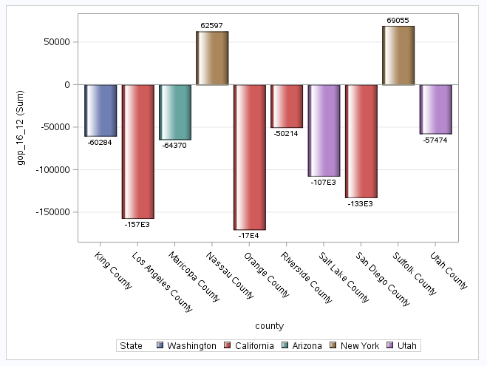
Top Ten Counties Republicans’ Largest Voting Change (2016 – 2012)

Slide 10
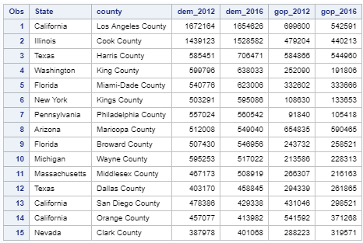
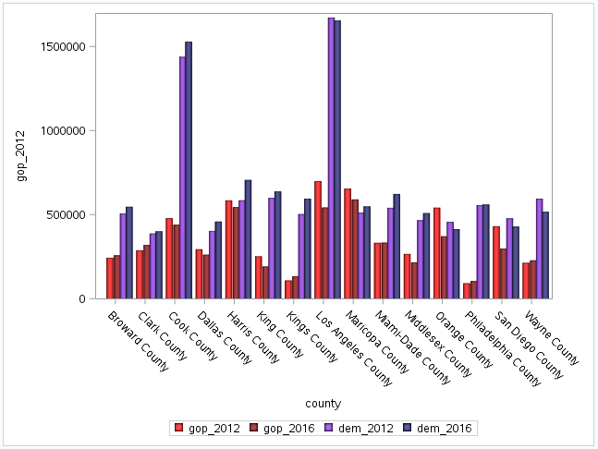
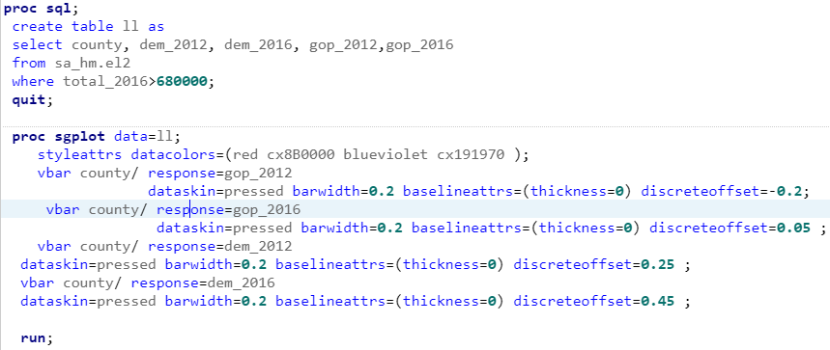
15 Counties with Highest Number of Voting Community in USA

Slide 11
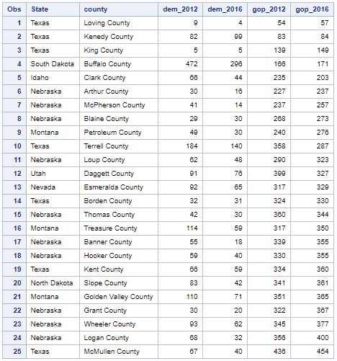
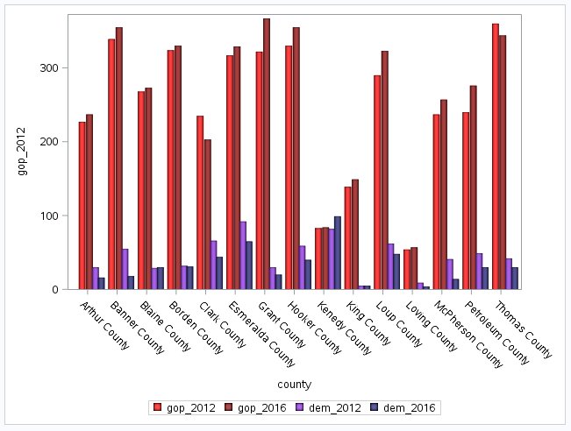
Counties with Lowest Number of Voting Community in USA

Slide 12
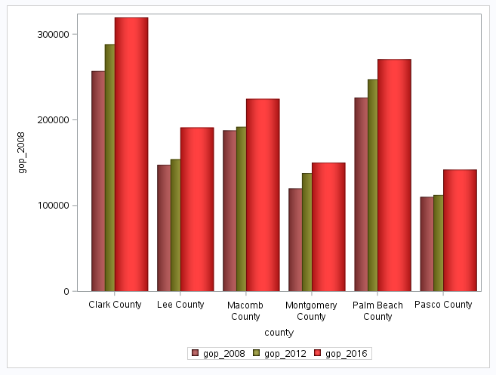
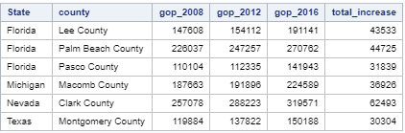
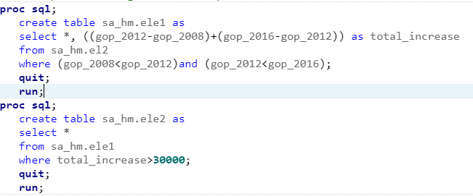
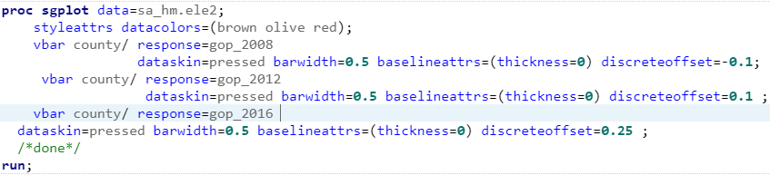
The Counties which Keep Increasing Republicans’ Vote in Largest Scale 2008-2016
1552 counties keep increasing Republican's vote from 2008 to 2016

Slide 13
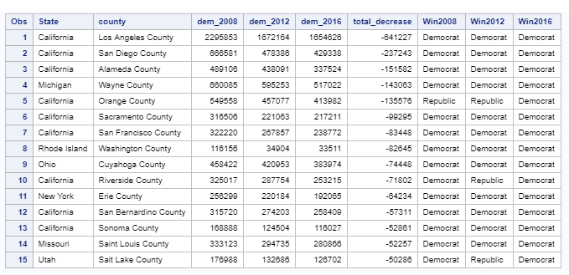
The Counties which Keep Decreasing Democrats’ Vote in Largest Scale 2016-2008
2448 counties keep decreasing Democrat's vote from 2008 to 2016

Slide 14
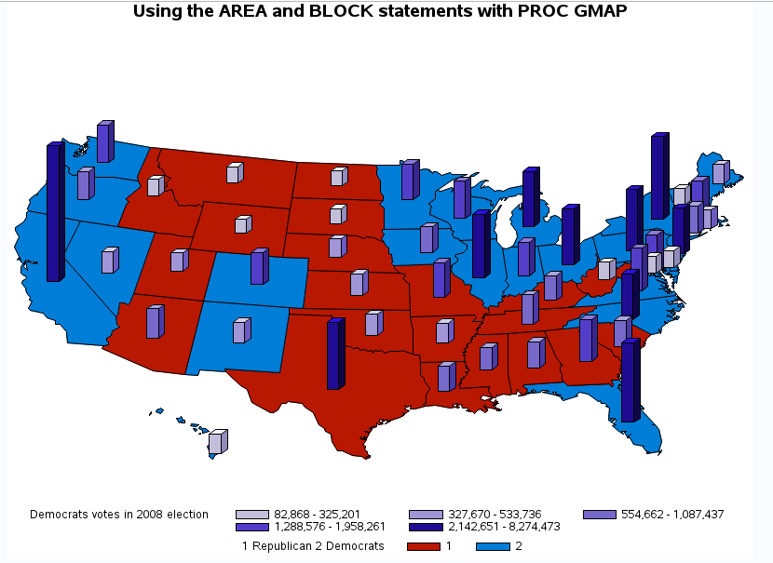


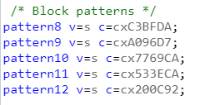

Democrats Won State vs Republicans Won State With Democrats Vote-2008

Slide 15
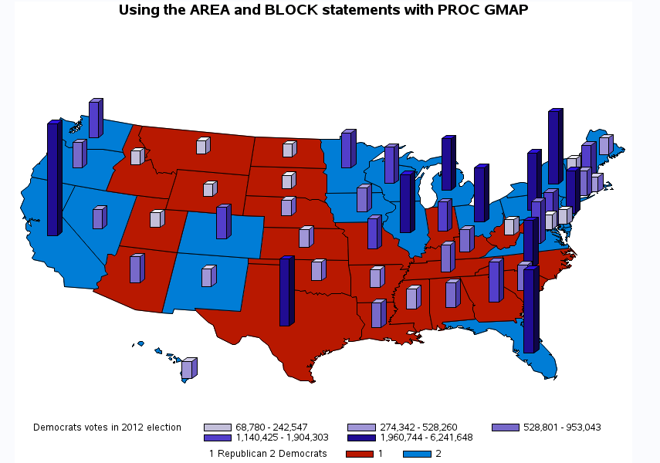


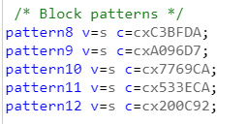

Democrats Won State vs Republicans Won State With Democrats Vote-2012

Slide 16
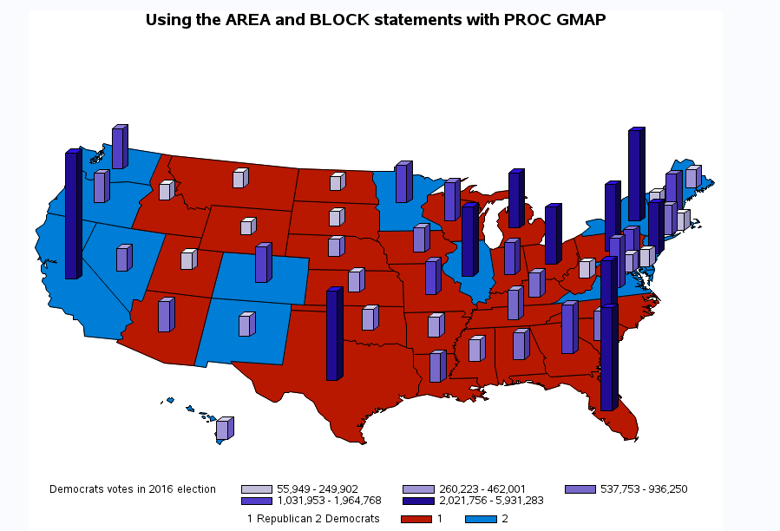


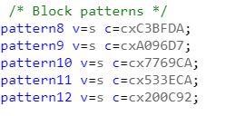
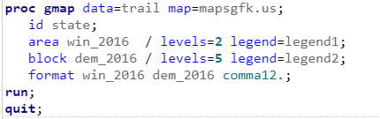
Democrats Won State vs Republicans Won State With Democrats Vote-2016

Slide 17
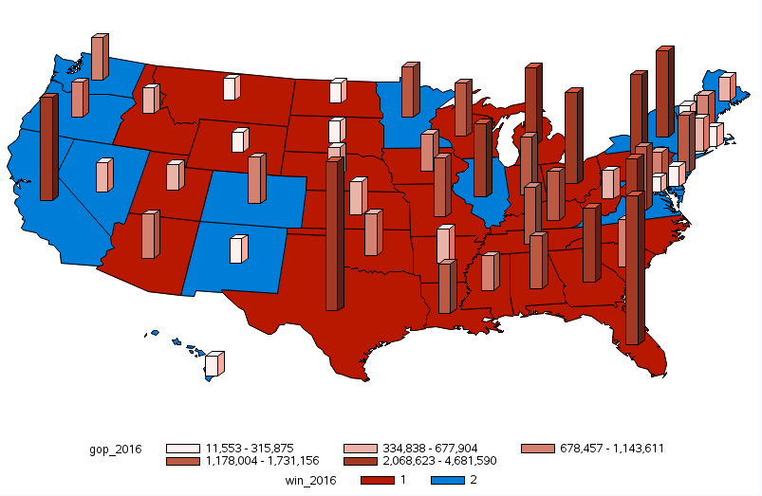

Democrats Won State vs Republicans Won State With Republicans Vote-2016

Slide 18
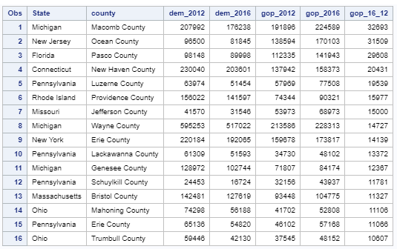
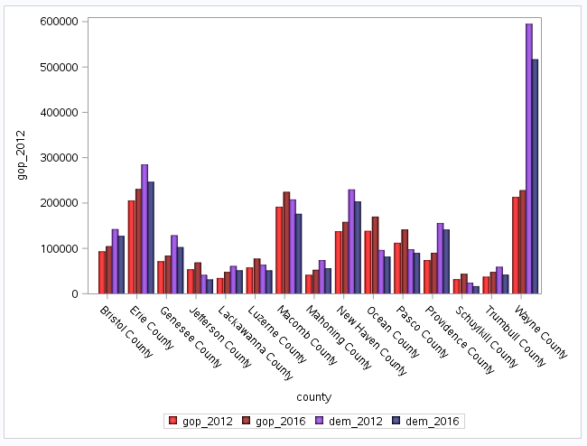
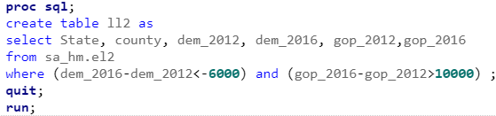
East and North Side of US Votes Switch Democrats’ to Republicans’

Slide 19
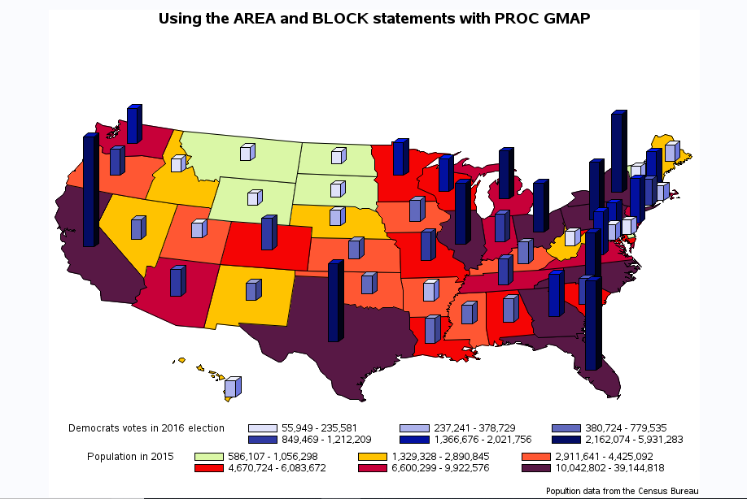
Democrats 2016 Votes vs Population

Slide 20
Summary
Democratic party won considerably low number of counties in all three election even though they win the two of them.
Democratic party has highest number of votes in total for all three election even though they lost the 2016 election.
Democratic party tend to win high crowded states and counties compare with state and counties which won by republican party.
Republican party keep increasing number of wining state and counties while Democratic party keep losing number of wining state and counties from 2008.
Republican party keep attacking Democratic party votes in the east side of the USA from 2008 to 2016
Republican party’s votes keep increasing in 1552 counties from 2008 to 2016.
Democratic party’s votes keep falling in 2448 counties from 2008 to 2016.

Slide 21


