Slide 1
Verilog Review

Slide 2
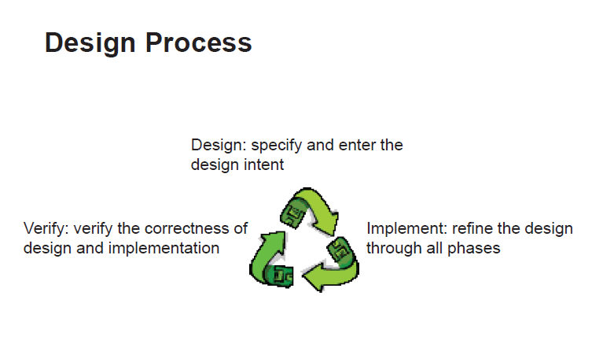

Slide 3
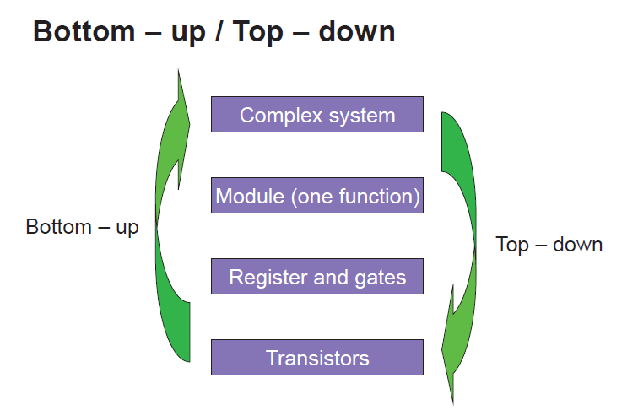

Slide 4
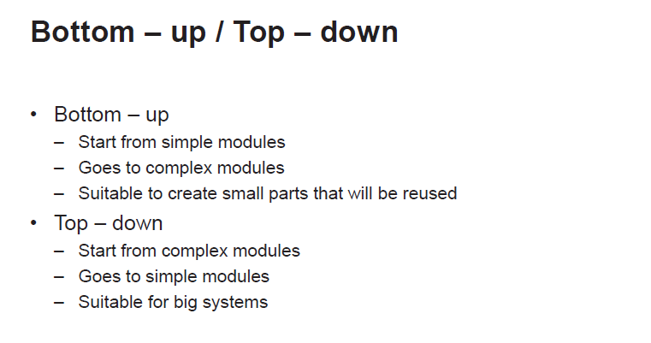

Slide 5
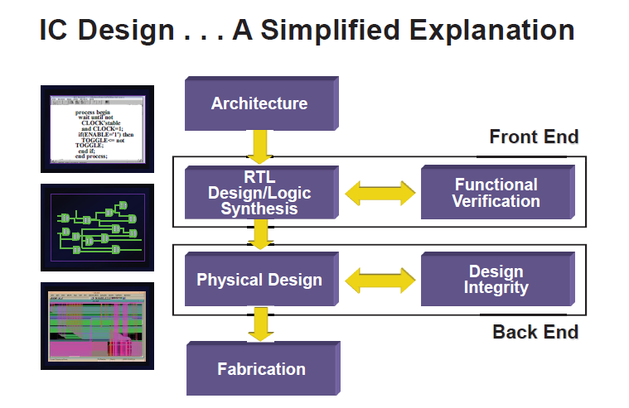

Slide 6
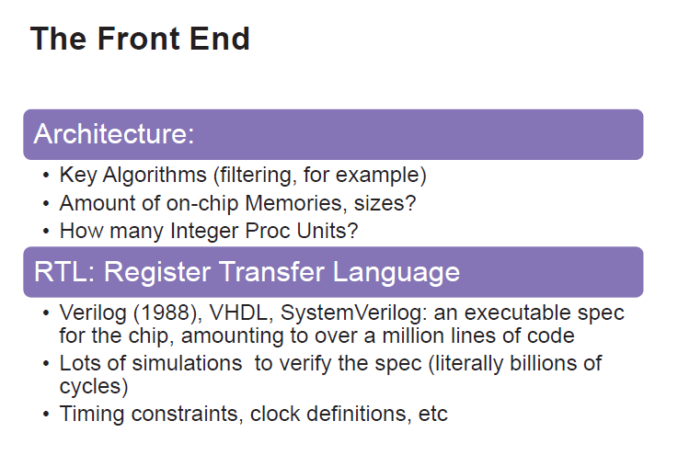

Slide 7
FPGA Design Flow
Design
Ideas
(Specifications)
Detailed (RTL)
Design
Functional
Simulation
Device
Programming
Timing
Simulation
Synthesis &
Implementation
FPGA
CPLD
t_{pd}=22.1ns
f_{max}=47.1MHz

Slide 8
RTL Specification
Determine I/O signals or Ports
Standard interface, protocol, custom interface
Partition design into functional blocks
Datapath, Control logic, Memory, etc.
Determine block interfaces
Specify each block separately at RTL
MUXs, counters, adders, registers etc.

Slide 9
Detailed Design
HDL (Hardware Description Language), e.g. Verilog, VHDL, SystemC
Requires some experience, harder to debug
Descriptive & portable
Easy to modify
Greater productivity
Use vendor-supplied IP libraries to reduce design time
Create & manage user-created libraries (circuits)

Slide 10
Functional Simulation
Preparation for simulation
Generate simulation patterns
HDL testbench
Functional simulation
To verify the functionality of your design only
Simulation results
Waveform display
Text output
Self-checking testbench
Challenge
Sufficient & efficient test patterns

Slide 11
HDL Synthesis
assign z=a & b
a
Synthesis = Translation + Optimization
Translate HDL design files into gate-level netlist
Optimize according to your design constraints
Area constraints
Timing constraints
Power constraints
Main challenges
Learn synthesizable coding style
Use proper design partitioning for synthesis
Specify reasonable design constraints
Use HDL synthesis tools efficiently
z
b

Slide 12
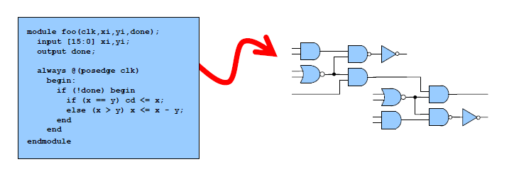
Logic Synthesis?

Slide 13
The Verilog Language
Verilog is a parallel, hardware description language (HDL).
Originally a modeling language for a very efficient event-driven digital logic simulator
Later pushed into use as a specification language for logic synthesis
Virtually every chip (FPGA, ASIC, etc.) is designed in part using Verilog.
Combines structural and behavioral modeling styles

Slide 14


Slide 16
The Verilog Language
Textual representation of Hardware constructs.
All statements are executed in parallel.
Code ordering is flexible.
a=1;b=2;c=a+b → c==3
c=a+b;a=1;b=2 → c==3
Execution of code is triggered by Events.
Sensitivity lists are used to define when a code section is executed
Different simulators may yield different results. Coding style is required

Slide 17
Abstraction levels
• Three coding styles:
Structural code (GTL (Gate Level), Netlist)
RTL (Register Transfer Level)
Behavioral (Testbench)
• DUT (Device Under Test)
Represents Hardware
Usually RTL or GTL
• Testbench
Represents System
Usually Behavioral
Using higher order languages (“e”/SystemVerilog)

Slide 18
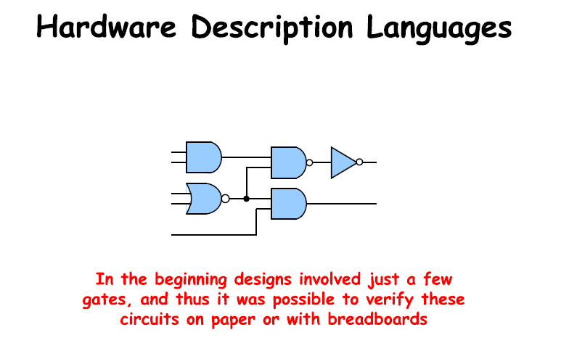

Slide 19
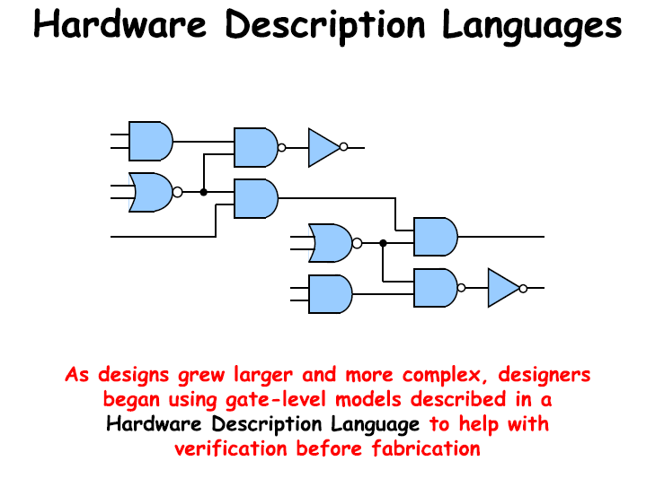

Slide 20
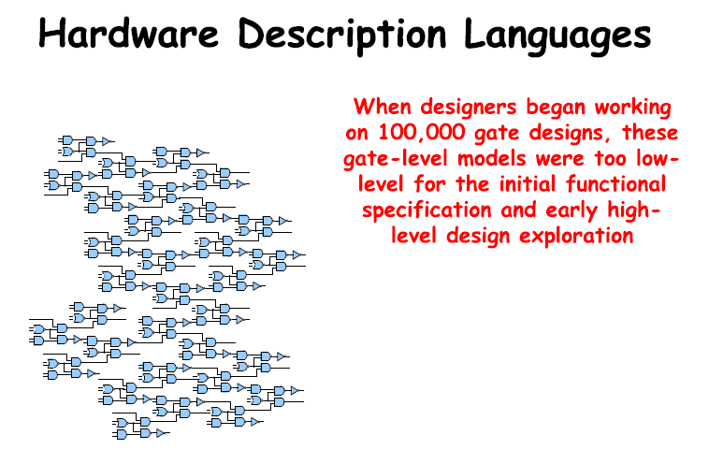

Slide 21
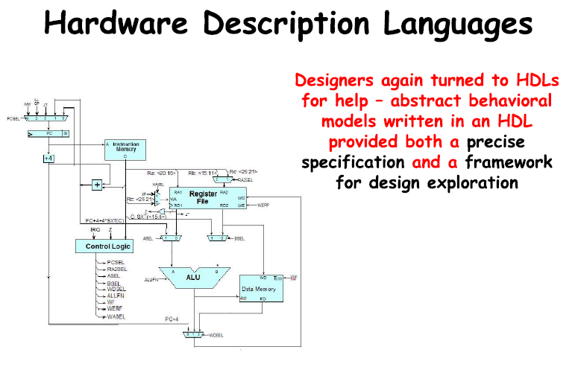

Slide 22


Slide 23
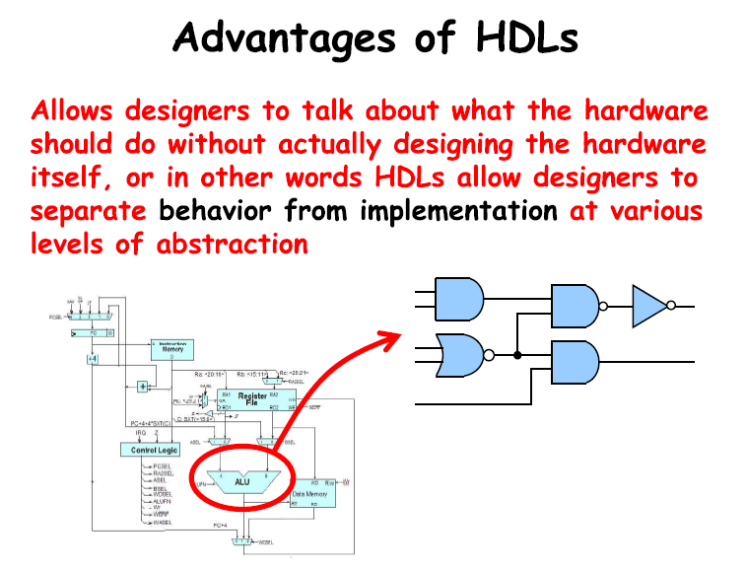

Slide 24
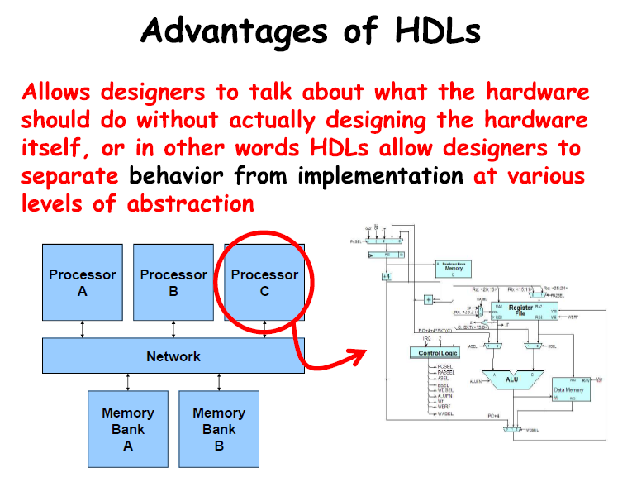

Slide 25


Slide 26
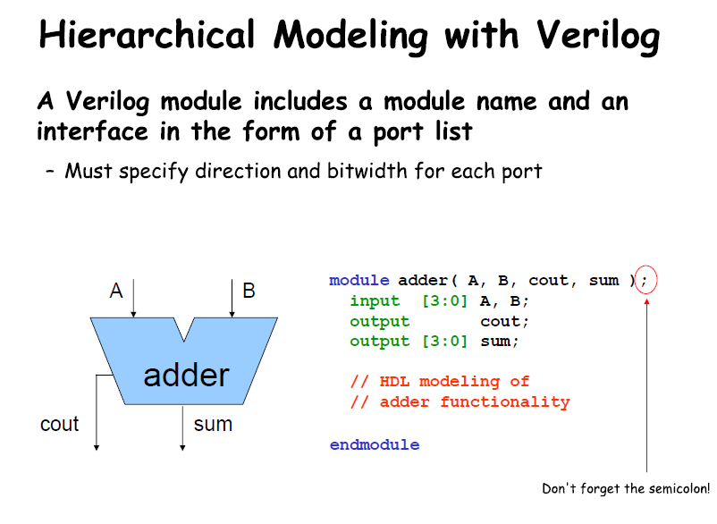

Slide 27
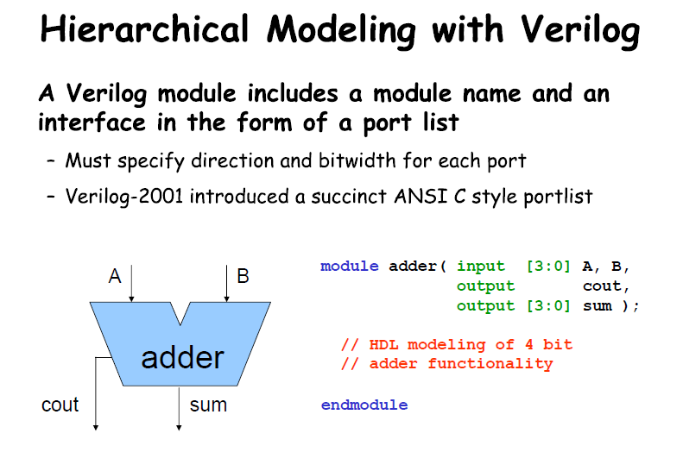

Slide 28
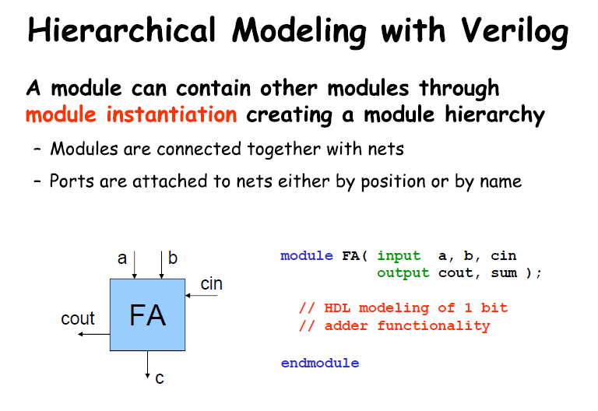

Slide 29
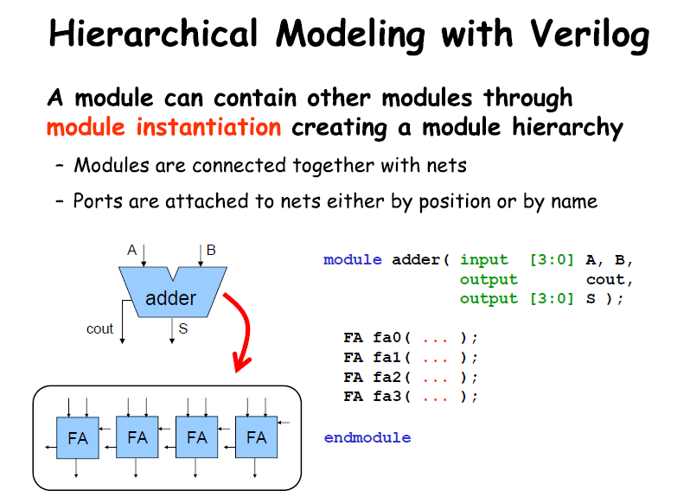

Slide 30
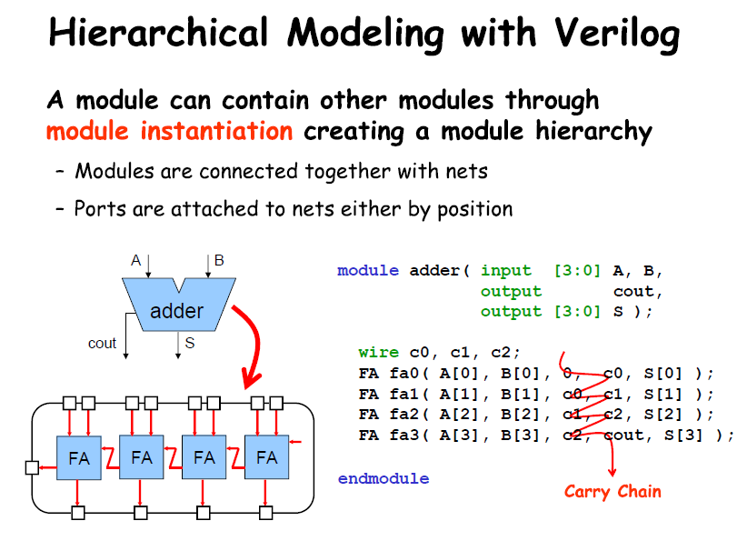

Slide 31
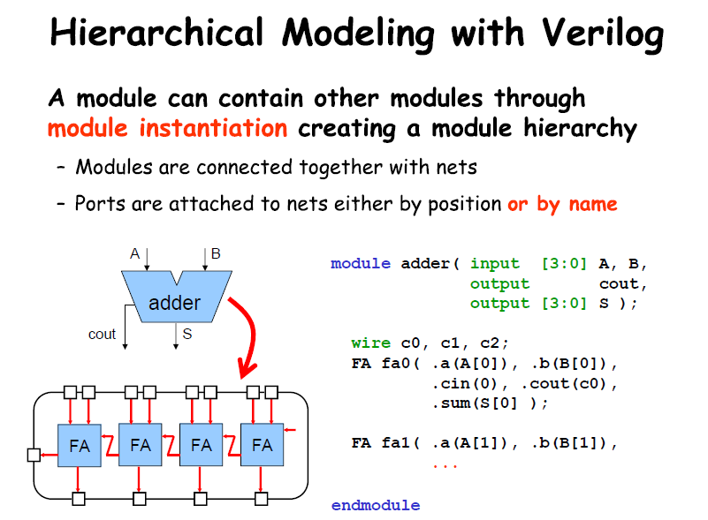

Slide 33
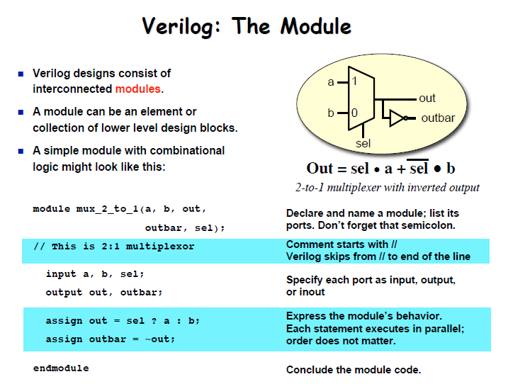

Slide 34
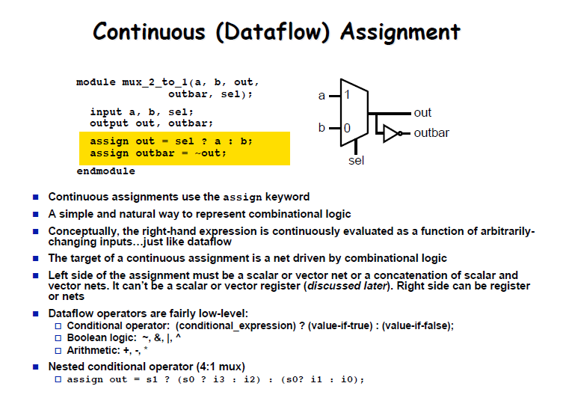

Slide 35
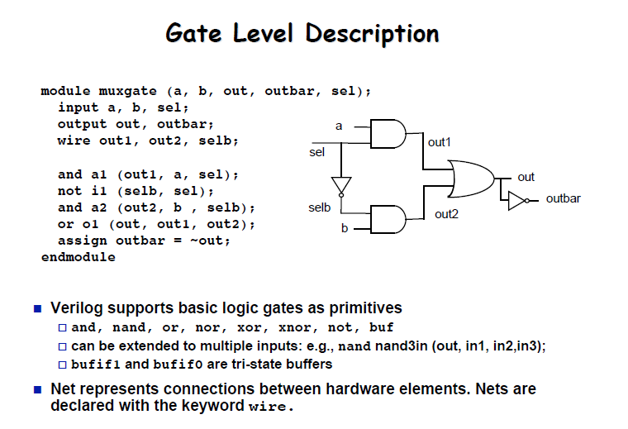

Slide 36
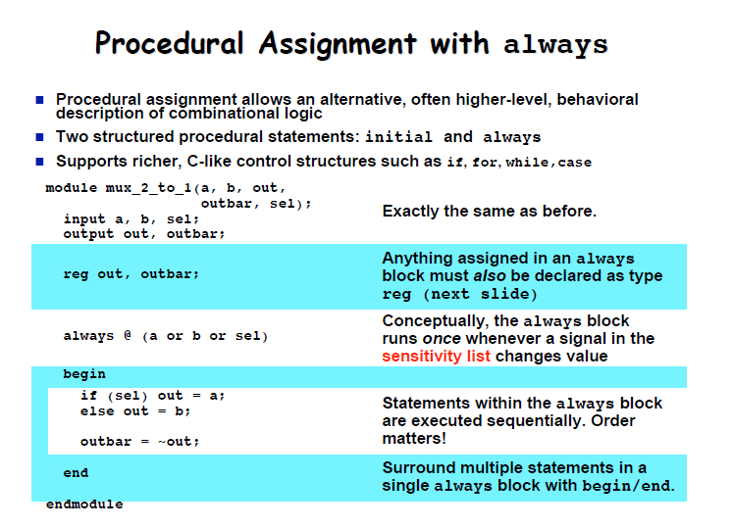

Slide 37
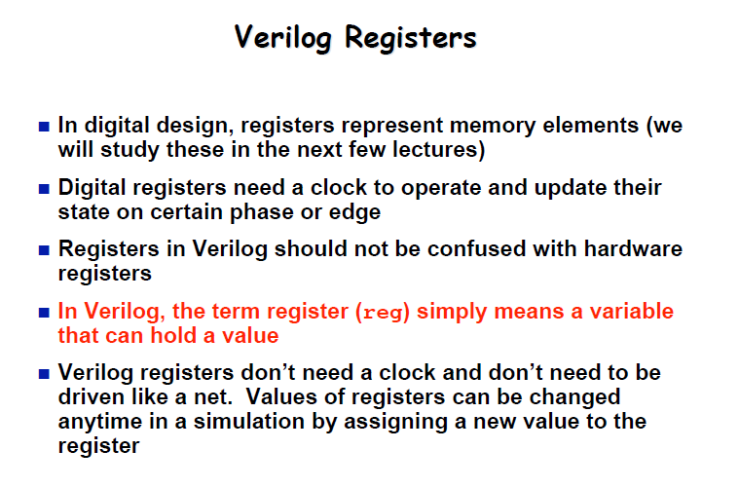

Slide 38
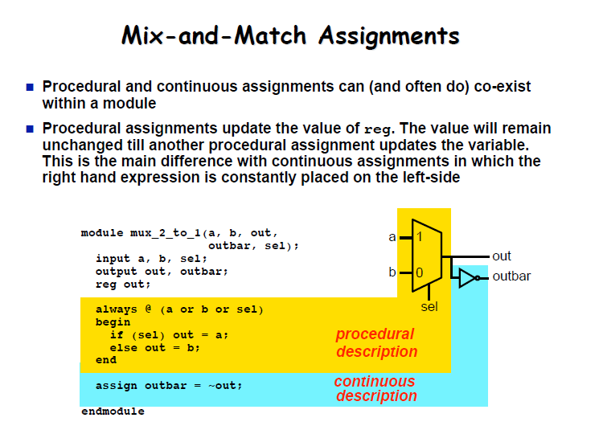

Slide 39
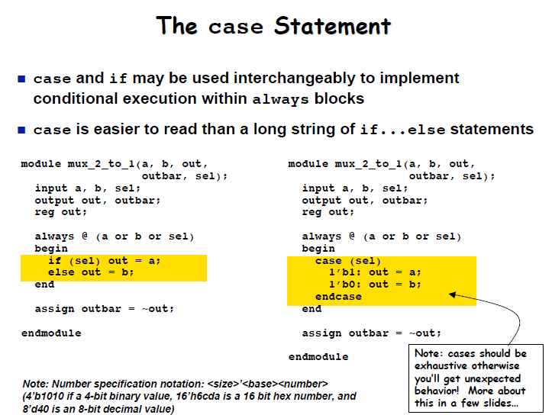

Slide 40
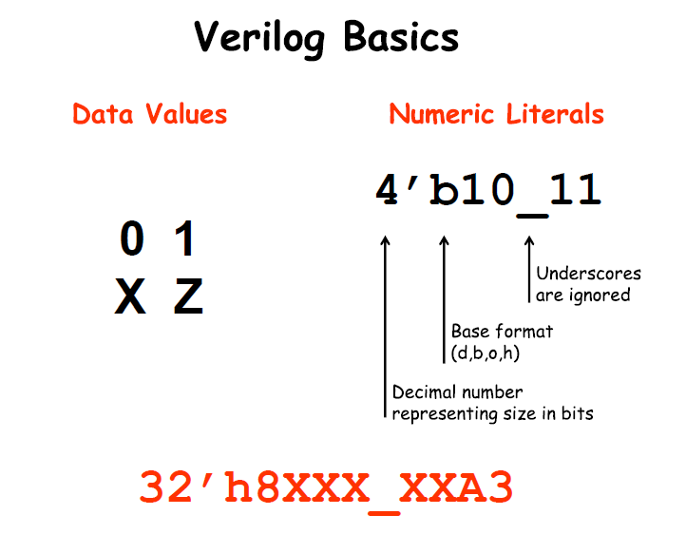

Slide 41
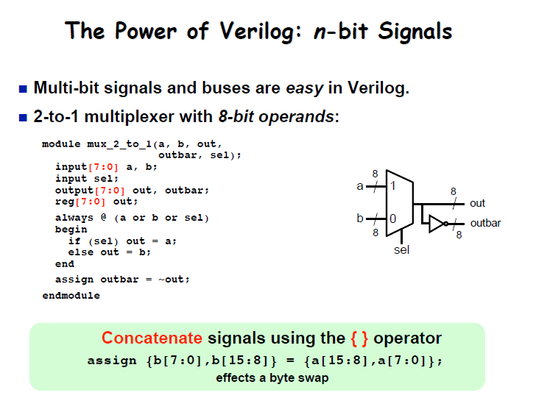

Slide 42
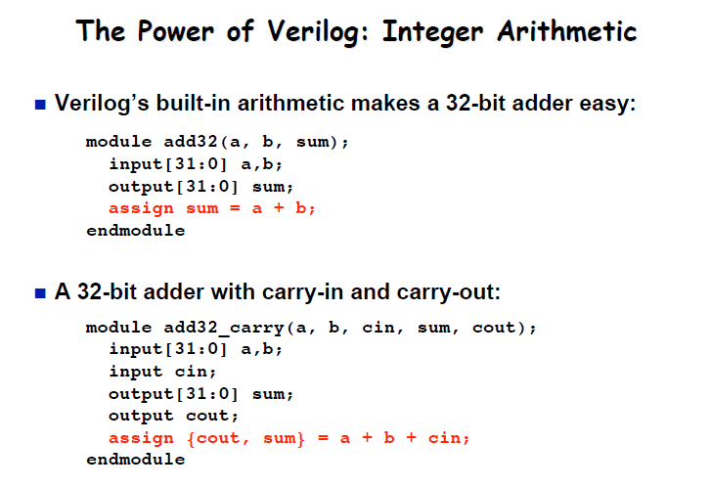

Slide 43
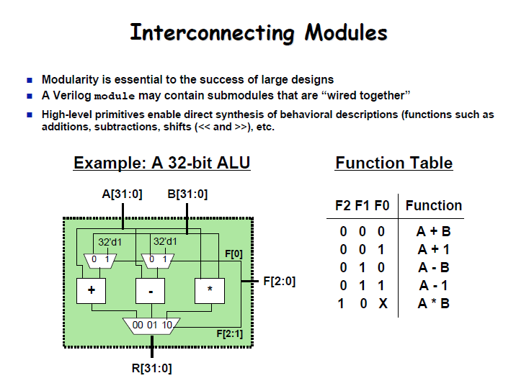

Slide 44
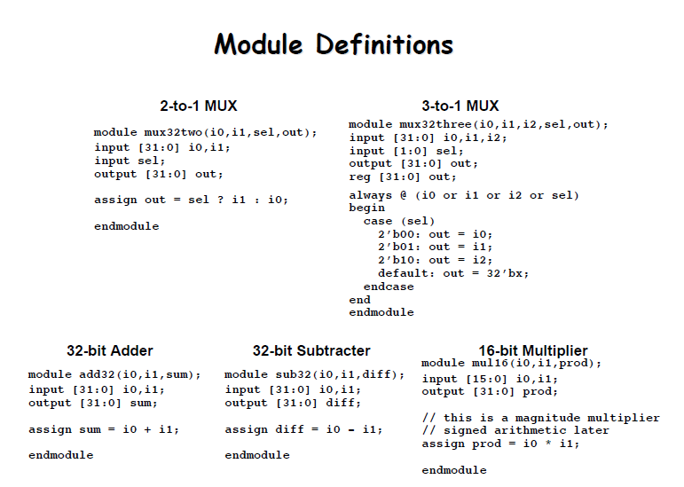

Slide 45
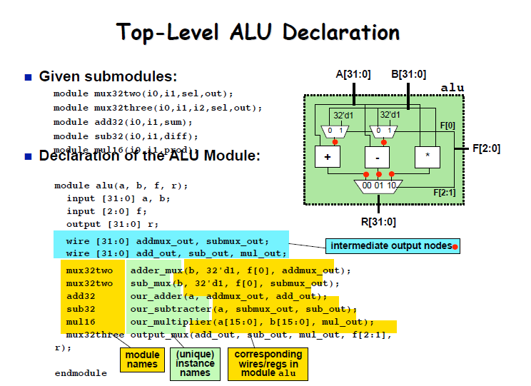

Slide 46
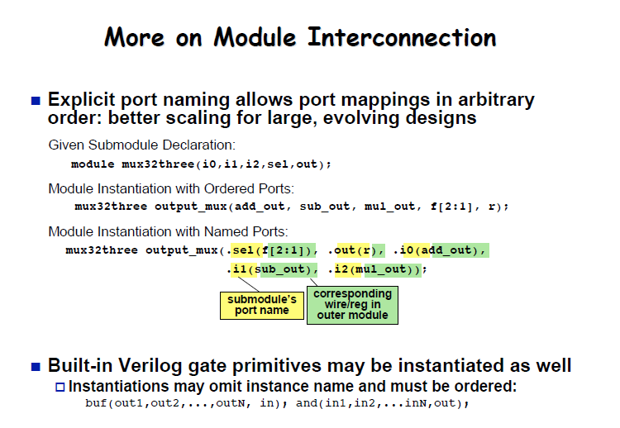

Slide 47
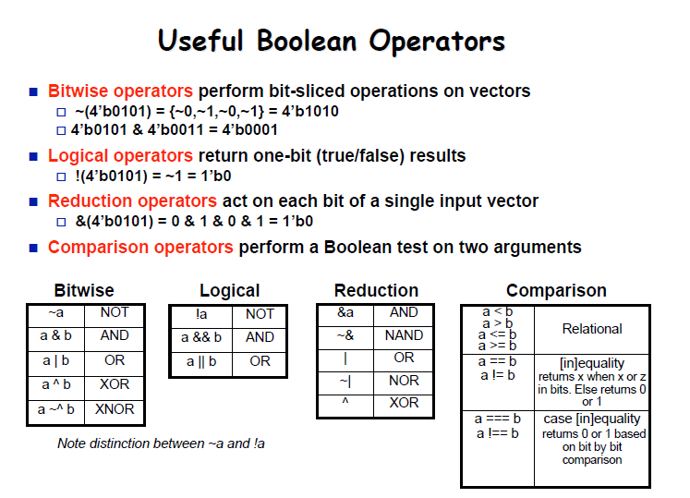

Slide 48
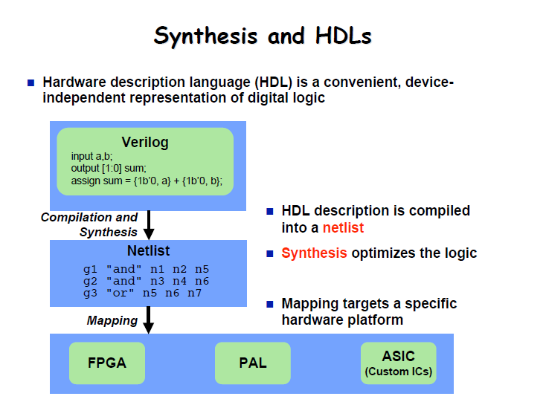

Slide 49
Verilog for Sequential Circuits

Slide 50

D-register in Verilog
module d_reg (input clk,
input D,
output reg Q) ;
always @ (posedge clk)
Q <= D;
endmodule
Use of posedge/negedge makes an always block sequential (edge-triggered)
The <= describes a ‘non-blocking’ assignment.
Guideline : Always use <= for sequential logic. Why we will see later.

Slide 51
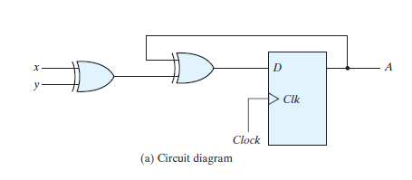
Problem: Verilog Code for the Circuit
module d_circuit (input clk,
input x,
input y,
output reg A) ;
wire x_xor_y, D_A;
assign x_xor_y = x^y;
assign D_A = A^(x_xor_y);
always @ (posedge clk)
A <= D_A;
endmodule
x
y
A
clk

Slide 52
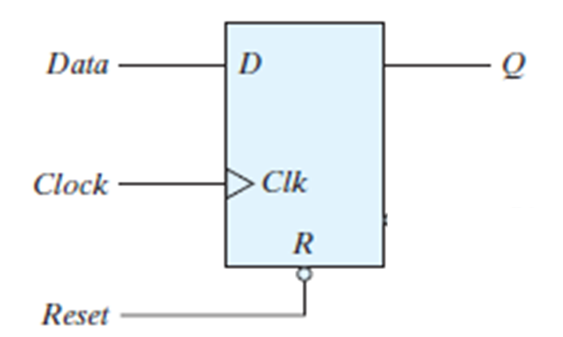
D-register with Asynchronous reset
module d_reg_rst (input clk,
input reset,
input D,
output reg Q) ;
always @ (posedge clk or negedge reset)
begin
if (reset == 0) Q<=0 // when reset
else Q <=D // normal
end
endmodule
The following is incorrect syntax: always @ (reset or posedge clk)
If one signal in the sensitivity list uses posedge/negedge, then all signals must.

Slide 53
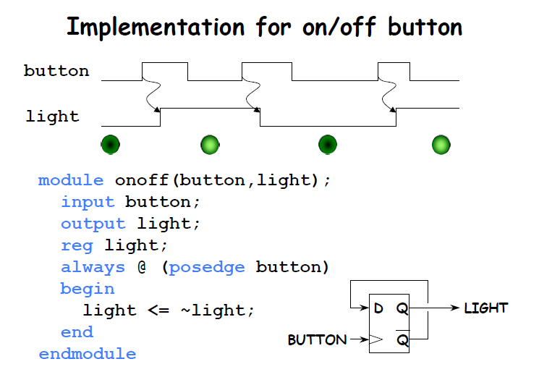

Slide 54
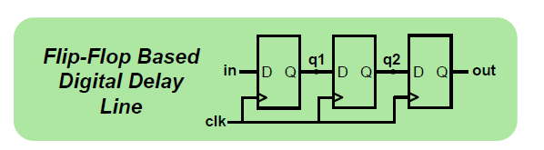
Blocking vs non-Blocking
module nonblocking(in, clk, out);
input in, clk;
output out;
reg q1, q2, out;
always @ (posedge clk)
begin
q1 <= in;
q2 <= q1;
out <= q2;
end
endmodule
module blocking(in, clk, out);
input in, clk;
output out;
reg q1, q2, out;
always @ (posedge clk)
begin
q1 = in;
q2 = q1;
out = q2;
end
endmodule

Slide 55
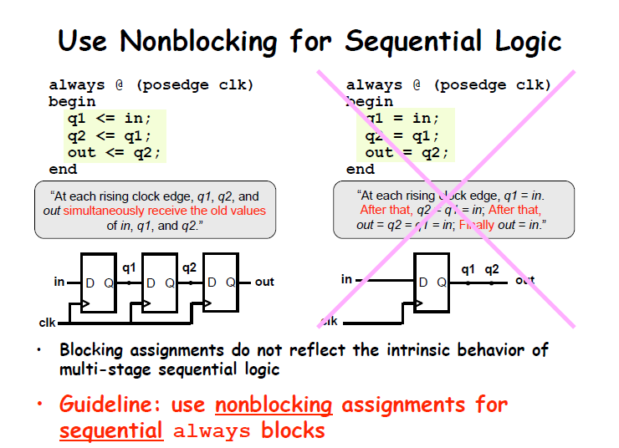

Slide 56
Blocking & Non-Blocking Assignments – Example
Non-Blocking
reg[7:0] A, B, C, D
always@(posedge clk)
begin
A <= B + C;
B <= A + D;
C <= A + B;
end
Blocking
reg[7:0] A, B, C, D
always@(posedge clk)
begin
A = B + C;
B = A + D;
C = A + B;
end
initial begin
A = 8’h1; B = 8’h2; C = 8’h3; D = 8’h4; end

Slide 57
Blocking vs non-Blocking : Summary
Blocking assignments, "=" evaluate the RHS and update the LHS immediately before any further instructions are executed.
Non-Blocking assignments, "<=" evaluate the RHS and postpone updating LHS until the end of present simulation timestep.

Slide 58
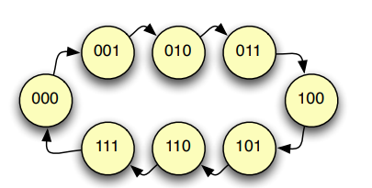
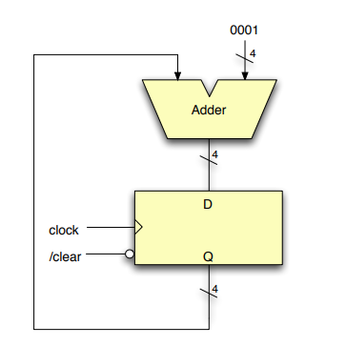
Sequential Component: Counter
Increment a multi-bit value on every clock
N-bit counter: counts from zero to 2^{N}-1
Technically, an N-bit FSM with a looped state transition diagram
Easier to think about as register and adder components
Variations –
Count down, count up/down
BCD counter: 0 ➙ 9

Slide 59
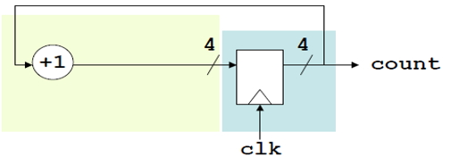
4-bit Counter
module counter(input clk,
output reg [3:0] count) ;
wire [3:0] D_count;
assign D_count = count + 1;
always @ (posedge clk)
count <= D_count;
endmodule

Slide 60
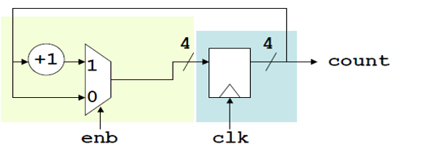
4-bit Counter with enable
module counter(input clk,
input enb,
output reg [3:0] count);
wire [3:0] D_count;
assign D_count = enb ? count + 1 : count;
always @ (posedge clk)
count <= D_count;
endmodule

Slide 61
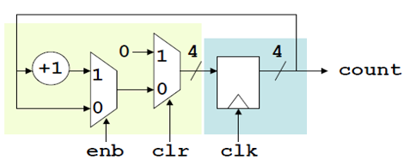
4-bit Counter with enable and clear
module counter(input clk, enb, clr,
output reg [3:0] count) ;
wire [3:0] D_count;
assign D_count = clr ? 4’b0 : (enb ? count + 1 : count);
always @ (posedge clk)
count <= D_count;
endmodule

Slide 62
Problem: 4-bit Down Counter with enable and clear
Cleared value should be 4’b1111
module counter(input clk, enb, clr,
output reg [3:0] count) ;
wire [3:0] D_count;
assign D_count = clr ? 4’b1111 : (enb ? count - 1 : count);
always @ (posedge clk)
count <= D_count;
endmodule

Slide 63
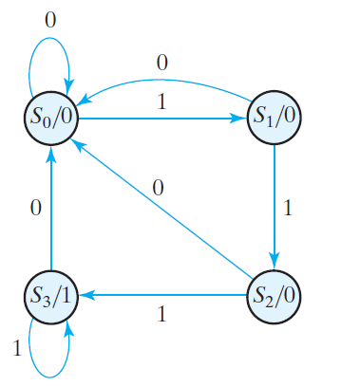
Design of Clocked Sequential Circuits
Suppose we wish to design a circuit that detects a sequence of three or more consecutive 1’s in a string of bits coming through an input line (i.e., the input is a serial bit stream).
S₀ : Reset State
S₁: One 1 is detected
S₂: Two 1s are detected
S₃: Three 1s are detected -> Output = 1
the circuit stays in S3 as long as there are three
or more consecutive 1’s received

Slide 64
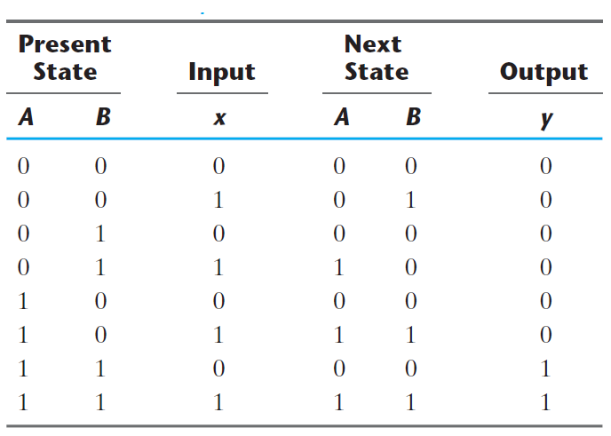
State Table for Sequence Detector

Slide 65
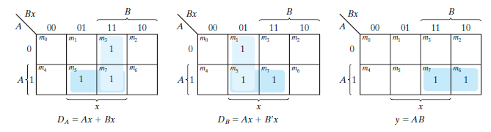
K-maps for Sequence Detector

Slide 66
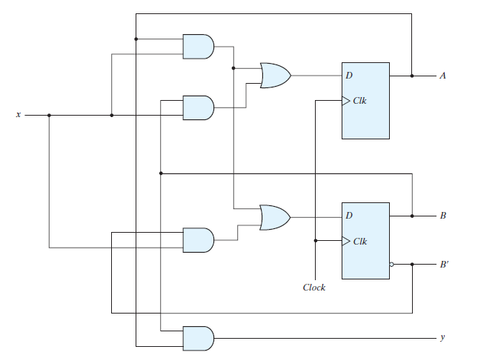
Final Circuit

Slide 67
Verilog Structural Description
module seq_det(input clk,
input x,
input reset,
output detect) ;
wire D_B, D_A;
reg A, B;
// Combinational Logic
assign D_A = A & x | B & x;
assign D_B = A & x | (~B & x);
assign detect = A & B;
// State Registers
always @ (posedge clk)
begin
if (reset)
begin
A <= 0;
B <= 0;
end
else
begin
A <= D_A;
B <= D_B;
end
end
endmodule

Slide 68
Verilog FSM Abstraction
module FSM_det(input clk, input, x, input reset, output detect);
reg [1:0] state, nextstate;
parameter S0 = 2'b00;
parameter S1 = 2'b01;
parameter S2 = 2'b10;
parameter S3 = 2’b11;
// State register
always @ (posedge clk)
if (reset) state <= S0;
else state <= nextstate;
// Next state logic
always @ (*)
case (state)
S0: if (x) nextstate = S1; else nextstate = S0;
S1: if (x) nextstate = S2; else nextstate = S0;
S2: if (x) nextstate = S3; else nextstate = S0;
S3: if (x) nextstate = S3; else nextstate = S0;
endcase
// Output logic
assign detect = (state == S3);
endmodule

Slide 69
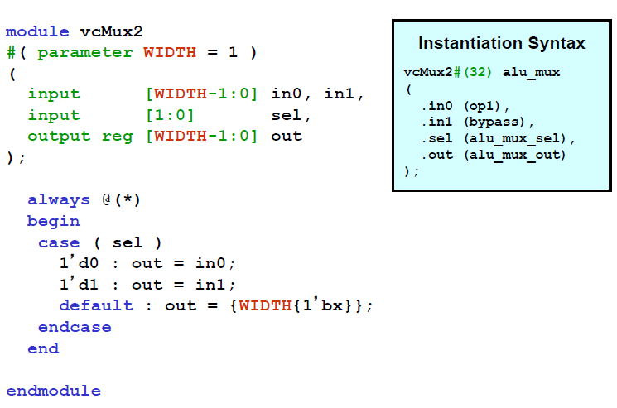
Power of Verilog: Parameterized Static Elaboration

Slide 70
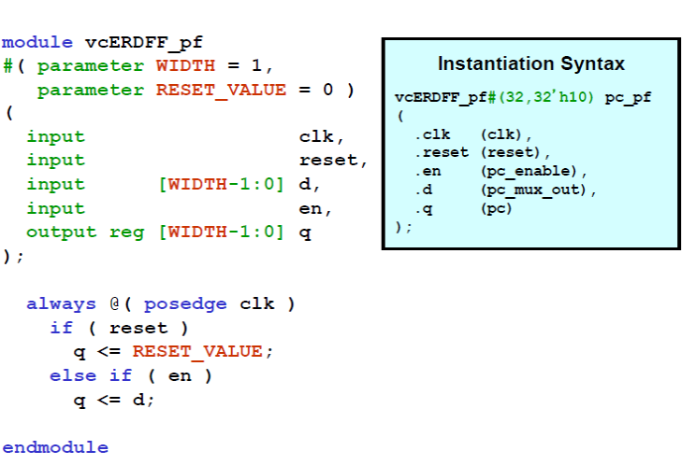
Power of Verilog: Parameterized Static Elaboration

Slide 71

Ripple Carry Adder

Slide 72

Ripple Carry Adder : Using genvar

Slide 73

Parameterized elaboration + genvar

Slide 74

Parameterized elaboration + genvar

Slide 75
Discrete-event Simulation
Basic idea: only do work when something changes
Centered around an event queue
Contains events labeled with the simulated time at which they are to be executed
Basic simulation paradigm
Execute every event for the current simulated time
Doing this changes system state and may schedule events in the future
When there are no events left at the current time instance, advance simulated time soonest event in the queue

Slide 76

Reg vs Wire
Outputs of an always block must be declared as reg

Slide 77

Reg vs Wire
Outputs of an assign statement must be declared as wire

Slide 78


Dangers of Verilog #1
module m3sample( input a, b, c, input [1:0] sel, output out );
reg out;
always @( * )
begin
case ( sel )
2’d0 : out = a;
2’d1 : out = b;
2’d2 : out = c;
default: out = 1’bx;
endcase
end
endmodule
If sel = 3, mux will output the previous value. What have we created?

Slide 79
What is inferred?
module unknown
(input clk,
input d,
output reg q);
always @(*)
begin
if (clk)
q = d;
end
endmodule

Slide 80

Dangers of Verilog #2
module prior1a (x, y, z, a, b, c, e, f, g);
output x, y, z;
input a, b, c, e, f, g;
reg x, y, z;
always @(a or b or c or e or f or g)
begin
{z,y,x} = 3’b0;
if ((a==1) && (b==1)) z = 1;
else if ((c==1) && (e==1)) y = 1;
else if ((f==1) && (g==1)) x = 1;
end
endmodule

Slide 81
Summary
Verilog allows us to do two things with the same piece of code:
Infer the physical structure of the logic to be created.
Simulate the behavior of the logic prior to building it.
We must write code to simultaneously satisfy two tools. In order of
importance...
Logic synthesizer - Our code must clearly infer the structure
(including errors!) we want from logic synthesis.
Logic simulator - Our code, when simulated, must exhibit the exact
behavior of the synthesized gates that are yet to be built.

Slide 82
Summary
Don't keep hacking code till the simulator is happy... Its working
gates you want!
Well structured RTL code written with an eye towards logic
synthesis almost always simulates correctly. The synthesizer is way
pickier than the simulator. This is a big reason for our structure first approach.
Debugging is very difficult for Verilog. Don’t write code and “see if it works.” Test each “unknown” thing individually until you know what it does; then combine into larger entities. Divide and conquer!

Slide 83
Verilog Coding Guidelines
Start with a Circuit Diagram. Don’t jump into coding without drawing the circuit diagram. Name all the input, output ports and internal wires. Always give meaningful names to ports, modules and wires. It increases readability and debuggability.
Use “assign” statements for simple combinational logic. Use combinational always blocks for complex combinational logic.
Clearly distinguish always blocks meant for combinational logic from those meant for sequential logic, do not mix combinational logic and sequential logic in the same always block
Only use blocking assignments (=) in combinational always blocks
Only use non-blocking assignments (<=) in sequential always blocks
Try to put as little logic in a sequential always block as possible. Keep it simple!
Write code which is aesthetically pleasing!

Slide 84
Verilog for Verification

Slide 85


Slide 86



Slide 87


Slide 88


Slide 89


Slide 90


Slide 91


Slide 92
Counter Test Bench
module counter_tb() ;
reg clk, clr, enb;
wire [3:0] count;
counter DUT ( .clk (clk), .clr (clr), .enb (enb), .count (count) );
initial begin
clk=0;
forever #5 clk=~clk; //Clock Generator
end
initial begin
#10 clr = 1'b1;
#20 clr = 0;
#10 enb=1;
end
endmodule

Slide 93


