Slide 1
Mental Health and Well-being
Surveillance, Assessment and Tracking
Solution Among Children
Project ID: PRJ 186
Mini Project — Review 1
Project / Subject Code: CSE7102
Arjun M — 20231CSE0277
Harsha R — 20231CSE0261
Abhishek M R — 20231CSE0268
Guide: Jatti Sai Kumar Sir
Presidency University — School of Computer Science and Engineering

Slide 2
1. Problem Statement & Motivation
Mental and emotional well-being concerns in children can be difficult to identify early.
Children may not consistently communicate changes in mood, sleep, stress, social behavior, or daily routines.
Existing approaches often depend on isolated questionnaires or one-time assessments.
The proposed solution provides continuous, child-friendly well-being tracking with privacy-aware monitoring.
The system is designed for non-clinical surveillance and early identification of potential risk patterns.
Academic engineering prototype — not a medical diagnostic system.

Slide 3
2. Literature Review & Research Gap
Existing Approach | Observed Limitation | Our Proposed Direction
Self-report questionnaires | Often one-time / periodic | Continuous longitudinal tracking
Mood tracking apps | Limited behavioral intelligence | Mood + lifestyle + journal signals
Text sentiment analysis | Focuses mainly on written text | NLP combined with structured assessment
Traditional screening | Limited continuous monitoring | Risk-tier monitoring with trend visualization
Research gap: age-appropriate interaction + multi-modal assessment + continuous tracking + support/referral integration.

Slide 4
3. System Architecture
1. Presentation Layer
Child check-in • Journal • Caregiver / Educator dashboard
2. Application Logic Layer
Authentication • Assessments • Risk rules • API services
3. ML / NLP Intelligence Layer
Risk stratification • Sentiment / affect analysis
4. Data Persistence Layer
User profiles • Check-ins • Assessments • Trends • Audit data
5. External Referral Layer
Verified support resources • Crisis / emergency referral pathways
Academic engineering prototype — not a medical diagnostic system.

Slide 5
4. Expected System Output
Child-friendly daily mood check-in using simple emoji-based interaction.
Structured well-being and lifestyle assessment.
Non-diagnostic ML risk stratification: Low / Healthy, Moderate / Monitoring, Elevated / Action Advised.
Optional journal analysis using NLP for emotional valence and affective tone.
Longitudinal trend visualization for changes over time.
Non-clinical coping support such as breathing and grounding exercises.
Role-based caregiver / educator insights with explainable trends.
Verified crisis and emergency support referral pathways when appropriate.
Academic engineering prototype — not a medical diagnostic system.

Slide 6
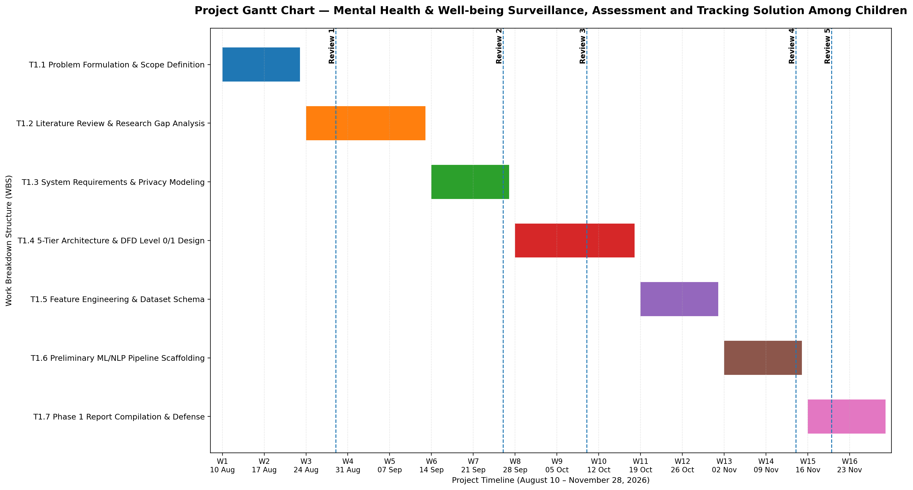
5. Project Gantt Chart
Review milestones: R1 — Aug 29 | R2 — Sep 26 | R3 — Oct 10 | R4 — Nov 14 | R5 — Nov 16–20, 2026
Academic engineering prototype — not a medical diagnostic system.

Slide 7
6. Review 1 — Key Takeaways
Problem scope and research gap have been defined.
A 5-tier system architecture and Level 0/Level 1 data flow are planned.
Expected outputs are clearly specified and remain non-diagnostic.
The project timeline is aligned with the university review milestones.
Next phase: move from design and specification toward implementation and validation.
Academic engineering prototype — not a medical diagnostic system.

