Slide 1
TIXHUB
Online Event & Ticket Booking System
Review 1: System Design & Entity-Relationship Modeling
Course: Database Management Systems Lab (30 Marks Assessment)
Technologies: Oracle Database 11g XE • Node.js / Express • SQL / PL-SQL • Vanilla JS
Notes:
Good morning respected professors. Today I am presenting Review 1 for TixHub, an Online Event and Ticket Booking System. In this review, I will detail our problem definition, system requirements, 3NF relational schema, and our comprehensive Entity-Relationship model.

Slide 2
DBMS LAB PROJECT • REVIEW 1
Problem Definition & Existing System Limitations
1. Manual Queueing & Delay
Physical ticket counters require customers to wait in long queues, leading to high transaction latency and poor user convenience.
2. No Real-Time Seat Transparency
Customers cannot view live seat occupancy maps or select specific seat rows before purchasing tickets.
3. Concurrency & Double-Booking
Traditional systems lack ACID transaction isolation, leading to race conditions where the same seat is sold to multiple buyers.
4. Fragmented History & Feedback
Absence of automated cancellation mechanisms, digital booking records, and verified attendee rating calculations.
Notes:
Traditional physical and unorganized ticketing channels suffer from major bottlenecks: long queues, absence of visual seat maps, race conditions leading to double bookings, and lack of automated cancellation and feedback management.

Slide 3
DBMS LAB PROJECT • REVIEW 1
Project Objectives & Proposed Solution
🎯 Categorized Event Catalog: Unified hub for Movies, Live Concerts, and College Festivals with date, venue, and pricing filters.
🎯 Visual Seat Reservation: Real-time interactive cinema-style seat map with instant capacity and pricing computation.
🎯 Atomic Concurrency Control: Oracle ACID transaction boundaries to guarantee zero double-booking under high concurrent traffic.
🎯 Role-Based Access Control: Cryptographic authentication using Bcrypt password hashing and JWT token verification for Users & Admins.
🎯 Instant Cancellation & Ratings: Immediate seat restoration upon cancellation and aggregate 1-5 star event ratings calculated via SQL.
Notes:
TixHub solves these challenges through an end-to-end relational database solution featuring categorized events, visual cinema-style seat maps, ACID transaction guarantees, role-based security, and dynamic cancellation with review aggregations.

Slide 4
DBMS LAB PROJECT • REVIEW 1
Requirement Analysis (Functional & Non-Functional)
⚙️ Functional Requirements
• User Registration & Login with Bcrypt hashing
• Admin event management (CRUD operations)
• Real-time search, category filtering & sorting
• Interactive multi-seat selection & checkout
• One-click booking cancellation & seat release
• Event rating submission (1 to 5 stars)
🛡️ Non-Functional Requirements
• Data Integrity: Enforce 3NF, PK, FK, and Check Constraints
• Concurrency & Atomicity: ACID-compliant transaction safety
• Security: JWT token authorization & encrypted passwords
• Performance: Sub-second response time via connection pooling
• Optimistic UI: Zero page reload latency on cancellation/ratings
• High Scalability: Normalized schema supporting concurrent buyers
Notes:
Our requirement analysis separates functional features—like authentication, seat reservation, and cancellations—from non-functional guarantees including 3NF normalization, ACID transaction boundaries, and cryptographic security.

Slide 5
DBMS LAB PROJECT • REVIEW 1
System Architecture & Technology Stack
Presentation Tier (Frontend)
HTML5 • CSS3 (Flexbox/Grid) • Vanilla JavaScript (ES6+)
• Interactive visual cinema seat map & optimistic DOM updates
• Responsive layout for mobile, tablet, and desktop screens
Application Tier (REST Backend)
Node.js • Express.js • JWT Authentication • Bcrypt.js
• Modular routing (/events, /bookings, /ratings, /auth)
• Role-Based Access Control middleware for User & Admin sessions
Database Tier (Oracle 11g XE)
Oracle Database 11g Express Edition • Thick Mode Connection Pool
• 5 Normalized relational tables, Check constraints, Triggers
• Optimized SQL aggregation (LISTAGG, AVG, MERGE, atomic transactions)
Notes:
TixHub follows a clean 3-tier architecture: the presentation layer in HTML5/CSS3/JavaScript, the application tier built on Express.js with JWT security, and the data tier powered by Oracle 11g XE with Thick Mode connection pooling and PL/SQL triggers.

Slide 6
DBMS LAB PROJECT • REVIEW 1
Database Entities, Attributes & Keys
📂 USERS: [PK: user_id (PK)]
Attributes: name, email, password_hash, role, created_at
📂 EVENTS: [PK: event_id (PK)]
Attributes: title, category, event_date, event_time, location, price, total_seats, icon
📂 BOOKINGS: [PK: booking_id (PK)] [FK: user_id (FK), event_id (FK)]
Attributes: client_id, total_price, booking_date, status
📂 BOOKING_SEATS: [PK: (booking_id, seat_number) PK] [FK: booking_id (FK)]
Attributes: Normalized 3NF table storing individual reserved seats
📂 RATINGS: [PK: rating_id (PK)] [FK: booking_id (FK), event_id (FK)]
Attributes: rating (1 to 5), rated_at
Notes:
Our database schema consists of 5 entities. Notably, BOOKING_SEATS is decomposed into an associative entity with a composite primary key to adhere to Third Normal Form (3NF), eliminating multi-valued seat dependencies.

Slide 7
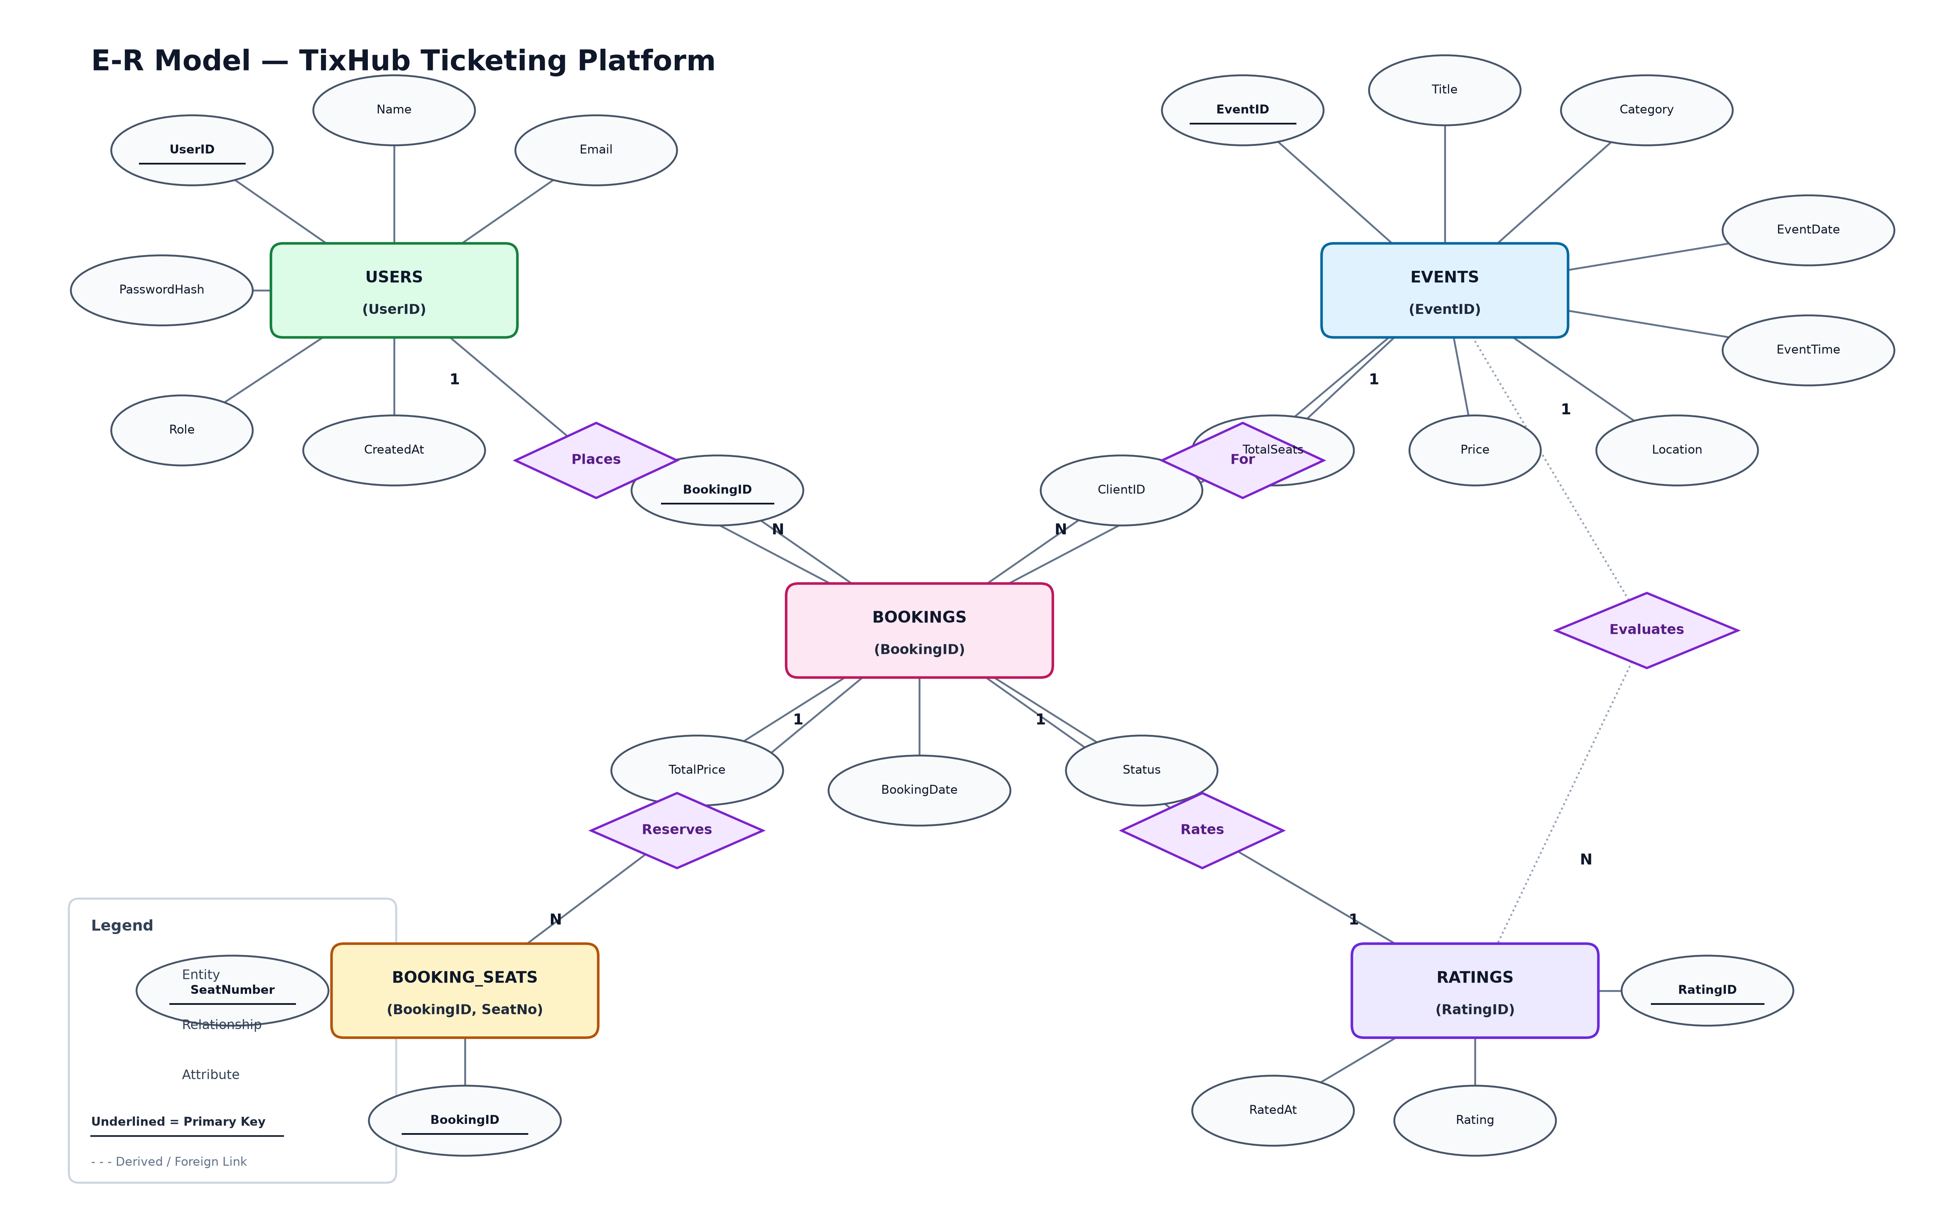
DBMS LAB PROJECT • REVIEW 1
Entity-Relationship (E-R) Model
Notes:
This slide demonstrates our E-R diagram. Users place bookings in a 1-to-many relationship. Events link to bookings in a 1-to-many relationship. Each booking reserves multiple seats in BOOKING_SEATS, and confirmed bookings can optionally submit a rating evaluating the event.

Slide 8
DBMS LAB PROJECT • REVIEW 1
Database Normalization (3NF) & Integrity Constraints
📐 Normalization (1NF → 2NF → 3NF)
• 1NF (First Normal Form): Atomic column values; eradicated multi-valued booked seat arrays into individual rows.
• 2NF (Second Normal Form): Full functional dependency; in BOOKING_SEATS, attributes depend on the entire composite key (booking_id, seat_number).
• 3NF (Third Normal Form): Eradicated transitive dependencies; user credentials and event metadata exist solely in their primary entity tables.
🔒 Database Integrity Constraints
• PRIMARY KEY: Unique identifiers on users, events, bookings, and ratings.
• FOREIGN KEY: Enforced referential integrity across all relationships.
• CHECK (role IN ('admin', 'user')): Strict RBAC domain enforcement.
• CHECK (rating BETWEEN 1 AND 5): Rating value validation.
• CHECK (status IN ('confirmed', 'cancelled')): Booking status validation.
• TRIGGERS & SEQUENCES: Automated key generation for Oracle 11g XE.
Notes:
Our schema strictly adheres to 3NF normalization to prevent insertion, update, and deletion anomalies. Integrity constraints including primary keys, foreign keys, and domain check constraints guarantee data validity.

Slide 9
DBMS LAB PROJECT • REVIEW 1
Implementation Roadmap for Review 2
🚀 Phase 1: Advanced SQL Queries & Analytical Aggregations
Implementing LISTAGG, AVG, GROUP BY, and multi-table JOINs for live seat matrices and ratings.
🚀 Phase 2: Atomic Transaction Checkout Engine
Multi-statement checkout execution with Oracle COMMIT / ROLLBACK semantics preventing race conditions.
🚀 Phase 3: Database Views & Indexing Optimization
Creating materialized views for active bookings and B-Tree indexes on search keywords and foreign keys.
🚀 Phase 4: Full End-to-End API Integration
Complete validation of frontend user flows with backend Oracle connection pooling and security tests.
Notes:
In Review 2, we will present the practical implementation: atomic checkout transactions, analytical queries with LISTAGG and AVG, index tuning, and full frontend-to-database integration.

Slide 10
THANK YOU!
TixHub — High-Performance Event & Ticket Booking System
Questions & Feedback are Welcome
Notes:
Thank you for your time and attention. I am now open to any questions or suggestions from the faculty.

