Slide 1
MACHINE LEARNING CASE STUDY · REVIEW 2
Water Quality Classification
& Urban Air-Quality Clustering
Classification Part B with five advanced models, a consolidated ten-model comparison, and full unsupervised clustering with K-Means and Agglomerative Hierarchical Clustering.
Part A — Classification Part B | Part B — Clustering | Streamlit UI

Slide 2
CONTENTS
What Review 2 covers
01
Classification Part B
Five required Review-2 classifiers, held-out metrics, confusion matrices, ROC-AUC, cross-validation and tuning.
02
Consolidated Classification
One fair comparison across all 10 classifiers and evidence-based final model selection.
03
Clustering Track
Beijing air-quality problem, preprocessing, K-Means, Agglomerative clustering, mandatory metrics and visualisations.
04
Application & Repository
Streamlit interface, saved models/results, README, requirements and current deployment status.
Contents

Slide 3
01
Classification Part B
Continuing the same water-quality task from Review 1: add the five required advanced classifiers, compare all ten on one held-out test set, and select the final model using training-only cross-validation.

Slide 4
PART A · PROBLEM
Review 2 continues the same classification task
What stays identical
What Review 2 adds
Target: Water_Quality_Class with three labels — Good, Moderate, Poor.
Review 2 uses the same source dataset as Review 1. All ten algorithms are evaluated under one shared split and preprocessing policy, so the comparison is meaningful.
Five required algorithms: Random Forest, AdaBoost, Gradient Boosting, Bagging, and MLP Neural Network.
It also adds the consolidated 10-model table, training-only cross-validation and the final model decision.
80,000
67,873
3
29
10
raw rows in source CSV
labeled unique rows
target classes
retained predictors
classifiers total
Project source: notebooks/classification_review2.ipynb · src/classification.py
Part A · Problem

Slide 5
PART A · DATA
Dataset audit, class balance and the shared split
Class
Rows
Share
Audit facts
Common evaluation plan
Moderate
39,544
58.26%
12,112 rows have missing target labels and are excluded from supervised modelling.
After target filtering and duplicate removal: 67,873 labeled unique rows.
Initial numeric predictor matrix: 55 columns.
80:20 stratified split.
Training algorithms use the same 12,000-row stratified training sample for laptop-feasible SVC and CV.
Held-out test set: 13,575 rows.
Good
15,644
23.05%
Poor
12,685
18.69%
12,000
13,575
55 → 29
42
shared training sample
held-out test rows
numeric predictors retained
random seed
Executed notebook output: classification_review2.ipynb cells 3–5.
Part A · Data

Slide 6
PART A · METHOD
Leak-free preprocessing reused across all ten classifiers
Date feature engineering
Sample Date → year, month, day-of-year, month sin/cos. Raw date/time text is not used directly.
1
Train-only feature retention
Columns with >80% missingness are rejected using the training sample only — never the test set.
2
Imputation + missing indicators
Median imputation is fitted inside each Pipeline; missingness indicator columns preserve information that a measurement was absent.
3
Scaling
StandardScaler is fitted inside the Pipeline. The identical policy is applied to every classifier.
4
Project implementation: src/classification.py · SimpleImputer(add_indicator=True) + StandardScaler inside Pipeline.
Part A · Method

Slide 7
PART A · MODELS
Algorithms 6–8 · Random Forest, AdaBoost, Gradient Boosting
6. Random Forest
7. AdaBoost
8. Gradient Boosting
100 decision trees are fitted on bootstrapped samples with random feature selection. The ensemble reduces the variance of a single tree.
Project settings
• n_estimators = 100
• max_depth = 16
• n_jobs = 2
• random_state = 42
Held-out: accuracy 0.8855 · weighted F1 0.8837 · ROC-AUC 0.9680
Sequential weak learners focus progressively on samples earlier learners classified incorrectly.
Project settings
• n_estimators = 80
• learning_rate = 0.5
• random_state = 42
Held-out: accuracy 0.7169 · weighted F1 0.6891 · ROC-AUC 0.8220
Trees are added sequentially to reduce the residual classification error of the current ensemble.
Project settings
• n_estimators = 80
• random_state = 42
Held-out: accuracy 0.8770 · weighted F1 0.8750 · ROC-AUC 0.9603
Exact model settings and scores: src/classification.py · results/classification_comparison.csv.
Part A · Models

Slide 8
PART A · MODELS
Algorithms 9–10 · Bagging and MLP Neural Network
9. Bagging Classifier
10. MLP Classifier
Independent decision trees are fitted to bootstrap samples and their predictions are combined. This reduces the instability of a single decision tree.
Project settings
• base estimator: DecisionTree(max_depth=12)
• n_estimators = 60
• n_jobs = 2
• random_state = 42
Held-out: accuracy 0.8788 · precision 0.8791 · recall 0.8788 · weighted F1 0.8778 · ROC-AUC 0.9607
A feed-forward neural network learns nonlinear feature interactions after imputation and scaling. Early stopping limits unnecessary training once validation performance stops improving.
Project settings
• hidden layers = (64, 32)
• activation = ReLU
• early_stopping = True
• max_iter = 120
• random_state = 42
Held-out: accuracy 0.8075 · weighted F1 0.8059 · ROC-AUC 0.9088
Exact model settings and scores: src/classification.py · results/classification_comparison.csv.
Part A · Models

Slide 9
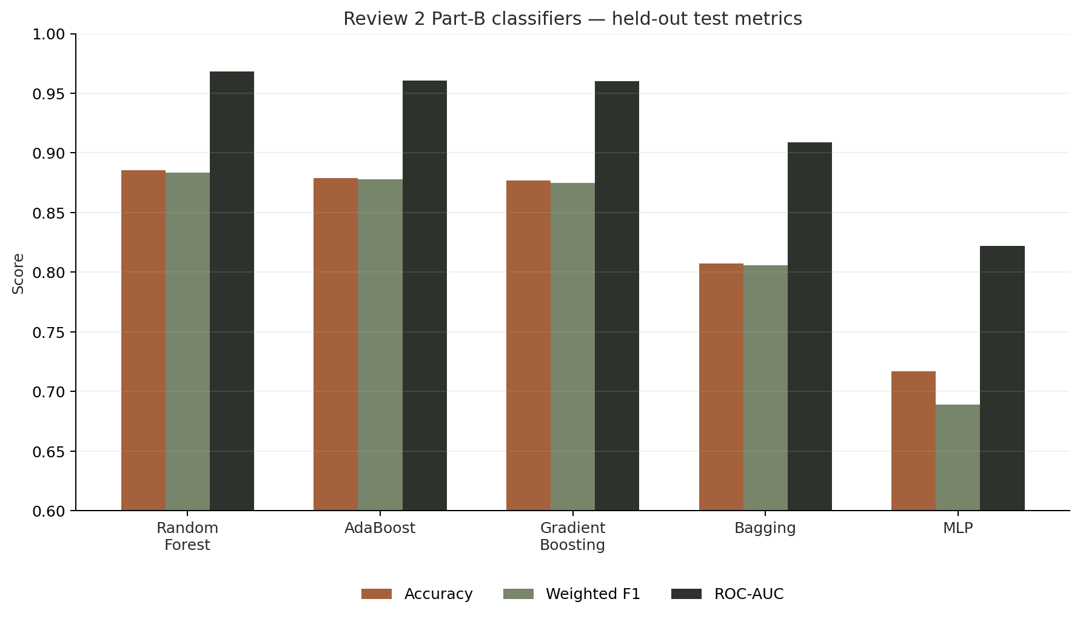
PART A · RESULTS
Part-B classifiers — held-out comparison
Random Forest leads
Accuracy 0.8855
Weighted F1 0.8837
ROC-AUC 0.9680
Close ensemble challengers
Bagging F1 0.8778
Gradient Boosting F1 0.8750
Both ROC-AUC ≈ 0.96
What this establishes
The three tree ensembles substantially outperform AdaBoost and MLP on this fixed evaluation plan. The test set remains descriptive; model selection uses training-only cross-validation.
Verified values: results/classification_comparison.csv in the GitHub project.
Part A · Results

Slide 10
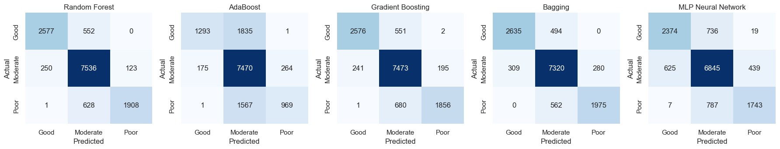
PART A · RESULTS
Confusion matrices — the five Review-2 models
Reading the matrices
Executed project notebook confusion matrices; rows = actual class, columns = predicted class.
Random Forest and Bagging sharply reduce confusion between Good/Poor and the majority Moderate class. AdaBoost sends many Good and Poor samples into Moderate, matching its lower weighted F1.
Part A · Results

Slide 11
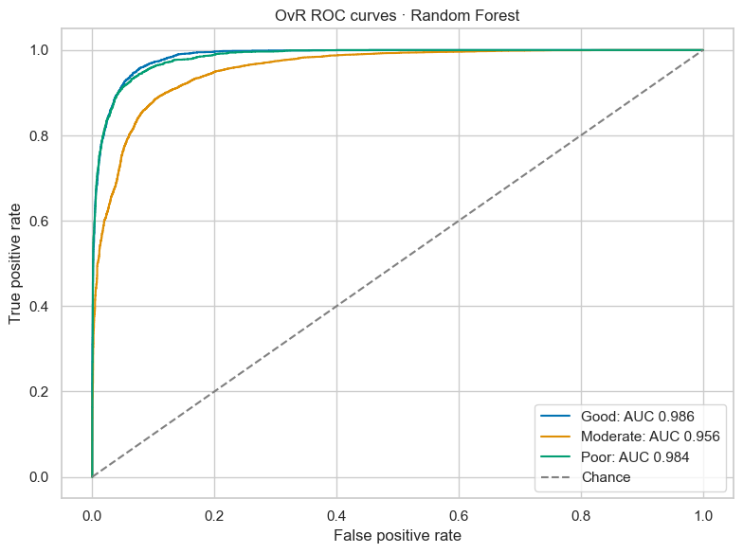
PART A · RESULTS
Random Forest ROC-AUC — one-vs-rest
Per-class AUC
Good: 0.986
Moderate: 0.956
Poor: 0.984
Weighted multiclass OvR ROC-AUC: 0.9680
Interpretation
The curves stay well above the chance diagonal. Moderate is the hardest one-vs-rest class of the three, but discrimination remains strong.
ROC figure: executed classification_review2.ipynb · weighted ROC-AUC from results/classification_comparison.csv.
Part A · Results

Slide 12
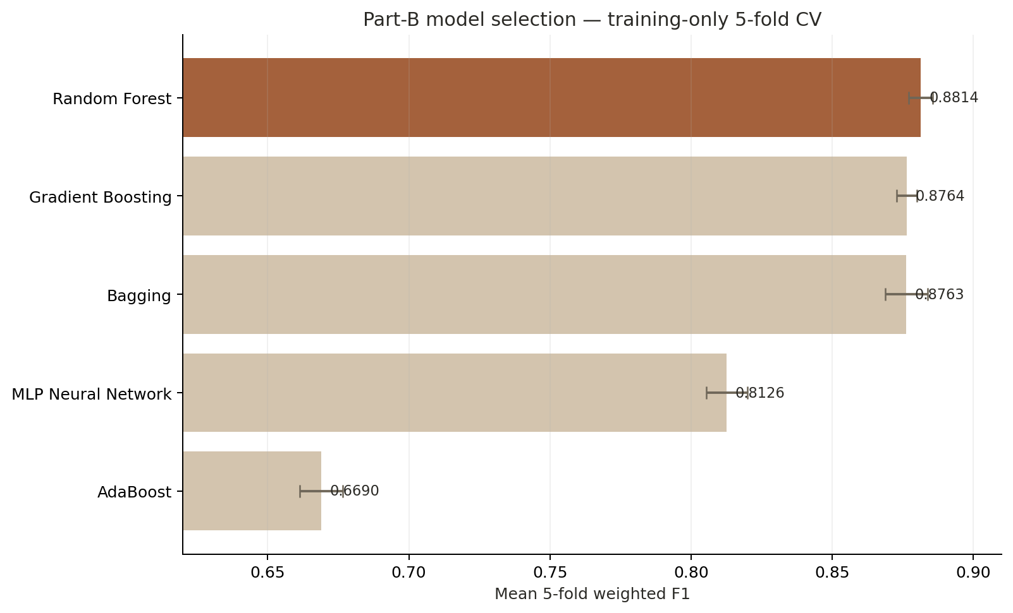
PART A · MODEL SELECTION
Five-fold training CV chooses the Part-B winner
1 · Random Forest
0.8814 ± 0.0042 weighted F1
2 · Gradient Boosting
0.8764 ± 0.0035 weighted F1
3 · Bagging
0.8763 ± 0.0075 weighted F1
Decision
Random Forest is selected because it has the highest mean five-fold F1 on training data.
Verified values: results/classification_cv.csv.
Part A · Model selection

Slide 13
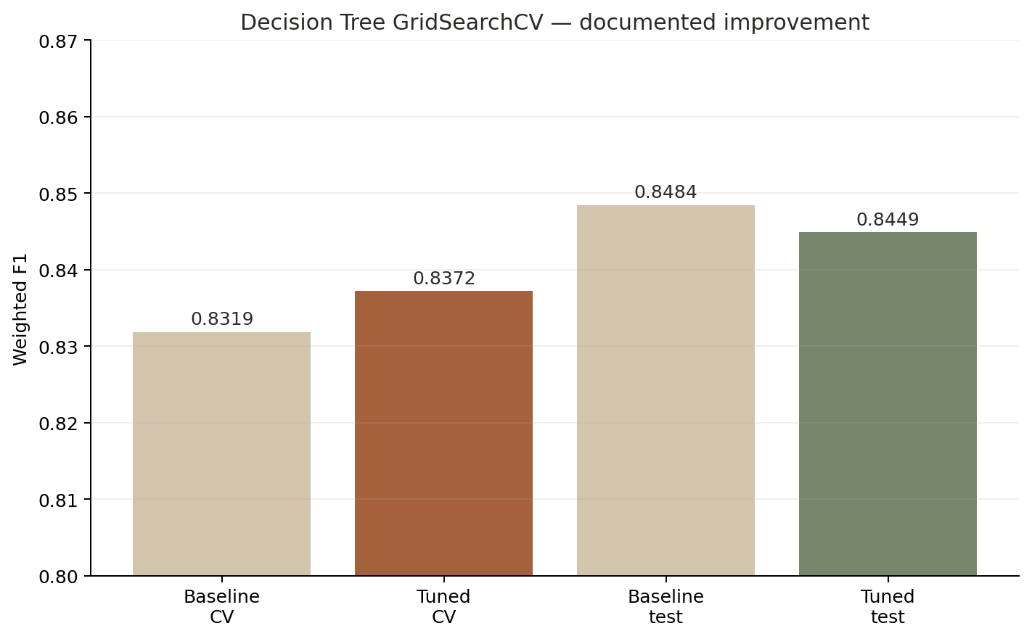
PART A · TUNING
GridSearchCV — documented cross-validation improvement
Best parameters
DecisionTreeClassifier
max_depth = 12
min_samples_leaf = 1
Training-CV improvement
3-fold weighted F1: 0.8319 → 0.8372
Improvement: +0.0053
Held-out check
Test F1 changes 0.8484 → 0.8449. The deck reports both results instead of hiding the slight test decrease.
Verified values: results/classification_tuning.csv · tuning performed using training folds only.
Part A · Tuning

Slide 14
PART A · RESULTS
Consolidated ten-algorithm classification comparison
Algorithm
Accuracy
Precision
Recall
Weighted F1
ROC-AUC
Random Forest
0.8855
0.8893
0.8855
0.8837
0.9680
Bagging
0.8788
0.8791
0.8788
0.8778
0.9607
Gradient Boosting
0.8770
0.8799
0.8770
0.8750
0.9603
Decision Tree
0.8455
0.8449
0.8455
0.8449
0.8834
MLP Neural Network
0.8075
0.8066
0.8075
0.8059
0.9088
Logistic Regression
0.7164
0.7251
0.7164
0.6946
0.8187
AdaBoost
0.7169
0.7499
0.7169
0.6891
0.8220
Support Vector Machine
0.7090
0.7226
0.7090
0.6841
0.8390
K-Nearest Neighbors
0.6817
0.6761
0.6817
0.6664
0.7807
Gaussian Naive Bayes
0.3976
0.5654
0.3976
0.3603
0.6544
Rubric requirement met
Exact table: results/classification_comparison.csv.
Part A · Results
One table contains Accuracy, Precision, Recall, weighted F1 and ROC-AUC for all ten classifiers on the same held-out test set.

Slide 15
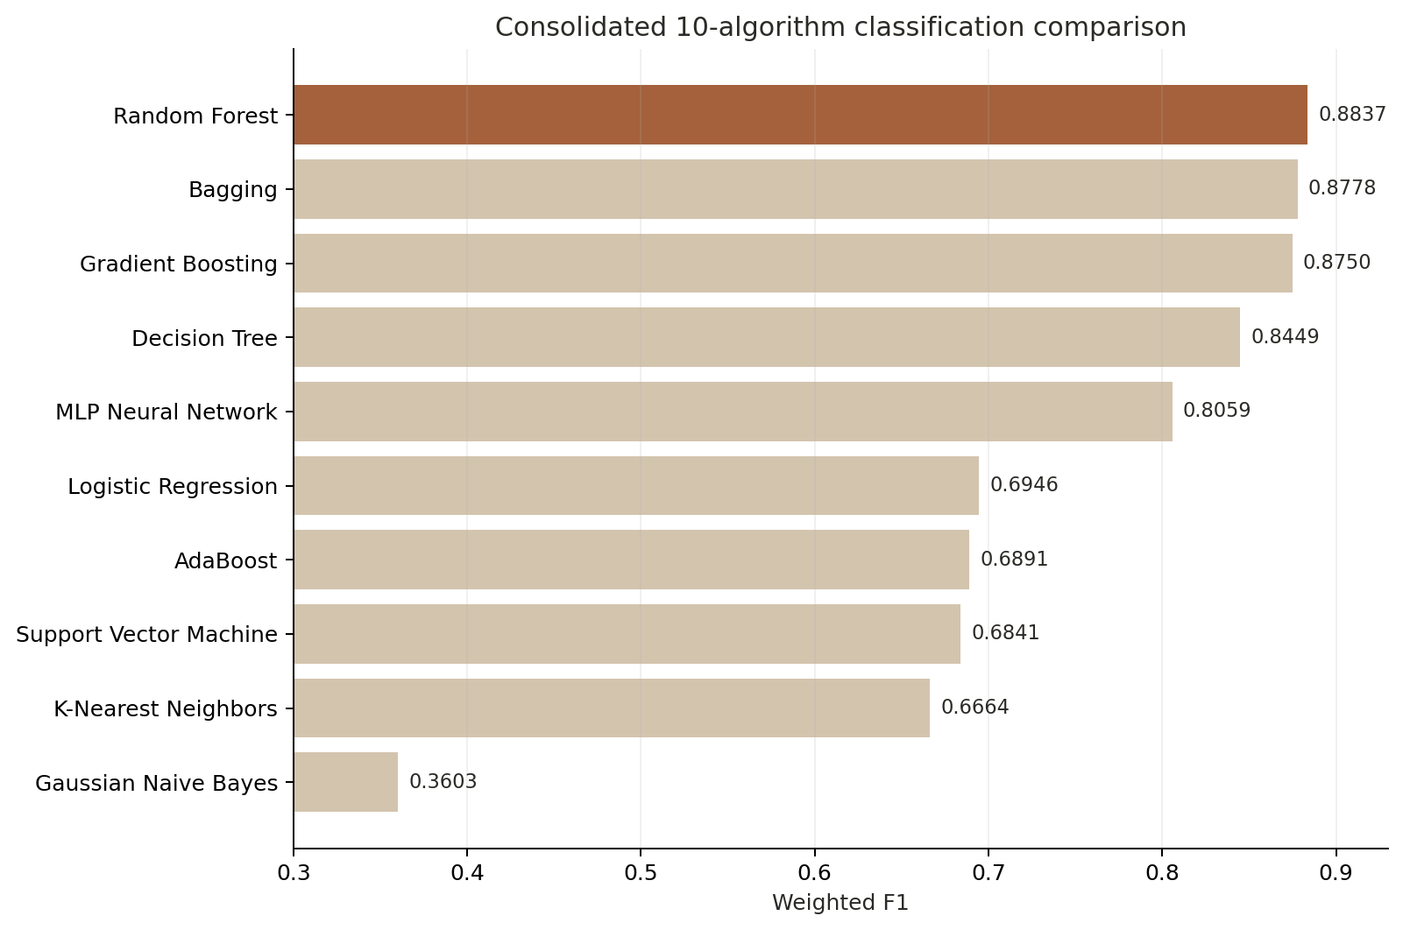
PART A · RESULTS
Which classifiers lead the prediction task?
1 · Random Forest
Weighted F1 0.8837
2 · Bagging
Weighted F1 0.8778
3 · Gradient Boosting
Weighted F1 0.8750
Result
Ensemble trees are the strongest family on this dataset.
Weighted F1 values from the executed 10-model comparison.
Part A · Results

Slide 16
PART A · CONCLUSION
Classification Part B — what we learned
Best final model
Selection rule
Trade-off
Random Forest
Held-out accuracy: 0.8855
Weighted F1: 0.8837
Weighted OvR ROC-AUC: 0.9680
The winner is selected using training-only 5-fold weighted F1 — not by searching the test set. Random Forest leads at 0.8814 ± 0.0042.
Bagging and Gradient Boosting are extremely close. Their test F1 scores are 0.8778 and 0.8750, showing that several ensemble approaches are viable.
Class imbalance
Tuning evidence
Saved output
Moderate represents 58.26% of labeled data. Weighted F1 is therefore reported alongside accuracy, precision, recall and ROC-AUC.
GridSearchCV improved Decision Tree training-CV F1 by +0.0053. Test F1 decreased slightly, which is transparently reported.
The project exports the full comparison, cross-validation and tuning CSVs and saves the selected classifier for the Streamlit application.
Review-2 classification evidence: results/ + models/classification_model.joblib.
Part A · Conclusion

Slide 17
02
Part B — Clustering
Discover recurring urban air-pollution and weather patterns without using a target label. The official rubric requires two clustering algorithms: K-Means and Agglomerative Hierarchical Clustering.

Slide 18
PART B · PROBLEM
Urban air-pollution pattern discovery
Problem statement
Why clustering is appropriate
Use unsupervised learning to group Beijing air-quality observations according to pollutant concentrations, weather, time and wind conditions. The goal is to discover recurring environmental regimes rather than predict a predefined class.
No air-quality class label is used during model fitting. K-Means and Agglomerative clustering are evaluated using internal clustering metrics and low-dimensional visualisations.
SDG connection
Practical use
Important limit
SDG 11 — Sustainable Cities & Communities. The analysis supports understanding and monitoring urban air-quality patterns.
Environmental teams can identify recurring pollution regimes, compare monitoring periods, and understand when high-pollution patterns occur.
Cluster IDs are arbitrary pattern labels. They are not official AQI classes and they are not medical or public-health advice.
Project statement: README.md · notebooks/clustering.ipynb · UCI Beijing Multi-Site Air Quality data.
Part B · Problem

Slide 19
PART B · DATA
Dataset audit — Beijing Multi-Site Air Quality
420,768
12
35,064
18
2013–17
hourly observations
monitoring stations
rows per station
raw columns
measurement period
Pollutants
Weather
Context / metadata
PM2.5
PM10
SO₂
NO₂
CO
O₃
Temperature (TEMP)
Pressure (PRES)
Dew point (DEWP)
Rain (RAIN)
Wind speed (WSPM)
Year · month · day · hour
Wind direction (wd)
Station
Station names and calendar values are retained for interpretation; no ground-truth pollution class is used.
Executed clustering notebook audit: 12 × 35,064 = 420,768 rows.
Part B · Data

Slide 20
PART B · DATA
Missing-value analysis and final clustering feature space
Variable
Missing rows
Project treatment
Final feature matrix
CO
20,701
• Negative pollutant concentrations are treated as missing.
• Median imputation is fitted before scaling.
• Six pollutant variables use log1p.
• Hour, month and wind direction become cyclic sin/cos features.
• StandardScaler puts all dimensions on a comparable scale.
17 clustering features
6 logged pollutants
5 weather variables
2 hour cyclic features
2 month cyclic features
2 wind-direction cyclic features
After preprocessing: no missing or infinite values.
O3
13,277
NO2
12,116
SO2
9,021
PM2.5
8,739
PM10
6,449
wd
1,822
17
0
0
42
clustering features
missing after preprocessing
infinite values
random seed
Missing counts: executed clustering notebook cell 21 · current preprocessing logic: src/clustering.py.
Part B · Data

Slide 21
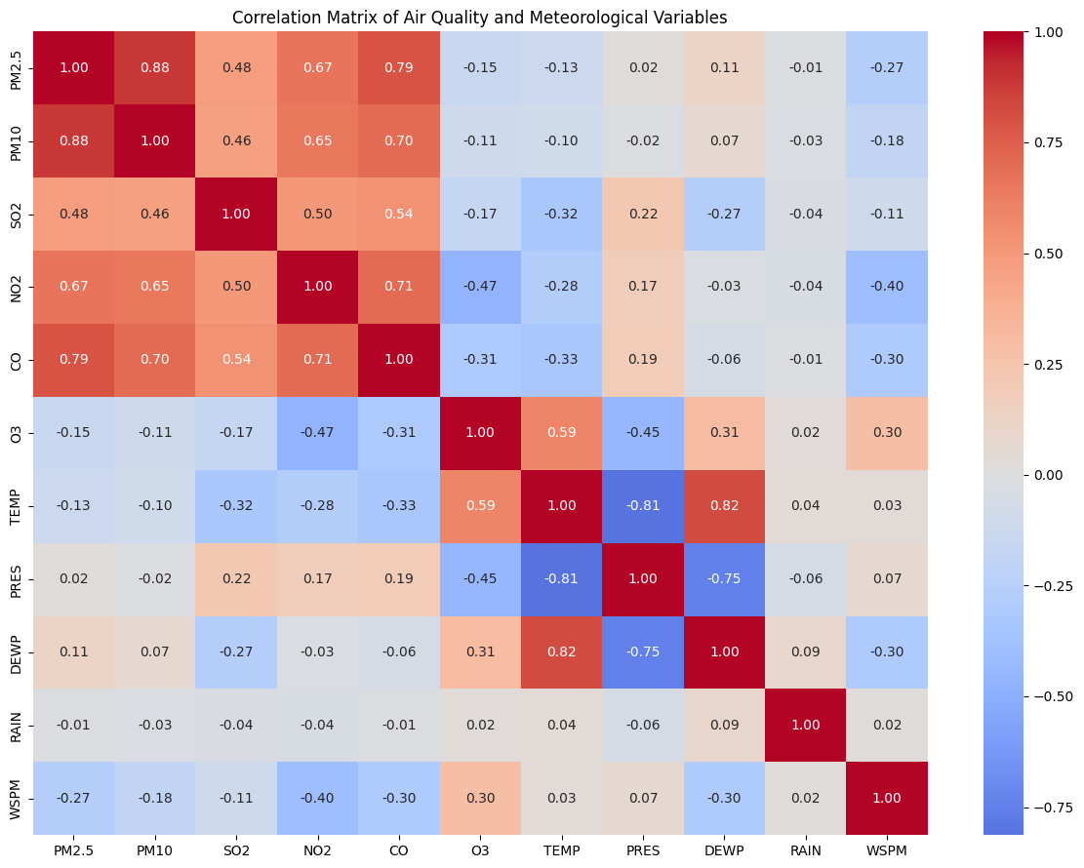
PART B · EDA
Correlation structure — pollutants and weather
What the heatmap shows
PM2.5 ↔ PM10: 0.88
PM2.5 ↔ CO: 0.79
NO2 ↔ CO: 0.71
TEMP ↔ DEWP: 0.82
TEMP ↔ PRES: −0.81
NO2 ↔ WSPM: −0.40
The data contains strong co-movement among combustion pollutants and clear meteorological structure.
Why scale?
K-Means and Ward clustering are distance-based; standardized features stop large-unit variables from dominating.
Figure and correlations: executed clustering notebook EDA.
Part B · EDA

Slide 22
PART B · METHOD
Clustering preprocessing pipeline
1 · Raw 12-station data
420,768 hourly records are combined after verifying a common schema and unique station timestamps.
2 · Engineer 17 features
Six pollutants → log1p; hour, month and wind direction → cyclic sin/cos; weather variables retained.
3 · Impute + scale
SimpleImputer(strategy="median") followed by StandardScaler. No target label is introduced.
4 · Fit / compare fairly
K-Means fits all 420,768 rows. Final K-Means and Ward metrics are computed on the same reproducible 3,000-row sample.
Current implementation: src/clustering.py · preprocessing + common-sample comparison.
Part B · Method

Slide 23
PART B · K-MEANS
K-Means clustering — how the project uses it
1. Choose candidate K
2. Fit the final model
3. Evaluate / interpret
Candidate K values: 2 through 7.
A reproducible 12,000-row selection sample is used for efficient K testing. A 1,500-row subset is used for candidate silhouette scoring.
The highest candidate silhouette occurs at K = 3.
Final K-Means uses:
• n_clusters = 3
• n_init = 10
• random_state = 42
After K is chosen, K-Means is fitted on the complete 420,768-row standardized feature matrix.
A common reproducible 3,000-row subset is used for the final K-Means vs Ward metric comparison.
Cluster profiles are calculated back in original pollutant/weather measurement units for interpretation.
K = 3
420,768
3,000
10
selected cluster count
rows in final K-Means fit
fair comparison rows
K-Means initialisations
Exact run parameters: src/clustering.py.
Part B · K-Means

Slide 24
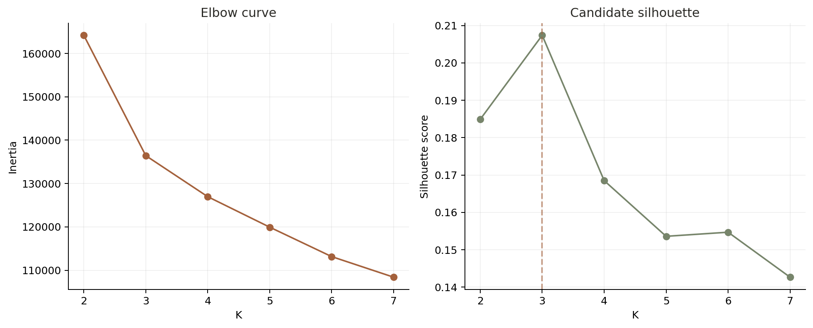
PART B · K-MEANS
Selecting K — Elbow + candidate silhouette
Why K = 3?
Candidate silhouette peaks at K=3 with 0.2074. Inertia also falls sharply from K=2 to K=3 before later improvements become smaller.
Exact candidate score
K=2: 0.1849
K=3: 0.2074
K=4: 0.1685
Important interpretation
The silhouette is modest rather than high. Air-quality conditions overlap continuously, so the clusters are useful environmental regimes, not perfectly separated natural classes.
Verified current outputs: results/clustering_elbow.csv.
Part B · K-Means

Slide 25
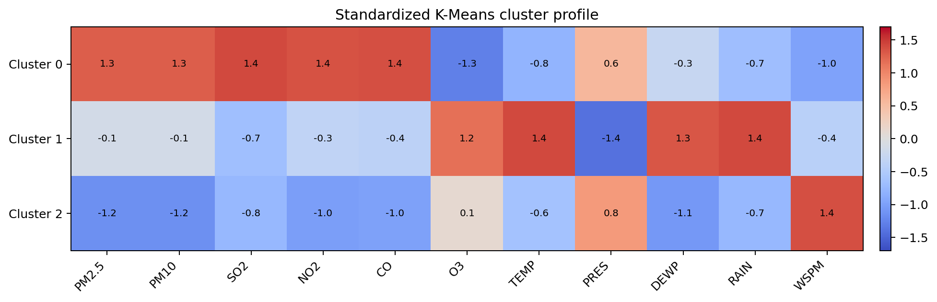
PART B · K-MEANS
Three discovered environmental profiles
Cluster 0 · 139,243 rows
Cluster 1 · 190,158 rows
Cluster 2 · 91,367 rows
Highest PM2.5 (138.8), PM10 (167.2), NO2 (83.4) and CO (2223.7); low O3 (16.8); low wind 1.19 m/s.
Warmest profile: TEMP 23.58°C, DEWP 14.28°C; highest O3 87.21; moderate particulate and combustion pollution.
Lowest PM2.5 15.62, PM10 36.46, NO2 22.55 and CO 425.45; highest wind speed 2.84 m/s.
Exact profiles and cluster sizes: results/clustering_profiles.csv. Names are descriptive only — not official AQI classes.
Part B · K-Means

Slide 26
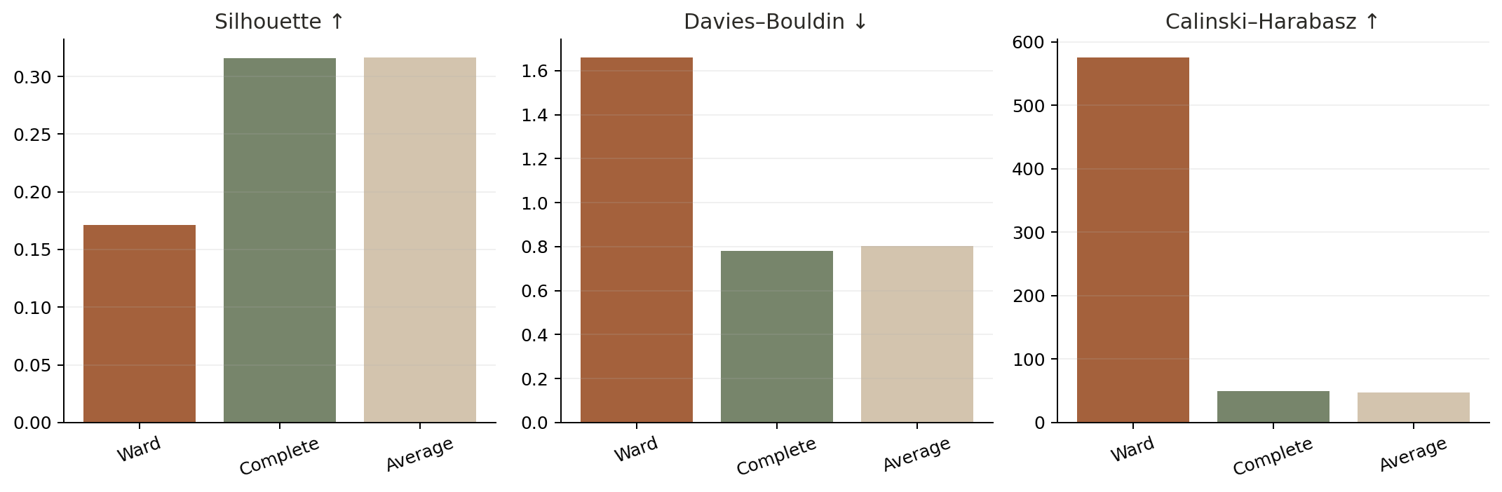
PART B · HIERARCHICAL
Agglomerative clustering — linkage comparison
Ward
Silhouette 0.1710
DB 1.6598
CH 575.60
Complete
Silhouette 0.3162
DB 0.7814
CH 49.25
Average
Silhouette 0.3165
DB 0.8024
CH 47.75
Why Ward is retained
Complete and Average score higher on silhouette/DB but collapse the Calinski–Harabasz score to ~49. The project keeps Ward for the compact-cluster comparison and reports the metric disagreement transparently.
Verified values: results/clustering_linkages.csv.
Part B · Hierarchical

Slide 27
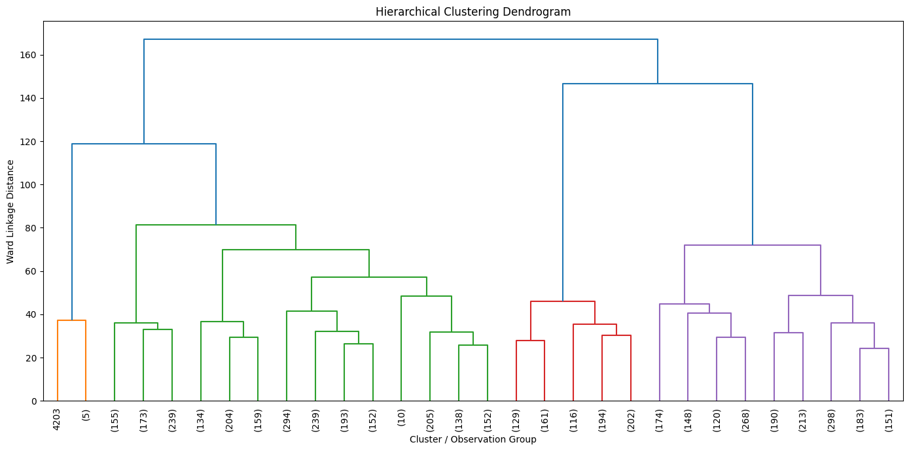
PART B · HIERARCHICAL
Dendrogram — hierarchical structure of the data
How to read it
Each leaf/group begins separately. Branches merge upward as Ward linkage combines the pair that causes the smallest increase in within-cluster variance. Higher merge height means more dissimilar groups.
Why show it?
The dendrogram exposes the hierarchy that K-Means does not provide and is the required visual evidence for Agglomerative Hierarchical Clustering.
Dendrogram figure from the executed clustering notebook; current project uses Ward linkage for the final hierarchical comparison.
Part B · Hierarchical

Slide 28
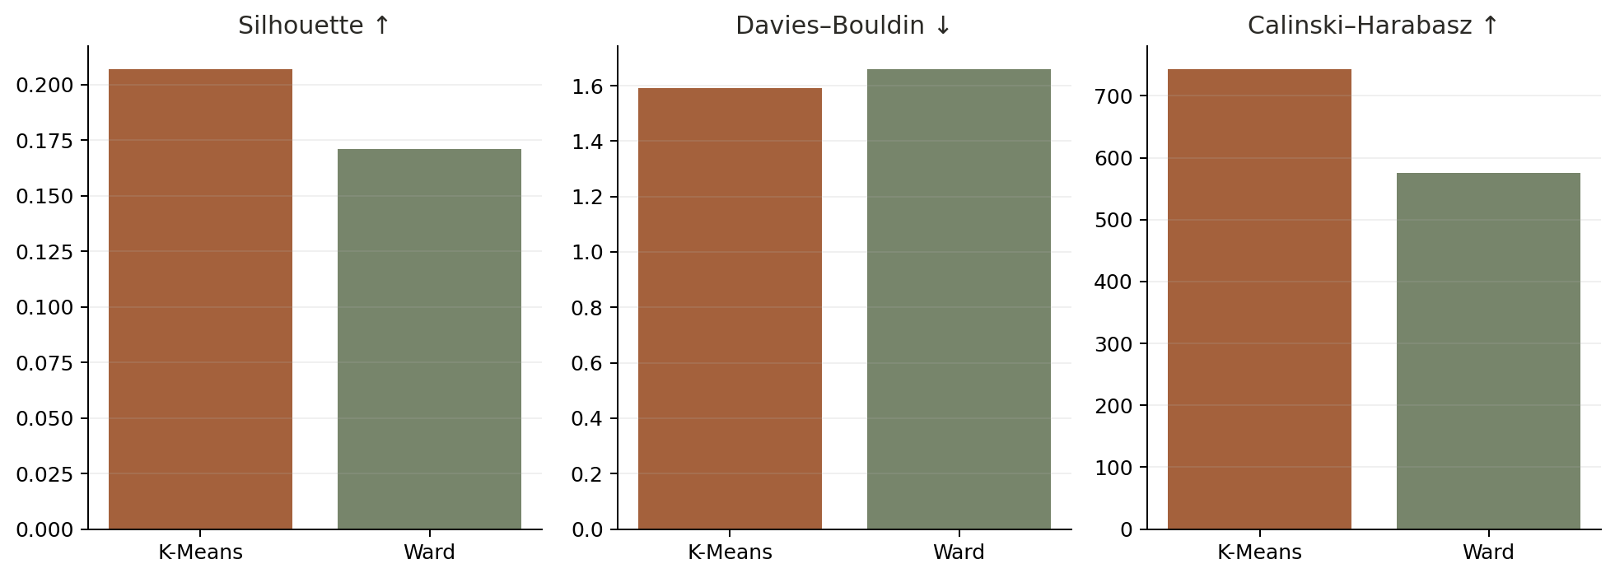
PART B · RESULTS
Fair model comparison — same 3,000 observations
Algorithm
Clusters
Rows
Silhouette
DB
CH
K-Means
3
3,000
0.2069
1.5907
743.27
Agglomerative (Ward)
3
3,000
0.1710
1.6598
575.60
Metric directions
Silhouette: higher is better
Davies–Bouldin: lower is better
Calinski–Harabasz: higher is better
Result
K-Means is better than Ward on all three mandatory metrics on the exact same evaluation rows.
Verified fair comparison: results/clustering_comparison.csv.
Part B · Results

Slide 29
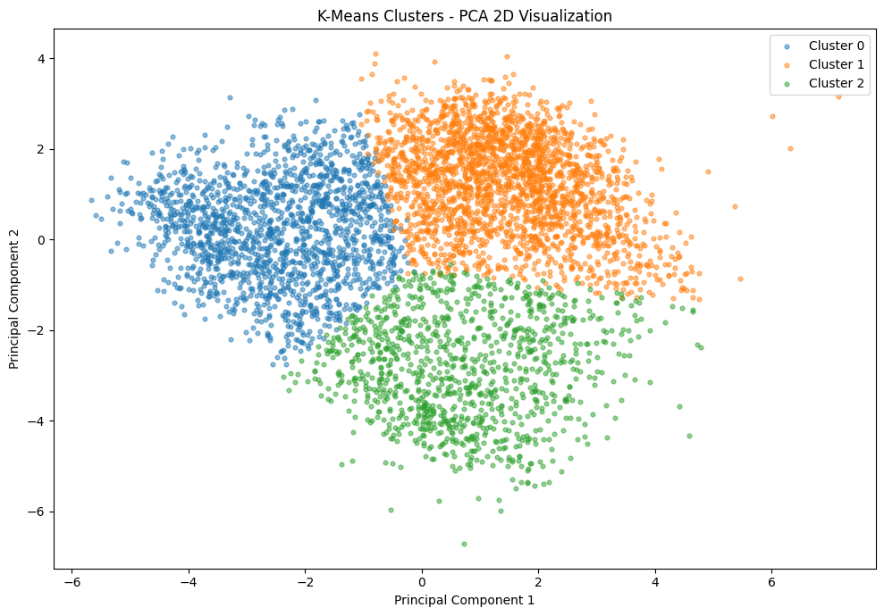
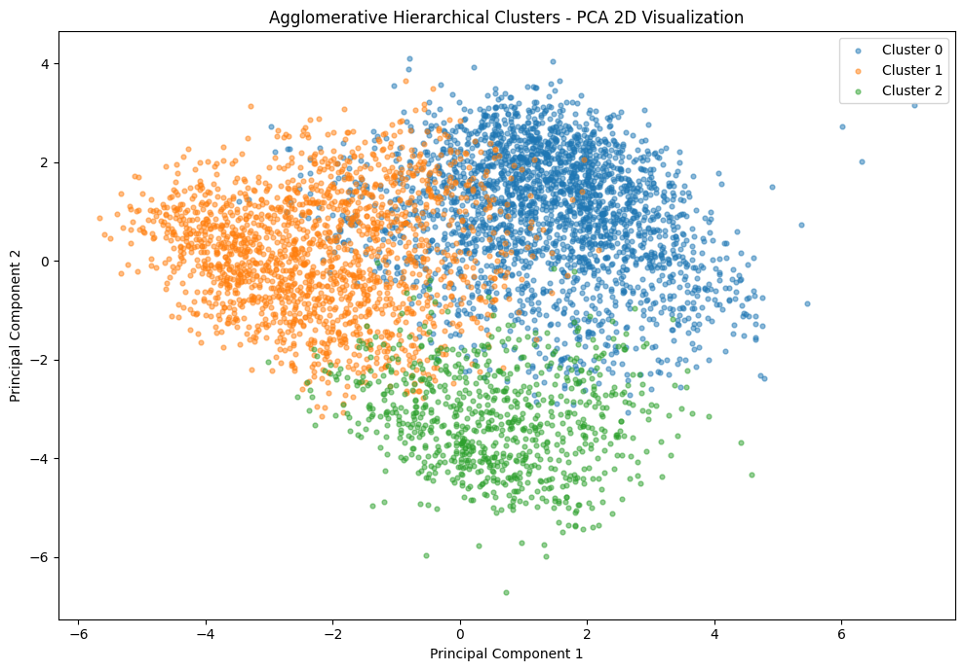
PART B · VISUALISATION
PCA — 2D cluster visualisation for both algorithms
K-Means PCA
Agglomerative PCA
PCA figures from the executed clustering notebook. The rubric requires a 2D PCA scatter for every clustering algorithm.
Part B · Visualisation

Slide 30
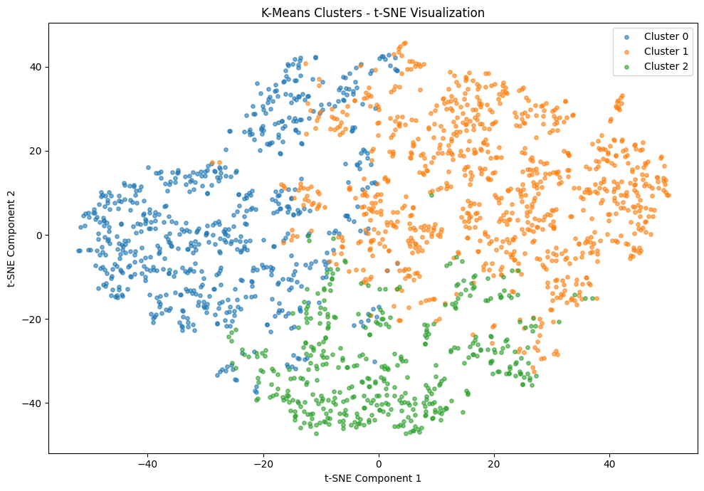
PART B · VISUALISATION
t-SNE — nonlinear view of local cluster structure
Why include t-SNE?
PCA preserves global linear variance; t-SNE emphasizes local neighborhoods. It gives a complementary view of how the K-Means assignments occupy the feature space.
Caution
t-SNE axes have no physical meaning. The plot is evidence of local grouping, not a new performance metric and not a ground-truth air-quality label.
t-SNE figure from the executed clustering notebook; the rubric encourages t-SNE for at least one algorithm.
Part B · Visualisation

Slide 31
PART B · CONCLUSION
Clustering — what we learned
K-Means result
Hierarchical result
Interpretation
K=3 is selected. On the common 3,000-row evaluation sample, K-Means achieves silhouette 0.2069, DB 1.5907 and CH 743.27.
Ward at K=3 gives silhouette 0.1710, DB 1.6598 and CH 575.60. Complete/Average show a metric trade-off and are retained in the linkage comparison.
The discovered regimes separate high particulate/combustion conditions, warmer ozone-rich conditions, and lower-pollution windier conditions.
Rubric visuals
Evaluation
Use limit
Elbow curve ✓
Dendrogram ✓
PCA for K-Means ✓
PCA for Agglomerative ✓
t-SNE ✓
Silhouette ✓
Davies–Bouldin ✓
Calinski–Harabasz ✓
Same 3,000 rows for final comparison ✓
Clusters are exploratory environmental profiles. The project explicitly does not present them as official AQI or health categories.
Review-2 clustering results: results/clustering_* files.
Part B · Conclusion

Slide 32
03
Application & Project Integration
The trained models and saved evidence are connected to one Streamlit application with Regression, Classification, Clustering and Study Results views.

Slide 33
INTEGRATION
Repository structure and Review-2 deliverables
notebooks/
src/
results/
Fully executed Review-2 classification and clustering notebooks with visible outputs.
Modular feature engineering, fitting, evaluation, export and release-validation code.
Classification comparison/CV/tuning, clustering elbow/linkage/PCA/profiles and validation evidence.
models/
app/
README + requirements
Saved classifier, clustering model and regression GUI model used by the app.
Streamlit interface: streamlit_app.py → dashboard.py.
README documents problem/data/results/setup/run instructions; requirements.txt and requirements-dev.txt are present.
Rubric integration
The project contains the notebook outputs, comparative tables, visualisations, README, environment files, modular code and Streamlit GUI required by Review 2. The repository is the single source of the current saved model/result artefacts.
GitHub repository: HarshaGaduputi/Machine-Learning-Case-Study.
Integration

Slide 34
BONUS · GUI
Interactive Streamlit application — what is implemented
Regression
Classification
Clustering
Study results
Building inputs → Site EUI estimate
90% internal error range + held-out charts
Water measurements → Good / Moderate / Poor
Calibrated probabilities + confusion/reliability evidence
Pollutants + weather + time/wind → K-Means cluster
PCA projection + comparison with historical cluster averages
10-classifier table · clustering metrics · elbow · PCA · linkage · method limits
Input safeguards implemented
Current bonus status
Forms start blank or can load a real source row. Unsupported/out-of-range inputs can be withheld instead of forcing a prediction. Accepted results include model version, entered values, imputed fields and limitations in a downloadable JSON record.
Interactive GUI: implemented ✓
Public deployment: not claimed ✗
The repository documents a deployment hold until dataset permissions and fresh-environment validation are resolved. Therefore the project currently earns the GUI bonus component only, not the deployment component.
UI behavior and status: app/dashboard.py · README.md · DEPLOYMENT.md.
Application

Slide 35
BONUS · GUI
How each Review-2 model is used in the interface
Classification view
Clustering view
Why K-Means in the UI?
Input contract
• sample date
• at least 12 of 24 measured water fields
Output
• predicted class
• calibrated class probabilities
• held-out confusion matrix
• reliability plot
Current validation notes in README: eligible held-out accuracy 90.2% and Poor recall 83.4% for the UI release gate.
Input contract
• at least 4 pollutant measurements
• 3 weather readings
• 2 time/wind fields
Output
• K-Means cluster
• new reading projected on historical PCA scatter
• entered pollutants vs cluster averages
Masked-input assignment stability reported in README: 91.9% on 3,000 station records.
K-Means can assign a new observation to the nearest learned cluster centre.
Agglomerative Hierarchical Clustering is used for the required analysis and comparison, but it does not naturally provide a predict() method for arbitrary new samples.
The UI therefore uses the saved K-Means model for new air-quality readings.
Exact interface behavior: README.md and app/dashboard.py in the GitHub project.
Application

Slide 36
IN SUMMARY
Review 2 — Classification + Clustering + UI
Classification
Clustering
67,873 labeled samples · 10 classifiers
Best final Part-B model: Random Forest
Accuracy 0.8855 · weighted F1 0.8837 · ROC-AUC 0.9680
Selected by 5-fold training CV: 0.8814 ± 0.0042
420,768 hourly readings · 12 stations · 17 features
K-Means + Agglomerative Ward at K=3
Fair 3,000-row comparison: K-Means leads all 3 mandatory metrics
Elbow · dendrogram · PCA · t-SNE · cluster profiles
Application: one Streamlit dashboard integrates Regression, Classification, Clustering and Study Results. GUI is implemented; public deployment is deliberately not claimed in the current repository.

