Slide 1
MACHINE LEARNING CASE STUDY
Building Energy Use Prediction
& Water Quality Classification
A complete end-to-end study: data audit, cleaning, exploratory analysis, feature engineering,
leak-free preprocessing pipelines, and comparison of 10 regression and 5 classification algorithms.
Part A — Regression | Part B — Classification
1

Slide 2
CONTENTS
What this presentation covers
01
Problem & Data Audit
What we are predicting, where the data comes from, and the quality checks run before any modelling.
02
Cleaning & EDA
Missing values, duplicates, leakage checks, distributions, correlations, scatter plots, box plots and outliers.
03
Feature Engineering
New features created from domain knowledge, features removed, and the final numerical / categorical split.
04
Pipelines & Models
Leak-free preprocessing pipelines, 10 regression algorithms and 5 classification algorithms with tuning.
Contents
2

Slide 3
01
Part A — Regression
Predicting Site Energy Use Intensity (site_eui) of commercial and residential buildings
from building characteristics, climate variables and historical temperature metrics.
3

Slide 4
PART A · PROBLEM
Problem overview
Buildings are one of the largest sources of electricity demand and greenhouse-gas emissions. Site Energy Use Intensity (site_eui, measured in kBtu per square foot) tells us how much energy a building uses for every square foot of floor space — it lets a small office and a large hospital be compared fairly.
Why this is a regression problem
The thing we want to predict — site_eui — is a continuous number (1.00 to 997.87 kBtu/sq.ft), not a category. Continuous targets are modelled with regression.
We are given 64 columns describing each building: its physical properties (floor area, year built), an efficiency benchmark (Energy Star rating), its location (state, elevation), and a full year of weather measurements for that location.
The task is to learn the relationship between these inputs and the measured energy use, so that energy use can be estimated for buildings where it was never measured.
City planners use EUI to decide which buildings to retrofit first.
Facility managers use it to find buildings that waste energy.
Utilities use it to forecast load on the electrical grid.
Measuring EUI directly needs meter data, which is often missing — so we predict it instead.
Part A · Problem
4

Slide 5
PART A · PROBLEM
Problem statement & objective
Problem statement
Objective
Given a dataset of commercial and residential building characteristics, climate variables and historical temperature metrics across several states, build a robust predictive regression framework that accurately estimates site_eui from facility attributes such as floor_area, year_built, energy_star_rating and facility_type, together with the climate context of the building.
Construct an end-to-end regression pipeline covering: raw dataset auditing → missing value treatment → duplicate removal → exploratory data analysis → domain feature engineering → zero-leakage preprocessing → training, hyperparameter tuning and comparison of ten regression algorithms.
75,757
64
10
site_eui
building records in train.csv
raw columns before cleaning
regression algorithms compared
target variable (kBtu/sq.ft)
Part A · Problem
5

Slide 6
PART A · DATA
Dataset audit — what is inside the file
Before touching the data we inspect it: how many rows and columns, what type each column is, how many values are missing, and how the target is distributed. Nothing is changed at this stage — we are only looking.
Column type | Count | Examples
int64 | 37 | january_min_temp, days_above_80F
float64 | 24 | floor_area, energy_star_rating
object (text) | 3 | State_Factor, building_class, facility_type
site_eui statistic | Value (kBtu/sq.ft)
count | 75,757
mean | 82.58
std | 58.26
min / max | 1.00 / 997.87
25% / 50% / 75% | 54.53 / 75.29 / 97.28
Checks performed: .shape · .info() · .describe() · .describe(include='object') · null counts · head() / tail() · column list
The mean (82.58) sits well above the median (75.29) and the maximum is far from the 75th percentile — an early sign that the target is right-skewed.
Part A · Data audit
6

Slide 7
PART A · DATA
Missing value analysis
For every column we count the empty cells with df.isnull().sum(), then convert that to a percentage with df.isnull().mean()*100. Only six columns have missing data.
Column | Missing | % | Why it is missing
days_with_fog | 45,796 | 60.45% | Few weather stations monitor fog
direction_peak_wind_speed | 41,811 | 55.19% | Wind direction not recorded at all stations
direction_max_wind_speed | 41,082 | 54.23% | Same stations, same gap
max_wind_speed | 41,082 | 54.23% | Missing on exactly the same rows
energy_star_rating | 26,709 | 35.26% | Building never benchmarked
year_built | 1,837 | 2.42% | Construction year not on record
How the pattern was read
The three wind columns are missing in blocks, not at random: direction_max_wind_speed and max_wind_speed have exactly the same 41,082 nulls and they fall on the same rows. That means the weather station itself did not report, which is information in its own right.
This is why those columns are kept and turned into missing-indicator flags later, instead of being thrown away.
Part A · Missing values
7

Slide 8
PART A · DATA
Missing value treatment strategy
Drop the column
days_with_fog (60.45% missing) and id
Above 60% missing there is not enough real data left to fill the gaps honestly. id is only a row number, so it has no predictive meaning.
Impute inside the pipeline
energy_star_rating, year_built, wind metrics
Numeric gaps are filled with the training-set median (robust to outliers); text gaps with the most frequent category.
Add a missing flag
energy_star_rating, 3 wind columns
A 0/1 column records that the value was missing, so the model can use 'unmeasured' as a signal instead of losing it.
Transform the target
site_eui → log1p(site_eui)
The target is heavily right-skewed; log1p compresses the extreme values so the models are not dominated by a few very high readings.
Result: 2 columns dropped → cleaned shape 75,757 × 63, with all remaining gaps handled inside the pipeline (never before the split).
Part A · Missing values
8

Slide 9
PART A · DATA
Duplicate analysis — explained simply
What a duplicate is
0
0
A duplicate row is a record where every single column has exactly the same value as another row. If the same building were recorded twice, the model would see that building twice and quietly treat its pattern as twice as important — a form of hidden bias.
A duplicate id means two different rows claim the same identity, which usually signals a merge or export error.
exact duplicate rows found
duplicate id values found
Decision
Because both checks returned zero, no rows were removed. This matters for two reasons:
1. The row count stays at 75,757, so every later percentage (missing %, outlier %) is computed on the full dataset.
2. It confirms the file is a clean export rather than a stack of merged extracts, so later checks can focus on value quality rather than record quality.
How it is checked
df.duplicated().sum() compares every row with every other row across all 64 columns and counts exact repeats.
df['id'].duplicated().sum() does the same on the identifier column only, catching repeated keys even when other values differ.
Part A · Duplicates
9

Slide 10
PART A · DATA
Consistency & logical validation
Duplicate checks find repeated rows; logical checks find impossible rows. Each rule below encodes something that must be true about a real building.
Rule | Meaning in plain words | Violations
0 < year_built ≤ 2022 | A building cannot be constructed in the future or in year zero | 6 records
floor_area > 0 | Every building must occupy some floor space | 0 records
site_eui > 0 | Energy use cannot be zero or negative | 0 records
january_min_temp ≤ january_avg_temp | A month's minimum cannot exceed its average | 0 records
What was done with the 6 bad records
They were not deleted. The invalid year_built values were replaced with NaN, which pushes them into the normal missing-value route — the pipeline's median imputer fills them using only training-set information. This keeps all 75,757 rows (every other column in those rows is still useful) while removing the impossible value.
Part A · Validation
10

Slide 11
PART A · DATA
Data leakage & redundancy analysis
What leakage means
Decisions taken
Leakage is when a feature secretly contains the answer. A model trained on such a feature scores brilliantly in testing and fails completely in the real world, because that information would not exist at prediction time.
The check: search every column name containing 'eui' and trace which columns are derived from the target.
site_eui / log_site_eui
Excluded from X — they are the target itself
id
Excluded — a row number the model could memorise
What redundancy means
days_with_fog
Excluded — 60.45% missing
Redundancy is when two columns carry the same information. floor_area and floor_area_log are perfectly related, as are year_built and age_of_building (= 2022 − year_built).
Keeping both makes linear model coefficients unstable and inflates tree importance across twins, so only one form of each pair is kept.
Year_Factor
Excluded — administrative recording year, not a building property
floor_area, year_built
Excluded — replaced by their engineered versions
Part A · Leakage
11

Slide 12
PART A · DATA
How the dataset is cleaned — the full path
1
2
3
4
5
6
Load raw file
Drop unusable columns
Create the model target
Check duplicates
Apply logical rules
Assemble df_master
train.csv → 75,757 rows × 64 columns
days_with_fog (60.45% null) and id removed
log_site_eui = log1p(site_eui) to tame the skew
0 duplicate rows, 0 duplicate ids — nothing removed
6 impossible year_built values masked to NaN
Clean table carried into EDA and feature engineering
Important detail — nothing is imputed here
Median and most-frequent imputation are deliberately left out of this cleaning stage and built into the modelling pipeline instead. If we filled the gaps now, the fill values would be computed from the whole dataset including the future test rows — which is exactly the leakage the pipeline is designed to prevent.
Part A · Cleaning
12

Slide 13
PART A · EDA
Exploratory data analysis — the plots used and why
Histogram + KDE
Shows the shape of one numeric column: where values cluster, and whether the tail stretches to one side (skew).
site_eui, floor_area, all monthly temperatures
Count / bar plot
Counts how often each category appears, revealing imbalance between groups.
State_Factor, building_class, top-20 facility_type
Correlation heatmap
A colour grid of the linear relationship between every pair of numeric columns, from −1 to +1.
Top 12 predictors against log_site_eui
Scatter plot
Plots two numeric columns against each other so the direction and tightness of the relationship is visible.
energy_star_rating, floor_area, HDD, CDD vs site_eui
Box plot
Summarises a distribution through its quartiles and marks points that fall outside the whiskers as outliers.
site_eui per State_Factor; 5 key numeric columns
Part A · EDA
13

Slide 14
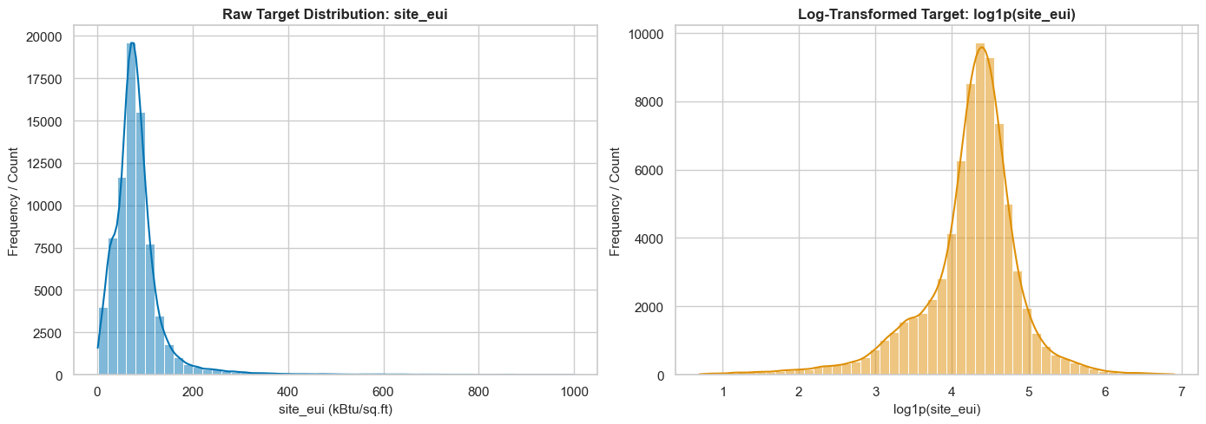
PART A · EDA
Target distribution — before and after log transform
What the graph shows
Raw site_eui is strongly right-skewed: skewness 4.7400, mean 82.58 against a median of 75.29. A small number of very high-consumption buildings stretch the right tail all the way to 997.87.
After log1p the skewness falls to −1.0756 and the distribution becomes far more balanced.
Why it matters: linear models assume errors are roughly symmetric. Training on the log scale stops a handful of extreme buildings from dominating the fitted line. Predictions are converted back with expm1 before scoring, so all reported R², RMSE and MAE are in real kBtu/sq.ft.
Raw site_eui (left) versus log1p(site_eui) (right)
Part A · EDA
14

Slide 15
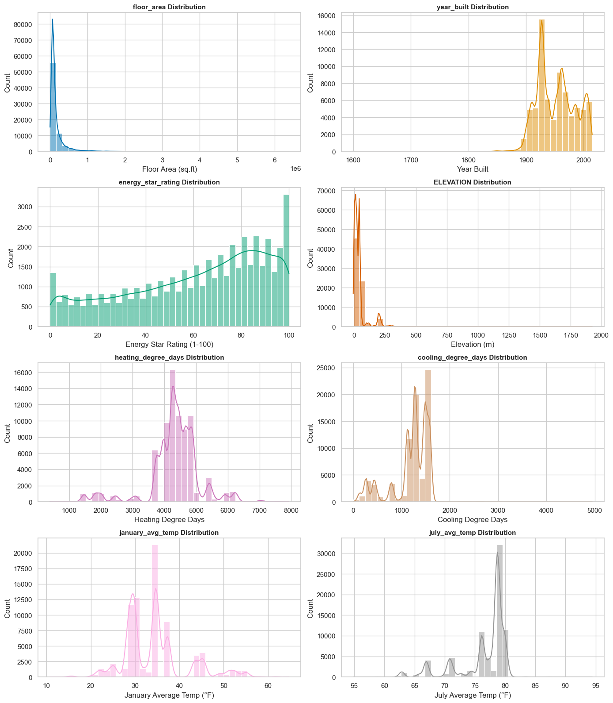
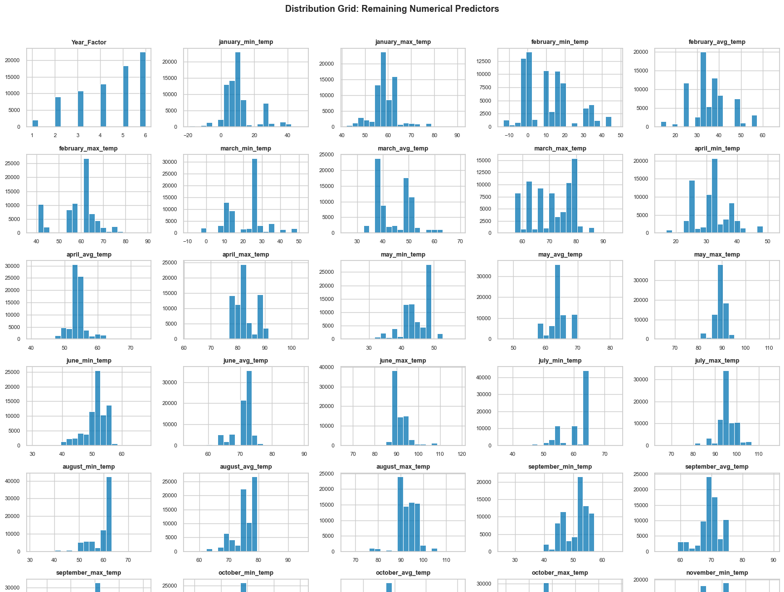
PART A · EDA
Numerical feature distributions
Reading the grid
floor_area: severe right skew (3.63) from tiny units to complexes above 6,000,000 sq.ft → log transform justified.
year_built: wide historical spread; impossible years already masked.
energy_star_rating: spread across the full 0–100 benchmark scale.
Heating / cooling degree days: clear regional climate clusters.
The remaining monthly min/avg/max temperature series (left, second grid) move together and overlap with the degree-day totals — a first hint of the multicollinearity that the heatmap confirms.
Part A · EDA
15

Slide 16
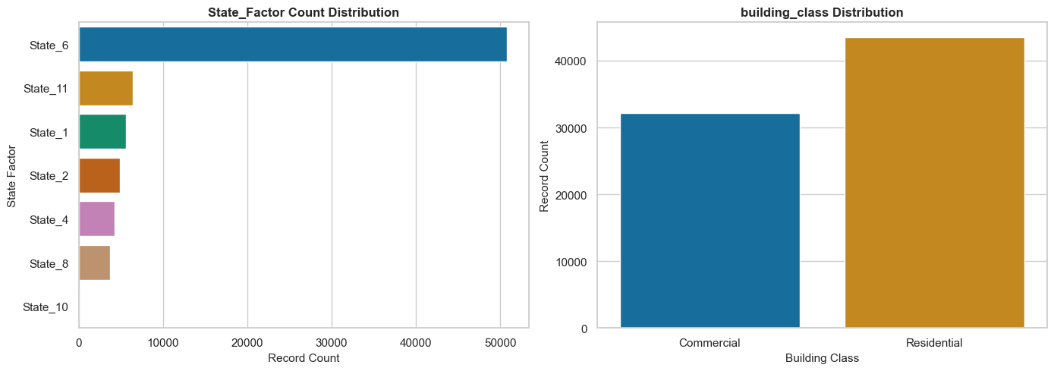
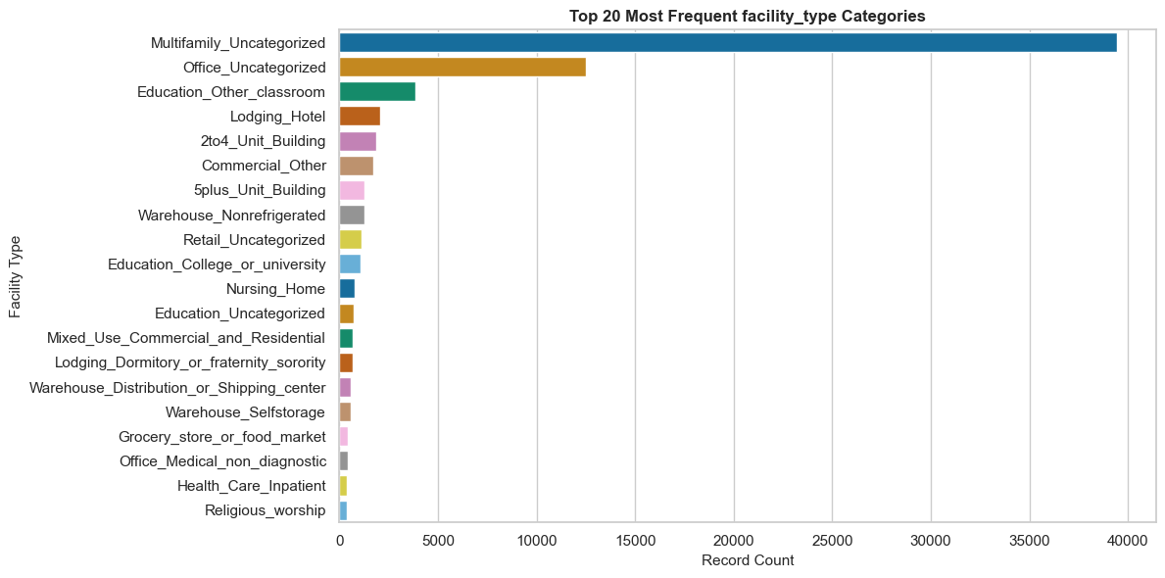
PART A · EDA
Categorical feature distributions
State_Factor: State 6 alone holds more than half of all records, followed by State 10, State 1 and State 8.
building_class: reasonably balanced — 40,855 Commercial (≈54%) against 34,863 Residential (≈46%).
facility_type: extremely uneven. Multifamily_Uncategorized has ≈39,455 rows and Office_Uncategorized ≈12,512, while dozens of types have only a handful.
Consequence: one-hot encoding with handle_unknown='ignore' is required so that rare categories seen only in the test split do not break the pipeline.
Part A · EDA
16

Slide 17
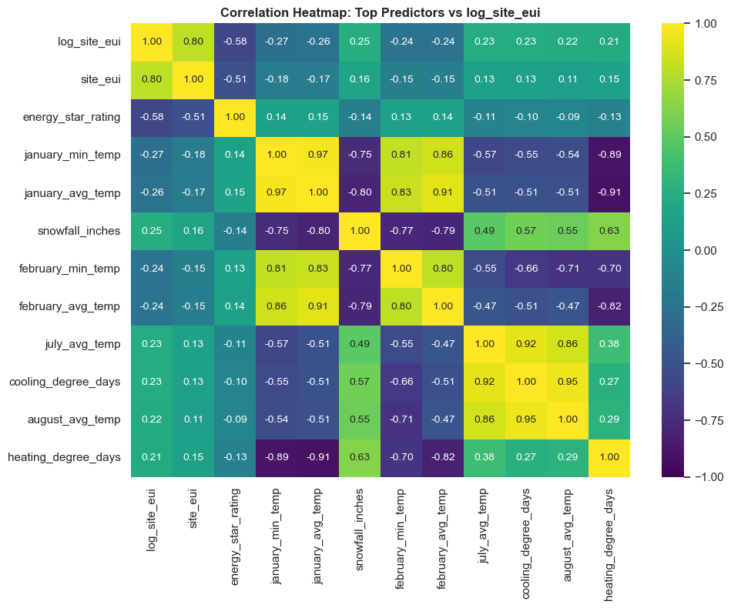
PART A · EDA
Correlation heatmap — how features relate
How to read it
Each cell is the Pearson correlation between two columns, from −1 (perfect opposite) through 0 (no linear link) to +1 (perfect match). The diagonal is always 1 because a column matches itself. Only the 12 features most correlated with log_site_eui are shown, so the grid stays readable.
energy_star_rating ↔ log_site_eui: −0.58, the strongest single relationship — better-rated buildings use less energy.
heating_degree_days: +0.21, colder places need more heating energy.
july_min_temp and related monthly series: weak individually but highly correlated with each other.
Part A · EDA
17

Slide 18
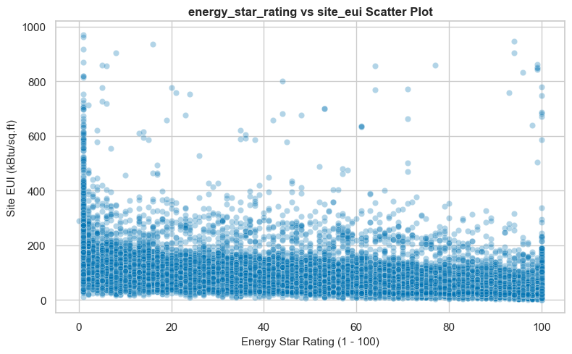
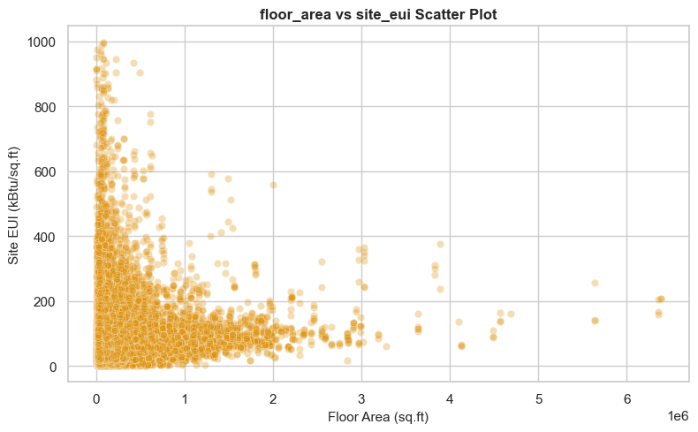
PART A · EDA
Feature–target relationships (1 of 2)
energy_star_rating vs site_eui
floor_area vs site_eui
r = −0.5110 on the raw target and −0.5754 on the log target. The cloud slopes clearly downward: higher-rated buildings use less energy per square foot. Spread is wide, so the rating explains part — not all — of the variation.
Most buildings sit at small floor areas with a long thin tail to the right. Small buildings show the widest range of EUI values including the extremes; as area grows the values settle lower and tighter — a mild downward trend.
Part A · EDA
18

Slide 19
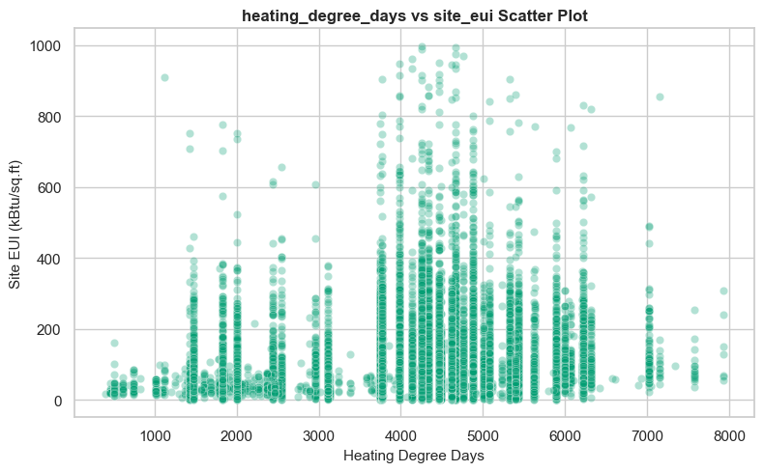
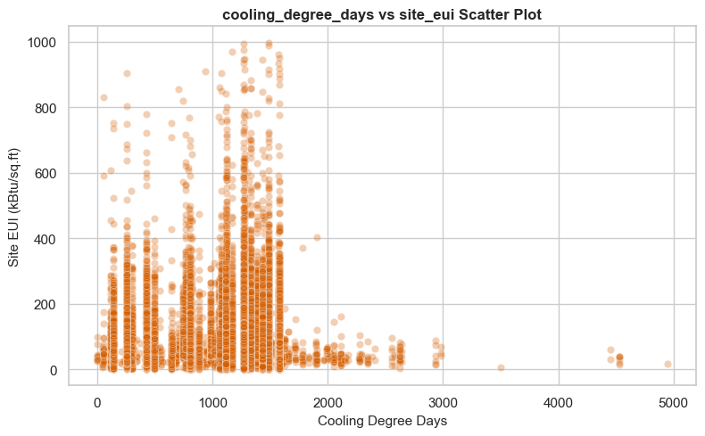
PART A · EDA
Feature–target relationships (2 of 2)
heating_degree_days vs site_eui
cooling_degree_days vs site_eui
A weak positive association: the more heating a location needs across the year, the higher the typical site EUI. This matches the physics — colder climates burn more energy keeping buildings warm.
Most records sit in the low-to-mid cooling range and the points are widely scattered. A band of high EUI values appears around 1,000–1,600 cooling degree days, but no clean straight-line trend — the link is real yet nonlinear.
Part A · EDA
19

Slide 20
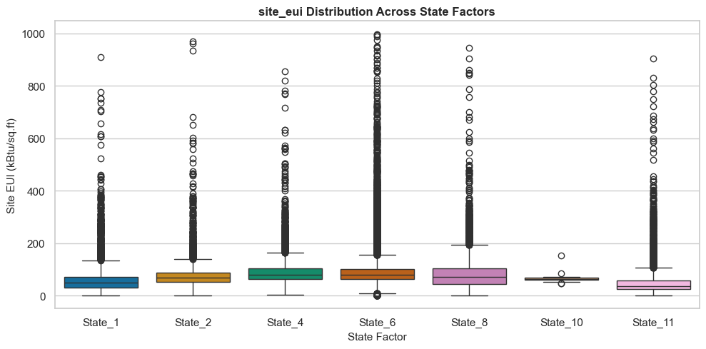
PART A · EDA
Box plots — what they are and the two kinds used
Anatomy of a box plot
• The box spans Q1 (25th percentile) to Q3 (75th percentile) — the middle half of the data.
• The line inside the box is the median (Q3 − Q1 is the IQR).
• The whiskers reach the furthest point still within 1.5 × IQR of the box.
• Every dot beyond a whisker is flagged as a statistical outlier.
site_eui distribution across State_Factor groups (grouped box plot)
Grouped box plot (categorical × numeric)
Single-variable box plot (numeric only)
One box per category — here one per State_Factor. Used to compare the target between groups and judge whether the category is worth keeping as a predictor.
State 8 has one of the highest median EUI values, State 11 the lowest; States 4 and 6 also run high while State 10 is low and compact. Because the medians differ, State_Factor carries real signal.
One box for one column, drawn purely to expose the spread and the outliers of that column — not to compare groups.
Used on site_eui, floor_area, energy_star_rating, ELEVATION and heating_degree_days as the visual half of the IQR outlier analysis on the next slide.
Part A · Box plots
20

Slide 21
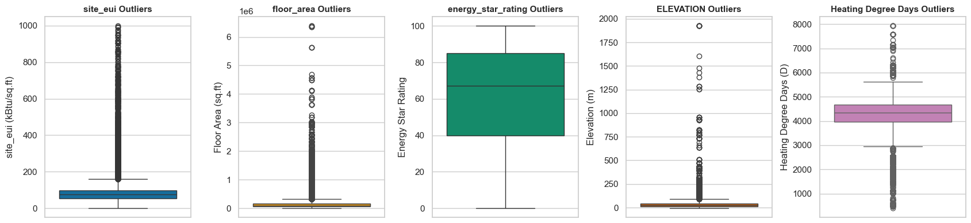
PART A · EDA
Outlier detection — the IQR method
Box plots for the five numeric columns selected for formal outlier analysis
Feature | Q1 | Q3 | IQR | Upper bound | Outliers | %
site_eui | 54.53 | 97.28 | 42.75 | 161.40 | 3,844 | 5.07%
floor_area | 62,379 | 166,000 | 103,621 | 321,431 | 8,245 | 10.88%
energy_star_rating | 40.00 | 85.00 | 45.00 | 152.50 | 0 | 0.00%
ELEVATION | 11.90 | 42.70 | 30.80 | 88.90 | 6,858 | 9.05%
heating_degree_days | 3,978 | 4,670 | 692 | 5,708 | 7,346 | 9.70%
How the limits are calculated
Q1 = 25th percentile, Q3 = 75th percentile
IQR = Q3 − Q1
Lower bound = Q1 − 1.5 × IQR
Upper bound = Q3 + 1.5 × IQR
Any value below the lower bound or above the upper bound is counted as an outlier; the count divided by the column's non-null rows gives the outlier percentage.
Part A · Outliers
21

Slide 22
PART A · EDA
Outlier treatment decision & EDA summary
Why the outliers are kept
EDA summary in one place
The high site_eui values are not typing errors — they are hospitals, laboratories and data centres, which genuinely consume far more energy per square foot than an office.
Deleting or capping them would throw away the very buildings a planner most wants to identify, and would make the model over-confident on ordinary buildings.
Instead, log1p compresses the scale so extreme values still count but no longer dominate. energy_star_rating shows 0 outliers because it is bounded to 0–100 by design.
The target is right-skewed (skew 4.74) and needs a log transform.
energy_star_rating is the single strongest predictor (r ≈ −0.58).
Building size matters, but through its log rather than its raw value.
Climate features are informative yet heavily correlated with each other.
Categorical columns are very unbalanced — encoding must tolerate rare and unseen categories.
Outliers are real buildings; they are transformed, not deleted.
4.74
−1.08
−0.58
3,844
0 removed
raw target skewness
after log1p
strongest correlation
site_eui IQR outliers
outlier rows deleted
Part A · Summary
22

Slide 23
PART A · FEATURES
Feature engineering — what was added
New feature | Built from | Formula | Why it helps
age_of_building | year_built | 2022 − year_built | Age drives insulation and equipment efficiency far more directly than a calendar year does
floor_area_log | floor_area | log1p(floor_area) | Cuts skew from 6.61 to 0.52, so huge complexes stop distorting linear and distance-based models
hdd_cdd_ratio | heating & cooling degree days | HDD / (CDD + 1) | One number describing whether a climate is heating-dominated or cooling-dominated (mean 4.71)
energy_star_missing_flag | energy_star_rating | isnull() → 0/1 | Marks the 26,709 unrated buildings so 'never benchmarked' becomes usable information
wind_direction_max_missing_flag | direction_max_wind_speed | isnull() → 0/1 | Records the 41,082 rows where the station reported nothing
wind_direction_peak_missing_flag | direction_peak_wind_speed | isnull() → 0/1 | Records the 41,811 rows with no peak-direction reading
max_wind_speed_missing_flag | max_wind_speed | isnull() → 0/1 | Same 41,082 rows as the max-direction flag, confirming a station-level gap
The +1 in hdd_cdd_ratio prevents division by zero in locations that never need cooling. All seven features are built from inputs only — never from the target — so none of them can leak.
Part A · Feature engineering
23

Slide 24
PART A · FEATURES
Feature engineering — what was removed
year_built
Dropped after age_of_building was created. age = 2022 − year_built, so the two are perfectly collinear: keeping both would give a linear model two ways to express the same effect and make its coefficients unstable.
floor_area
Dropped after floor_area_log was created, for the same reason — the log and the raw value carry identical information on different scales.
days_with_fog
Dropped during cleaning: 60.45% of values are missing, too sparse to impute without inventing data.
id
Dropped as a non-predictive primary key. A tree model can memorise row identifiers and appear accurate while learning nothing.
Year_Factor
Excluded at feature-selection time: it records which administrative year the row came from, so a model could latch onto the data-collection batch rather than building physics.
site_eui, log_site_eui
Excluded from the feature matrix X — these are the target. Including either would be textbook leakage.
Part A · Feature engineering
24

Slide 25
PART A · FEATURES
Categorical vs numerical features
The final predictor set holds 65 columns: 3 categorical and 62 numerical. The split decides which preprocessing branch each column travels through.
Categorical features (3)
Numerical features (62)
Feature | Levels | Handling
State_Factor | 11 states | Most-frequent impute → one-hot
building_class | 2 classes | Most-frequent impute → one-hot
facility_type | 60+ types | Most-frequent impute → one-hot
Group | Count | Examples
Building properties | 3 | energy_star_rating, floor_area_log, age_of_building
Location | 1 | ELEVATION
Monthly temperatures | 36 | january_min/avg/max_temp … december
Climate aggregates | 5 | heating_ & cooling_degree_days, avg_temp, precipitation_inches, snowfall_inches
Threshold day counts | 9 | days_below_30F … days_above_110F, snowdepth_inches
Wind metrics | 3 | max_wind_speed, direction_max / peak_wind_speed
Engineered flags & ratio | 5 | hdd_cdd_ratio + 4 missing-indicator flags
Why one-hot with drop='first'
Text cannot enter a model directly. One-hot creates a 0/1 column per category; dropping the first level avoids the dummy-variable trap (perfectly redundant columns). handle_unknown='ignore' means a category that appears only in the test set is encoded as all zeros rather than crashing the pipeline. After encoding, 65 columns expand to 128 model features.
Part A · Feature types
25

Slide 26
PART A · MODELLING
Regression feature selection & dataset creation
How selected_predictors is built
65
128
excluded_cols = ['id', 'Year_Factor', 'site_eui', 'log_site_eui', 'floor_area', 'year_built']
selected_predictors = every remaining column of df_master.
This is a rule-based selection rather than an automatic one: each exclusion has a written justification (identifier, administrative artefact, target, or collinear twin), which keeps the choice reproducible and auditable.
predictors selected
features after encoding
6
0
columns deliberately excluded
target-derived inputs left in X
Regression dataset creation
df_regression = df_master.copy() — a frozen snapshot after cleaning and feature engineering.
X = df_regression[selected_predictors] → 75,757 × 65
y_log = df_regression['log_site_eui']
Remaining gaps in X (energy_star_rating, 3 wind columns, age_of_building) are intentionally left for the pipeline to fill.
Selection philosophy
Keep every domain-relevant physical, climate and structural-missingness signal; remove only identifiers, administrative artefacts, target representations and exact collinear twins. Regularised models (Lasso, ElasticNet) then prune what is left — the tuned Lasso zeroes 32 of 128 encoded features, 25% sparsity.
Part A · Feature selection
26

Slide 27
PART A · MODELLING
Train–test split (stratified 80 : 20)
Bin the target
Set | Rows | Columns
X_train | 60,605 | 65
X_test | 15,152 | 65
y_quantiles = pd.qcut(y_log, q=10) turns the continuous target into 10 equal-sized bands.
Split with stratify
train_test_split(..., test_size=0.2, random_state=42, stratify=y_quantiles) keeps the same share of every band in both sets.
log_site_eui | Train | Test
Mean | 4.2424 | 4.2401
Std | 0.6480 | 0.6505
Median | 4.3346 | 4.3346
Verify
Train and test target statistics are compared before any model is fitted.
Why stratify a continuous target?
The near-identical statistics confirm the stratification worked: both sets describe the same population, so test performance is trustworthy.
Ordinary random splitting can land most of the very high-EUI buildings in one side. Binning into deciles first and stratifying on those bins guarantees that rare extreme values appear in both train and test, so the test score is a fair estimate.
Part A · Split
27

Slide 28
PART A · MODELLING
Preprocessing pipeline — how it is wired
Numerical branch — 62 columns
Categorical branch — 3 columns
Pipeline([
('imputer', SimpleImputer(strategy='median')),
('scaler', StandardScaler())
])
Median fills gaps without being dragged by extreme values; StandardScaler rescales every column to mean 0 and standard deviation 1 so no feature dominates by unit alone.
Pipeline([
('imputer', SimpleImputer(strategy='most_frequent')),
('ohe', OneHotEncoder(drop='first',
handle_unknown='ignore'))
])
Missing text becomes the most common category; one-hot turns every level into a 0/1 column the model can read.
ColumnTransformer — the junction
ColumnTransformer([('num', num_pipeline, num_cols), ('cat', cat_pipeline, cat_cols)]) routes each column to the correct branch and glues the results back together: 65 input columns → 128 model-ready features. The whole transformer is then placed inside each model's Pipeline, so GridSearchCV refits the preprocessing separately on every cross-validation fold.
Zero-leakage guarantee
fit_transform() is called on X_train only; X_test is passed through transform() alone. Every median, every scaling mean and standard deviation, and the full list of one-hot categories are learned from training rows exclusively — the test set contributes nothing to the preprocessing. handle_unknown='ignore' then absorbs any category the training data never contained, so the guarantee holds without special-casing.
Part A · Pipeline
28

Slide 29
PART A · ALGORITHMS
Algorithms 1–3 · Linear and regularised models
1. Linear Regression (OLS)
Fits a straight-line combination of the 128 features by minimising the sum of squared errors. No penalty, no hyperparameter — the baseline every other model must beat.
R² 0.3229 · RMSE 48.15 · MAE 23.56
2. Ridge Regression (L2)
Adds α·Σβ² to the loss, shrinking large coefficients so correlated features (the monthly temperature series) share influence instead of fighting. Tuned over 13 α values by 5-fold GridSearchCV; best α = 3.1623.
R² 0.3222 · RMSE 48.18 · MAE 23.56
3. Lasso Regression (L1)
Adds α·Σ|β|, which can push coefficients to exactly zero and so performs automatic feature selection. Default α = 1.0 badly underfits (R² −0.0564); tuning selects α = 0.0001 and zeroes 32 of 128 features (25% sparsity).
R² 0.3219 · RMSE 48.19 · MAE 23.57
All three land near R² ≈ 0.32, which tells us the relationship between building attributes and energy use is largely non-linear — regularisation alone cannot fix that.
Part A · Algorithms
29

Slide 30
PART A · ALGORITHMS
Algorithms 4–5 · ElasticNet and Polynomial
4. ElasticNet Regression
5. Polynomial Regression
Blends both penalties: α·ρ·Σ|β| + ½·α(1−ρ)·Σβ². The mixing parameter l1_ratio (ρ) decides how much of the penalty behaves like Lasso and how much like Ridge.
Grid search over α ∈ {0.0003, 0.001, 0.01} and ρ ∈ {0.1, 0.5} selected α = 0.0003, ρ = 0.1.
Default settings scored R² 0.1126; tuning lifted it to 0.3167 — the clearest demonstration in the study of how much hyperparameter search matters for penalised models.
Creates squared and interaction terms so a linear model can bend. Expanding all 128 features to degree 3 would create 366,144 terms, so expansion is restricted to the 15 features with the largest absolute OLS coefficients.
Degree 1 → 15 features, degree 2 → 135, degree 3 → 815.
Degree | Features | R² | RMSE | MAE
1 | 15 | 0.1008 | 55.49 | 30.86
2 | 135 | 0.1104 | 55.19 | 30.56
3 | 815 | 0.1114 | 55.16 | 30.57
Reading the polynomial result
Multiplying the feature count by 54 (15 → 815) buys only +0.011 R². The restriction to 15 features is the binding constraint: the discarded 113 features carried information that no amount of curvature among the survivors can recover. Degree 2 is reported in the final comparison as the better complexity-to-benefit trade.
Part A · Algorithms
30

Slide 31
PART A · ALGORITHMS
Algorithms 6–8 · Tree-based models
6. Decision Tree
Splits the feature space into rectangular regions; each leaf predicts the average target of the training rows that reach it. Captures non-linearity with no scaling needed, but an unconstrained tree memorises the training set.
Default R² 0.1405 → Tuned 0.4308
max_depth 20, min_samples_split 10
7. Random Forest
Grows 200 trees, each on a bootstrap sample of rows and a random subset of features, then averages them. Averaging cancels the individual trees' errors, which is why it beats a single tree so decisively.
Default R² 0.5166 → Tuned 0.5180
max_depth None, min_samples_split 5, n_estimators 200 — best model overall
8. Gradient Boosting
Builds trees one after another, each new tree fitted to the errors left by the ensemble so far. Learning rate controls how much of each correction is applied.
Default R² 0.3408 → Tuned 0.3806
learning_rate 0.1, max_depth 3, n_estimators 200
Gradient Boosting is capped at max_depth 3 by the grid, which keeps each tree shallow — one reason it trails Random Forest here despite usually being the stronger family.
Part A · Algorithms
31

Slide 32
PART A · ALGORITHMS
Algorithms 9–10 · Distance and kernel models
9. Support Vector Regressor
10. K-Nearest Neighbours Regressor
SVR fits a tube of width ε around the data and penalises only the points falling outside it, with an RBF kernel bending the tube into a curved surface.
Kernel methods scale roughly with the square of the sample count, so fitting all 60,605 training rows is impractical. A reproducible random subset of 15,000 rows (random_state=42) is used instead, with its own ColumnTransformer fitted on that subset only.
Settings: kernel='rbf', C=10, ε=0.1 → 130 processed features.
Predicts a building's EUI by averaging the EUI of the k most similar buildings in feature space.
Settings: n_neighbors=10, weights='distance', so closer neighbours count more than distant ones.
KNN depends entirely on the distance metric, which is why StandardScaler is essential — without it, floor_area_log and a 0/1 flag would carry wildly different weight in the same distance calculation.
0.3471
0.2587
What their scores tell us
Both sit mid-table. SVR is handicapped by its 15,000-row subset; KNN struggles because in 128 dimensions every building is roughly equidistant from every other — the curse of dimensionality in action.
SVR test R² (RMSE 47.29)
KNN test R² (RMSE 50.38)
Part A · Algorithms
32

Slide 33
PART A · RESULTS
Regression model comparison
# | Model | Untuned R² | Tuned R² | RMSE | MAE | Best parameters
1 | Random Forest Regressor | 0.5166 | 0.5180 | 40.63 | 19.24 | max_depth None, min_samples_split 5, n_estimators 200
2 | Decision Tree Regressor | 0.1405 | 0.4308 | 44.15 | 21.46 | max_depth 20, min_samples_split 10
3 | Gradient Boosting Regressor | 0.3408 | 0.3806 | 46.06 | 21.74 | learning_rate 0.1, max_depth 3, n_estimators 200
4 | Support Vector Regressor | 0.3471 | 0.3471 | 47.29 | 22.12 | rbf, C=10, ε=0.1, 15,000 samples
5 | Linear Regression | 0.3229 | 0.3229 | 48.15 | 23.56 | None (OLS baseline)
6 | Ridge Regression | 0.3227 | 0.3222 | 48.18 | 23.56 | alpha = 3.1623
7 | Lasso Regression | −0.0564 | 0.3219 | 48.19 | 23.57 | alpha = 0.0001
8 | ElasticNet Regression | 0.1126 | 0.3166 | 48.38 | 23.64 | alpha = 0.0003, l1_ratio = 0.1
9 | KNN Regressor | 0.2587 | 0.2587 | 50.38 | 24.04 | n_neighbors 10, weights distance
10 | Polynomial Regression (deg 2) | 0.1104 | 0.1104 | 55.19 | 30.56 | Degree 2 on top 15 features
R², RMSE and MAE are all computed after converting predictions back to the original kBtu/sq.ft scale with expm1, so the numbers are directly interpretable: the best model is typically within ≈19 kBtu/sq.ft of the true value.
Part A · Results
33

Slide 34
PART A · RESULTS
Tuned R² across the ten models
Ensembles win: Random Forest (0.5180) explains roughly half the variation in building energy intensity.
Tuning matters most for trees: a single Decision Tree jumps from 0.1405 to 0.4308 once depth is limited.
All linear models cluster near 0.32 — proof the underlying relationship is non-linear.
Polynomial expansion on 15 features is the weakest approach, confirming feature coverage beats feature curvature.
Part A · Results
34

Slide 35
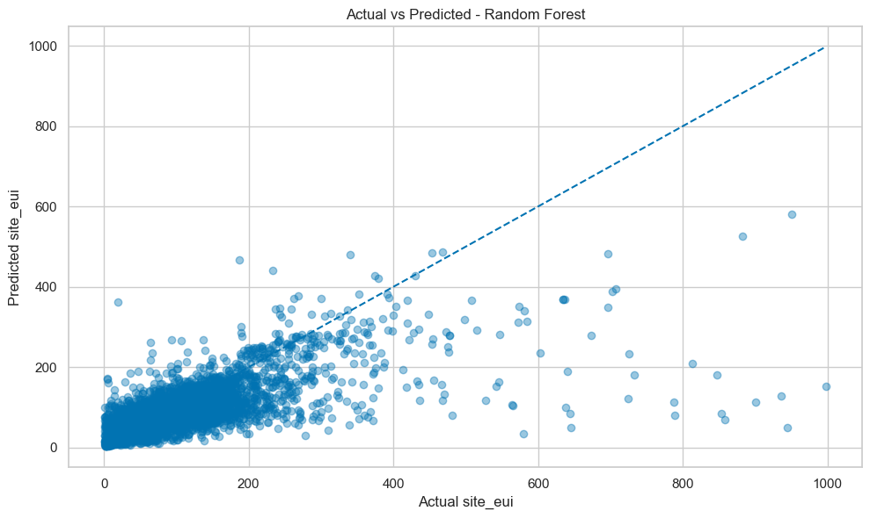
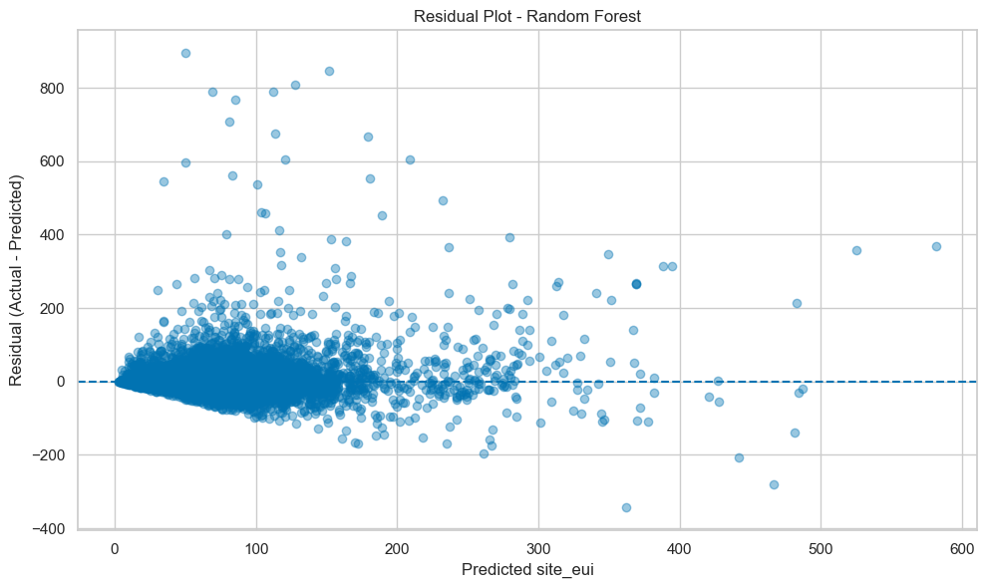
PART A · RESULTS
Five-fold cross-validation & residual diagnostics
Model | Test R² | Mean 5-fold CV R² | Std
Random Forest Regressor | 0.5180 | 0.6067 | 0.0063
Decision Tree Regressor | 0.4308 | 0.5010 | 0.0138
What cross-validation adds
The training data is split into five parts; each part takes a turn as the validation set. Five scores instead of one show how stable the model is. Random Forest's tiny standard deviation (0.0063) means its performance barely changes with the data it sees — the model is reliable, not lucky.
Reading the two plots
Actual vs Predicted (top): points hug the dashed 45° line at low and medium EUI, then fall below it for very high values — the model under-predicts the most extreme buildings.
Residuals (bottom): errors are centred on zero with no curved pattern, which means no systematic bias; their spread widens as predictions grow, the expected signature of a skewed target.
Part A · Validation
35

Slide 36
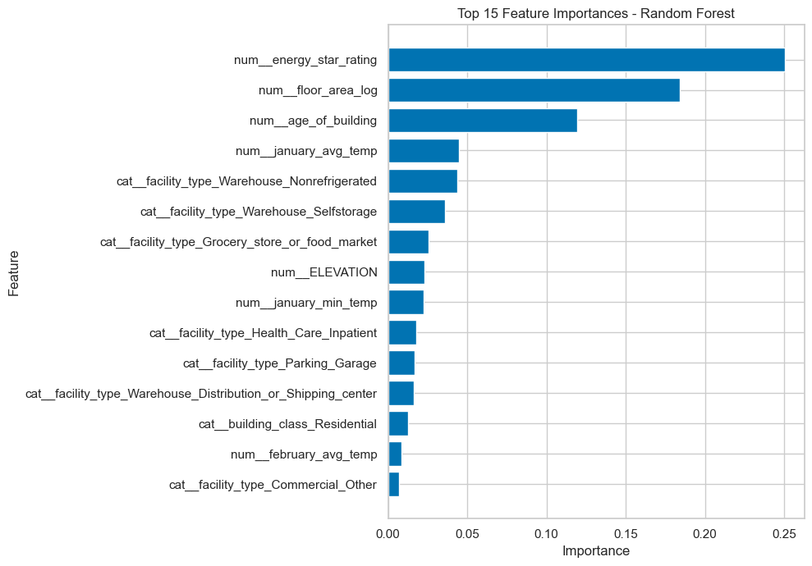
PART A · RESULTS
Which features drive the prediction
energy_star_rating — 0.2503, by far the strongest single driver.
floor_area_log — 0.1838, the engineered log of building size.
age_of_building — 0.1195, another engineered feature.
january_avg_temp — 0.0445, winter climate context.
Warehouse and grocery facility types — 0.0434 / 0.0357 / 0.0254.
Feature engineering paid off
Two of the top three drivers (floor_area_log, age_of_building) did not exist in the raw file. Together they account for ≈30% of total importance — direct evidence that the engineering step improved the model rather than just reshaping it.
Part A · Results
36

Slide 37
PART A · CONCLUSION
Regression — what we learned
Best model
Biggest lever
Random Forest Regressor: test R² 0.5180, RMSE 40.63, MAE 19.24 kBtu/sq.ft, with a mean 5-fold CV R² of 0.6067 (std 0.0063).
energy_star_rating alone carries 25% of the model's importance — the single most useful piece of information about a building.
Engineering wins
Honest limits
floor_area_log and age_of_building rank second and third, together ≈30% of importance, despite being derived rather than collected.
About half the variance stays unexplained: occupancy, equipment and operating hours are simply not in this dataset, and very high-EUI buildings are systematically under-predicted.
Part A · Conclusion
37

Slide 38
02
Part B — Classification
Sorting water samples into Good, Moderate or Poor quality from 50+ chemical and physical measurements,
using five classification algorithms compared on the same test set.
38

Slide 39
PART B · PROBLEM
Problem definition & dataset
Here the target is a label, not a number. Each water sample must be placed into one of three quality classes, so this is a multi-class classification problem rather than a regression one.
The task
80,000
53
Given laboratory and field measurements of a water sample — pH, dissolved oxygen, turbidity, nitrates, heavy metals and more — predict its Water_Quality_Class: Good, Moderate or Poor.
This mirrors how an environmental agency works: a full laboratory panel is expensive, so a model that infers the class from routinely collected measurements helps prioritise which sites need deeper testing.
raw samples in the dataset
columns (52 measurements + target)
3
5
target classes
algorithms compared
Why it is classification, not regression
Class | Share of training data
Moderate | 58.26%
Good | 23.05%
Poor | 18.69%
The answer is one of three named categories with no meaningful arithmetic between them — 'Moderate' is not the average of 'Good' and 'Poor' in any measurable sense. Models are therefore judged on accuracy, precision, recall, F1 and ROC-AUC instead of R² or RMSE.
Part B · Problem
39

Slide 40
PART B · DATA
Dataset audit & missing values
The same audit discipline as Part A: check shape, data types, missing values and target balance before changing anything.
What the audit found
How missingness is handled here
• 80,000 rows × 53 columns.
• Two text columns (Sample Date, Sample Time) plus the target; everything else is float64.
• Missing values are severe and widespread — many trace-element columns are almost entirely empty.
• The target itself has 12,011 missing labels.
No column is dropped for sparsity in this notebook. Instead, every numeric predictor passes through median imputation learned on the training split only.
The consequence is stated plainly: a column that is 99% empty contributes almost nothing but one repeated median value, so it adds little signal — which is exactly what the feature-importance chart later confirms.
Column | Missing | %
total_solids | 79,365 | 99.2%
sulfate | 78,858 | 98.6%
lithium | 77,440 | 96.8%
strontium | 77,302 | 96.6%
fluoride | 76,819 | 96.0%
uranium | 76,334 | 95.4%
Rows with a missing target are removed
A supervised classifier needs a known answer to learn from, and a row with no label can be neither trained on nor scored. The 12,011 unlabelled rows are therefore dropped — this is the one place where deletion is the only correct choice.
Part B · Data audit
40

Slide 41
PART B · DATA
Duplicate check & basic cleaning
80,000
− 116
− 12,011
67,873
Rows in the raw file
Exact duplicate rows removed with drop_duplicates()
Rows whose Water_Quality_Class was missing
Rows carried into modelling
Why duplicates are removed here but not in Part A
What is deliberately not done
The check is the same — df.duplicated().sum() compares every column of every row — but the answer differs: the building dataset had zero exact repeats, while this water dataset has 116.
Leaving them in would quietly weight those 116 samples double during training and could place identical rows in both the training and test sets, inflating the test score. A re-check after removal confirms zero duplicates remain.
No feature value is filled in by hand at this stage, and no outlier is touched. Both operations learn something from the data, so both are postponed until after the train/test split and implemented inside the pipeline.
This is the same zero-leakage principle used throughout Part A, applied to a different dataset.
Part B · Cleaning
41

Slide 42
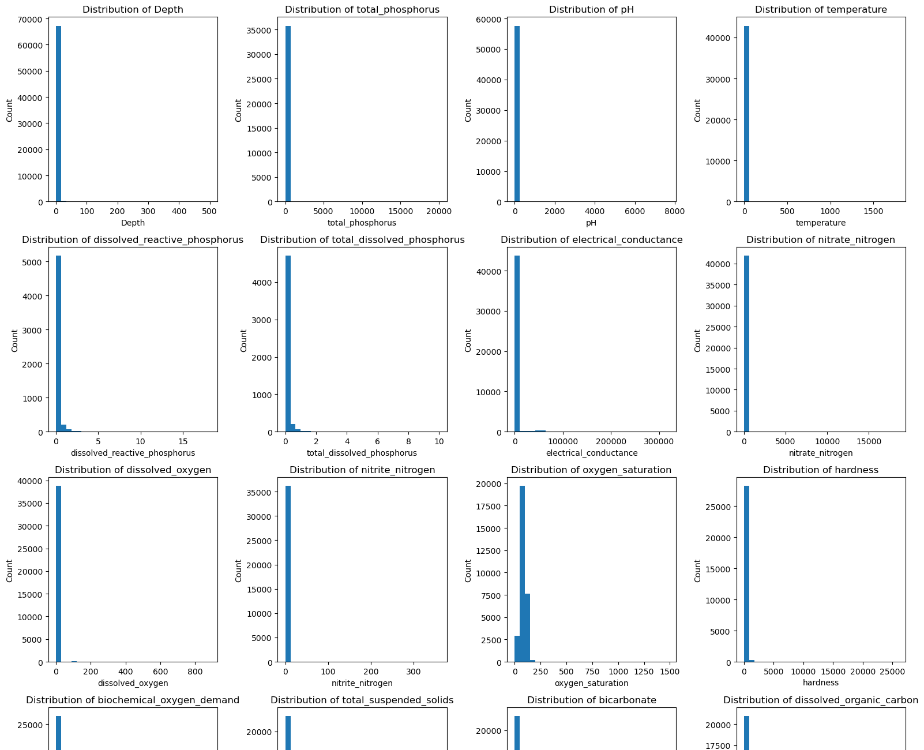
PART B · EDA
Feature distributions
What the histograms show
Every numeric column is plotted with 30 bins. Two things stand out immediately:
1. The ranges are wildly different — pH sits between roughly 0 and 14, while electrical conductance runs into the thousands.
2. Many panels are built on very few observations, reflecting the heavy missingness found in the audit.
Why this drives the design
Different ranges are precisely why StandardScaler is needed: KNN measures distances and SVM positions a boundary, so both are distorted when one feature is numerically larger than another.
The missing values are left for the pipeline, applied after the split so the test set never influences the fill value.
Histograms for the numeric measurements (top rows of the 52-panel grid)
Part B · EDA
42

Slide 43
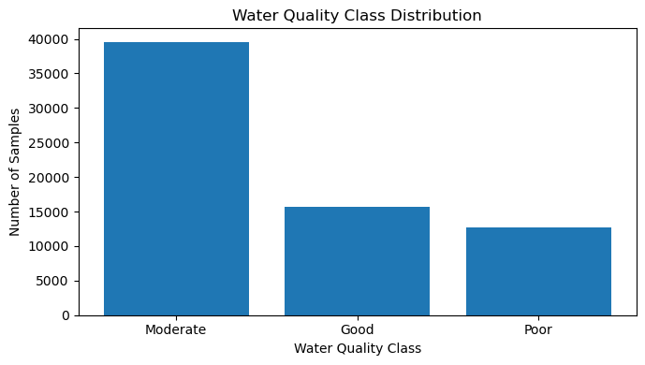
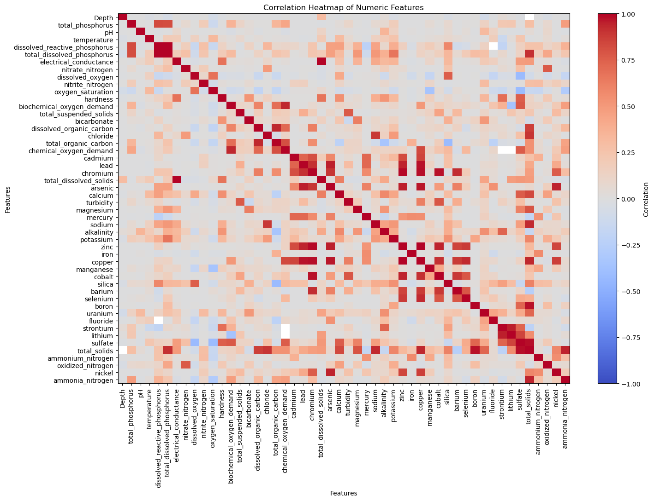
PART B · EDA
Target balance and feature correlations
Class distribution
Moderate dominates at 58.26% of samples, with Good at 23.05% and Poor at 18.69%. This imbalance is why accuracy alone is misleading — always guessing 'Moderate' would already score about 58%. Weighted F1 and per-class ROC-AUC are reported alongside accuracy for this reason, and the split is stratified so both sets keep the same proportions.
Correlation heatmap
Blue-to-red grid of correlations between all numeric measurements. Chemically related groups (the nitrogen series, the dissolved-solids family) move together, while trace metals are largely independent — useful context before choosing models.
Part B · EDA
43

Slide 44
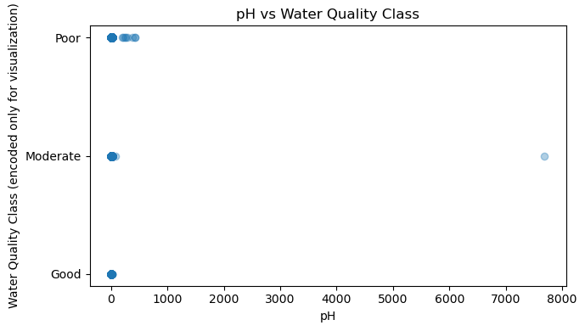
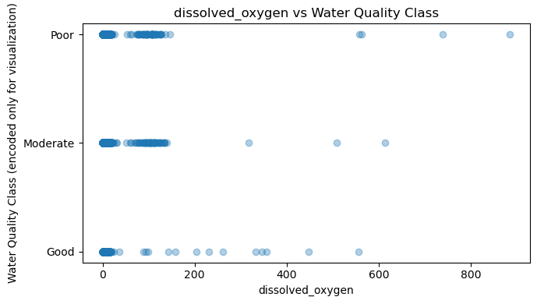
PART B · EDA
Feature vs target relationships
pH across the three classes
Dissolved oxygen across the three classes
The class labels are temporarily mapped to 0 = Good, 1 = Moderate, 2 = Poor purely so they can be drawn on an axis. pH values spread widely inside every class, so pH on its own separates the classes only weakly.
A similar picture: helpful but not decisive alone. This is the argument for multivariate models — the classes are distinguished by combinations of measurements, not by any single threshold. Note the numeric mapping is for plotting only and never becomes a model input.
Part B · EDA
44

Slide 45
PART B · FEATURES
Feature engineering & the final feature set
New feature | Built from | How | Why
sample_year | Sample Date | dt.year | Captures long-run trends and any change in laboratory practice between years
sample_month | Sample Date | dt.month | Water chemistry is seasonal — runoff, temperature and algal activity all vary by month
sample_dayofyear | Sample Date | dt.dayofyear | A finer seasonal position than month, useful for tree splits
solids_conductivity_ratio | total_solids ÷ electrical_conductance | Zeros replaced with NaN first to avoid division by zero | Relates dissolved material to how well the water conducts electricity — a physically meaningful ratio
What is removed
Why no target-based features
The raw Sample Date and Sample Time text columns are dropped once their useful parts have been extracted — a model cannot read a date string, and the information now lives in three clean numeric columns.
The final feature matrix is then restricted with select_dtypes(include=np.number), so only numeric predictors reach the five classifiers.
Every engineered feature is built from input columns only. None of them consults Water_Quality_Class, so none can leak the answer — the same rule followed in Part A.
All features here are numerical; the only categorical column in the modelling set is the target itself, which is label-encoded rather than one-hot encoded.
Part B · Features
45

Slide 46
PART B · MODELLING
Train/test split and the preprocessing pipeline
Split | Rows | Share
Training set | 54,298 | 80%
Test set | 13,575 | 20%
Total modelling rows | 67,873 | 100%
1. SimpleImputer(strategy='median')
Fills every missing measurement with that column's training-set median. The median is used rather than the mean because water chemistry has long tails.
Stratified on the class label
2. IQRCapper (custom transformer)
train_test_split(..., test_size=0.20, random_state=42, stratify=y) keeps the 58 / 23 / 19 class mix identical in both sets. Without it the smallest class, Poor, could be under-represented in the test set and the scores would swing from run to run.
A hand-written BaseEstimator/TransformerMixin class. In fit() it learns Q1, Q3 and IQR per column and stores bounds Q1 − 1.5·IQR and Q3 + 1.5·IQR; in transform() it clips values to those bounds.
3. StandardScaler()
Target encoding
Rescales each column to mean 0, standard deviation 1 so no measurement dominates by unit alone — essential for KNN and SVM.
LabelEncoder maps Good → 0, Moderate → 1, Poor → 2. It is fitted on the training labels and applied to the test labels. The original names are kept for confusion matrices and reports; this encoding touches the target only and never creates an input feature.
Capping instead of deleting keeps every sample while limiting the influence of extreme readings — and because the bounds are learned in fit(), each cross-validation fold computes its own.
Part B · Pipeline
46

Slide 47
PART B · ALGORITHMS
Algorithms 1–3 · Logistic Regression, KNN, Naive Bayes
1. Logistic Regression
Estimates the probability of each class from a weighted sum of the features, then picks the highest. Multi-class handling is built in. Used as the baseline: simple, fast, and a fair reference point for everything else. max_iter=1000 so the solver converges on 54,298 rows.
Accuracy 0.6767 · Weighted F1 0.6600 · ROC-AUC 0.7833
2. K-Nearest Neighbours
Classifies a sample by looking at the 5 nearest training samples and taking their majority class. It makes no assumption about the shape of the boundary, which suits chemistry data where classes curve around each other. Scaling is essential — distance is meaningless across mixed units.
Accuracy 0.7497 · Weighted F1 0.7483 · ROC-AUC 0.8480
3. Gaussian Naive Bayes
Applies Bayes' theorem while assuming every feature is independent of the others given the class, with each modelled as a bell curve. The independence assumption is clearly false here (chemically linked measurements move together), which is why it trails KNN — but it is extremely fast and a useful probabilistic yardstick.
Accuracy 0.6703 · Weighted F1 0.6637 · ROC-AUC 0.7824
Part B · Algorithms
47

Slide 48
PART B · ALGORITHMS
Algorithms 4–5 · Decision Tree and SVM
4. Decision Tree Classifier
5. Support Vector Machine (SVC)
Asks a sequence of yes/no questions about measurements ('is dissolved oxygen below x?') until it reaches a leaf holding a class.
Strengths: it needs no scaling, handles non-linear boundaries naturally, and can be read and explained to a non-technical audience. Its feature importances are inspected later.
Risk: an unlimited tree memorises the training data. max_depth and min_samples_split are therefore tuned by GridSearchCV.
Looks for the boundary that separates the classes with the widest possible margin. Configured here with a linear kernel, C = 1.0 and max_iter = 1000.
Scaling matters greatly because the boundary's position depends on feature magnitudes.
On this dataset it performs poorly: the 1,000-iteration cap stops the linear solver long before convergence on 54,298 rows and 50+ features, so the boundary it returns is far from optimal.
0.7184
0.3758
Reading the SVM result honestly
An accuracy of 0.3758 is below the 58% that always guessing 'Moderate' would achieve, and its ROC-AUC of 0.5588 is barely better than chance. The conclusion is not that SVM is unsuitable for water-quality data, but that this particular configuration did not converge — raising max_iter or switching to an RBF kernel on a subsample would be the next step.
Decision Tree accuracy (untuned)
SVM accuracy — the clear outlier
Part B · Algorithms
48

Slide 49
PART B · RESULTS
Baseline evaluation — all five algorithms
Algorithm | Accuracy | Precision | Recall | Weighted F1 | ROC-AUC
KNN | 0.7497 | 0.7477 | 0.7497 | 0.7483 | 0.8480
Decision Tree | 0.7184 | 0.7186 | 0.7184 | 0.7185 | 0.7455
Logistic Regression | 0.6767 | 0.6705 | 0.6767 | 0.6600 | 0.7833
Gaussian Naive Bayes | 0.6703 | 0.6632 | 0.6703 | 0.6637 | 0.7824
SVM | 0.3758 | 0.4686 | 0.3758 | 0.3857 | 0.5588
Accuracy
Share of all samples classified correctly. Misleading on its own when one class holds 58% of the data.
Precision
Of the samples predicted to be in a class, how many really were — the cost of a false alarm.
Recall
Of the samples truly in a class, how many were found — the cost of a miss.
What the table says
Weighted F1
KNN leads every metric before tuning, which fits what the EDA showed — the classes are separated by combinations of measurements rather than by simple thresholds, and a neighbourhood vote captures that naturally. Precision and recall sit close together for the four working models, meaning no class is being systematically over- or under-predicted. SVM is the exception and is discussed on the previous slide.
Harmonic mean of precision and recall, averaged across classes in proportion to class size. The headline metric here.
ROC-AUC (OvR)
Probability the model ranks a random positive above a random negative, computed one class against the rest.
Part B · Results
49

Slide 50
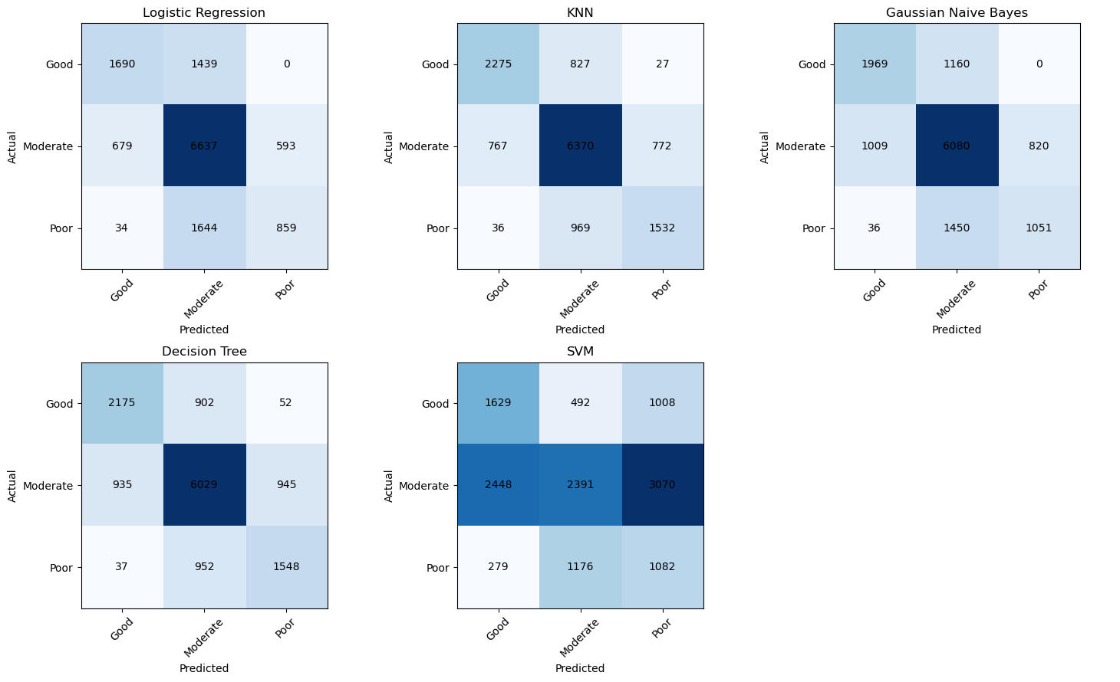
PART B · RESULTS
Confusion matrices
How to read one
Rows are the true class, columns the predicted class, in the order Good, Moderate, Poor. Cells on the diagonal are correct predictions; everything off the diagonal is a mistake, and its position says exactly which class was confused with which.
Most errors fall between neighbouring quality levels — Good confused with Moderate, Moderate with Poor.
Confusing Good with Poor is rare, so the models learn the ordering of quality even though the labels are unordered.
The SVM panel collapses toward a single column, the visual signature of a boundary that never converged.
Part B · Results
50

Slide 51
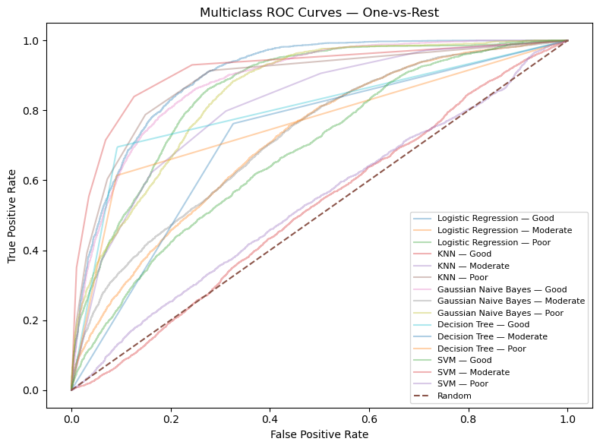
PART B · RESULTS
Multi-class ROC-AUC (One-vs-Rest)
What One-vs-Rest means
A single ROC curve compares two classes. With three classes, each one is taken in turn as 'positive' and the other two combined as 'negative', giving three curves per model.
Each curve plots true-positive rate against false-positive rate as the decision threshold moves. The dashed diagonal is random guessing; the further a curve bulges toward the top-left, the better.
KNN gives the highest baseline AUC at 0.8480, and the tuned Decision Tree tops the study at 0.8626.
Logistic Regression (0.7833) and Naive Bayes (0.7824) are close, despite different assumptions.
SVM sits at 0.5588 — near the diagonal, i.e. barely better than chance.
Part B · Results
51

Slide 52
PART B · MODELLING
GridSearchCV hyperparameter tuning
Tuned model | Accuracy | Weighted F1 | ROC-AUC
Tuned Decision Tree | 0.7552 | 0.7549 | 0.8626
Tuned Logistic Regression | 0.6767 | 0.6600 | 0.7833
How the search works
GridSearchCV trains a model for every combination in a parameter grid, scoring each with cross-validation on the training data only. Scoring metric: weighted F1.
Because preprocessing lives inside the same Pipeline object, every fold re-learns its own medians, IQR bounds and scaling — so the validation score is never inflated by information from the fold it is being tested on.
What tuning achieved
Model | Grid searched | Best
Logistic Regression | C ∈ {0.1, 1.0} | C = 1.0
Decision Tree | max_depth ∈ {10, 20} min_samples_split ∈ {2, 5} | max_depth = 10 min_samples_split = 5
The Decision Tree improved from 0.7185 to 0.7549 weighted F1 — limiting depth to 10 stopped it memorising the training rows, and its ROC-AUC jumped from 0.7455 to 0.8626, the best in the study.
Logistic Regression did not move: C = 1.0 was already the default, so the grid simply confirmed the baseline.
Model | GridSearch F1 | Mean 5-fold F1 | Std
Tuned Decision Tree | 0.7438 | 0.7495 | 0.0047
Tuned Logistic Regression | 0.6638 | 0.6639 | 0.0045
Why only two models are tuned
The full dataset is large and KNN and SVM are the most expensive to refit repeatedly. Tuning is spent where it returns the most, and all five algorithms are still trained and reported.
Part B · Tuning
52

Slide 53
PART B · RESULTS
Final model selection
How the winner was chosen
Selection uses the mean 5-fold weighted F1 measured on the training data, not the test score. This keeps the test set untouched during decision-making, so its numbers remain an honest final evaluation rather than a figure the model was chosen to maximise.
On that basis the Tuned Decision Tree wins with 0.7495 mean CV F1 against 0.6639 for Tuned Logistic Regression.
0.7552
0.7549
final test accuracy
final test weighted F1
Saved artefacts
Reading the chart
final_classification_model.pkl, target_label_encoder.pkl and three CSV result tables are written with joblib so the model can be reused without retraining.
Only 0.0066 F1 separates the tuned Decision Tree from untuned KNN — a tuned KNN would be the obvious next experiment.
Part B · Results
53

Slide 54
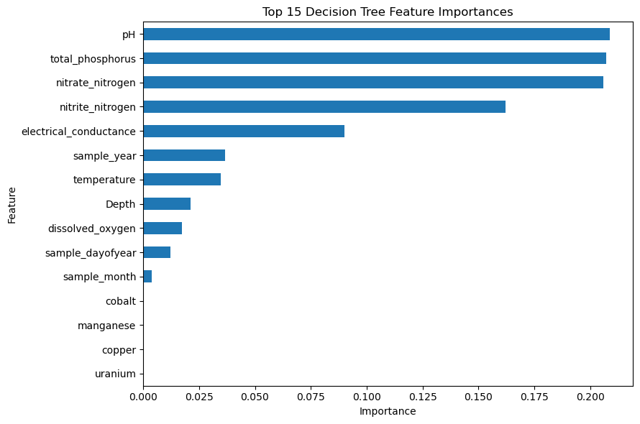
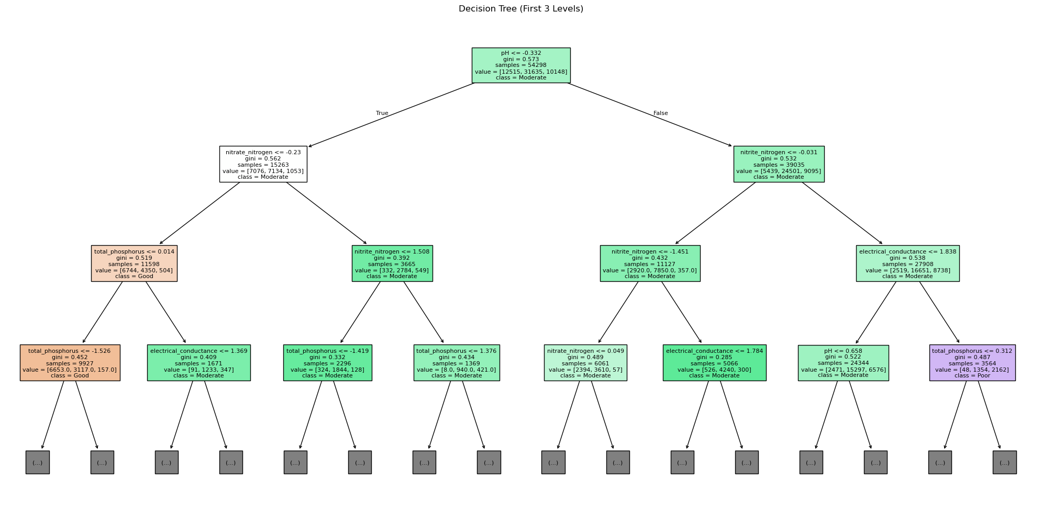
PART B · RESULTS
Decision Tree interpretation
Top levels of the fitted tree
What the tree shows
Top 15 feature importances
Each node names the measurement being tested and the threshold applied; branches lead to the class that best fits the samples reaching that point.
With max_depth limited to 10, the tree stays readable at the top levels — an analyst can follow the first few questions and see exactly why a sample was labelled Poor. The near-empty trace-element columns contribute almost nothing, which is what the audit predicted.
Why importance matters here
Importance measures how much each measurement reduced impurity across all the splits it was used in. It turns the model into an argument about water chemistry rather than a black box.
Part B · Results
54

Slide 55
PART B · CONCLUSION
Classification — what we learned
Best model
Close runner-up
Tuned Decision Tree — test accuracy 0.7552, weighted F1 0.7549, ROC-AUC 0.8626, selected on a mean 5-fold training F1 of 0.7495 (std 0.0047).
Untuned KNN at 0.7483 weighted F1 and 0.8480 ROC-AUC, confirming that local similarity between samples carries most of the signal.
Data quality is the ceiling
Selection discipline
Many measurements are over 95% missing, so median imputation supplies a single repeated value for them. Better sampling coverage would lift performance more than any change of algorithm.
Every preprocessing step was fitted inside the pipeline and the final model chosen on cross-validated training scores — the test set was used once, for reporting only.
Part B · Conclusion
55

Slide 56
IN SUMMARY
Two problems, one method
Regression
Classification
75,757 buildings · 65 predictors · 10 algorithms
Best: Random Forest — R² 0.5180, RMSE 40.63, MAE 19.24
Top driver: energy_star_rating (0.2503 importance)
67,873 water samples · 3 classes · 5 algorithms
Best: Tuned Decision Tree — accuracy 0.7552, F1 0.7549
Selected on 5-fold training F1, ROC-AUC 0.8626
The same discipline carried both tracks: audit the data before touching it, justify every removal in writing, engineer features from domain knowledge, keep all learned preprocessing inside a pipeline fitted on training data alone, tune with cross-validation, and report the test set once.
56

