Slide 1
Micro Services

Slide 2
Type of micro services?
Front end micro services.
Back end micro services.

Slide 3
Benefits
Split large applications into small containers.
Each container can use any programming language and framework.
Containers are portable.
Small container spin-up or shutdown fast.

Slide 4
How we can run together?
We use container to run each services separately on same page. Each container app can use different framework.

Slide 5
MICRO SERVICES
Splitting large and complex applications into smaller components with a single function

Slide 6
MICRO BACK END
We can use one front end and multiple back ends micro services. Because back end needs heavy computation, so we can divide load for back end multiple micro services

Slide 7


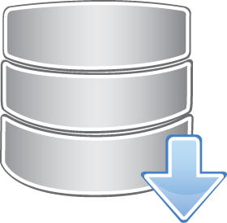
Architecture # 1
Front end
Back end micro services
database

Slide 8
Architecture # 2
Front end
Front end
Front end
Front end
Back end
Back end
Back end
Back end
Data base
Data base
Data base
Database

Slide 9
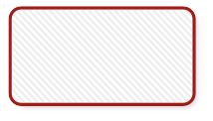
Architecture # 3
Front end consuming multiple Back end
Back end
Back end
Back end
Back end
Data base
Data base
Data base
Database

Slide 10
Logo | Header
Menu | Section _{Content} Section
MICRO Fronted
Splitting large UIs into smaller web modules and web components

Slide 11
Principles
Stand-alone run
Independent development
Stand-alone deployment

Slide 12
Routing
Each route is a different project
Use HTTP server routing to redirect multiple apps
Easy implementation
Independent development

Slide 13



Routing
Menu 1 - /myapp/menu1
Menu 2 - /myapp/menu2
Menu 3 - /myapp/menu3

Slide 14
i Frame
Embedded modules and projects
Easy to implement
Complex to maintain
Very useful in legacy projects

Slide 15
Micro-Apps
Fast distributed development
Challenging integration
Few reusable components
Independent development

Slide 16
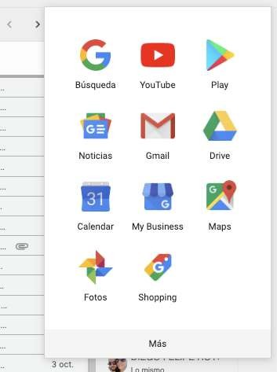
Micro-Apps Examples:

Slide 17
Pure components
Javascript functions
Internal libraries
Npm, unpkg, etc.
Advanced JS knowledge is required

Slide 18
Frameworks make life EASY
Luig, Single spa,

Slide 19
Demo App
infrastructure

Slide 20

(iframe src=localhost:500)
(iframe src=localhost:80)
React App-1
React
App-2
Node-api
HTML page
Mysql-db

Slide 21







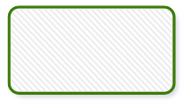
HTML page holding iframes for microservices
Component #1
Component #2
Component #3
Micro service 1
Micro service 2
Micro service 3
All micro services can shares same data
Json data

Slide 22
THANKS!

