Slide 1
Automated Identification of Gait Abnormalities
Predicting Gait Deviation Index (GDI) from DensePose IUV Sequences
Re-implementation and improvement of Gotlin, Pancholi & Agarwal (CS229 / Paper 31)
Data: github.com/agotlin/CS229DP
UE24CS352A · Machine Learning Mini-Project

Slide 2
Agenda
1. Motivation & clinical background
6. Models: baselines → CNN–LSTM → attention → multi-task
2. What is GDI? Why predict it from video?
7. Training setup & metrics
3. Paper 31 (Gotlin et al.) — what they did
8. Results (to fill after runs)
4. Dataset (CS229DP DensePose IUV + GDI)
9. Improvements vs the paper
5. Our pipeline & patient-disjoint evaluation
10. Limitations & conclusion

Slide 3
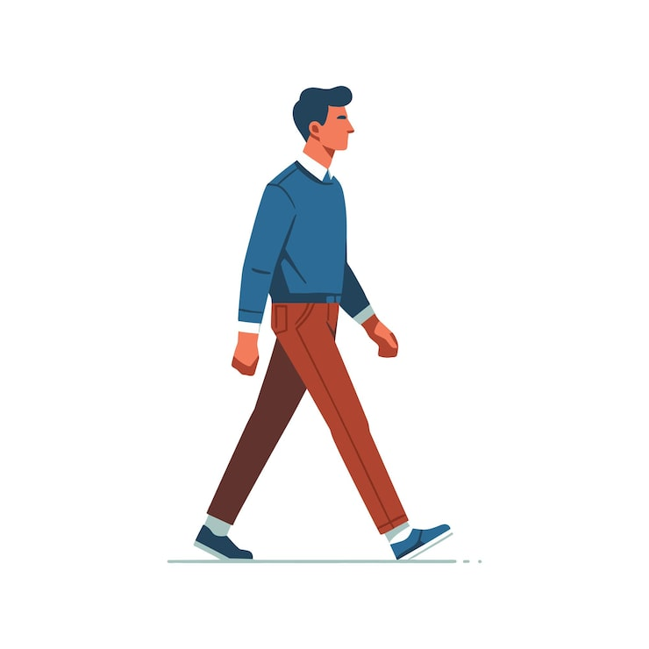
INTRODUCTION
Gait
The pattern of walking: step timing, speed, balance, and how joints move over time.
Clinical problem
Neurological disease changes gait. Marker-based labs are accurate but costly and slow.
Video opportunity
If pose can be estimated from ordinary video, we can support cheaper, scalable assessment.
This project
Predict a continuous clinical score (GDI) from DensePose body-surface maps, then improve the original CS229 design.

Slide 4
What is the Gait Deviation Index (GDI)?
GDI is a single number that summarises how much a patient’s kinematics deviate from a typical able-bodied gait pattern. Higher values are closer to typical gait; lower values indicate greater abnormality. It is widely used in clinical gait laboratories.
Typical range
Why ML?
Our target
Often scaled so ~100 ≈ average typical gait; many patients score lower.
Computing GDI normally needs full 3D motion capture. Predicting it from video pose could reduce cost.
Regression: predict continuous GDI from a short sequence of DensePose IUV frames. Metric = RMSE.

Slide 5
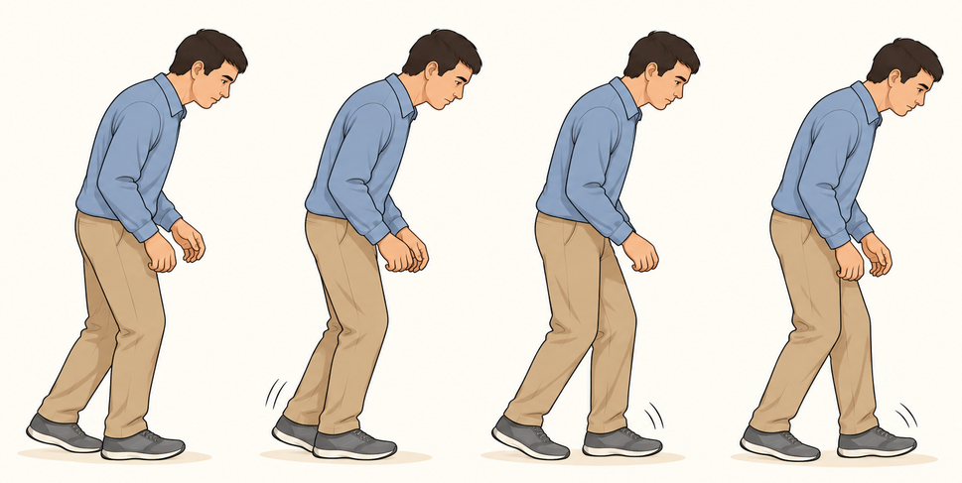
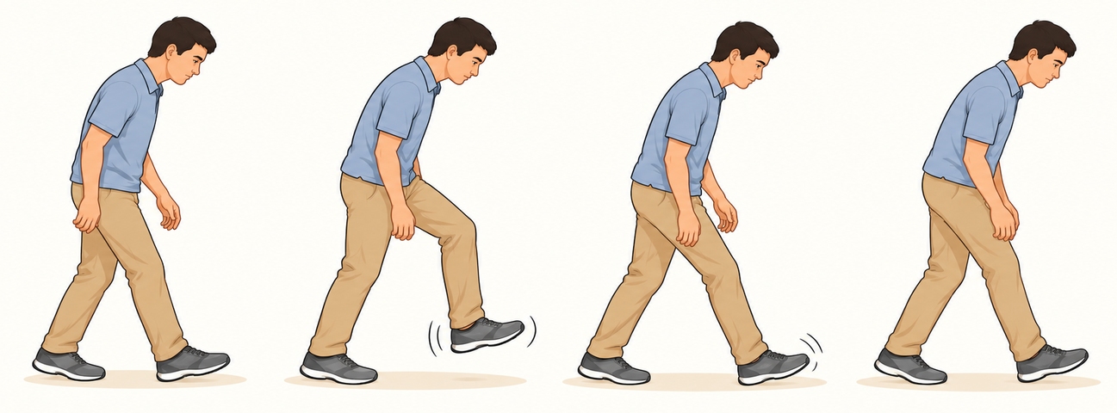
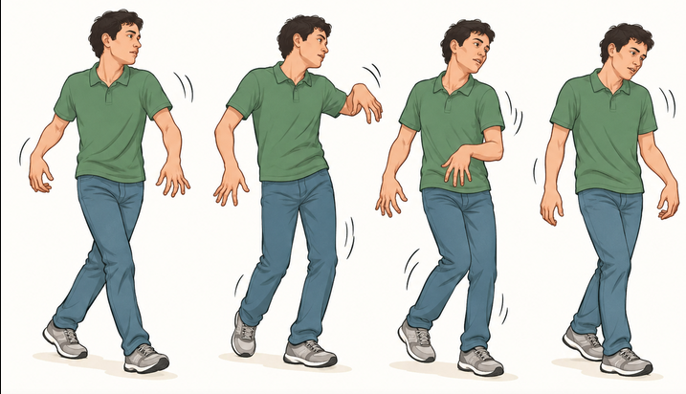
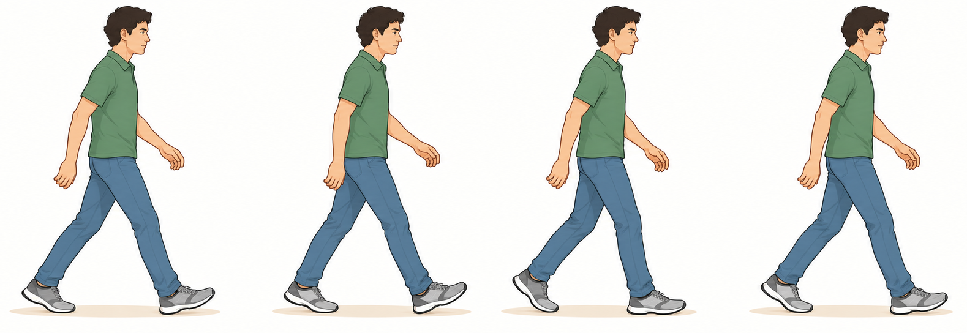
Diseases and Their Gait Characteristics
Many conditions lower GDI. Paper 31 predicts the score, not the disease name.
Parkinson’s Disease
ALS
Huntington’s Disease
Typical reference
Shuffling, short steps, reduced arm swing, altered rhythm.
Muscle weakness, uneven loading, prolonged stance phases.
Irregular timing, large step-to-step variation.
Regular timing, balanced left–right pattern (higher GDI).

Slide 6
Paper 31 — Gotlin et al. (CS229)
Data
~3,000 clinical walking videos from Gillette Children’s gait lab, each with physician-derived GDI.
Pose
DensePose RCNN maps every person pixel to a 3D body surface → IUV images (Index, U, V channels).
Model
CNN over each frame, then LSTM over a short temporal window; output = continuous GDI.
Result
Best reported RMSE ≈ 4.4 (CNN + LSTM). Beats simple baselines and some transfer models on their split.
Limit
Raw videos are private. Public release is CS229DP: path CSVs + processed IUV maps (data.zip).

Slide 7
DATASET — CS229DP in detail
Repository: github.com/agotlin/CS229DP
Artifact
Role
imagepath_gdi.csv
~234k rows: path to each *_IUV.png, continuous GDI, optional label_norm bin
imagepath_gdi_10.csv
Smaller subset for smoke tests and debugging
data.zip / densepose-out/
Actual IUV PNG files under <patient_id>-processed/
Patient folder
e.g. 07337701-processed — all frames share one GDI label
IUV image
3-channel map: body-part index (I) + surface coordinates (U, V)

Slide 8
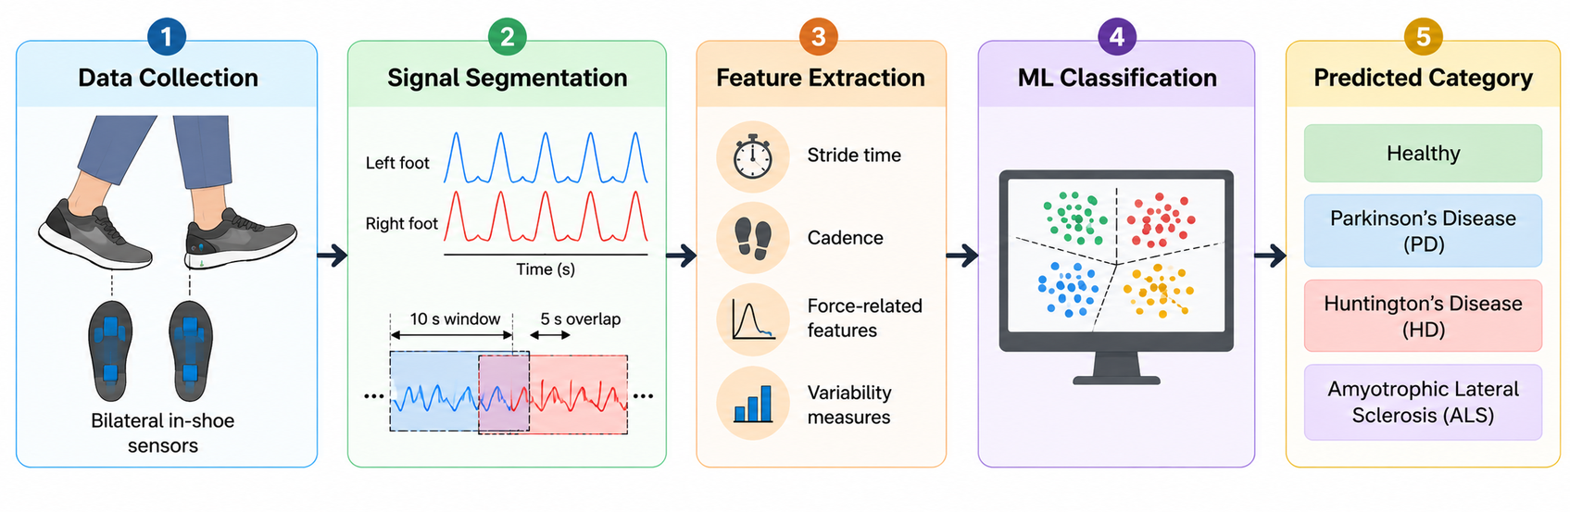
METHODOLOGY — End-to-end pipeline
Clinical ML concept (illustration). Our concrete steps on CS229DP:
1
2
3
4
5
6
Load CSV
Resolve PNGs
Windows
Split
Train
Evaluate
Paths + GDI
densepose-out/
T = 10 frames
By patient
MSE / multi-task
RMSE + plots

Slide 9
Why patient-disjoint splits?
Frames from the same patient are highly correlated (same body, same session, same GDI). If those frames appear in both train and test, RMSE looks artificially good. We assign every sequence from a patient to only one of train / val / test.
Train 70%
Val 15%
Test 15%
Patients used to fit CNN, LSTM, attention, multi-task heads.
Early stopping on validation RMSE; pick best checkpoint.
Final reported RMSE only — never used for tuning.

Slide 10
MACHINE LEARNING MODELS — Overview
1. Linear / Ridge baselines
Mean and std of IUV channels over the window → linear model. Fast sanity check; no temporal structure.
2. CNN + BiLSTM (paper spirit)
Per-frame CNN → bidirectional LSTM → last timestep → scalar GDI. Closest to Paper 31’s main idea.
3. CNN + BiLSTM + Attention ★
Same backbone; soft attention weights over time. Model can emphasise heel-strike or mid-stance frames.
4. Multi-task ★
Shared encoder predicts GDI (MSE) and a coarse severity bin (cross-entropy). Aux task can regularise features.

Slide 11
Architecture — Layer-level detail
Input
Frame CNN
BiLSTM
Pooling
Heads
Shape (B, 10, 3, H, W)
10 IUV frames
RGB = I,U,V channels
Resized (e.g. 64×64)
Conv–BN–ReLU ×3
MaxPool
AdaptiveAvgPool
→ 128-d vector / frame
2 layers
Hidden 128
Bidirectional
→ 256-d / timestep
Baseline: last step
Ours: attention
over all 10 steps
Linear → 1 (GDI)
Optional: 3-way
severity logits

Slide 12
Training setup
Item
Setting
Loss (main)
Mean Squared Error on GDI
Loss (multi-task)
MSE + 0.3 × CrossEntropy on severity bins (GDI <70 / 70–90 / ≥90)
Optimiser
Adam, lr = 1e-4, weight decay = 1e-5
Regularisation
Dropout 0.3, BatchNorm in CNN, early stopping (patience 8) on val RMSE
Batch size
16 sequences
Sequence length
10 frames (same order of magnitude as the paper)
Hardware
CUDA if available, else CPU; start with small CSV subset

Slide 13
Evaluation metrics & plots
RMSE
Scatter plot
Root Mean Squared Error between predicted and true GDI. Primary metric (paper uses this). Lower is better.
Predicted GDI vs true GDI. Points near the diagonal mean good calibration across the score range.
Residual histogram
Learning curves
Distribution of (pred − true). Check bias and heavy tails.
Train vs validation RMSE over epochs. Detect overfitting when curves diverge.

Slide 14
RESULTS AND PERFORMANCE
Fill numbers after: python -m src.run_experiments
Model
Test RMSE
Notes
Linear / Ridge
___
No temporal model
CNN + BiLSTM
___
Paper-style backbone
CNN + BiLSTM + Attn
___
Our temporal attention
Multi-task
___
GDI + severity bin
Paper 31 (reference)
~4.4
Their data/split; not identical setup
Also show: scatter_*.png, curves_*.png, residuals_*.png from outputs/figures/

Slide 15
Improvements over Paper 31
Kept from the paper
What we add
• DensePose IUV as the pose representation
• CNN spatial encoder per frame
• LSTM for temporal modelling
• Continuous GDI regression target
• RMSE as the primary metric
• Short fixed-length frame windows
• CS229DP path / label layout
• Temporal attention over LSTM states
• Multi-task severity classification head
• Strict patient-disjoint splits
• Bidirectional LSTM + BatchNorm
• Linear / Ridge baselines
• Early stopping & modern Adam setup
• Full reproducible PyTorch package

Slide 16
Limitations & honesty
Image availability
Training only works if data.zip IUV PNGs are present and paths resolve. CSVs alone are not enough.
Not identical to paper run
We may use a subset, different resize, and patient-disjoint splits — RMSE is not a one-to-one bake-off.
No raw hospital video
We cannot re-run DensePose from scratch on Gillette RGB; we rely on released maps.
Clinical deployment
GDI prediction from vision still needs prospective validation, calibration, and ethics review.

Slide 17
CONCLUSION
We re-implement GDI prediction from DensePose IUV using the public CS229DP release.
1
The core idea of Paper 31 (CNN + temporal model → GDI) is preserved and made runnable.
2
We improve evaluation (patient-disjoint) and modelling (attention, multi-task, baselines).
3
Next steps: full image set, stronger backbones, uncertainty estimates, and careful clinical framing.
4

Slide 18
How to reproduce
cd gait-gdi-cs229 && pip install -r requirements.txt
python -m src.setup_data
# Download data.zip from CS229DP; unzip → data/densepose-out/
python -m src.baselines
python -m src.train --model attn --epochs 40
python -m src.train --model multitask --epochs 40
python -m src.evaluate --ckpt attn_best.pt
python -m src.run_experiments --epochs 40

Slide 19
Questions?
Metric: GDI RMSE (lower is better)
Data: github.com/agotlin/CS229DP
Code: gait-gdi-cs229/

