Slide 1
3.4.1 Structure and Working of a Deep Neural Network
Structure of a Deep Neural Network
A Deep Neural Network (DNN) consists of three main types of layers: the input layer, hidden layers, and output layer.
The input layer receives input data, such as pixel values from an image captured by a camera.
The hidden layers contain interconnected artificial neurons, also called nodes, that process the input data.
The output layer generates the final result, such as the probability that an image contains a cat.
In a fully connected network, each neuron in one layer is connected to every neuron in the next layer.
Different layers in a neural network may contain different numbers of neurons.

Slide 2
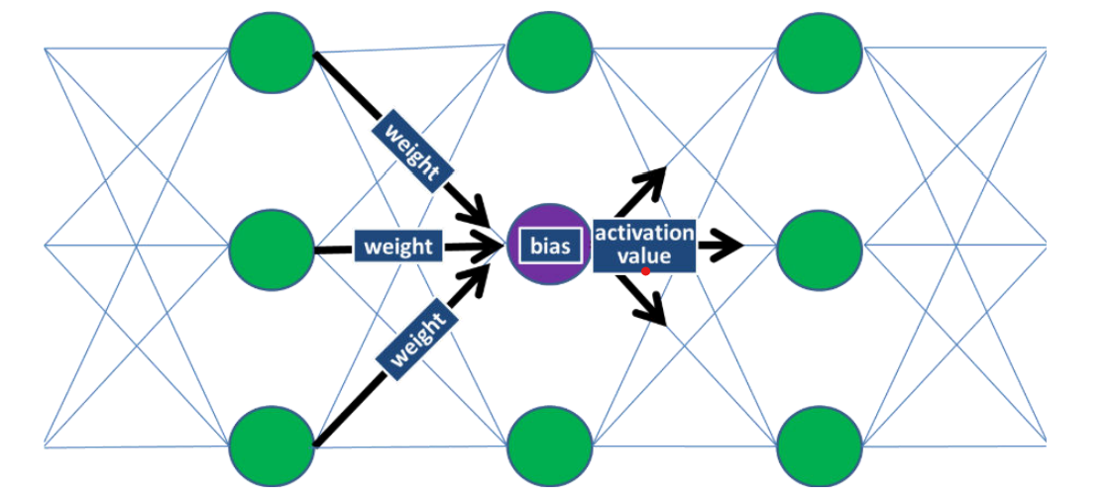
3.4.1 Structure and Working of a Deep Neural Network

Slide 3
3.4.1 Structure and Working of a Deep Neural Network
2. Working of a Deep Neural Network
Neurons perform mathematical calculations and pass information from the input layer through the hidden layers to the output layer.
Each layer processes the received information and gradually transforms it into more meaningful and abstract representations.
As information moves through the network, the neurons identify patterns and features that help generate predictions.

Slide 4
3.4.1 Structure and Working of a Deep Neural Network
3. Weights, Biases, and Activation Functions
Weights determine how strongly the output of one neuron influences another connected neuron.
Bias is an additional numerical value added to the weighted sum of inputs to help the neuron adjust its output.
Weighted Sum is calculated by multiplying each input activation value by its corresponding weight and adding the results together.
Activation Function is a non-linear mathematical function applied to the weighted sum and bias to calculate the neuron's output.
Activation Value is the final value generated by a neuron after applying the activation function.
Different activation functions can produce different activation values and influence how the network processes information.
The bias used in neural network calculations is different from bias related to fairness or discrimination in AI systems.

Slide 5
3.4.1 Structure and Working of a Deep Neural Network
4. Training a Deep Neural Network
Initialization: Before training begins, the network's weights are typically assigned small random values, while biases may be initialized to small random values or zero.
Forward Propagation: Training data passes through the network, and each neuron performs calculations to generate a predicted output.
Loss Calculation: The predicted output is compared with the known correct result to calculate the prediction error, also called loss.
Backpropagation: The error information is propagated backward through the network to determine how the weights and biases should be adjusted.
Weight and Bias Adjustment: The network updates its weights and biases to reduce prediction errors and improve its performance.
Repeated Training: The process continues with more training data, allowing the network to gradually learn patterns and improve predictions.
Epoch: One complete pass through the entire training dataset is called an epoch.
Training Completion: Training ends when the network achieves sufficiently good performance or meets a predefined stopping condition.

Slide 6
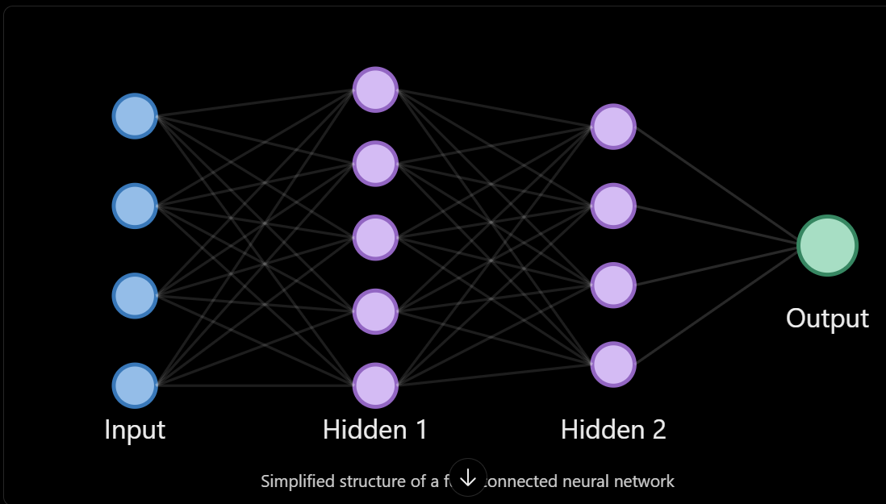
3.4.1 Structure and Working of a Deep Neural Network
5. Example: Cat Image Recognition

Slide 7
3.4.2 Hands-on Exercise: Experience the Implementation of a Perceptron Students will be led through an exercise demonstrating a Perceptron learning a simple function, such as an AND function. The exercise should cover how a Perceptron learns by modifying its weights and bias values across multiple epochs until the error is minimized to zero. Various mechanisms (e.g., spreadsheet, simulation) may be used for this activity.

Slide 8
3.4.1 Structure and Working of a Deep Neural Network
5. Example: Cat Image Recognition
The input layer receives the pixel values of an image containing a cat.
The hidden layers process the image data and learn to recognize features such as edges, shapes, ears, and eyes.
The output layer generates a prediction, such as a 90% probability that the image contains a cat.
The predicted result is compared with the actual label to calculate the loss.
Backpropagation helps determine the adjustments required for the weights and biases.
The network repeats this training process over multiple epochs to improve its prediction accuracy.
In simple words: A deep neural network learns by receiving data, processing it through interconnected neurons, making predictions, calculating errors, and repeatedly adjusting its weights and biases to improve future predictions.

