Slide 1
3.4 Neural Networks
• Artificial neural networks
○ Initially designed to mimic the functioning of the human brain
▪ The brain can be viewed as a network of interconnected biological neurons
• Single-layer perceptron
○ One of the earliest artificial neural network implementations
○ Consists of just one layer
○ Used in supervised learning for binary classification
○ Works on linearly separable problems
▪ Determines whether an input belongs to a specific class or not

Slide 2
3.4 Neural Networks Cont.
• Example: Email spam classification
○ A perceptron can classify emails as spam or not spam
○ It learns to separate the two categories using a straight-line
decision boundary in the input feature space
• Deep neural networks
○ Most modern neural networks have several layers
○ Networks with multiple layers are called deep neural networks
• Multi-layer perceptrons (MLPs)
○ Fully connected networks can be considered multi-layer perceptrons

Slide 3
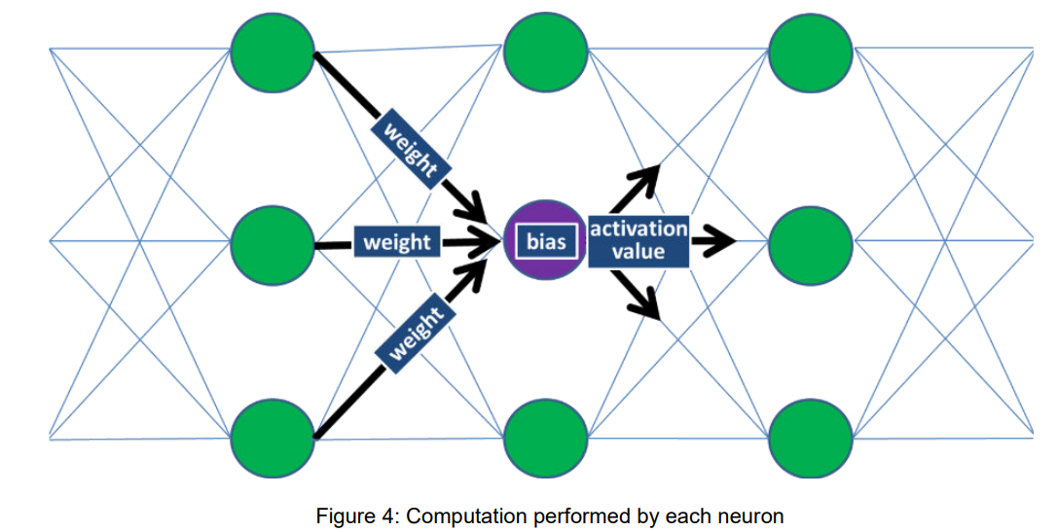
3.4 Neural Networks Cont.

