Slide 1
3.1.1 Different Forms of Machine Learning
• Machine learning (ML) algorithms are categorized into three main approaches: supervised learning, unsupervised learning, and reinforcement learning.
• Each approach solves different kinds of problems. The choice depends on the available data and the specific task.

Slide 2
Supervised Learning
• In supervised learning, algorithms train models using labeled data: each set of inputs has a corresponding output label.
• For example, training images can be labeled “dog” or “cat”.
• The model learns to map inputs to outputs by identifying patterns in the training data.
• Supervised learning is typically divided into classification and ML regression.

Slide 3
Supervised Learning
Labeled data means we provide both the input and the correct answer during training.
For example, we show an AI model 1,000 pictures of cats and dogs and tell it which pictures contain cats and which contain dogs.
The model learns patterns and then tries to identify new pictures on its own.

Slide 4
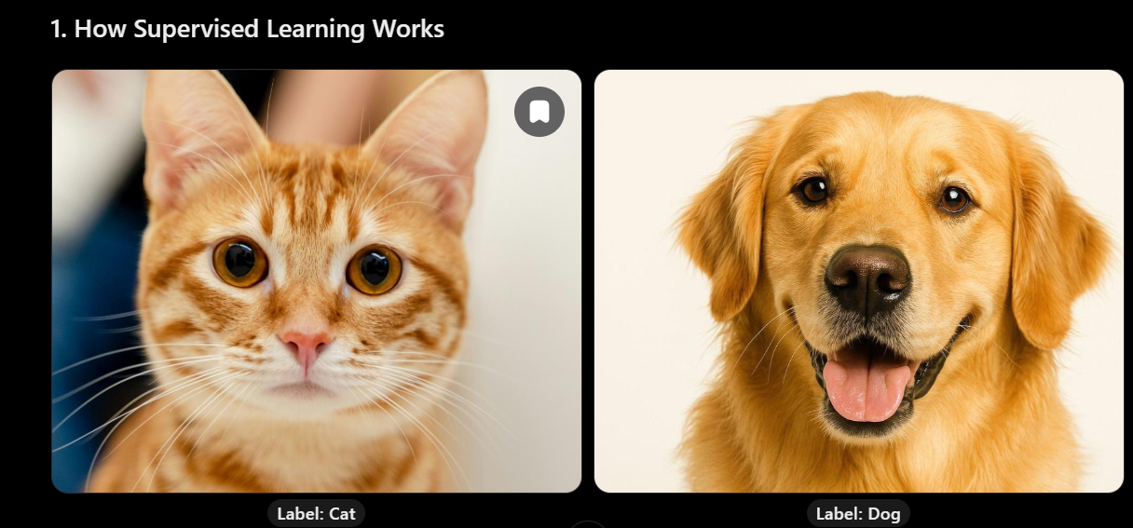
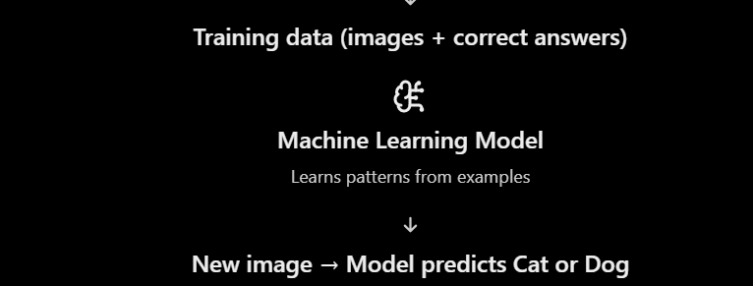
Supervised Learning

Slide 5
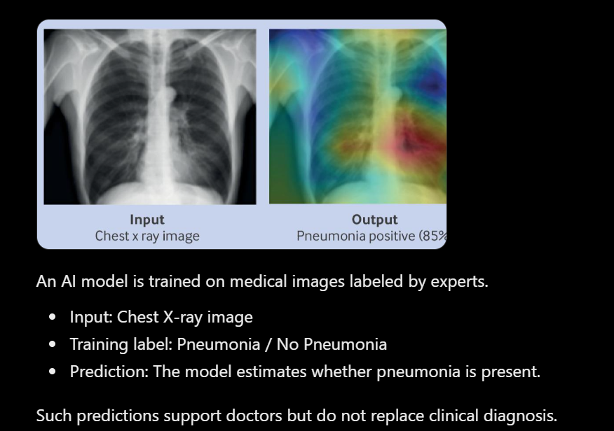
Supervised Learning
Example : Medical Diagnosis (Classification)

Slide 6
Supervised Learning
Simple steps:
Provide labeled training data.
The model learns relationships between inputs and correct outputs.
Give the model new, unseen data.
The model predicts an answer based on what it learned.
Evaluate the prediction against the correct answer.

Slide 7
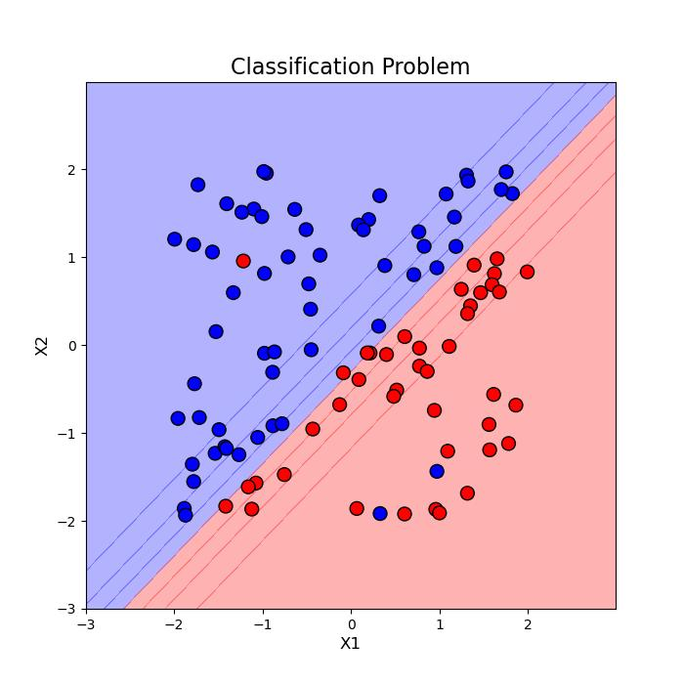
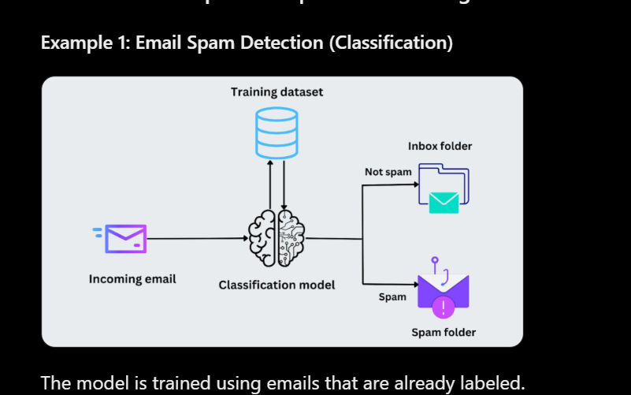
Supervised Learning — Classification
• Classification assigns inputs to predefined classes or categories.
• Example: classifying emails as spam or not spam.
• Another example: recognizing classes of objects in images.

Slide 8
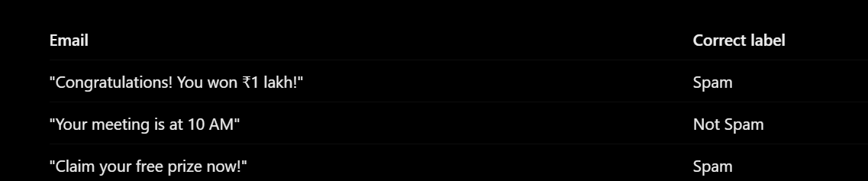
Supervised Learning — Classification

Slide 9
Supervised Learning — ML Regression
• ML regression predicts continuous numerical values.
• Example: estimating a person’s age based on lifestyle data.
• Another example: forecasting stock prices.

Slide 10
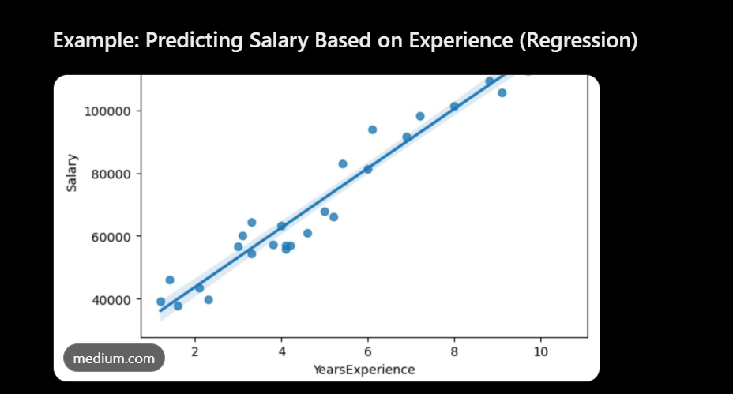
Imagine an IT company wants to predict an employee's salary based on their years of experience.
The AI model is trained using historical employee salary data.
How does it work?
The model learns that salary tends to increase with experience.
A new employee has 6 years of experience.
The model predicts a salary of ₹8 lakh per year, following the pattern in this example.
Supervised Learning — Regression
Years of experience (Input) | Salary (Output)
1 year | ₹3 lakh
2 years | ₹4 lakh
3 years | ₹5 lakh
4 years | ₹6 lakh
5 years | ₹7 lakh

Slide 11
Unsupervised Learning
• Unsupervised learning uses unlabeled data, with no explicit output labels.
• The algorithm infers patterns or structures and can group similar inputs based on shared features.
• Unsupervised learning is typically categorized into clustering and association.
Unlike supervised learning, we don't provide the correct answers. The AI discovers hidden patterns, similarities, and relationships in the data on its own.

Slide 12
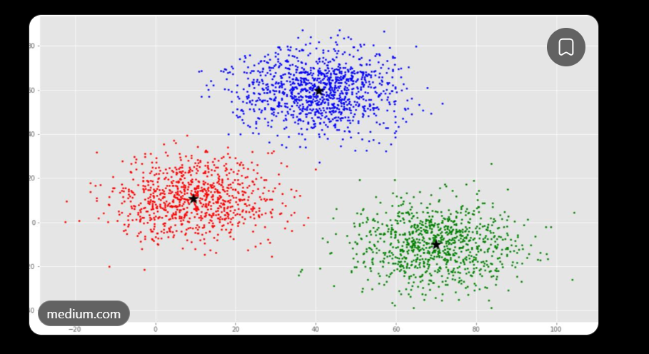
Unsupervised Learning — Clustering
• Clustering groups data points according to their similarities.
• Example: segmenting customers into different groups for targeted marketing.

Slide 13
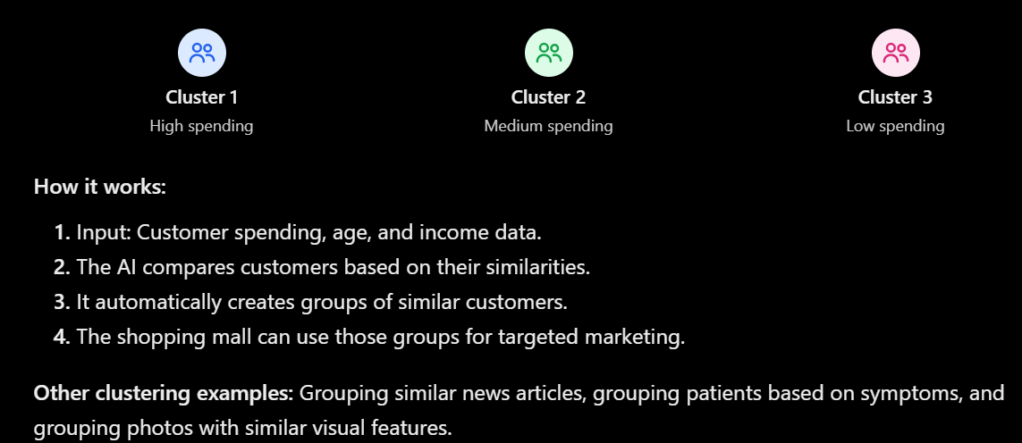
Unsupervised Learning — Clustering
Example: Customer Segmentation in a Shopping Mall
Imagine a shopping mall has data about 1,000 customers, including their age, annual income, and shopping spending.
The AI analyzes the data and discovers three groups.

Slide 14
Unsupervised Learning — Association
• Association identifies relationships or dependencies among data attributes.
• Example: finding patterns in customers’ purchasing behavior to recommend products.
Finding Relationships Between Items
Association is an unsupervised learning technique that discovers items or events that frequently occur together.

Slide 15
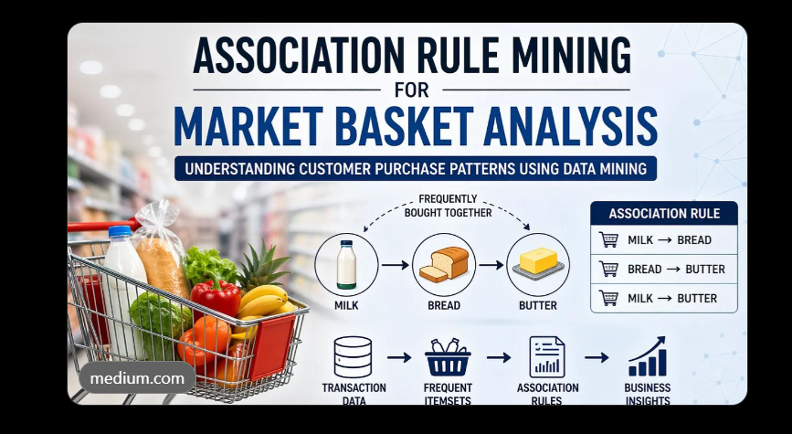
Unsupervised Learning — Association
Example: Supermarket Basket Analysis
Imagine a supermarket analyzes customers' shopping bills.
The algorithm discovers that customers who purchase bread frequently purchase butter.
Customer | Items purchased
Customer 1 | Bread, Butter, Milk
Customer 2 | Bread, Butter
Customer 3 | Milk, Eggs
Customer 4 | Bread, Butter, Jam
Customer 5 | Bread, Milk, Butter

Slide 16
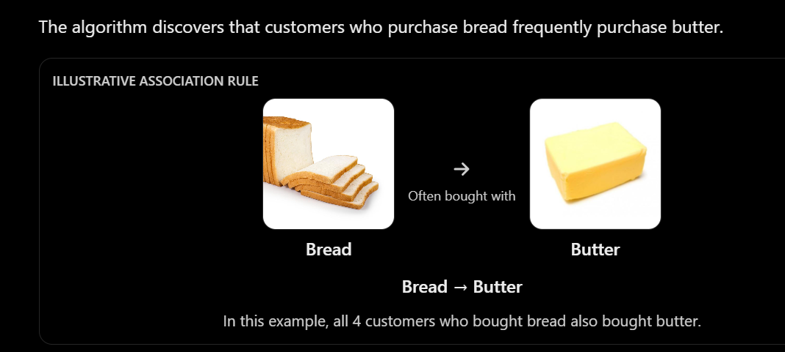
Unsupervised Learning — Association
How it works:
Input: Thousands of shopping transactions.
The algorithm identifies products frequently purchased together.
It discovers patterns such as Bread → Butter.
The supermarket can use these patterns to recommend related products or create combo offers.

Slide 17
Reinforcement Learning
• An AI-based system, called an “intelligent agent”, learns by interacting with its environment.
• The agent receives positive feedback (rewards) or negative feedback (penalties) based on the outcomes of its actions.
• This enables it to learn from experience rather than directly from a labeled training dataset.
Reinforcement Learning is a type of Machine Learning in which an AI agent learns by trial and error, receiving rewards for good actions and penalties for bad actions.
The goal is to learn actions that maximize the total reward over time.

Slide 18
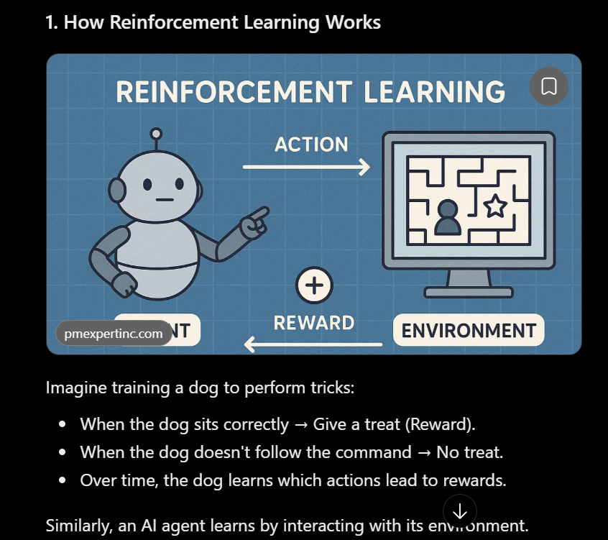
Reinforcement Learning

Slide 19
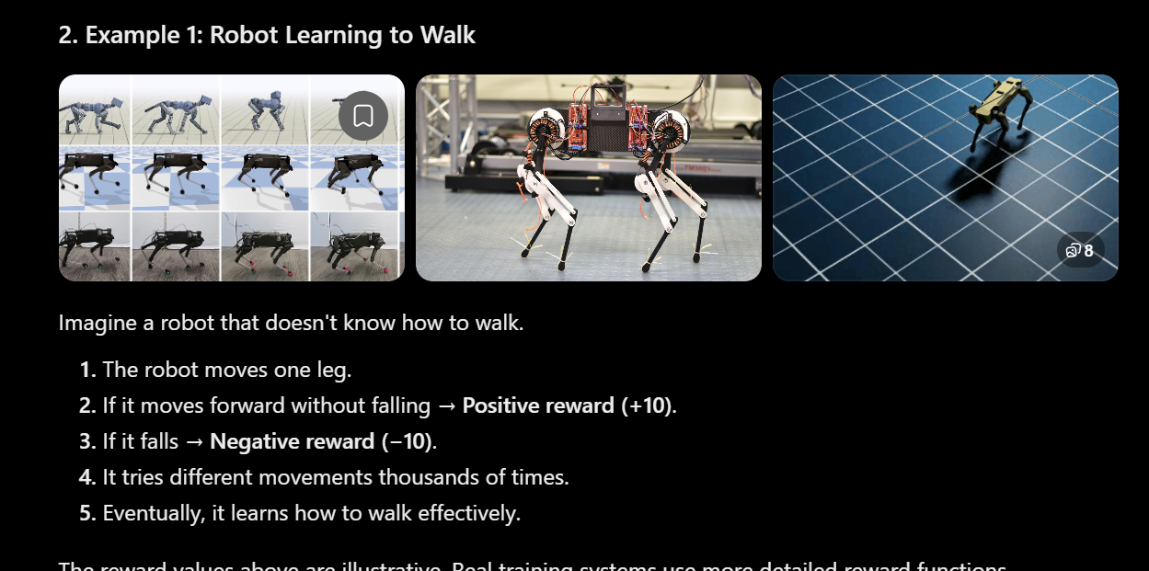
Reinforcement Learning

Slide 20
Reinforcement Learning — Challenges and Applications
• Challenges include setting up the environment, designing the reward function, and selecting the best strategy to meet the desired goal.
• Applications include robotics, autonomous vehicles, and adaptive systems such as chatbots.

Slide 21
Choosing the Right Form of Machine Learning
• Supervised learning: uses labeled data; commonly supports classification and prediction of numerical values.
• Unsupervised learning: uses unlabeled data; commonly discovers clusters and associations.
• Reinforcement learning: an agent learns from environmental interactions, rewards, and penalties.
• The suitable ML approach depends on the problem, the nature of the available data, and the intended task.

Slide 22
Thank you

