Slide 1
3.1.1 ML Workflow
• Machine learning (ML) algorithms are categorized into three main approaches: supervised learning, unsupervised learning, and reinforcement learning.
• Each approach solves different kinds of problems. The choice depends on the available data and the specific task.

Slide 2
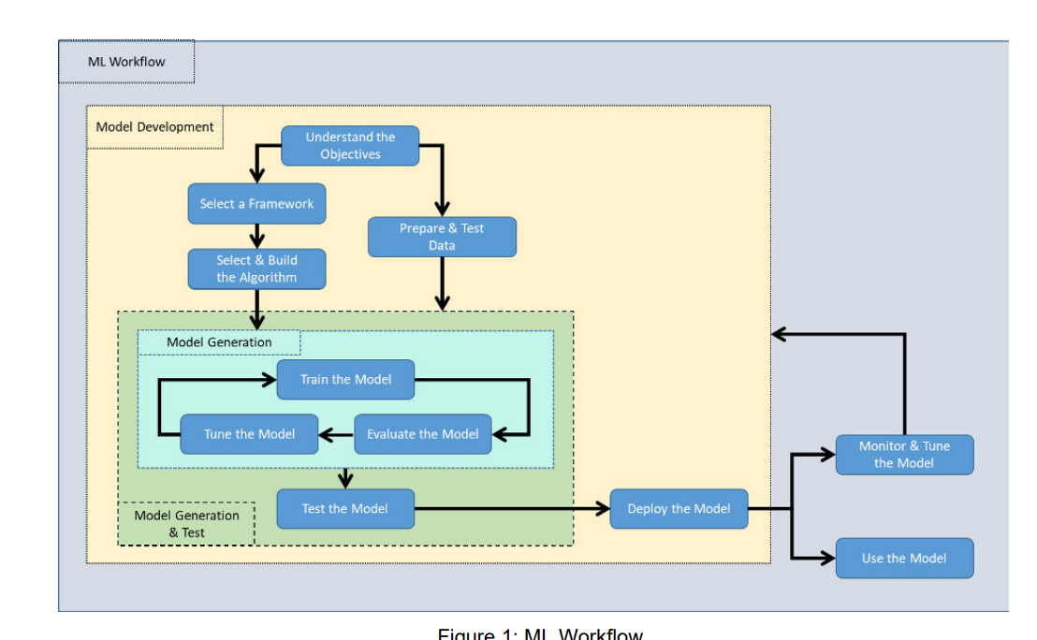
ML Work flow

