Slide 1
Context Analyzer A text classification web-app using NLP
Guide
Mr. Tamal Dey,
Assistant Professor,
Dept. Of Computer Applications,
PES University
By
Harsha K Y
PES1201801839

Slide 2
Abstract
Context Analyzer is a text classification application used to classify text into genres like Sports, Business, Technology, Politics, etc..
It provides APIs (Application Programming Interface) for text classification.
The input can be a pdf, txt document or a piece of text. The trained model is used to sort the text into appropriate classes.
Sentiment analysis API can be used to analyze tweets, reviews, and categorize them into positive, negative, neutral.
A lot of data being generated today consists of unstructured text data.
NLP (Natural Language Processing) helps us build models that lets computers make sense of the text data.

Slide 3
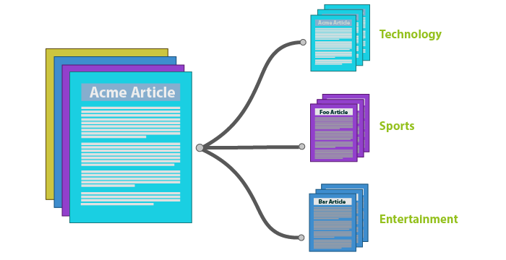
Introduction
Using a Machine Learning model to classify text data/documents online will save a lot of time and resources.
Classification tasks that would take humans weeks to complete can be done in hours by a computer with a good ML model.

Slide 4
Introduction
Purpose:
Text classification is a very important task in supervised machine learning.
Assigning categories to documents like web pages, books, articles, etc has many applications like spam filtering, email routing, sentiment analysis.
A piece of text is assigned to one or more classes or categories. This can be done either manually or using ML algorithms.
Context Analyzer uses one such ML algorithm so solve this classification problem.
The best way to build APIs currently is to use an efficient language like JavaScript with its Node.js runtime. The integration of Tensorflow.js with Node.js allows us to build highly scalable and robust APIs.

Slide 5
Introduction
Context Analyzer provides NLP APIs for the most important text classification tasks.
The Multi-class classification API takes text data as input and returns a probability score. The text data is assigned to the class with the highest value.
The Sentiment analysis API takes text data as input and returns a probability score that can be used to find out if a person's opinion on something is positive or negative.
For tech related text inputs, the API also tells us what particular technologies are being mentioned.

Slide 6
Literature Survey
A lot of research is being done every day in NLP. Providing NLP APIs is a complex task.
Tensorflow.js with Node.js can be used to build such APIs.
Tensorflow.js allows us to interact with ML models directly from the browser. This is what makes it currently the best library for building NLP APIs.
Since Tensorflow.js still only runs on experimental Node.js. Currently only Google provides NLP APIs built on Tensorflow.js.

Slide 7
Literature Survey
Existing Systems:
Google Cloud Natural Language API makes use of Tensorflow.js with Node.js to provide NLP services.
OpenNLP, Stanford NLP provide NLP libraries that can be integrated with a given language.
TextRazor provides NLP APIs but it is not built using Tensorflow.js.
Proposed System:
Context Analyzer makes use of tfjs with Node.js. Meaning, it does not depend on running python microservices for importing model and preprocessing.
All that is required is a cloud service to host the model.json file and the rest is taken care of by the APIs.
This is better than providing libraries as there is no need to import anything. The only requirement is to make API calls.

Slide 8
Tools and Technologies
Front-end
HTML, CSS, Handlebars.js
Back-end
Node.js, Express.js
Languages and Libraries
Python 3, Tensorflow.js
Code Editor
Visual Studio Code

Slide 9
Functional Requirements
Pre-Processing
Clean the input data. Tokenize the data to turn it into a single Tensor.
Train the model using the pre-processed dataset
Train Keras sequential model using appropriate parameters.
Test the model for accuracy scores
The trained model is used to make predictions. The predictions are used to calculate accuracy scores.
Server side pre-processing
The user inputs text data that has to be converted to a tensor. This needs the same pre-processing techniques.
Probability score output to human readable class
The model returns a probability score as output that has to be shown as human readable class.

Slide 10
Non-functional Requirements
Scaling: To be able to build more NLP APIs for different tasks.
Performance: Increase accuracy of the predictions.
Availability: To make sure that the web-app is always functioning properly and available to its users.
Maintenance: Future updates must be smooth. Should work well with future versions of the technologies used.

Slide 11
Modules
Data Gathering
Get the BBC News, imdb reviews datasets
Data Cleaning/Pre-processing
Preparing the dataset using NLTK and split it for training and testing
Initialize Model
Select the best model for the task at hand
Training the Model
Feed the train data to the model
Model Evaluation
Measure the accuracy of the trained model
Make Predictions
Use the trained model to make predictions

Slide 12
Thank You

