Slide 1
Text Classifier
Guide
Mr. Tamal Dey,
Associate Professor,
Dept. Of Computer Applications,
PES University
By
Harsha K Y
PES1201801839

Slide 2
Abstract
Text Classification is an automated process of classifying text/document data into predefined categories.
Classifying emails as spam/not spam, news articles into categories like Sports, Business, Tech, Politics etc..
Text classification also plays a major role in sentiment analysis done on reviews, comments on certain topics, tweets, and other social media posts.
A lot of data being generated today consists of unstructured text data.
NLP helps us build models that lets computers make sense of the text data.

Slide 3
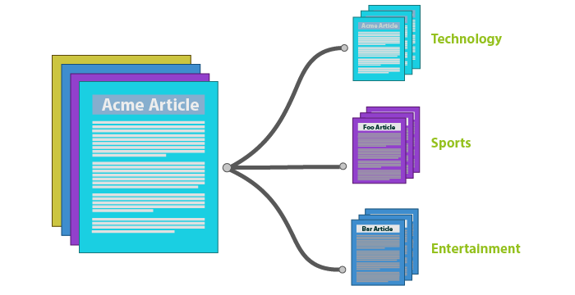
Abstract
Using a Machine Learning model to classify text data/documents online will save a lot of time and resources.
Classification tasks that would take humans weeks to complete can be done in hours by a computer with a good ML model.

Slide 4
Tools and Technologies
Dataset
BBC News dataset, StackOverflow dataset, imdb reviews dataset
Pre-processing
NLTK, TF-IDF
Model
CNN or SVM
Training
Keras or Tensorflow, nvidia cuda 9 enabled GPU
Languages and Libraries
Web-App
Flask or Tensorflow.js

Slide 5
Modules
Data Gathering
Get the datasets from the sources
Data Cleaning/Pre-processing
Preparing the dataset for training and testing
Initialize Model
Select the best model for the task at hand
Training the Model
Feed the train data to the model
Model Evaluation
Measure the accuracy of the trained model
Make Predictions
Use the trained model to make predictions

Slide 6
Thank You

