Slide 1
Context Analyzer A text classification web-app using NLP
Guide
Mr. Tamal Dey,
Assistant Professor,
Dept. Of Computer Applications,
PES University
By
Harsha K Y
PES1201801839

Slide 2
Abstract
Context Analyzer is a text classification application used to perform sentiment analysis, classify text into genres like Sports, Business, Technology, Politics, etc., and detect spam.
It provides APIs for text classification.
The user inputs some text through the UI or using the API. The trained model is then used to sort the text into appropriate classes.
For example, sentiment analysis API can be used to analyze tweets, reviews, and categorize them into positive, negative.
A lot of data being generated today consists of unstructured text data.
NLP helps us build models that lets computers make sense of the text data.

Slide 3
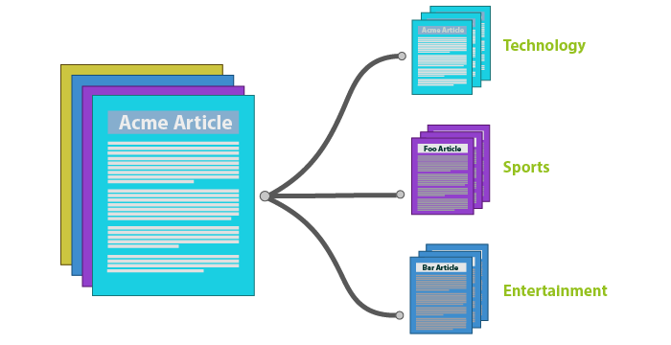
Introduction
Using a Machine Learning model to classify text data/documents online will save a lot of time and resources.
Classification tasks that would take humans weeks to complete can be done in hours by a computer with a good ML model.

Slide 4
Introduction
Purpose:
If an organization or an individual wants to integrate text classification tasks into their product or application, they would have to start collecting data, hire skilled ML engineers, spend a lot of money and time building out an effective and accurate model.
All of that can be avoided when companies just use the APIs provided by Context Analyzer.
The purpose of this project was to automate certain NLP tasks and also provide them as services through APIs.
Integrating APIs is much cheaper and faster than building an entire team to carry out these tasks.

Slide 5
Introduction
Scope:
The main users of this project will be those looking to integrate NLP tasks into their application with very little effort or resources
The sentiment analysis API can be used for predicting sentiments from the data that you get from social media platforms, reviews on products, etc.
Category prediction is a multi-class classification task that can be used on news articles or blogs to classify them into different categories like politics, entertainment, sports, health etc.
The spam detection API allows users to determine whether a message is spam

Slide 6
Literature Survey
A lot of research is being done every day in NLP. Providing NLP APIs is a complex task.
Tensorflow.js with Node.js can be used to build such APIs.
Tensorflow.js allows us to interact with ML models directly from the browser.
Tensorflow.js was only running on experimental Node.js for a long time. Currently only Google provides NLP APIs built on Tensorflow.js.

Slide 7
Literature Survey
Papers
Title: Recurrent Neural Network for Text Classification with Multi-Task Learning
Authors: Pengfei Liu, Xipeng Qiu, Xuanjing Huang
Publication: arXiv:1605.05101 [cs.CL] 2016
Summary: The paper mainly talks about using a multi-task learning framework to jointly learn across multiple related tasks. The goal is to prove that their proposed model can improve the performance of a task with the help of other related tasks. They achieve this by introducing three RNN based architectures. The differences among them are only the mechanisms of sharing information among several tasks.

Slide 8
Literature Survey
Title: Long Short-Term Memory
Authors: Sepp Hochreiter, Jurgen Schmidhuber
Publication: Neural Computation 9(8):1735-1780, 1997
Summary: This paper introduces Long Short Term Memory for the first time. It aims to solve the problems with back propagation over time, and it does. The authors have given a detailed architecture and conducted experiments to prove that LSTM is better than traditional RNNs. Their experiments showed that LSTM also leads to more successful runs and learns much faster.

Slide 9
Literature Survey
Existing APIs / Libraries:
Google Cloud Natural Language API makes use of Tensorflow.js with Node.js to provide NLP services.
OpenNLP, Stanford NLP provide NLP libraries that can be integrated with a given language.
TextRazor provides NLP APIs but it is not built using Tensorflow.js.

Slide 10
Proposed System
The application consists of three different models; all built using CNNs.
The three models are trained on IMDB reviews dataset, huffPost news dataset, and SMS spam dataset.
The models are going to be used for sentiment analysis, category prediction, and spam detection respectively.
To provide these services as APIs, Node.js, along with its integration of Tensorflow.js-node will be used.
This means most of the tasks will be done on the browser itself.
The web-app also provides a UI for the above mentioned tasks. This UI can be used by one time users.

Slide 11
Tools and Technologies
Front-end
HTML5, CSS3, Handlebars.js v4.1.x
Back-end
Node.js v13 or higher, Express.js v4.17.x
Languages and Libraries
Python 3.6, Tensorflow.js-node v1.7.x
Code Editor
Visual Studio Code

Slide 12
Functional Requirements
Data Collection
Download the BBC News, imdb reviews, sms spam datasets.
Pre-Processing
Clean the input data. Tokenize the data to turn it into a single Tensor.
Train the model using the pre-processed dataset
Train Keras sequential model using appropriate parameters.
Test the model for accuracy scores
The trained model is used to make predictions. The predictions are used to calculate accuracy scores.
Server side preprocessing
The user inputs text data that has to be converted to a tensor. This needs the same pre-processing techniques.
Probability score output to human readable class
The model returns a probability score as output that has to be shown as human readable class.

Slide 13
Non-functional Requirements
Scaling: Using technologies like Node.js with Tensorflow.js which allows for the web application to be scaled easily.
Performance: Increase accuracy of predictions by tuning hyper-parameters. Use the ability to run things faster with asyncrhronous programming.
Availability: Ensure that the web-app is always functional and available to use for the users. The server handling the API requests must always be up. Any sort of downtime will cause inconvenience to users.
Maintenance: Checking the functionality of the application from time to time to ensure it is working properly. Updating deprecated functions in various libraries.

Slide 14
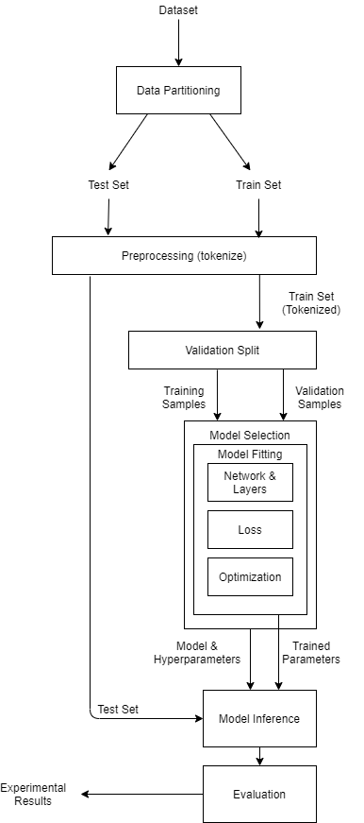
Flow Diagram – ML View

Slide 15
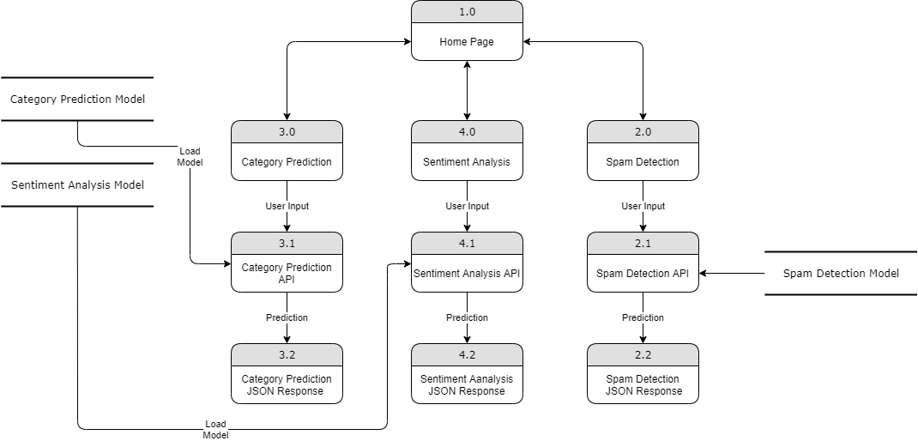
Data Flow Diagram – Web App View

Slide 16
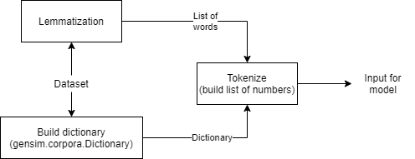
Detailed Methodology
How the text is pre-processed

Slide 17
Detailed Methodology
How the text is pre-processed
The datasets contain text data that need some pre-processing. The neural network does not take in raw text data as input, so we need to convert this text data into a sequence of numbers (or a tensor) which is the appropriate input for the neural network.
A dictionary of words in the datasets are built first. If the dictionary is not built, new text inputs will be stored as [0, 0, 1, 2, 3, 4, etc.]. This leads to wrongful predictions.
The list of words is then passed to a function that tokenizes it. Tokenizing is converting the list of words into sequences of numbers so that they can be used as input to the neural network.

Slide 18
Detailed Methodology
Convolutional Neural Network
Convolutional Neural Networks are specialized neural networks that take in input as a 2D matrix. In the case of NLP, the input will be text data, this is converted into a sequence of numbers in the preprocessing section and used as input to the CNN.
Each row of the matrix corresponds to one token, typically a word, but it could be a character. That is, each row is vector that represents a word.

Slide 19
Detailed Methodology
LSTM (Long Short Term Memory)
For certain tasks, we only need to look at recent information to perform the present task.
For example, consider a language model trying to predict the next word based on the previous ones. If we are trying to predict the last word in “the clouds are in the sky,” we don’t need any further context – it’s pretty obvious the next word is going to be sky.
In such cases, where the gap between the relevant information and the place that it’s needed is small, RNNs can learn to use the past information.

Slide 20
Detailed Methodology
LSTM (Long Short Term Memory)
There are also cases where we need more context.
Consider trying to predict the last word in the text “I grew up in France… I speak fluent French.” Recent information suggests that the next word is probably the name of a language, but if we want to narrow down which language, we need the context of France, from further back.
It’s entirely possible for the gap between the relevant information and the point where it is needed to become very large.
Unfortunately, as that gap grows, RNNs become unable to learn to connect the information.

Slide 21
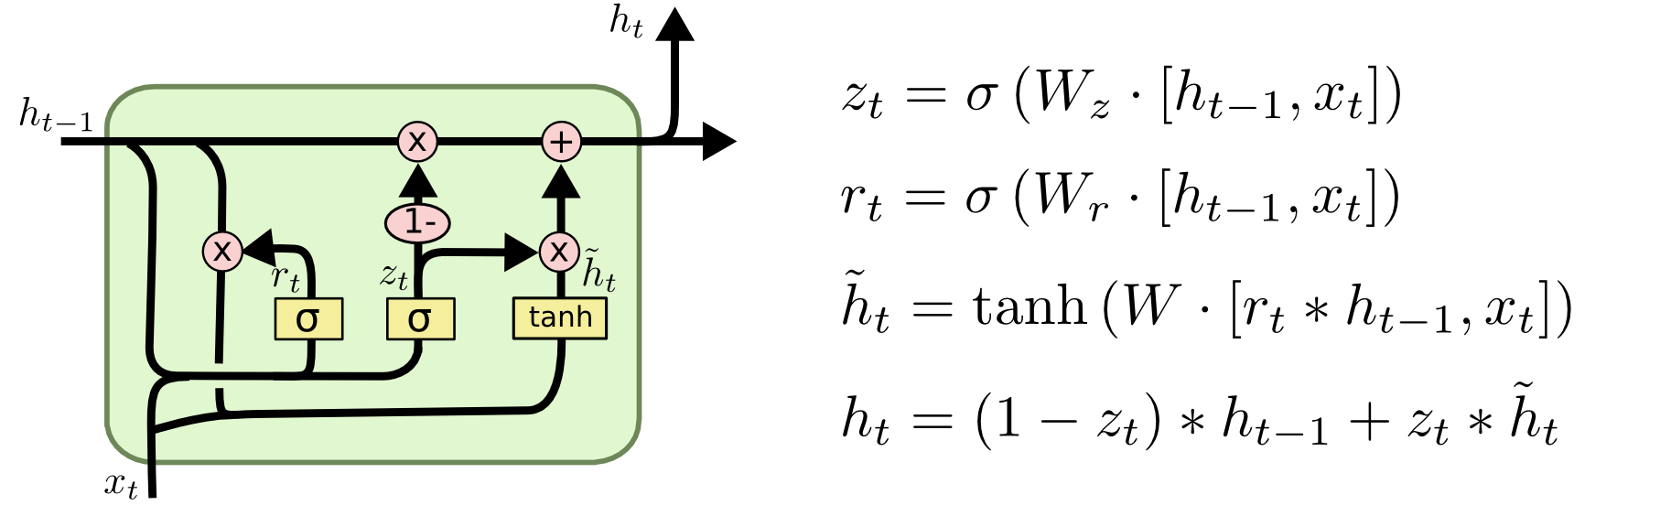
Detailed Methodology
LSTM (Long Short Term Memory)
LSTMs are explicitly designed to avoid the long-term dependency problem. Remembering information for long periods of time is practically their default behavior, not something they struggle to learn.

Slide 22
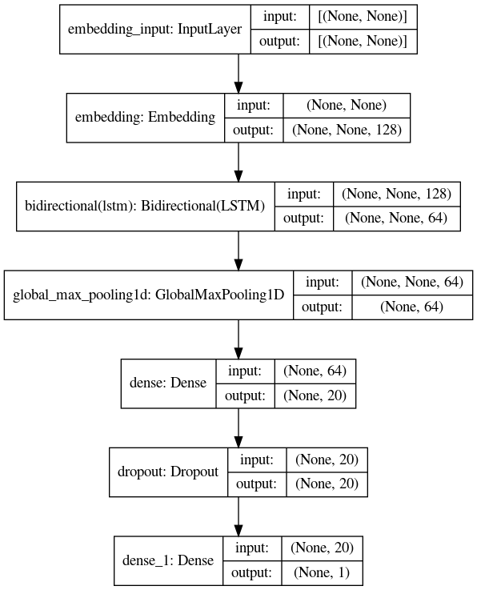
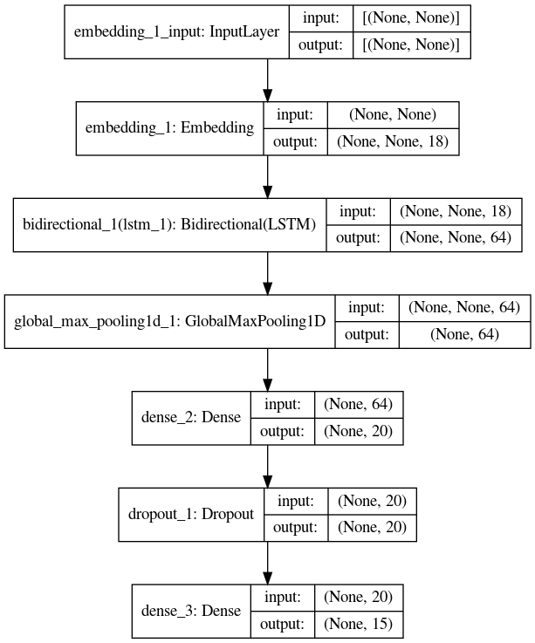
Model Generation – Sentiment Analysis Model
Category Classification Model

Slide 23
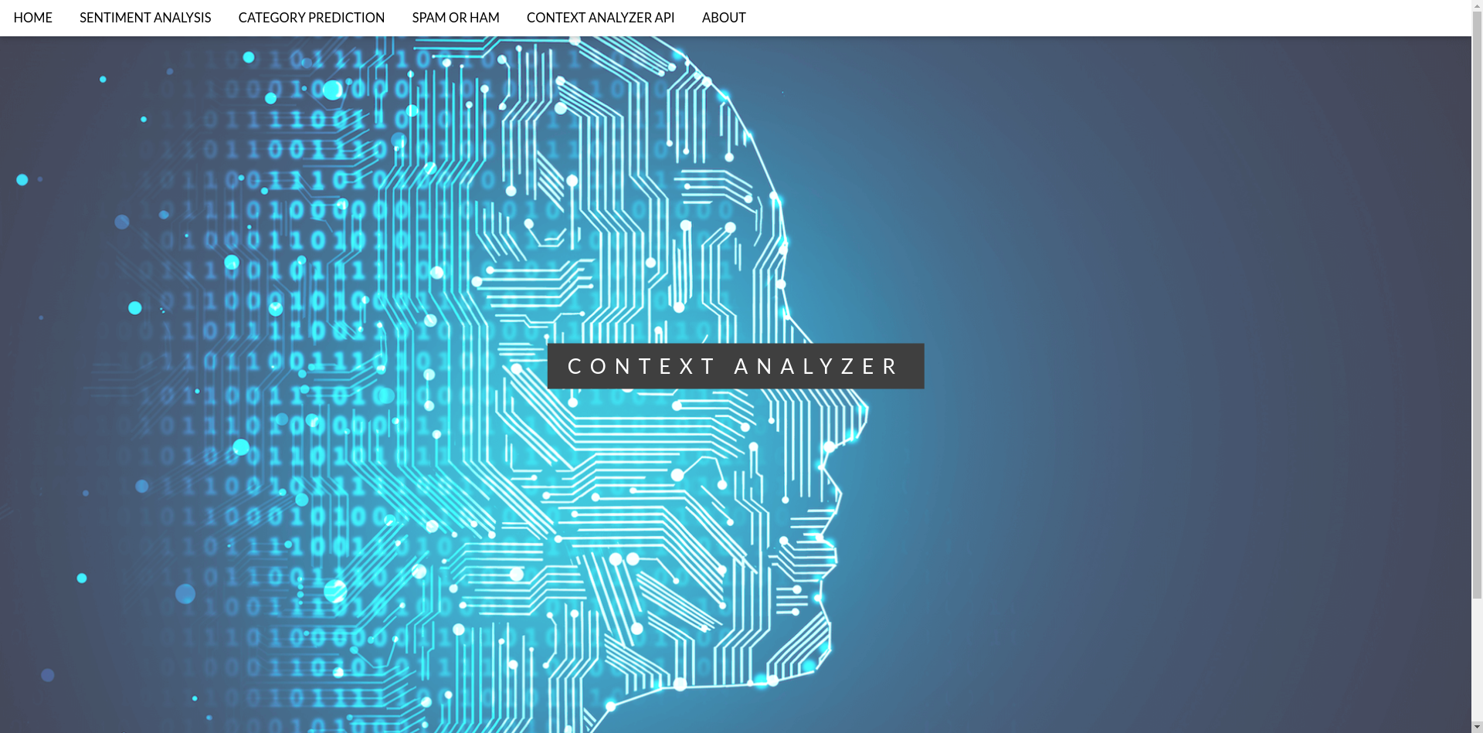
Screenshots
Home Page

Slide 24
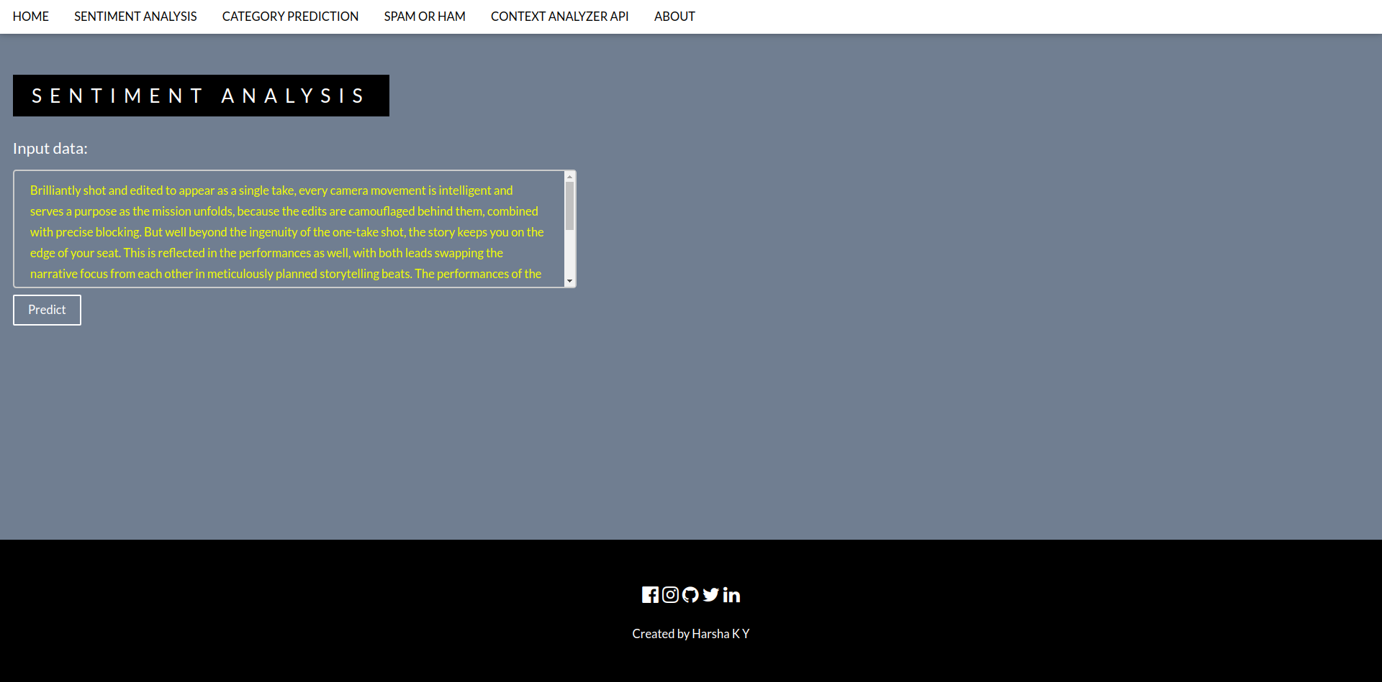
Screenshots
Sentiment Analysis

Slide 25
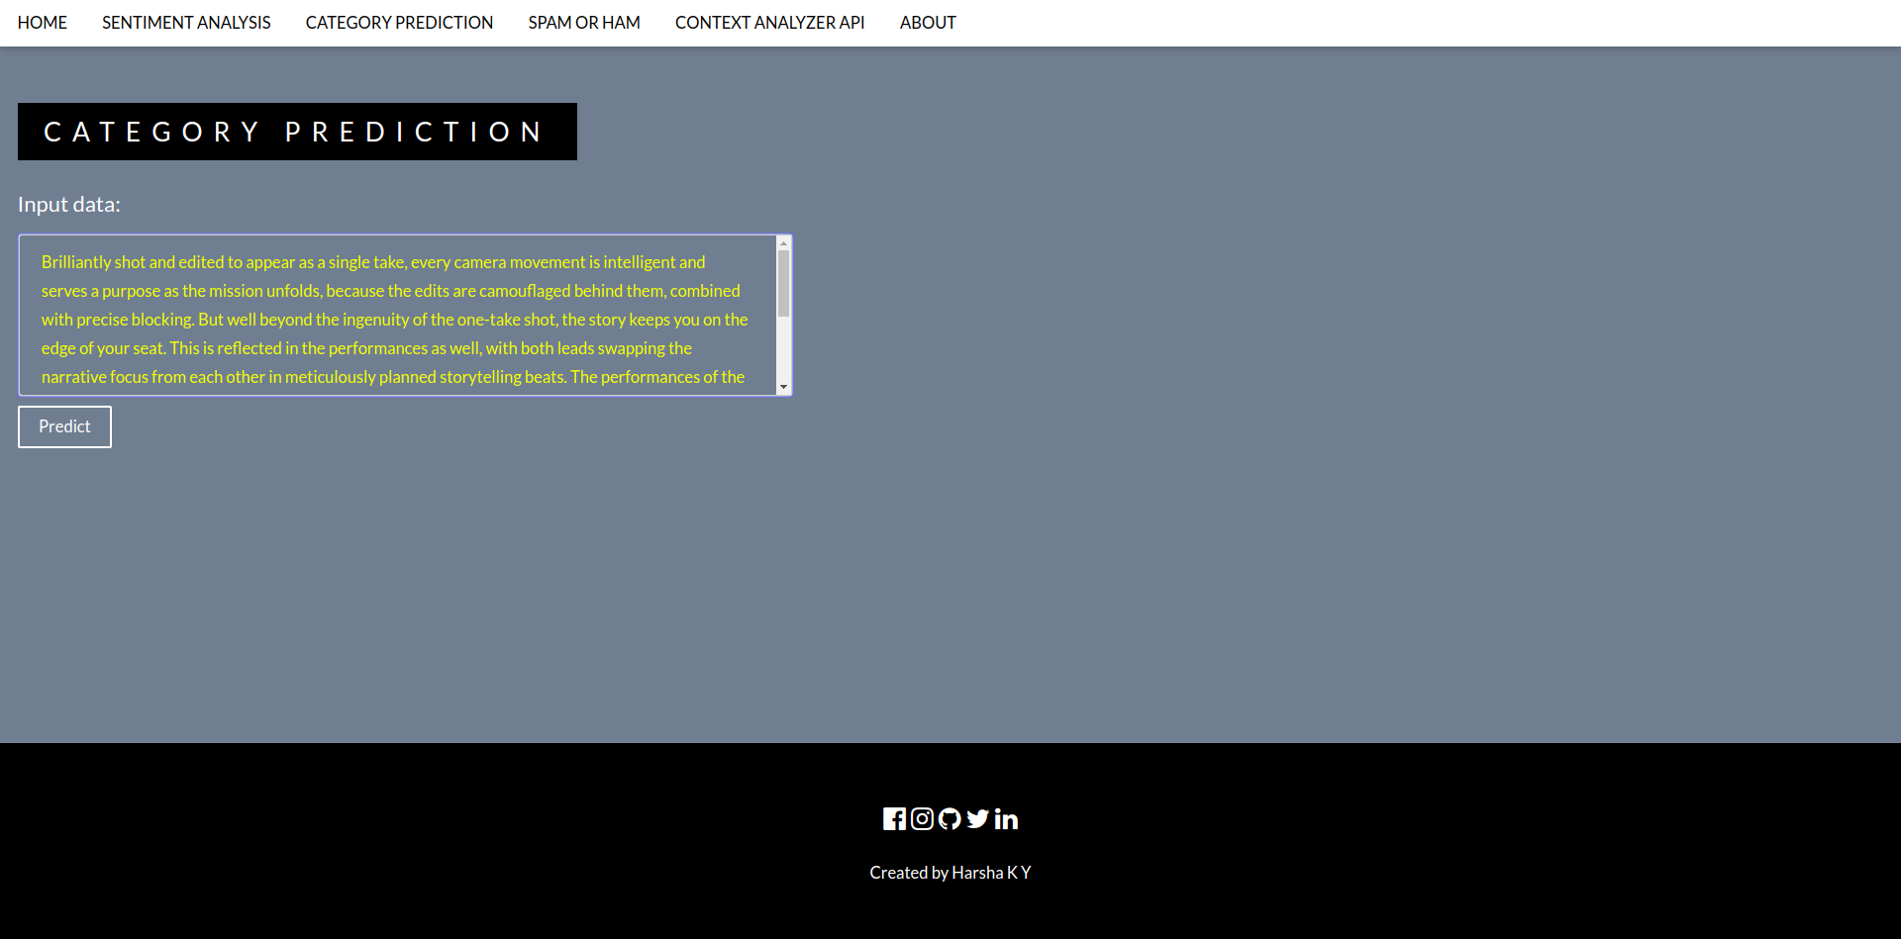
Screenshots
Category Prediction

Slide 26
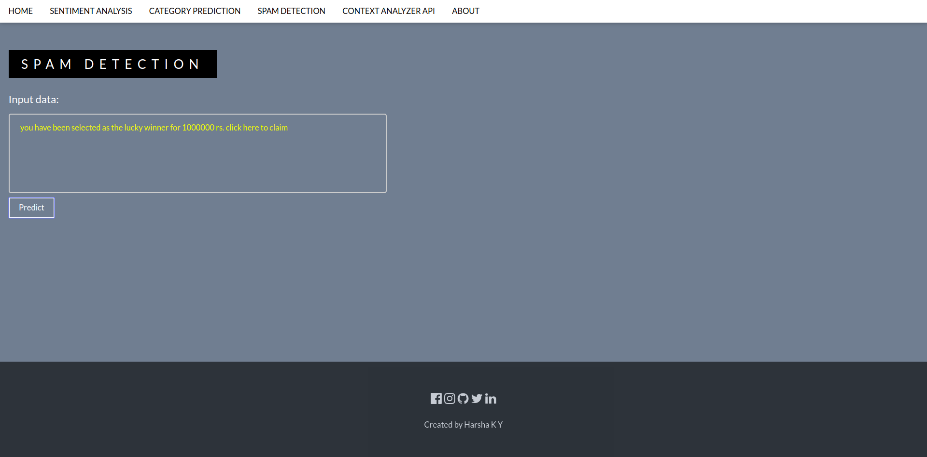
Screenshots
Spam Detection

Slide 27
Testing
Performed API testing on all the routes in the application
Used Postman to simulate the GET and POST requests
Screenshots of test cases in the following slides...

Slide 28
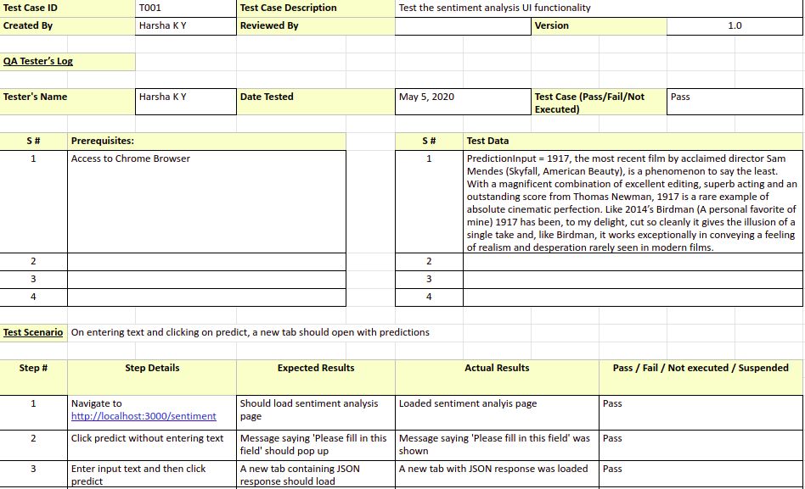
Testing
Test case T001

Slide 29
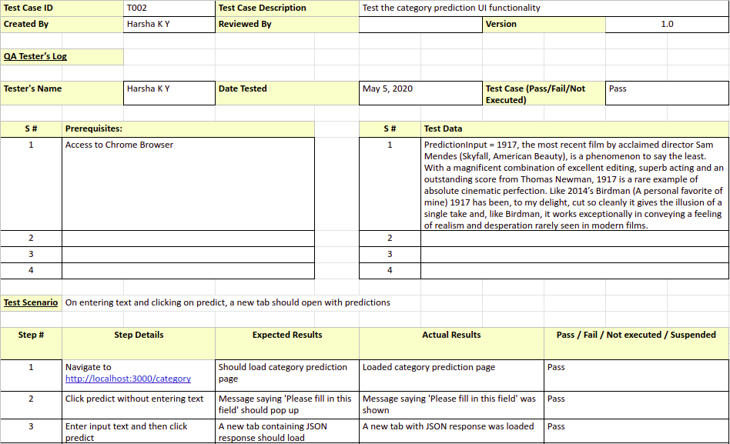
Testing
Test case T002

Slide 30
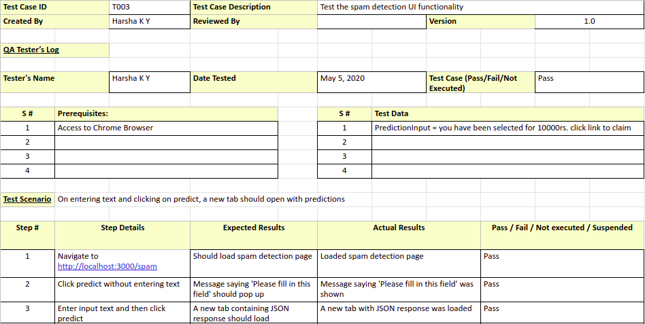
Testing
Test case T003

Slide 31
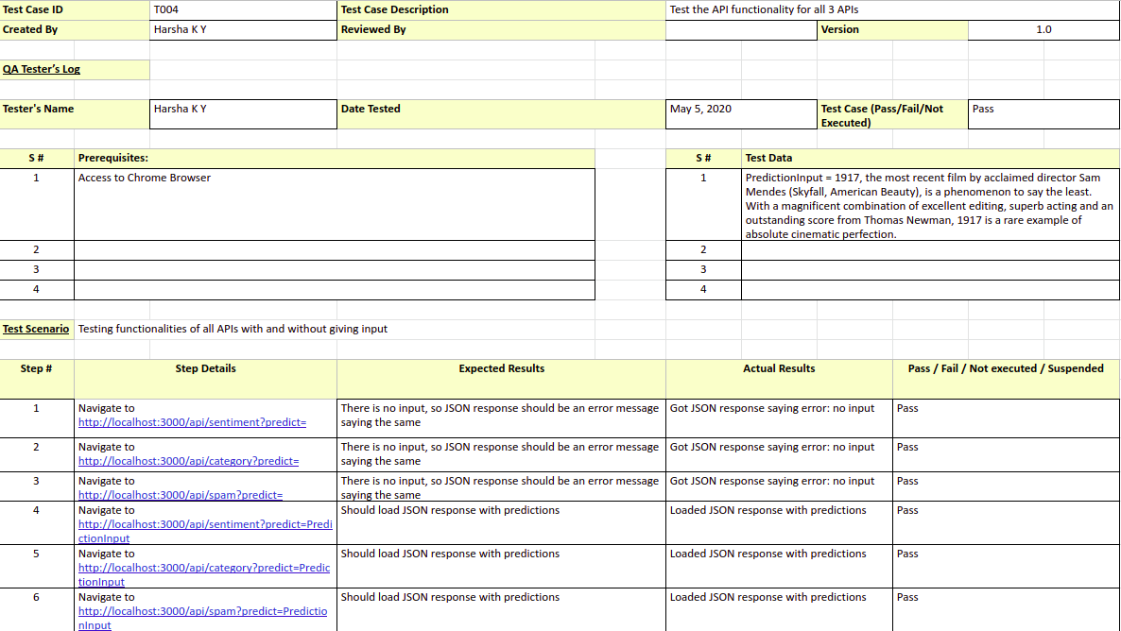
Testing
Test case T004

Slide 32
Conclusion
The goal of this project from the start was to build reliable, accurate APIs for NLP tasks.
After achieving that for 3 different tasks; Sentiment Analysis, Category Prediction, Spam Detection, it is safe to say that ML APIs are going to dominate in the near future.
It is very easy for users to just integrate APIs for NLP tasks than build them from scratch.
The tools and technologies used to build this application allow for easy integration of new features and new APIs.
I have also provided a page with documentation for the API, users are going to find it easy to make use of my APIs.
Since most of the tasks are done on the browser itself, it requires very less computation power. This means that the APIs can be easily used for predictions on mobile devices as well.

Slide 33
Future Enhancements
The accuracy can and should increase.
The API itself should provide more features. Features like text labeling, summary generation, etc. should be implemented.
Users and API keys specific to the user must be set up. As of now, the APIs are free for all and not specific to the users.
Develop APIs for more NLP tasks.

Slide 34
Bibliography
Marc Moreno Lopez, Jugal Kalita, Deep Learning Applied to NLP, arXiv:1703.03091v1 [cs.CL] 2017
Pengfei Liu, Xipeng Qiu, Xuanjing Huang, Recurrent Neural Network for Text Classification with Multi-Task Learning, arXiv:1605.05101 [cs.CL] 2016
Sepp Hochreiter, Jurgen Schmidhuber, Long Short Term Memory, Neural Computation 9(8):1735-1780, 1997
Tensorflow.js - https://www.tensorflow.org/js
Node.js - https://nodejs.org/en/docs/
hbs - https://nodejs.org/en/docs/
Express.js - https://expressjs.com/en/5x/api.html
Keras - https://keras.io/api/
Gensim - https://radimrehurek.com/gensim/auto_examples/index.html
The imdb reviews dataset - https://www.kaggle.com/lakshmi25npathi/imdb-dataset-of-50k-movie-reviews
The news dataset - https://www.kaggle.com/rmisra/news-category-dataset
The spam detection dataset - https://www.kaggle.com/uciml/sms-spam-collection-dataset

Slide 35
Thank You

