Slide 1
Context Analyzer A text classification web-app using NLP
Guide
Mr. Tamal Dey,
Assistant Professor,
Dept. Of Computer Applications,
PES University
By
Harsha K Y
PES1201801839

Slide 2
Abstract
Context Analyzer is a text classification application used to classify text into genres like Sports, Business, Technology, Politics, etc..
It provides APIs for text classification.
Input can be a pdf, txt document or a piece of text. The trained model is then used to sort the text into appropriate classes.
Sentiment analysis API can be used to analyze tweets, reviews, and categorize them into positive, negative, neutral.
A lot of data being generated today consists of unstructured text data.
NLP helps us build models that lets computers make sense of the text data.

Slide 3
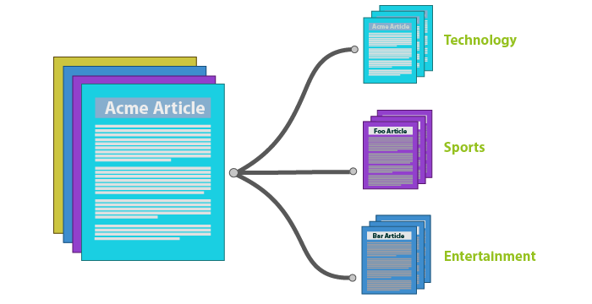
Introduction
Using a Machine Learning model to classify text data/documents online will save a lot of time and resources.
Classification tasks that would take humans weeks to complete can be done in hours by a computer with a good ML model.

Slide 4
Introduction
Purpose:
Text classification is a very important task in supervised machine learning.
A piece of text is assigned to one or more classes or categories. This can be done either manually or using ML algorithms.
Context Analyzer uses one such ML algorithm so solve this classification problem.
The best way to build APIs currently is to use an efficient language like JavaScript with its Node.js runtime. The integration of Tensorflow.js with Node.js allows us to build highly scalable and robust APIs.
Scope:
The application provides text classification services through APIs.
Sentiment analysis can be done on data from social media platforms, reviews on things like movies, food, productions on an online store etc..
Multi-class classification can be done on news articles, articles related to technology.

Slide 5
Literature Survey
A lot of research is being done every day in NLP. Providing NLP APIs is a complex task.
Tensorflow.js with Node.js can be used to build such APIs.
Tensorflow.js allows us to interact with ML models directly from the browser. This is what makes it currently the best library for building NLP APIs.
Since Tensorflow.js still only runs on experimental Node.js. Currently only Google provides NLP APIs built on Tensorflow.js.

Slide 6
Literature Survey
Papers
Title: Recurrent Neural Network for Text Classification with Multi-Task Learning
Authors: Pengfei Liu, Xipeng Qiu, Xuanjing Huang
Summary: Neural network based methods have obtained great progress on a variety of natural language processing tasks. However, in most previous works, the models are learned based on single-task supervised objectives, which often suffer from insufficient training data. In this paper, we use the multitask learning framework to jointly learn across multiple related tasks. Based on recurrent neural network, we propose three different mechanisms of sharing information to model text with task-specific and shared layers. The entire network is trained jointly on all these tasks. Experiments on four benchmark text classification tasks show that our proposed models can improve the performance of a task with the help of other related tasks.

Slide 7
Literature Survey
Title: Long Short-Term Memory
Authors: Sepp Hochreiter, Jurgen Schmidhuber
Summary: Learning to store information over extended time intervals via recurrent backpropagation takes a very long time, mostly due to insufficient, decaying error back flow. We briefly review Hochreiter's 1991 analysis of this problem, then address it by introducing a novel, efficient, gradient-based method called "Long Short-Term Memory" (LSTM). Truncating the gradient where this does not do harm, LSTM can learn to bridge minimal time lags in excess of 1000 discrete time steps by enforcing constant error flow through "constant error carrousels" within special units. Multiplicative gate units learn to open and close access to the constant error flow. LSTM is local in space and time; its computational complexity per time step and weight is O(1). Our experiments with artificial data involve local, distributed, real-valued, and noisy pattern representations. In comparisons with RTRL, BPTT, Recurrent Cascade-Correlation, Elman nets, and Neural Sequence Chunking, LSTM leads to many more successful runs, and learns much faster. LSTM also solves complex, artificial long time lag tasks that have never been solved by previous recurrent network algorithms.

Slide 8
Literature Survey
Existing Systems:
Google Cloud Natural Language API makes use of Tensorflow.js with Node.js to provide NLP services.
OpenNLP, Stanford NLP provide NLP libraries that can be integrated with a given language.
TextRazor provides NLP APIs but it is not built using Tensorflow.js.
Proposed System:
Context Analyzer makes use of tfjs with Node.js. Meaning, it does not depend on running python microservices for importing model and preprocessing.
All that is required is a cloud service to host the model.json file and the rest is taken care of by the APIs.
This is better than providing libraries as there is no need to import anything. The only requirement is to make API calls.

Slide 9
Tools and Technologies
Front-end
HTML, CSS, Handlebars.js
Back-end
Node.js, Express.js
Languages and Libraries
Python 3, Tensorflow.js
Code Editor
Visual Studio Code

Slide 10
Functional Requirements
Pre-Processing
Clean the input data. Tokenize the data to turn it into a single Tensor.
Train the model using the pre-processed dataset
Train Keras sequential model using appropriate parameters.
Test the model for accuracy scores
The trained model is used to make predictions. The predictions are used to calculate accuracy scores.
Server side preprocessing
The user inputs text data that has to be converted to a tensor. This needs the same pre-processing techniques.
Probability score output to human readable class
The model returns a probability score as output that has to be shown as human readable class.

Slide 11
Non-functional Requirements
Scaling: To be able to build more NLP APIs for different tasks.
Performance: Increase accuracy of the predictions.
Availability: To make sure that the web-app is always functioning properly and available to its users.
Maintenance: Future updates must be smooth. Should work well with future versions of the technologies used.

Slide 12
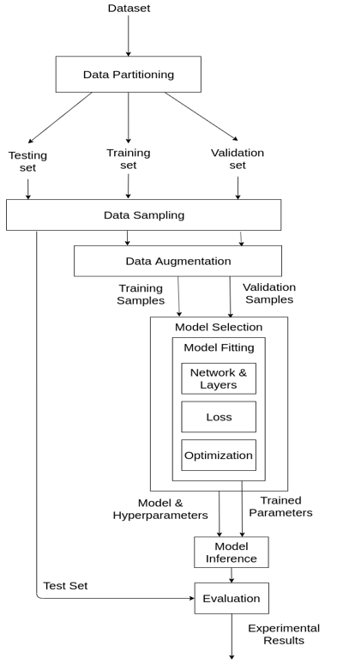
Flow Diagram – ML View

Slide 13
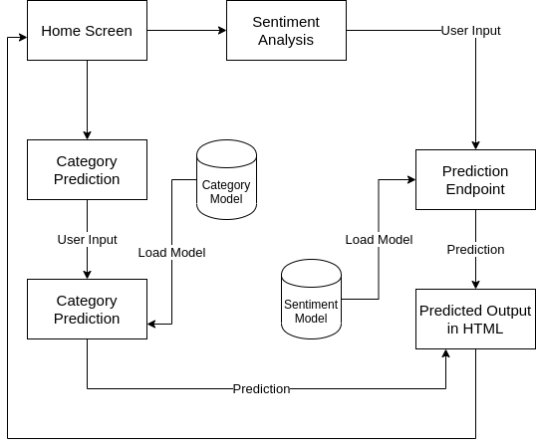
Flow Diagram – Web App View

Slide 14
Detailed Methodology
How the text is pre-processed
The datasets contain text data that need some pre-processing. The neural network does not take in raw text data as input, so we need to convert this text data into a sequence of numbers (or a tensor) which is the appropriate input for the neural network.
A dictionary of words in the datasets are built first. If the dictionary is not built, new text inputs will be stored as [0, 0, 1, 2, 3, 4, etc.]. This leads to wrongful predictions.
The text data is then passed to another function which does lemmatization. Lemmatization is removing connectors in sentences like and, it, there and simplifies words like "do, done, doing, did" into "do".
This list of words is then passed to another function that tokenizes it. Tokenizing is converting the list of words into sequences of numbers so that they can be used as input to the neural network.

Slide 15
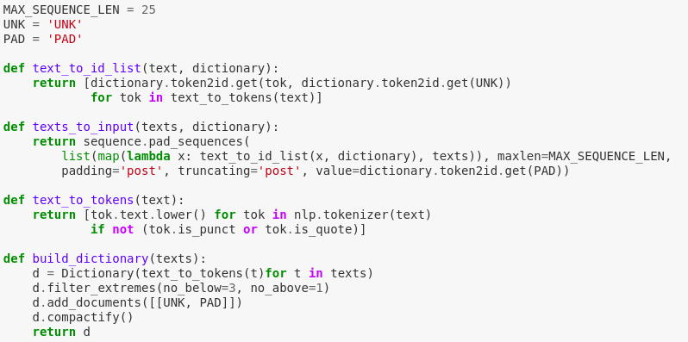
Detailed Methodology
How the text is pre-processed

Slide 16
Detailed Methodology
The Neural Network
Convolutional Neural Networks are specialized neural networks that take in input as a 2D matrix. In the case of NLP, the input will be text data, this is converted into a sequence of numbers in the preprocessing section and used as input to the CNN.
Each row of the matrix corresponds to one token, typically a word, but it could be a character. That is, each row is vector that represents a word.

Slide 17
Detailed Methodology
LSTM (Long Short Term Memory)
Sometimes, we only need to look at recent information to perform the present task.
For example, consider a language model trying to predict the next word based on the previous ones. If we are trying to predict the last word in “the clouds are in the sky,” we don’t need any further context – it’s pretty obvious the next word is going to be sky.
In such cases, where the gap between the relevant information and the place that it’s needed is small, RNNs can learn to use the past information.

Slide 18
Detailed Methodology
LSTM
But there are also cases where we need more context.
Consider trying to predict the last word in the text “I grew up in France… I speak fluent French.” Recent information suggests that the next word is probably the name of a language, but if we want to narrow down which language, we need the context of France, from further back.
It’s entirely possible for the gap between the relevant information and the point where it is needed to become very large.
Unfortunately, as that gap grows, RNNs become unable to learn to connect the information.

Slide 19
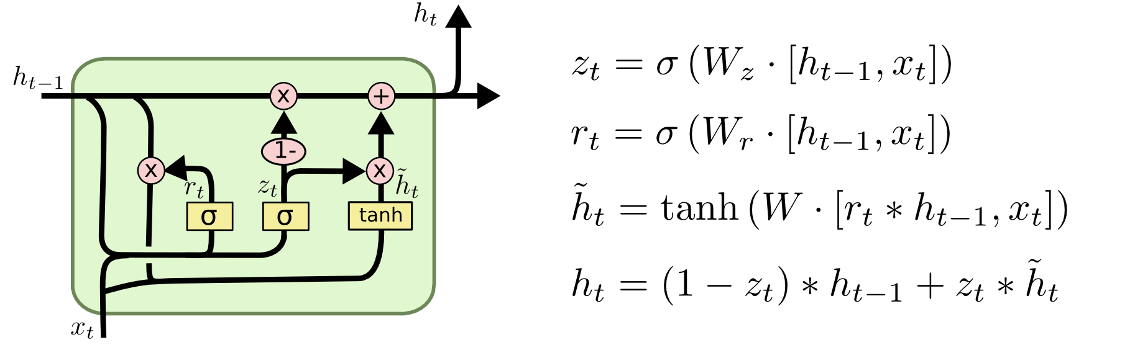
Detailed Methodology
LSTM (Long Short Term Memory)
LSTMs are explicitly designed to avoid the long-term dependency problem. Remembering information for long periods of time is practically their default behavior, not something they struggle to learn.

Slide 20
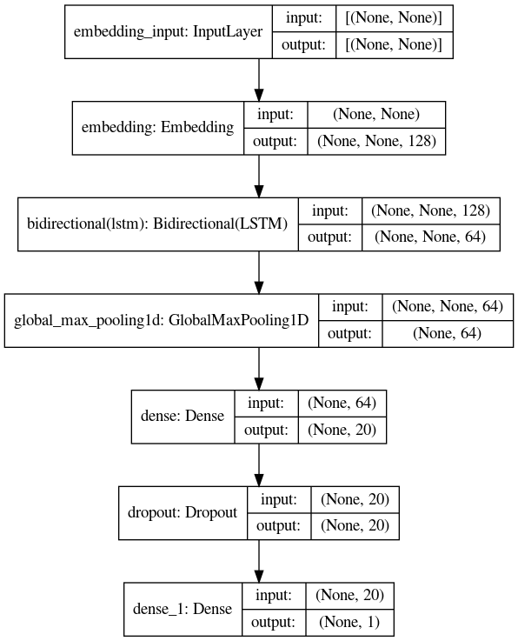
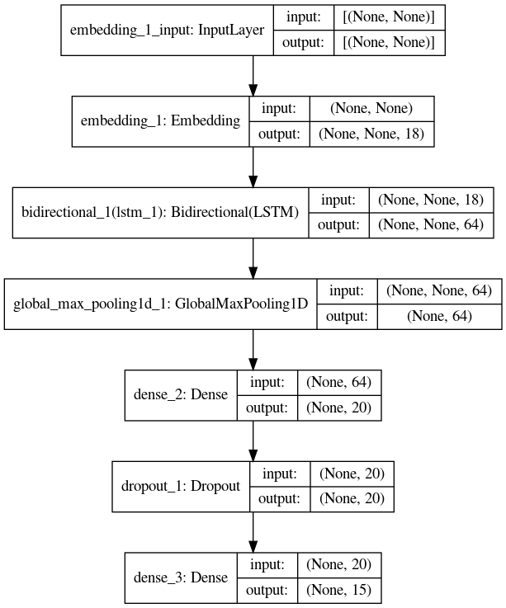
Model Generation – Sentiment Analysis Model
Category Classification Model

Slide 21
Modules
Data Gathering
Get the BBC News, imdb reviews datasets
Data Cleaning/Pre-processing
Preparing the dataset using NLTK and split it for training and testing
Initialize Model
Select the best model for the task at hand
Training the Model
Feed the train data to the model
Model Evaluation
Measure the accuracy of the trained model
Make Predictions
Use the trained model to make predictions

Slide 22
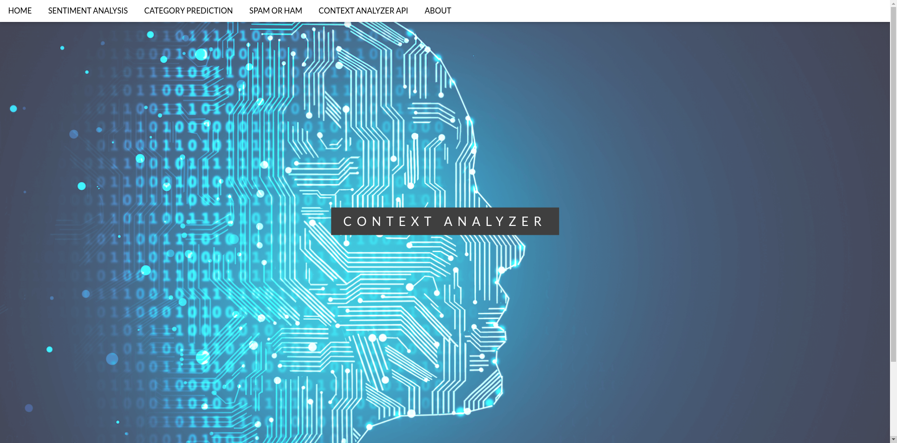
Screenshots
Home Page

Slide 23
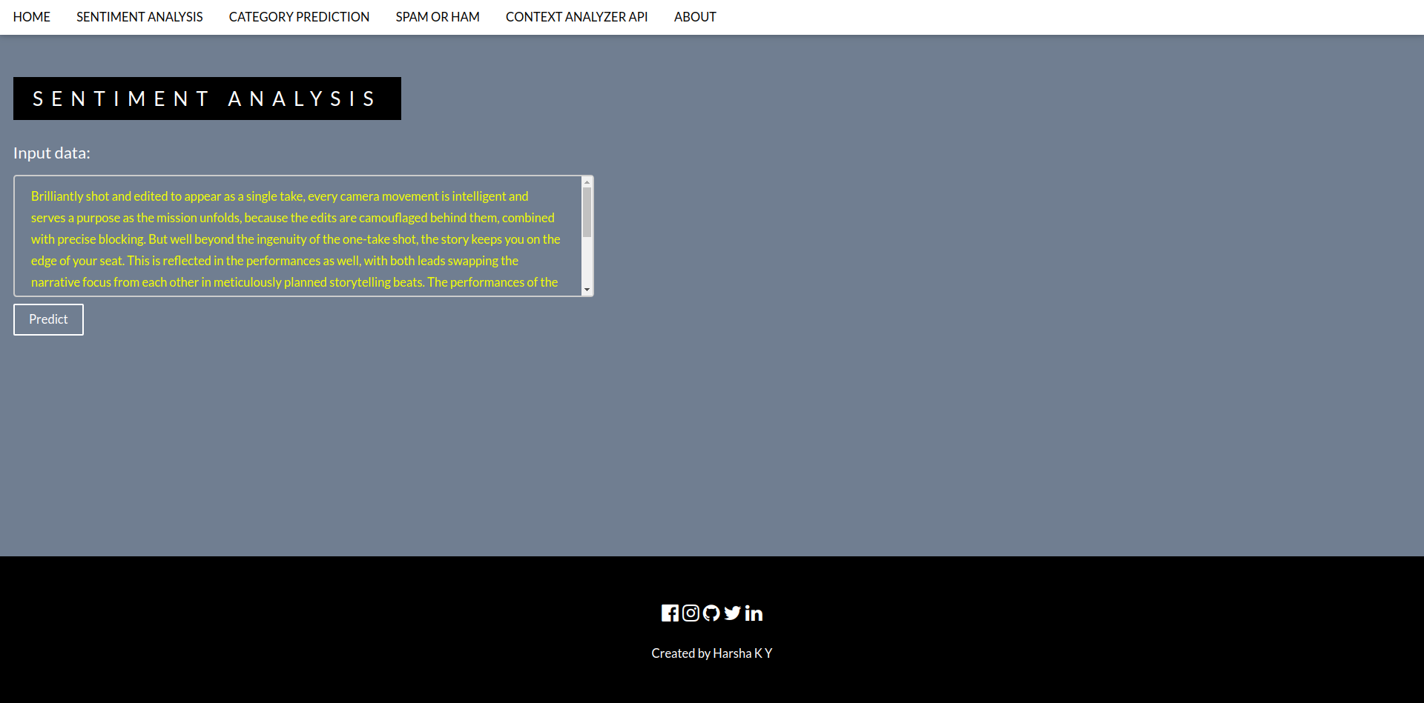
Screenshots
Sentiment Analysis

Slide 24
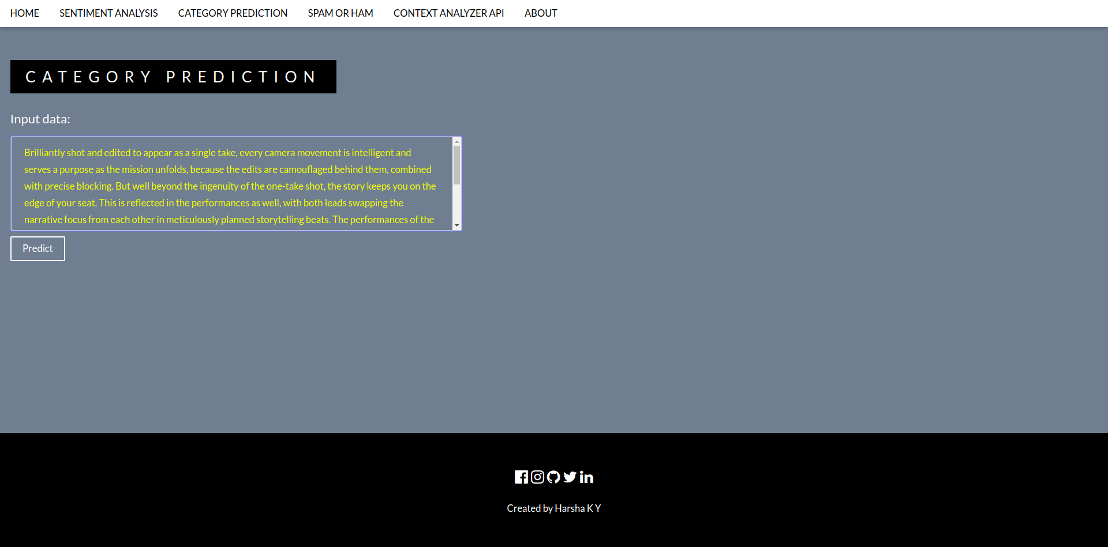
Screenshots
Category Prediction

Slide 25
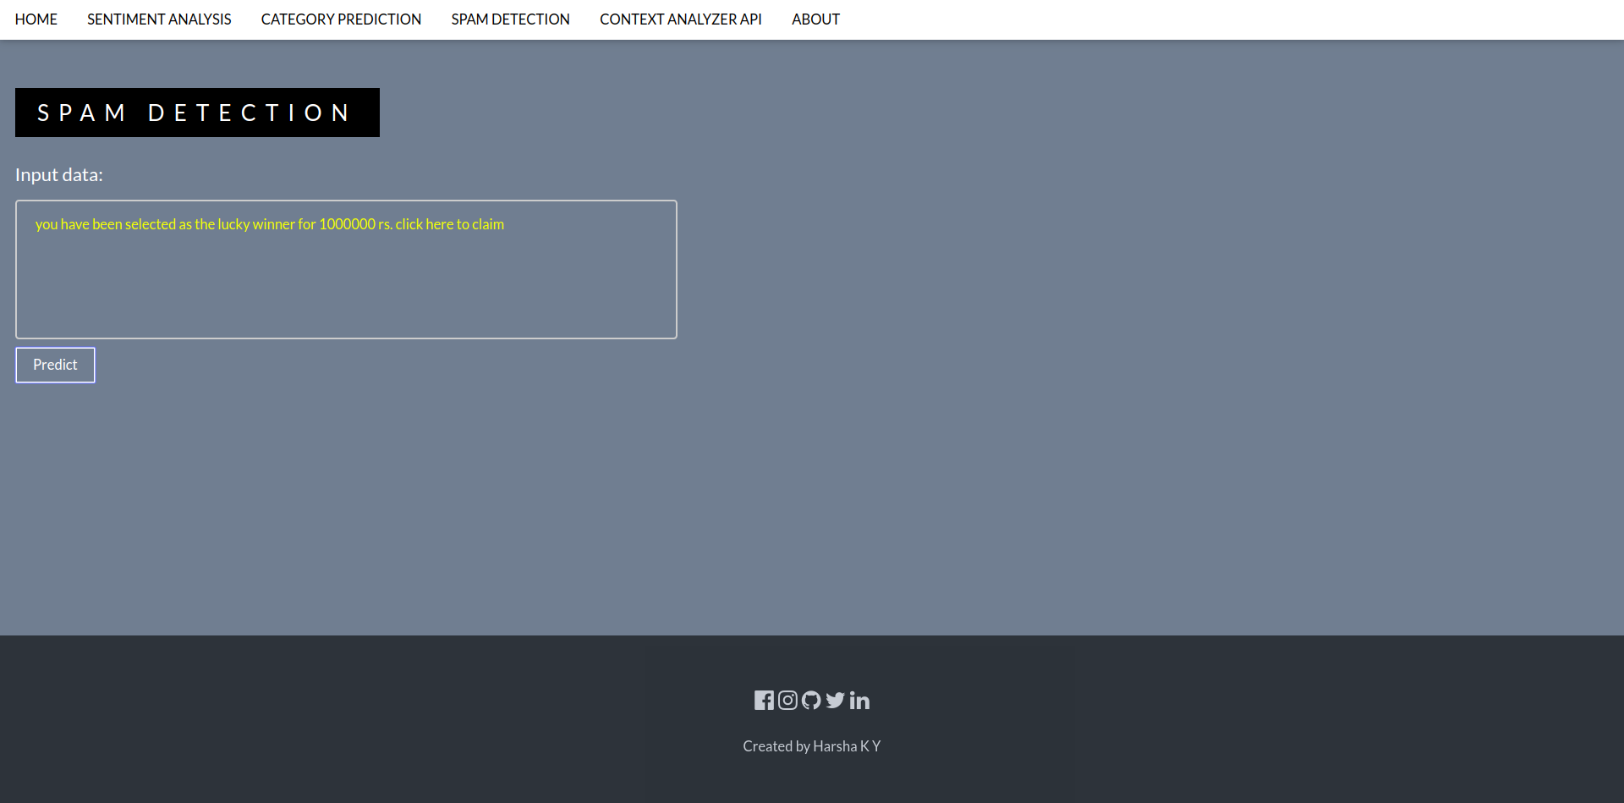
Screenshots
Spam Detection

Slide 26
Testing
Did API testing on all the routes in the application
Used Postman to simulate the GET and POST requests
Screenshots of test cases in the following slides...

Slide 27
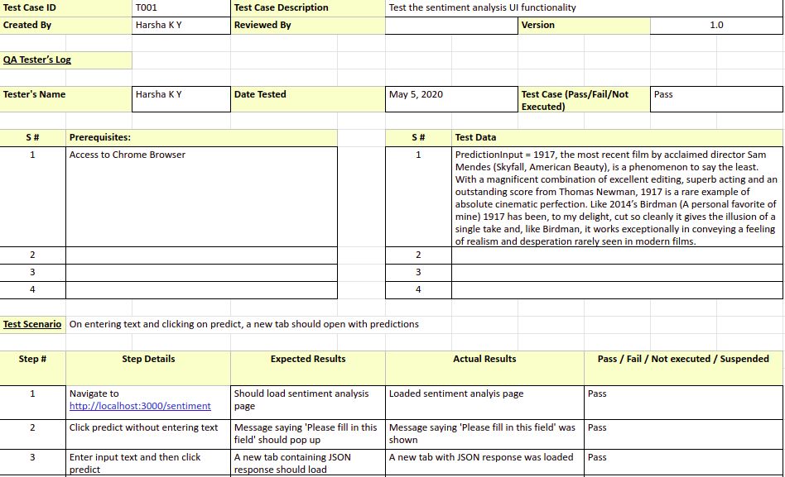
Testing
Test case T001

Slide 28
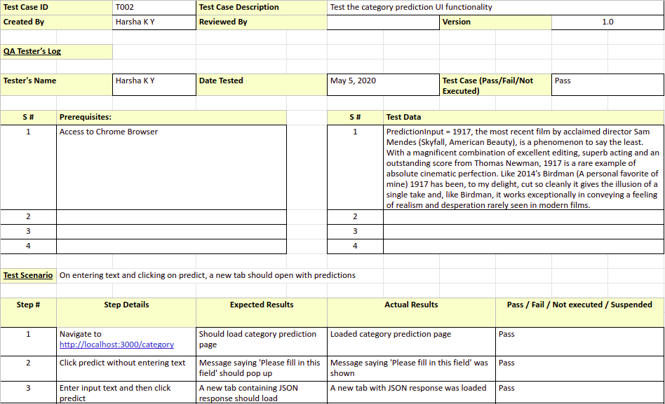
Testing
Test case T002

Slide 29
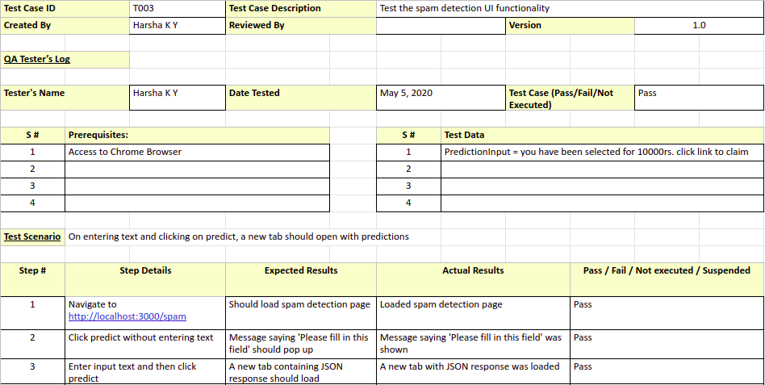
Testing
Test case T003

Slide 30
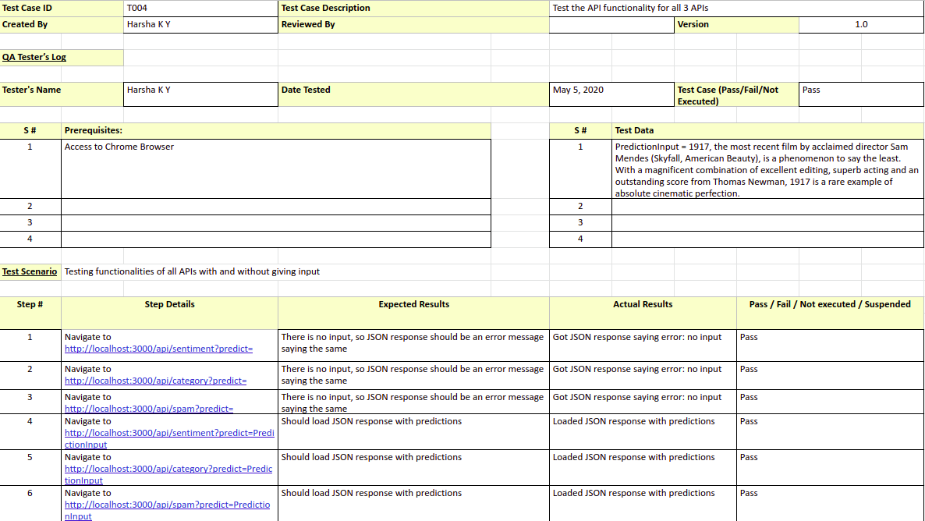
Testing
Test case T004

Slide 31
Conclusion
The goal of this project from the start was to build reliable, accurate APIs for NLP tasks.
Having achieved that for 3 different tasks; Sentiment Analysis, Category Prediction, Spam Detection, it is safe to say that ML APIs are going to dominate in the near future.
It is very easy for users to just integrate APIs for NLP tasks than build them from scratch.
The tools and technologies used to build this application allow for easy integration of new features and new APIs.
Having provided a page with documentation for the API, users are going to find it easy to make use of my APIs.
Since most of the tasks are done on the browser itself, it requires very less computation power. This means that the APIs can be easily used for predictions on mobile devices as well.

Slide 32
Future Enhancements
There is a lot of potential still left for the project to fulfill.
The accuracy can and should increase.
The API itself should provide more features. Features like text labeling, summary generation, etc. should be implemented.
Users and API keys specific to the user must be set up. As of now, the APIs are free for all and not specific to the users.
Develop APIs for more NLP tasks.

Slide 33
Bibliography
Marc Moreno Lopez, Jugal Kalita – Deep Learning Applied to NLP – ArXiv 2017
Pengfei Liu, Xipeng Qiu, Xuanjing Huang - Recurrent Neural Network for Text Classification with Multi-Task Learning – ArXiv 2016
Tensorflow.js - https://www.tensorflow.org/js
Node.js - https://nodejs.org/en/docs/
hbs - https://nodejs.org/en/docs/
Express.js - https://expressjs.com/en/5x/api.html
Keras - https://keras.io/api/
Gensim - https://radimrehurek.com/gensim/auto_examples/index.html
The imdb reviews dataset - https://www.kaggle.com/lakshmi25npathi/imdb-dataset-of-50k-movie-reviews
The news dataset - https://www.kaggle.com/rmisra/news-category-dataset
The spam detection dataset - https://www.kaggle.com/uciml/sms-spam-collection-dataset

Slide 34
Thank You

