Slide 1
F & S
Fitness And Sports For Life

Slide 2
Team Leader And Members
Team Leader :
Members :
Vinay, Harsha, Sudarshan, Pavani, Harshini, Namratha, Supriya, Meenakshi,
Mohith, Akranth, Dikshant, Shriganesh, Naaz.

Slide 3
Content
Objectives.
F&A And Health.
F&A And Diet.
Introduction To AI.
Use Of AI.
AI Tools.

Slide 4
Objective
Fitness and strength have several objectives. They include improving overall health, increasing muscle strength, enhancing endurance, promoting flexibility and achieving specific fitness goals. Regular exercise and strength training can help improve cardiovascular health, build muscle mass, and enhance physical performance. Its important to set specific objectives that align with our personal fitness goals and work towards them consistently.

Slide 5
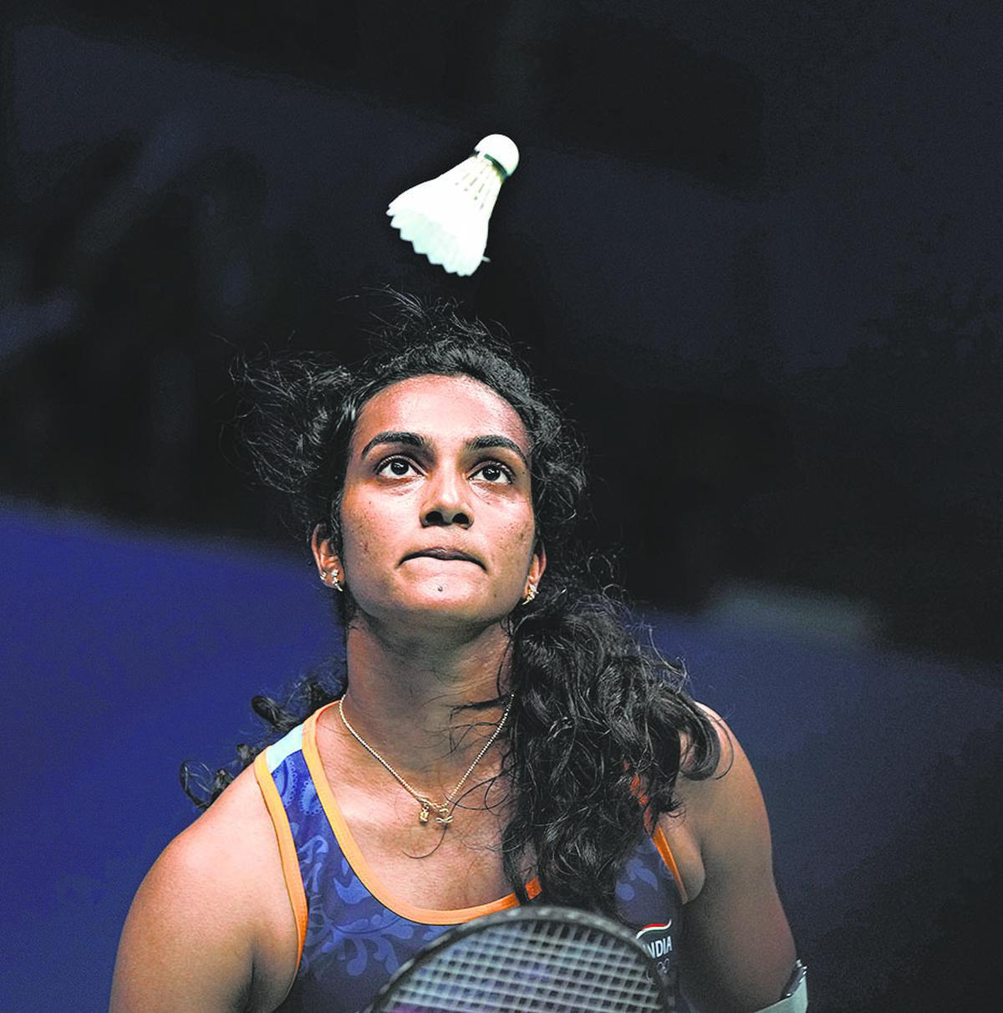
F&S And Health
Regular exercise through sports can help reduce the risk of chronic diseases such as obesity, heart disease, stroke, and diabetes. Sports can also help improve cardiovascular health by strengthening the heart and lungs. Regular exercise can help lower blood pressure, improve blood flow, and reduce the risk of heart attack and stroke. Additionally, sports can help improve bone density, reducing the risk of osteoporosis and bone fractures.

Slide 6
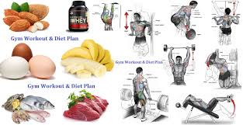
F&S And Diet
A balanced diet should include a combination of carbohydrates, proteins, fats, vitamins, and minerals. Consuming a well-balanced meal a few hours before exercise and refueling with a combination of carbohydrates and protein post-workout can support recovery. A good sport person need healthy diet. Nowadays its very easy to use AI for everything and F&S is no exception.

Slide 7
Introduction To AI
AI technology is used in sports and gyms in various ways. For example, AI can analyze player performance and provide insights to coaches. It can also track and analyze movement patterns to help improve technique. In gyms, AI can create personalized workout plans and provide real-time feedback on form and intensity. It's pretty cool how technology is enhancing our fitness experiences.
In sports, AI technology can be used for performance analysis by collecting data from sensors and cameras. This data is then processed by AI algorithms to provide valuable insights on player performance, such as speed, agility, and accuracy. Coaches can use this information to make data-driven decisions and tailor training programs for individual athletes.

Slide 8
Use Of AI
For a smart workout plan AI algorithm, you can explore approaches like reinforcement learning , where the algorithm learns to recommend exercises based on user feedback and progress. You can also consider supervised learning, using labeled data of successful workout plans and user outcomes to train the model.
Another option is to utilize a combination of rule-based systems and machine learning. The rules can incorporate established principles of fitness, while the machine learning component adapts recommendations based on individual user data.

Slide 9
AI Tools
Bodybuilding.com: This website offers a wide range of resources, including workout plans, nutrition advice, and articles on strength training.
Fitness Blender: Fitness Blender provides free workout videos for all fitness levels, with a focus on strength training, cardio, and flexibility.
Men's Health and Women's Health: These websites offer fitness tips, workout routines, and nutrition advice specifically tailored for men and women, respectively.
Nike Training Club: Nike Training Club provides a variety of workout programs and training plans for all fitness levels, along with instructional videos and tracking features.

Slide 10
Thank You

Slide 11
Sources
https://www.linkedin.com/pulse/importance-sports-physical-mental-health-christian-Gallardo,

