Slide 1
Weather & Hike Trails Web App
- Shweta Korulkar
- Harsha Ramayanam

Slide 2
Weather App
To check weather of any location.
Check weather and check for a hike.

Slide 3
Features
Search weather by City Name.
Geo location
Get 5 days weather forecast
Get 24 hours weather information of given location.
Link to home page and hike page
Changing background image according to weather condition.

Slide 4
Stack
FRONT END → HTML5, CSS3, JAVASCRIPT, ReactJS
BACK END → Node.js, REST API’s
API used: OpenWeatherMap API

Slide 5
Problem
Difficulty with displaying background image according to weather condition.
Tried using getElementById to display background image but didn’t worked.

Slide 6
Solution
Used style attribute to set background image according to weather condition. Also had to import all images in file.

Slide 7
Future work
Animated background image

Slide 8
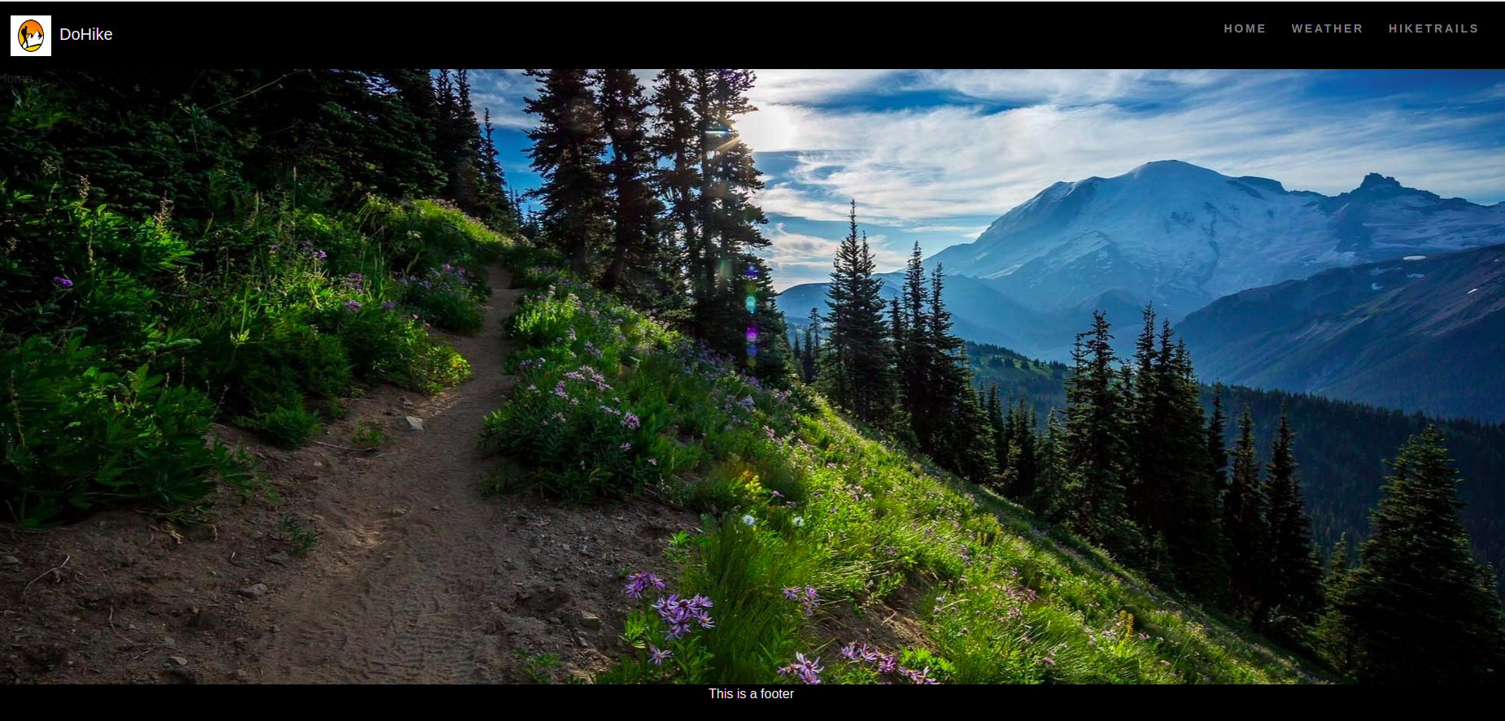
Demo

Slide 9
