Slide 1
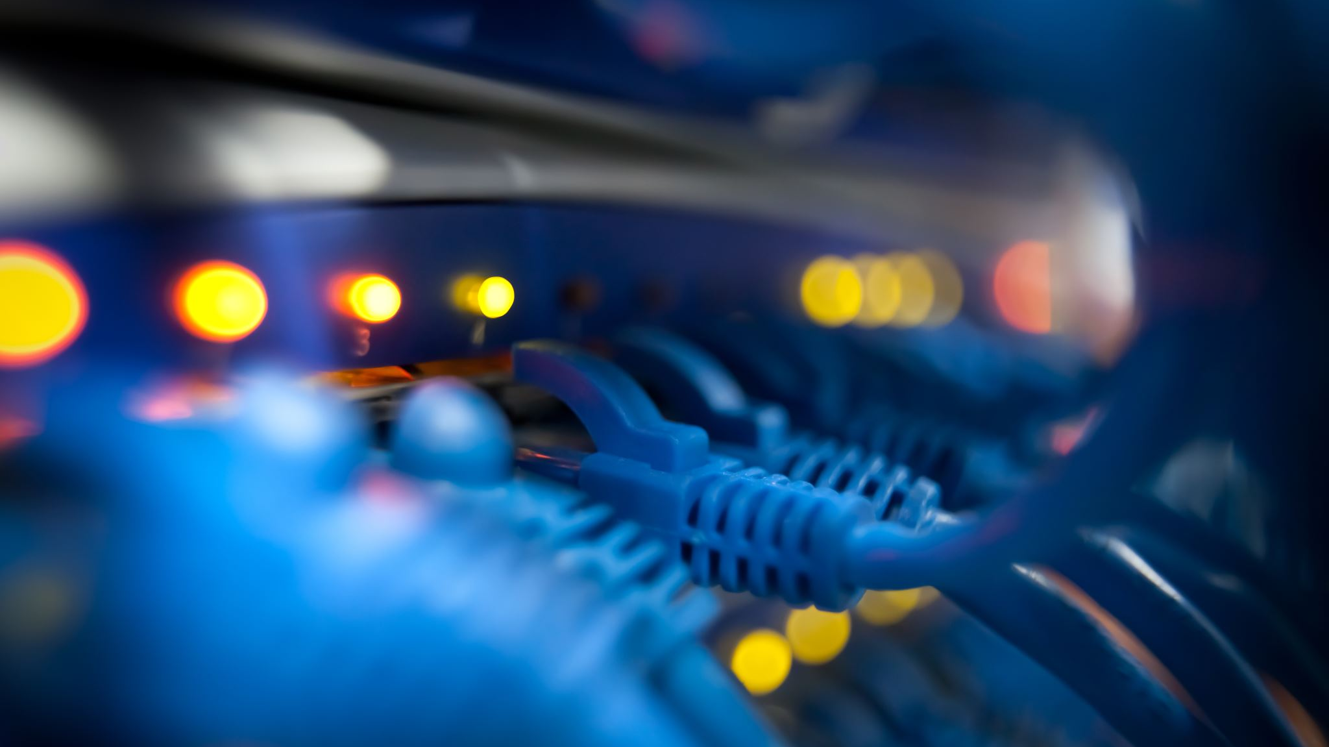
Telecom Customer Churn Prediction
Group:
Mahesh Kumar Pabbati,
Rangareddy gari harshavardhan reddy
Sai Abhishek Vallepu
Manoj Naga sai deepak Yejju

Slide 2
Problem Statement
Problem: Customer churn is a critical issue for the telecom industry, leading to revenue losses and increased customer acquisition costs. Understanding which customers are likely to churn allows the company to take proactive retention measures.
Goal:
Predict which customers are likely to churn based on historical data.
Identify key drivers of churn to support targeted retention strategies.
Business Impact: Retaining at-risk customers through offers, discounts, or improved customer service.

Slide 3
Data Availability
• Dataset:
Contains customer demographics, account information, service usage, and the churn label (Churn column: Yes/No).
Key features include tenure, MonthlyCharges, TotalCharges, Contract, and InternetService.

Slide 4
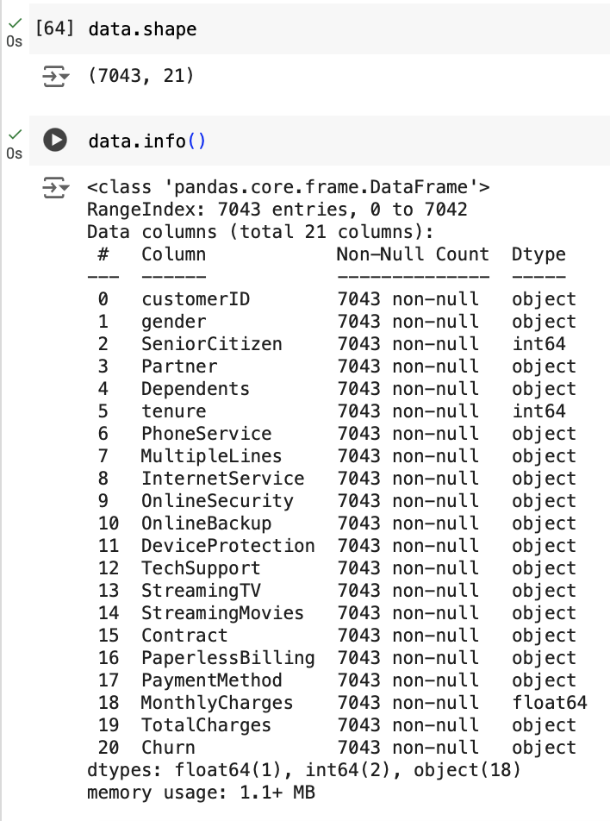
Data Preprocessing
Most of the variables
are Categorical except
SeniorCitizen
Tenure
Monthly Charges

Slide 5
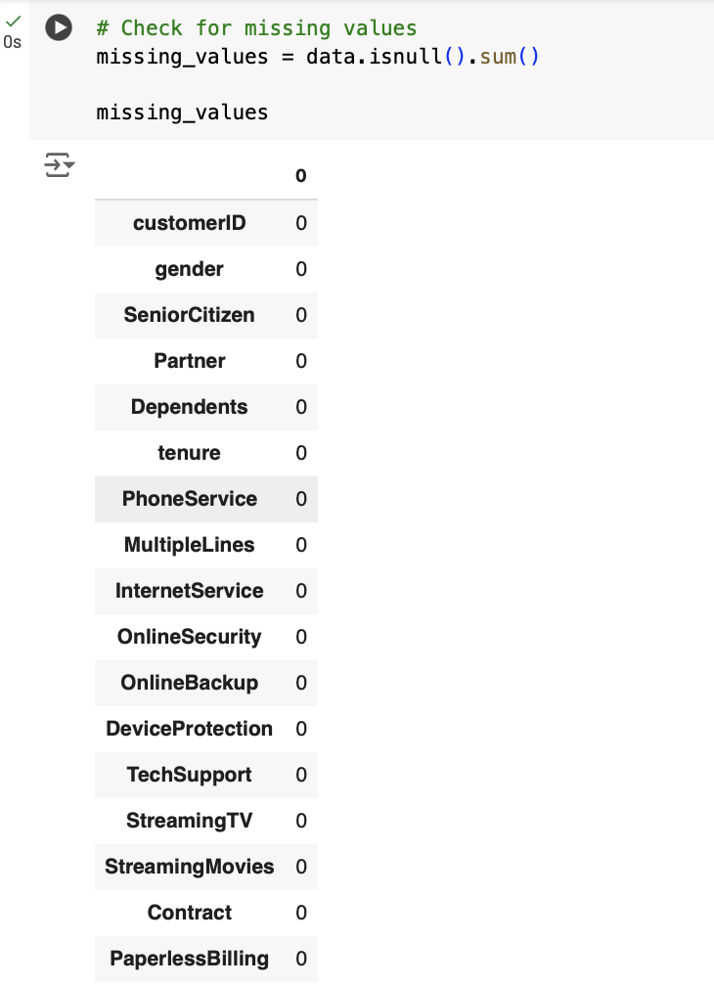
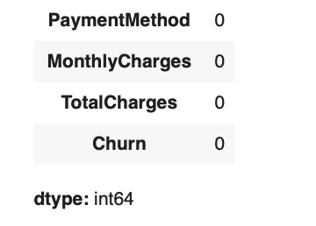
Data Preprocessing
During the preprocessing
no missing values were
found.

Slide 6
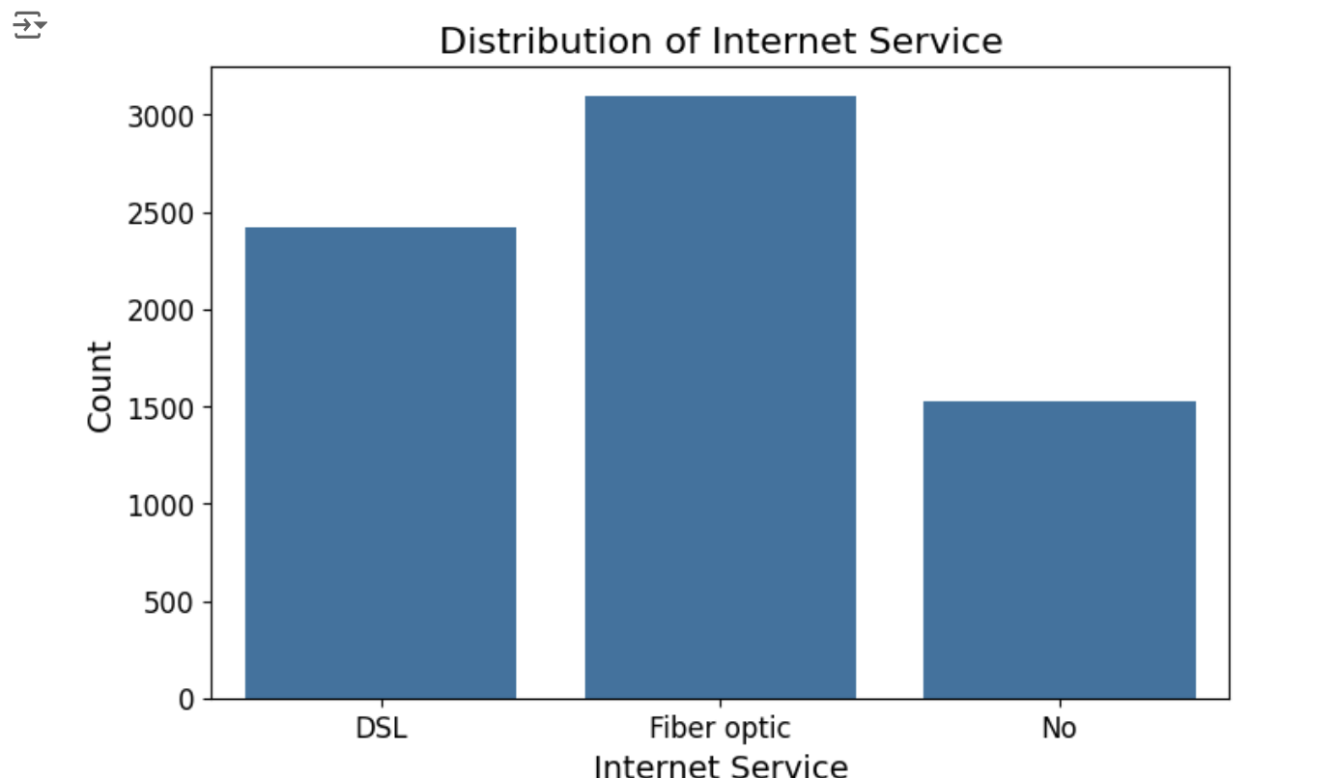
Visualization of some important variables among all the customers
Most of the customers (around 3000)
have Fiber optic as their Internet Service.

Slide 7
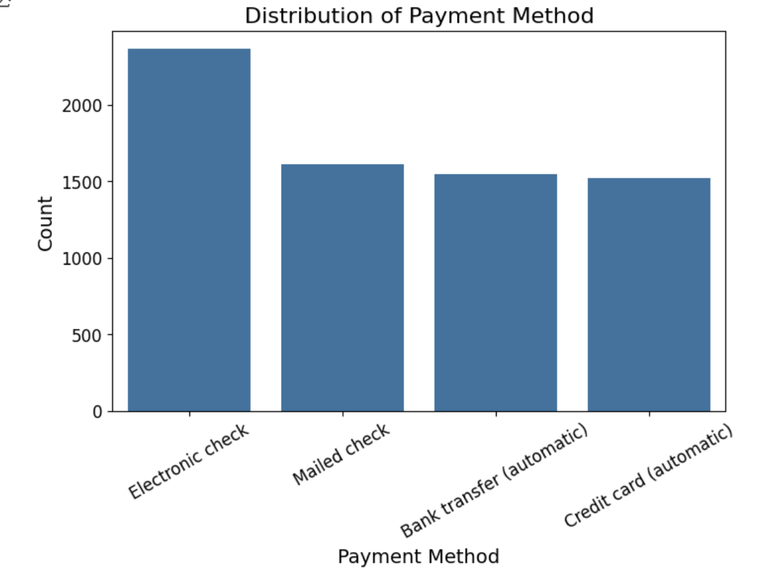
Visualization of some important variables among all the customers
Most of the customers (around 2500)
have Electronic check as their Payment Method.

Slide 8
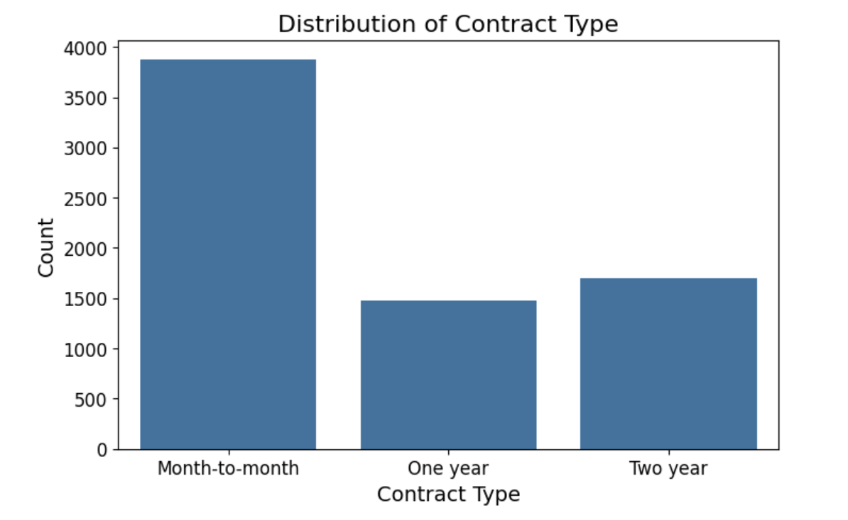
Visualization of some important variables among all the customers
Most of the customers (around 3800)
have Month-to-Month Contract.

Slide 9
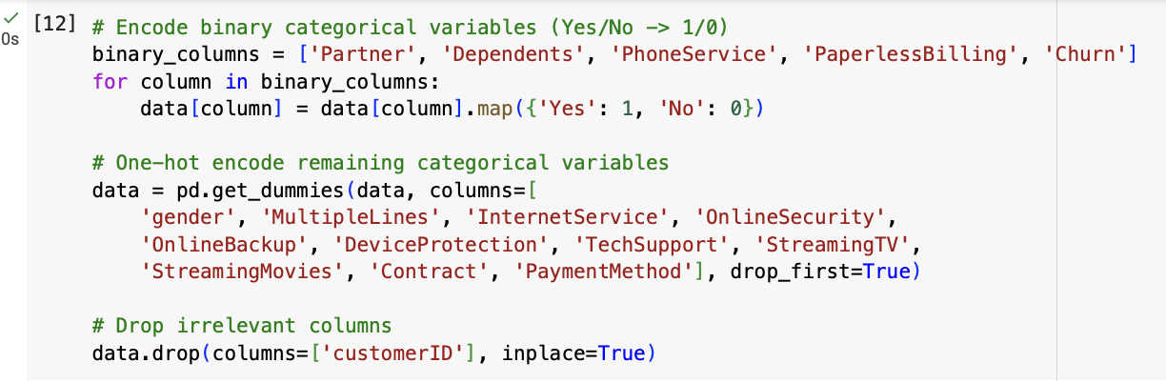
Data Preprocessing
Categorical variables are converted into Numeric variables thereby
making the data suitable for Analysis and Prediction

Slide 10
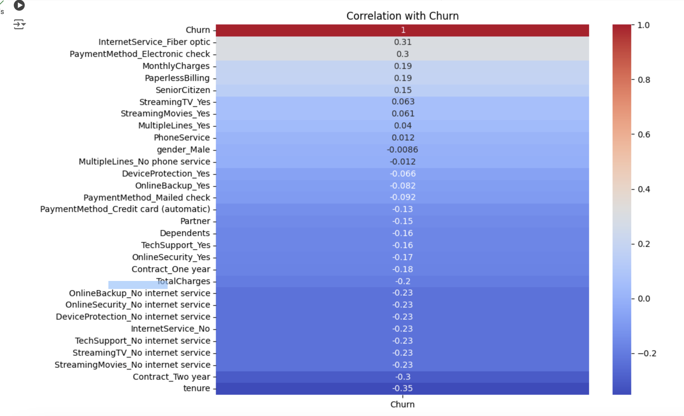
Correlation
“InternetService_Fiber optic” and “PaymentMethod_Electronic check”
have highest positive correlation with Target variable “Churn”
“Contract_Two year” and “tenure”
have highest negative correlation with Target variable “Churn”

Slide 11
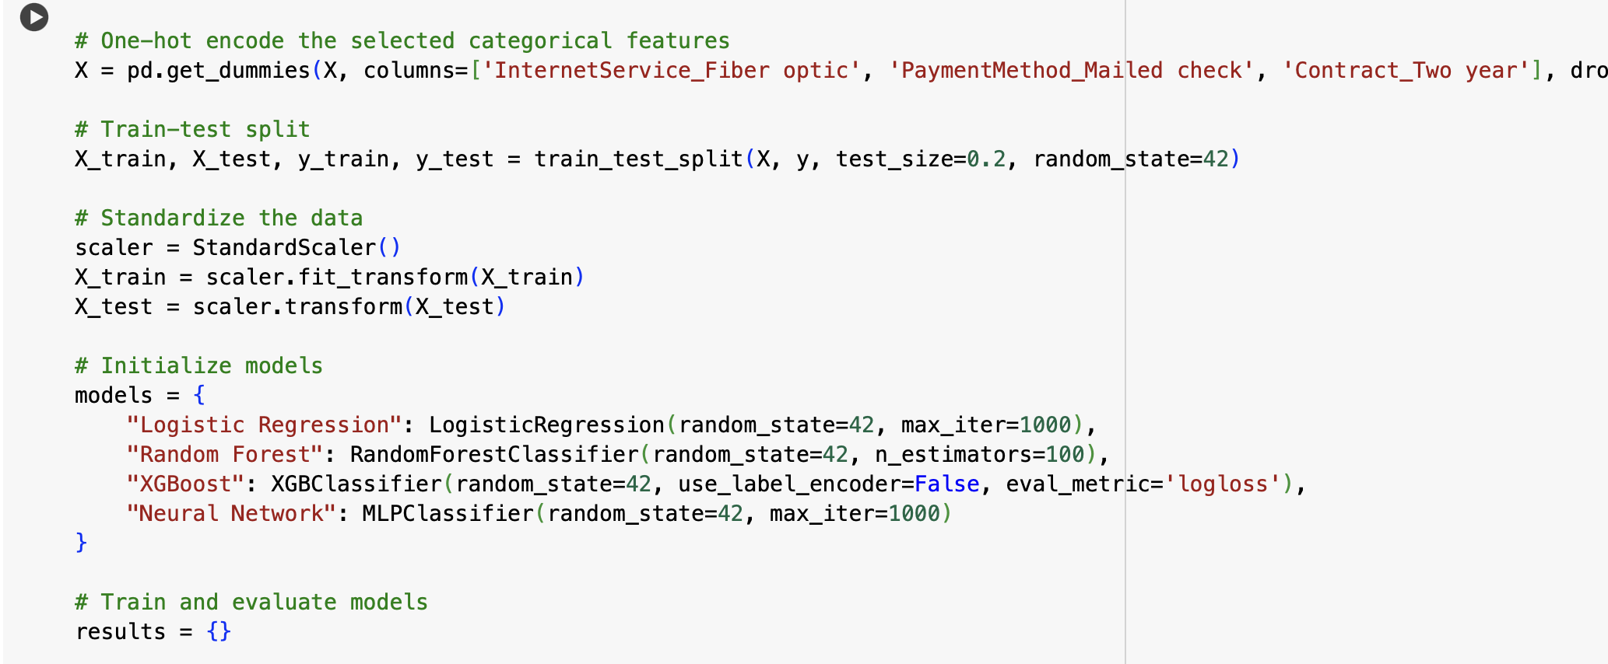
models
Models Implementation

Slide 12
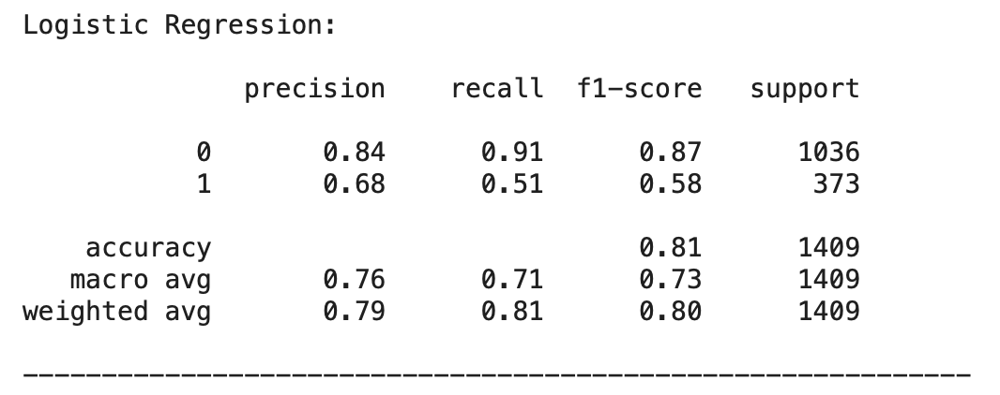
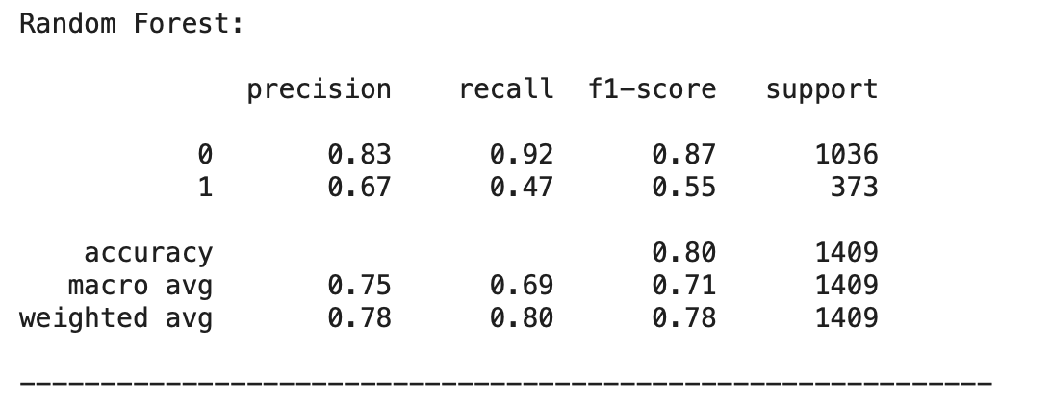
models

Slide 13
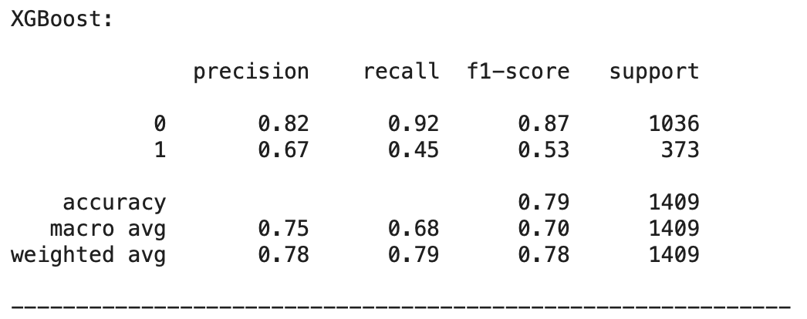
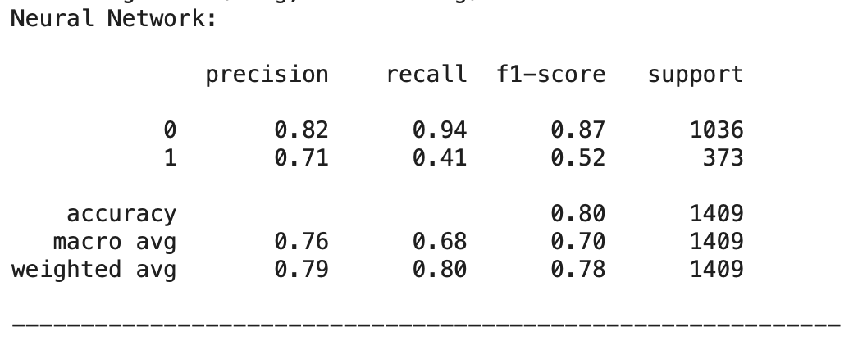
models

Slide 14
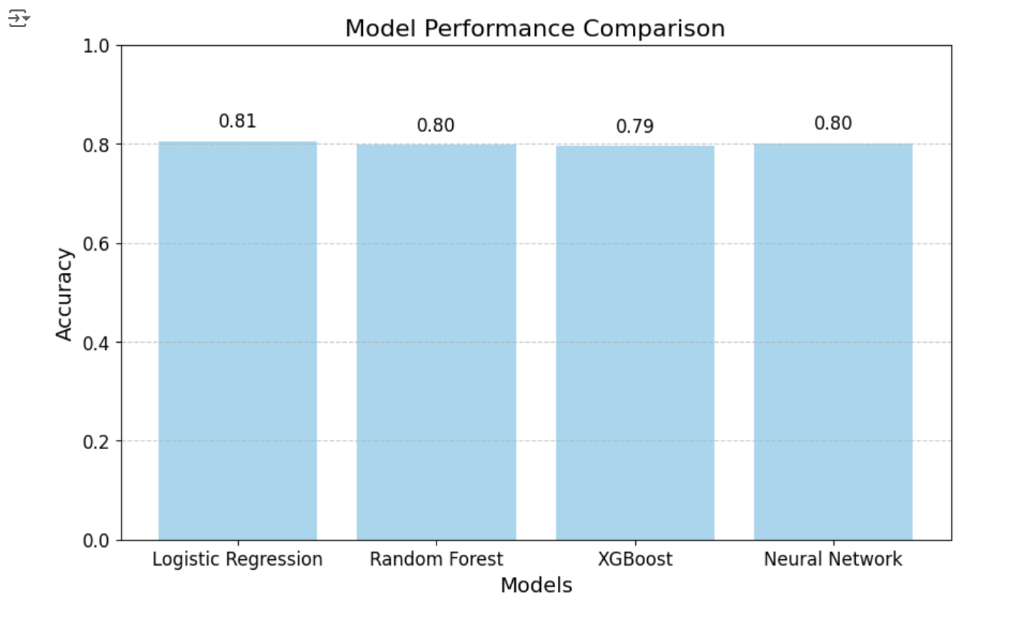
Model comparison
From the bar graph, we can say that
Logistic Regression has the highest accuracy
and hence chosen as the best model for
Prediction.

Slide 15
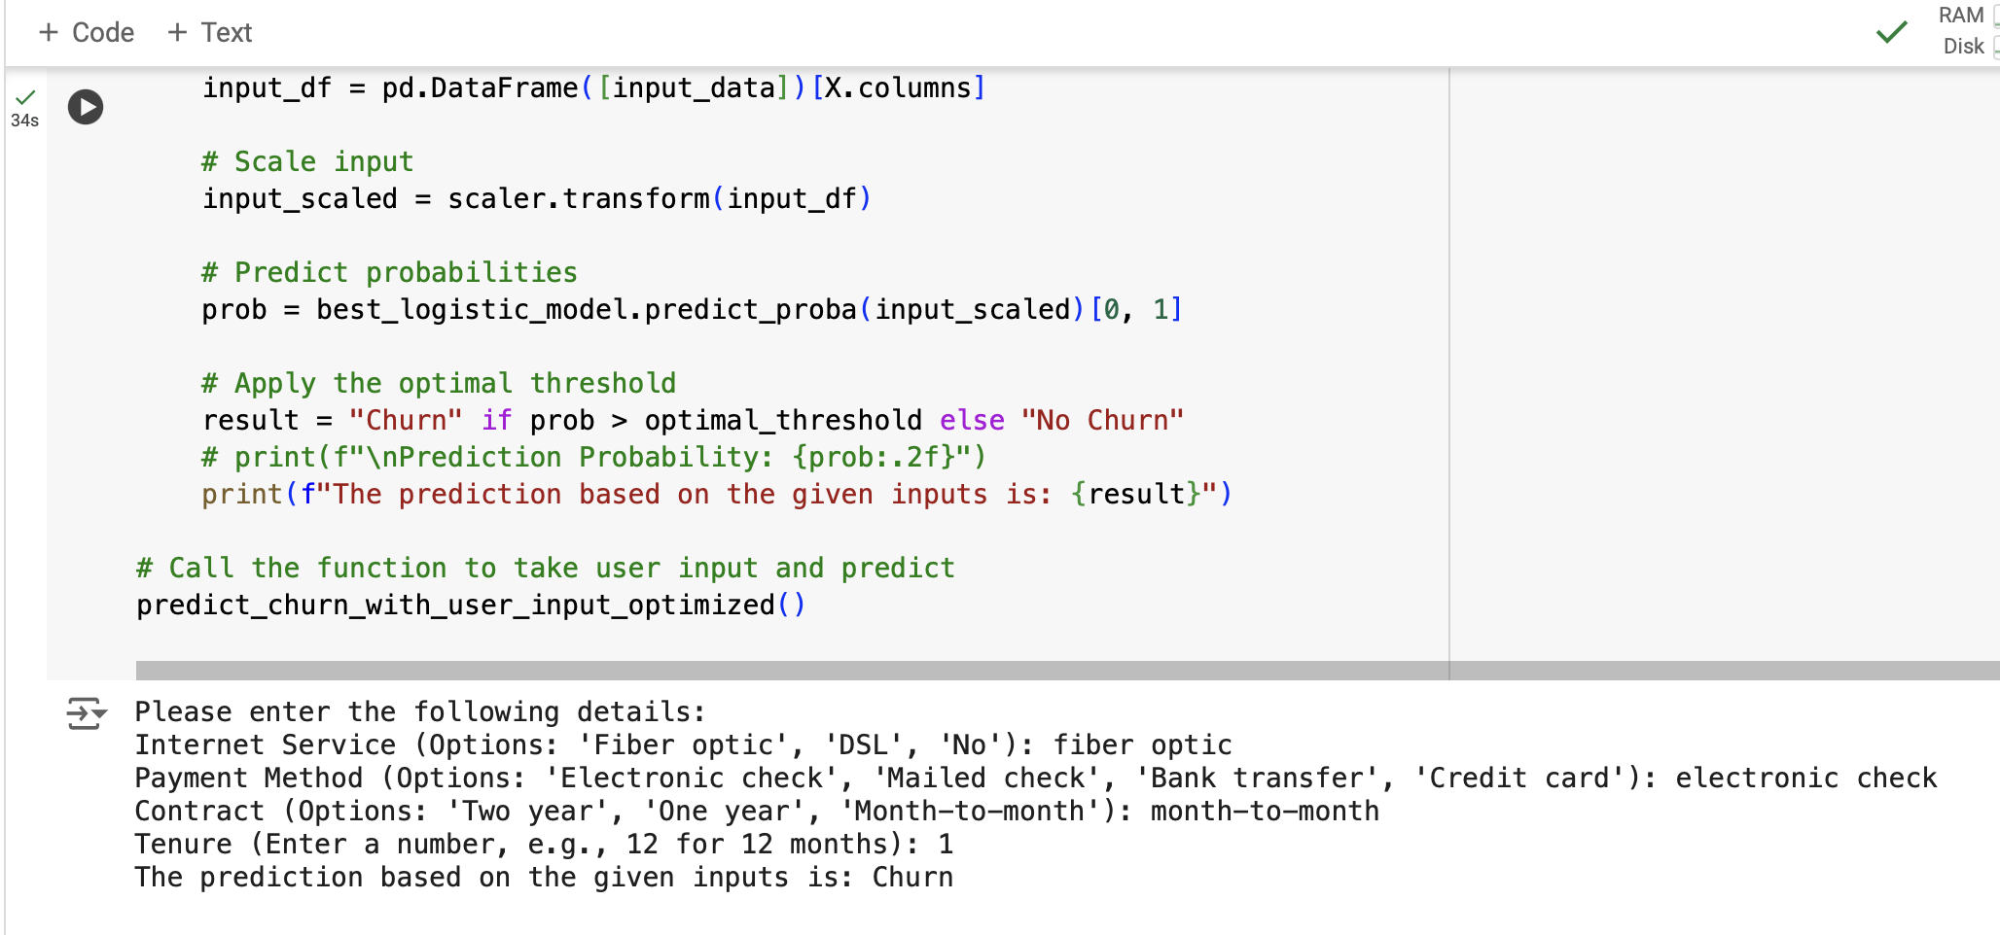
prediction

Slide 16
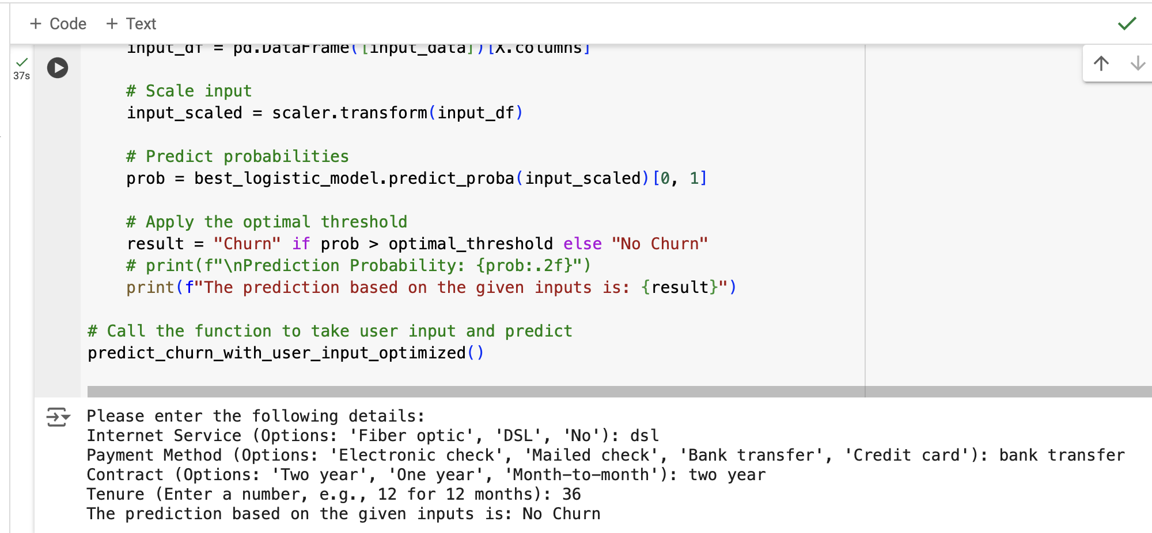
prediction

Slide 17
analysis
Customers with Fiber optic service and Electronic check payment method are more likely to churn. A Month-to-month contract offers flexibility to leave anytime, and a short tenure (1 month) indicates a lack of loyalty or dissatisfaction with the service.
Customers with DSL service and Bank transfer payment method are less likely to churn, reflecting stability and trust in the service. A One-year contract indicates commitment, and a long tenure (36 months) reflects satisfaction and loyalty.

Slide 18
Conclusion
The telecom company should focus on:
Improving the Fiber optic experience through better service and pricing.
Promoting automated payment methods like Bank transfer or Credit card.
Encouraging long-term contracts with attractive incentives.
Engaging new customers effectively to reduce early churn.
Leveraging predictive analytics to identify and address high-risk customers proactively.
By addressing these key areas, the company can improve customer retention and reduce churn.

Slide 19
Dataset source
https://www.kaggle.com/datasets/blastchar/telco-customer-churn/data

Slide 20
Thank you

