Slide 1


“Patient Report Management System”
Submitted by:
Submission type : Individual
Name: BODDU HARSHA SRIKANTH
Batch : B-12
LMS Id :
Program : AXIS FINTECH
Date: 25/05/2023

Slide 2

Table of contents
Introduction
Project Overview
Architecture Design
User Interface Design
Back-end Development
Front-end Development
Conclusion
Future Work
References
Appendices

Slide 3
Introduction
Patient report management system is a web-based application that allows healthcare professionals , doctors, surgeons or health care related professionals to manage patient records and reports efficiently. This system is designed to simplify the process of maintaining patient records and reduce the likelihood of errors in record-keeping. The system is accessible to authorized healthcare professionals only and maintains the privacy and confidentiality of patient records.
The main purpose of this project is to manage reports of patients and to allow the medical professionals only to modify the reports including test reports and diagnosis information.
This system can be used in hospitals by doctors to get information from patients and store them for the future purpose. The present system is very slow and unable to retrieve the old data quickly due to the paper based system. This System can reduce patients waiting time , so all the patients can be treated accurately.

Slide 4
Project Overview
This project is mainly focused on saving patients information and users(doctors) can also diagnose the patients problems and generate reports based on their test results, so this design is used to achieve this requirement and Interface for this project is so simple. Admin , User and Patient has separate dashboards, where they can manage their accounts.
Admin Functionalities:
1.Admin can create – Users, Patients, Reports, Appointments.
2.Admin can update – Users, Patients, Reports, Appointments.
3.Admin can delete – Users, Patients, Reports, Appointments.
4.Admin can login, logout.
User Functionalities:
1.User can create – Patients, Reports, Appointments.
2.User can update – Patients, Reports, Appointments.
3.User can delete – Patients, Reports, Appointments.
4.User can login, logout and register.
Patient Functionalities:
1.Patient can view their reports and appointments.
2.Patient can login and logout.

Slide 5
Project Overview
Technology Stack used:
Backend:
1. Java
2.Spring Boot
Database:
1. MySQL
Frontend:
1.Html
2.CSS
3.BOOTSTRAP
4.React js
Tools used:
1. Backend – Eclipse IDE, Spring tools
2. Database – MySQL 8 WORKBENCH
3. Frontend – VS CODE.

Slide 6
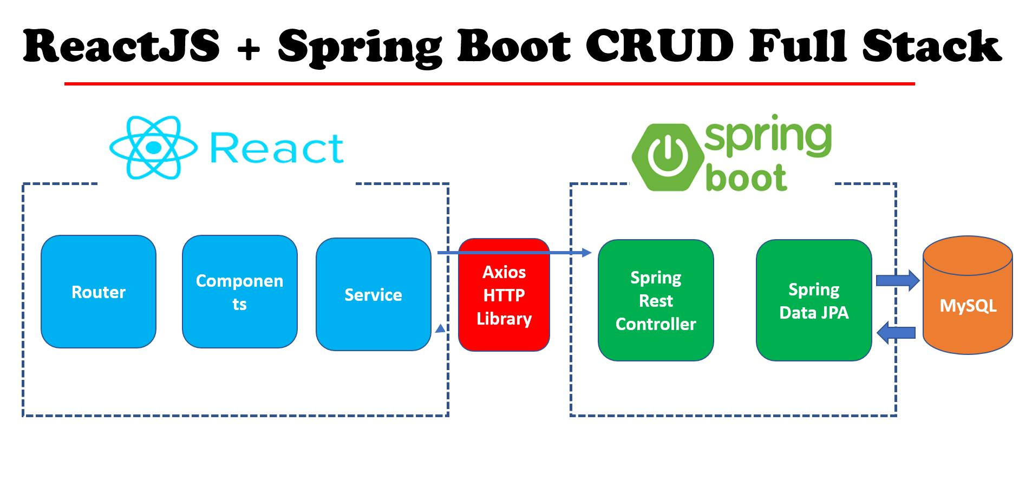
Architecture Design

Slide 7
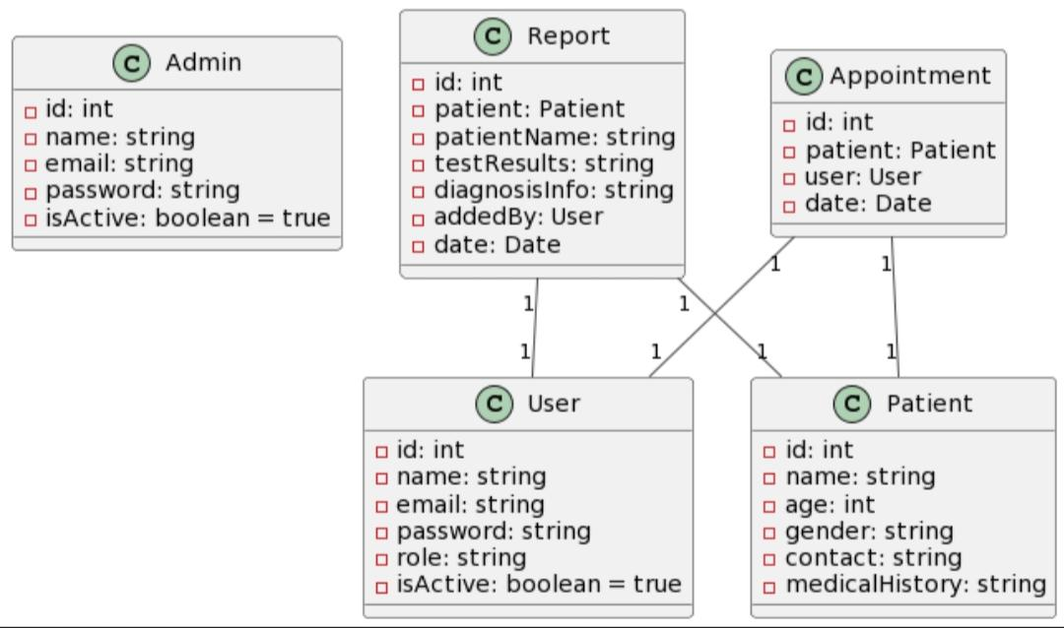
User Interface Design
CLASS DIAGRAM:

Slide 8
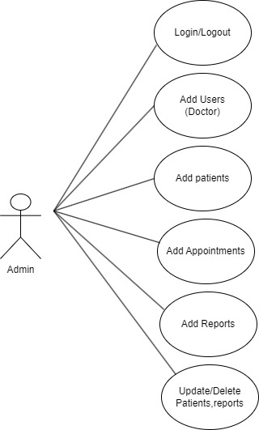
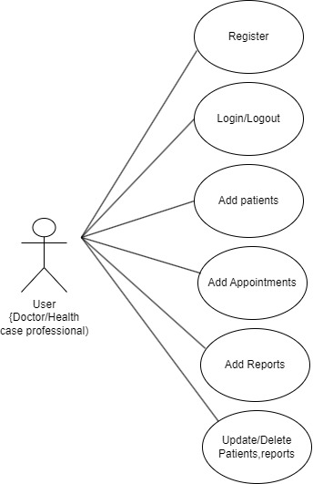
User Interface Design
USE CASE DIAGRAM:

Slide 9
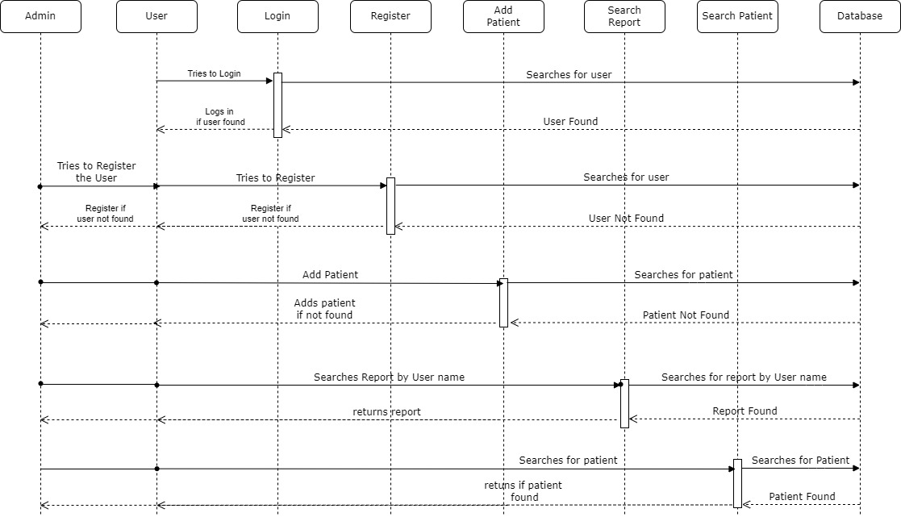
User Interface Design
SEQUENCE DIAGRAM:

Slide 10
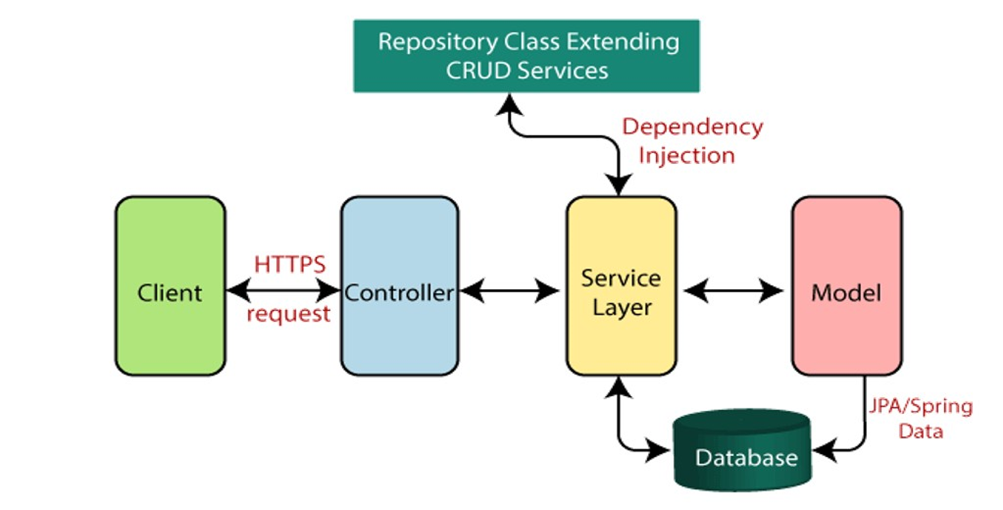
Back-end Development
SPRING BOOT ARCHITECTURE

Slide 11
Back-end Development
Spring Boot provides a good platform for Java developers to develop a stand-alone and production-grade spring application that you can just run. You can get started with minimum configurations without the need for an entire Spring configuration setup.
Advantages of Spring Boot:
1.Easy to understand and develop spring applications 2.Increases productivity 3.Reduces the development time
Dependencies used in project:
Lombok : Project Lombok is Java library tool that generates code for minimizing boilerplate code. The library replaces boilerplate code with easy-to-use annotations.
Spring data JPA : Spring Data JPA handles most of the complexity of JDBC-based database access and ORM (Object Relational Mapping). It reduces the boilerplate code required by JPA. It makes the implementation of your persistence layer easier and faster.
MySql Driver : This dependency is used to connect our spring boot project to the MySql database to store the data of our project in an efficient and organised way, so by using this we can also retrieve the data from the database easily.

Slide 12
Back-end Development
Spring Boot Starter Web : This dependency provides a good support to build project with restful web services. For building a RESTful Web Services, we need to add the Spring Boot Starter Web dependency into the build configuration file.
Spring Boot dev-tools : This dependency is used to improve the development time while working with the Spring Boot application. Spring Boot DevTools pick up the changes and restart the application.
Spring Boot Integration with MySQL:
MySQL offers unparalleled scalability to make it easy to manage deeply integrated Spring Boot applications that operate on terabytes of data. Moreover, on-demand flexibility is the main feature of MySQL . Spring Boot can build stand-alone web applications with integrated servers. Now using MySQL Database instead of internal memory storage can minimize the query execution time. Spring Boot MySQL Integration, will be more suitable better for real-time work, and the users will get a better experience.
Why do we need MySQL as a database :
MySQL is an Relationship based management system(RDBMS) based on the Structured Query Language(SQL) which is the popular language for accessing and managing the records in the database. MySQL is open-source and free software .It is supported by Oracle Company. The data in a MySQL database are stored in tables. A table is a collection of related data, and it consists of columns and rows.

Slide 13
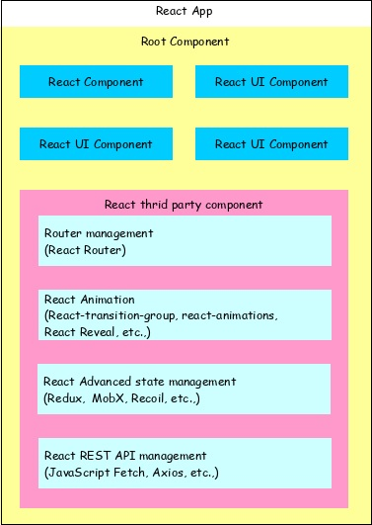
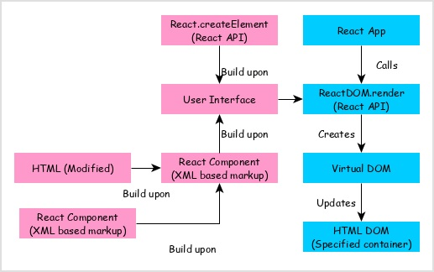
Front-end Development
REACT ARCHITECTURE:

Slide 14
Front-end Development
What is React? Why do we need it :
React is a JavaScript library developed by Facebook which, among other things, was used to build Instagram. It aims to allow developers to create fast user interfaces for websites and applications alike easily. The main concept of React js is virtual DOM. It is a tree based on JavaScript components created with React that mimics a DOM tree. It does the least amount of DOM manipulation possible to keep your React components up to date.
Products built with React are simple to scale, a single language used on the server/client/mobile side of things grants outstanding productivity, there are workflow patterns for convenient teamwork, UI code is readable and maintainable, and more. World-leading companies have used React and other JS technologies in some of the top market-defining products (Instagram, Facebook being the most vivid examples).
React Packages used in Project :
1.React Router DOM : This project utilize Router in React JS to create a React application with navigation across multiple pages. React Router is a JavaScript framework that lets us handle client and server-side routing in React applications. It enables the creation of single-page web or mobile apps that allow navigating without refreshing the page. It also allows us to use browser history features while preserving the right application view.
2.React Axios : Axios allows us to communicate with APIs easily in our React apps. Though this can also be achieved by other methods like fetch or AJAX, Axios can provide a little more functionality that goes a long way with applications that use React.

Slide 15
Conclusion
The patient report management system is an essential tool for healthcare professionals developed using Spring Boot, React js and MySQL to efficiently manage patient records and reports. This system streamlines the process of maintaining patient records and reduces the likelihood of errors in record-keeping. The system ensures the privacy and confidentiality of patient records and reports and provides authorized healthcare professionals with easy access to patient information. The database design for the system includes four tables that store user information, patient information, report information, and appointment information.

Slide 16
Future Work
In this project, As of now we have considered that goal of our project has been accomplished, but there are plenty of improvements that could be done in order to achieve better results.
Some of the improvements that can be done in the future:
Adding prescription details in the data, after diagnosis and reports.
Also including a feature where patient can directly interact with doctor/health care professional.
Patient can also download prescription details.
Also adding a chatbot feature, where patient chat with it 24/7 for details about hospital or any suggestions.
The above points are the enhancements/features, which can be done to increase the usability of this project. We developed this project scalable, so that if we want to add any feature in future, it will be possible to add that requirement.

Slide 17
References
Spring Boot Documentation
Link : https://docs.spring.io/spring-boot/docs/￼￼￼￼￼￼￼￼￼￼￼￼￼￼￼￼￼￼￼￼￼￼￼￼￼￼￼￼￼
React Js Documentation
Link :￼https://react.dev/￼
MySQL Documentation
Link : https://dev.mysql.com/doc/

Slide 18
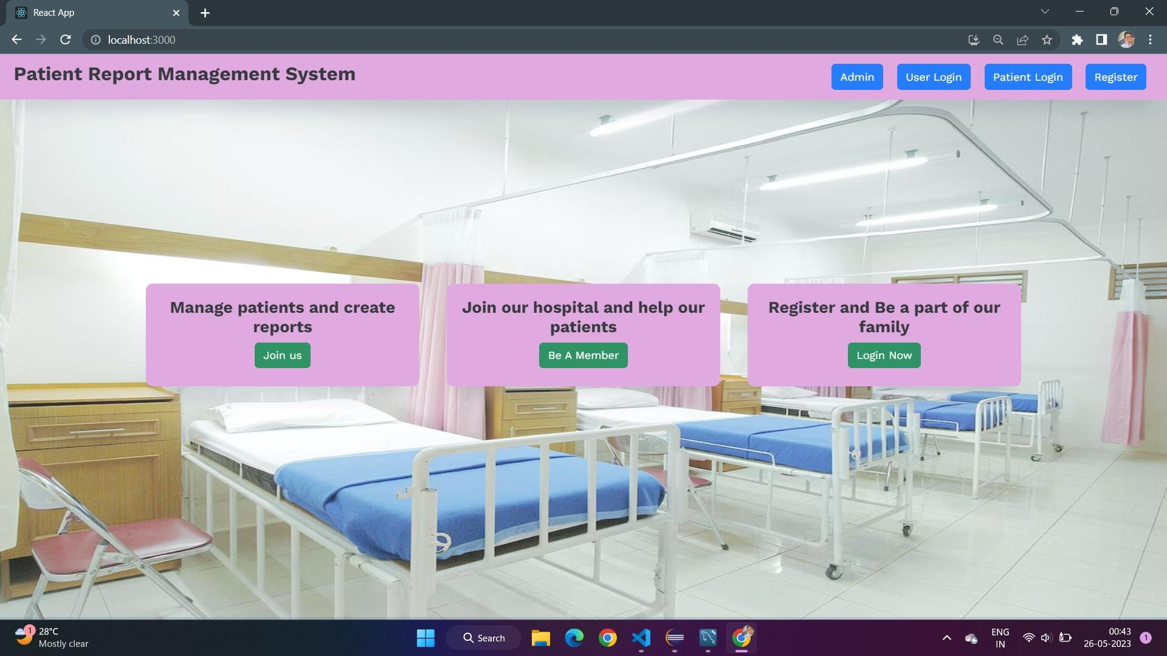
Appendices
HOME PAGE:

Slide 19
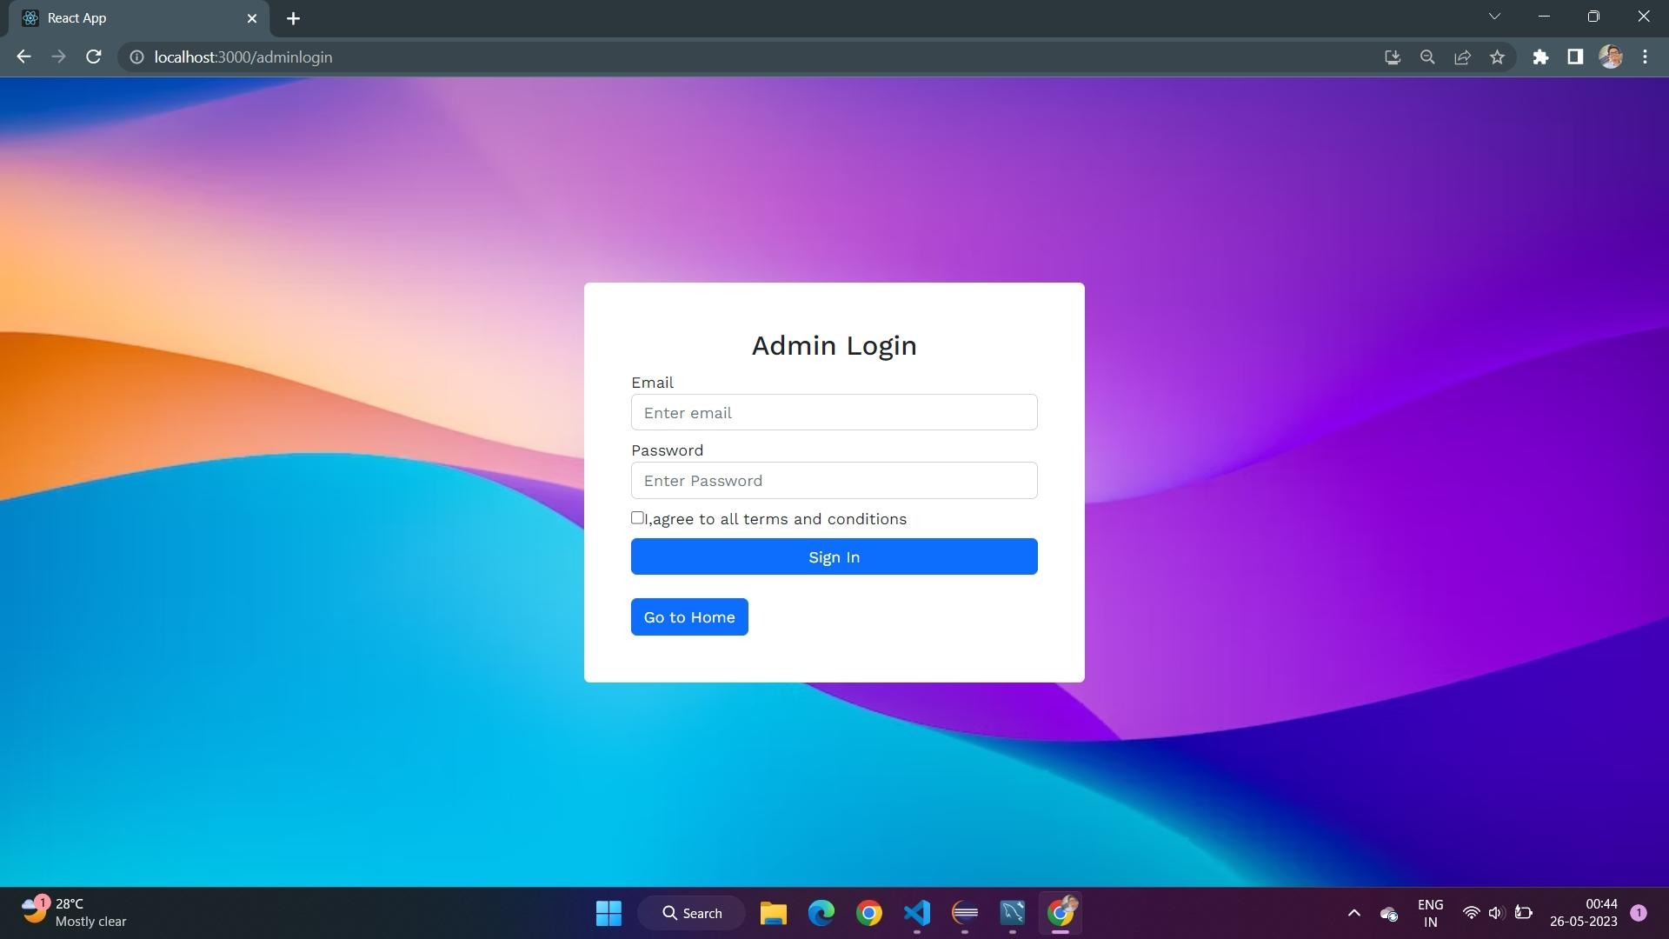
Appendices
ADMIN LOGIN PAGE:

Slide 20
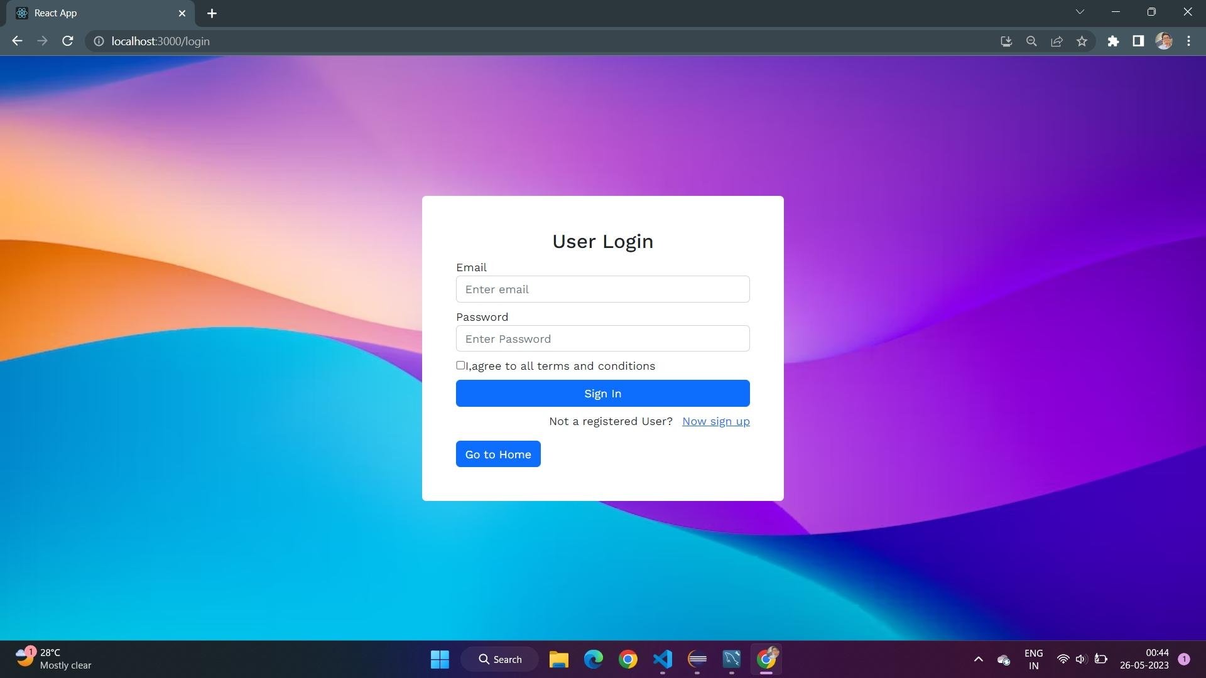
Appendices
USER LOGIN PAGE:

Slide 21

Appendices
PATIENT LOGIN PAGE:

Slide 22
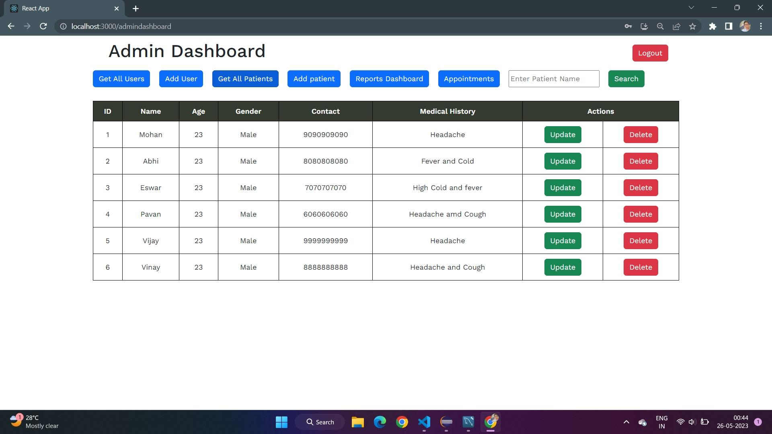
Appendices
ADMIN DASHBOARD:

Slide 23
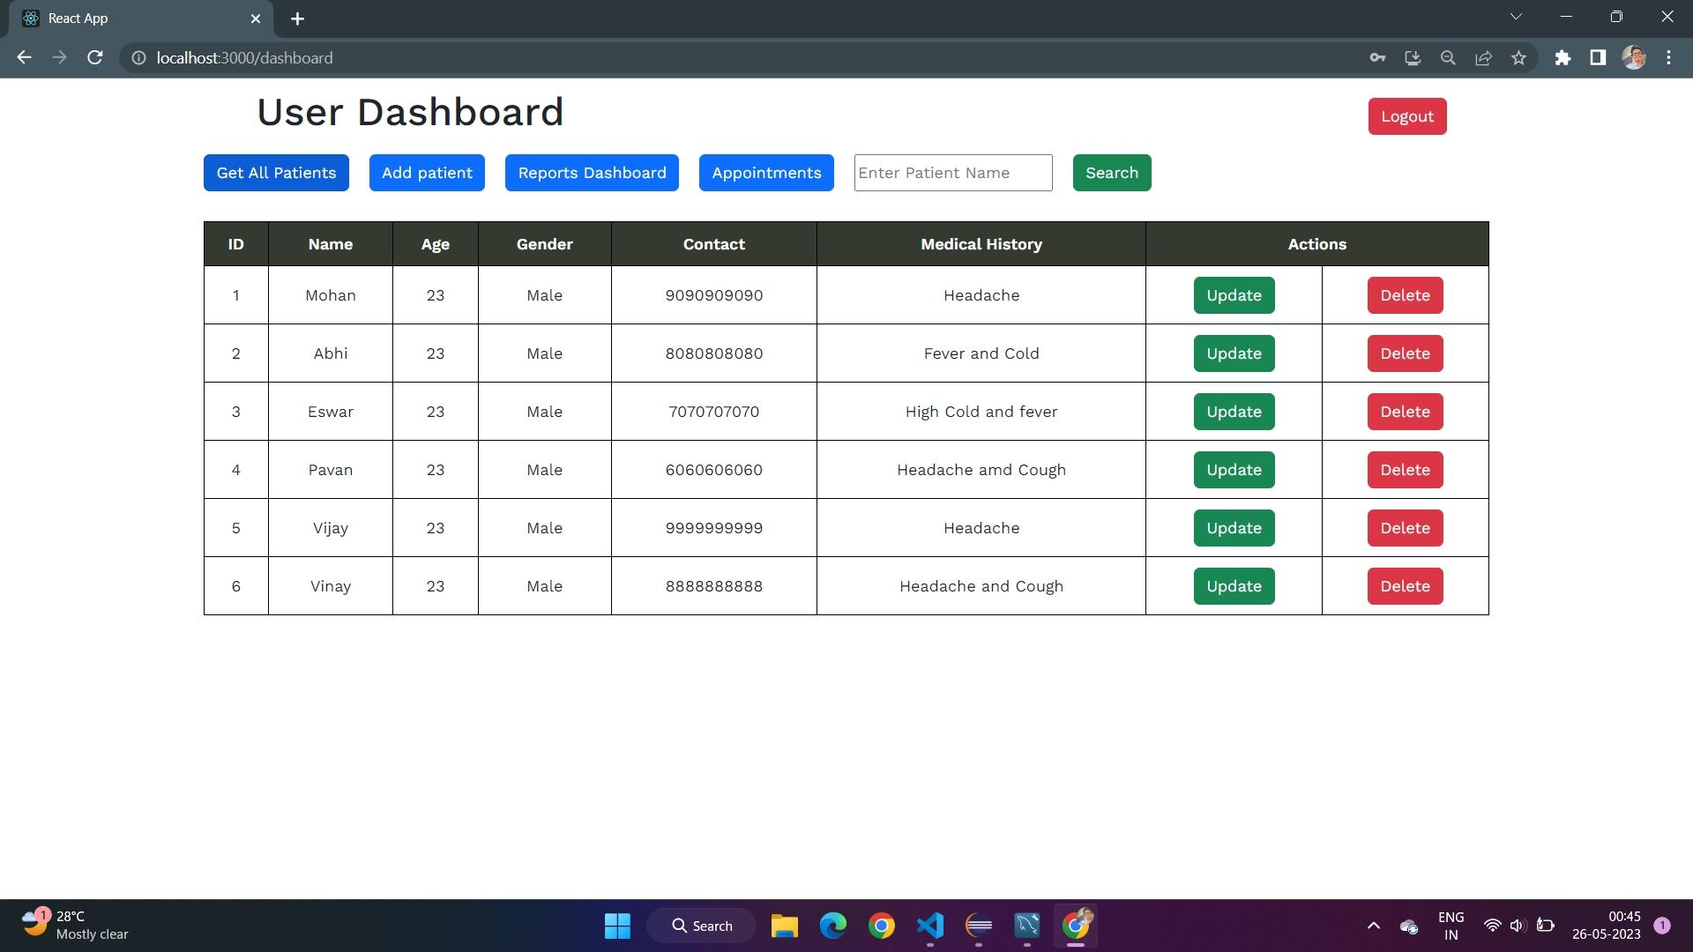
Appendices
USER DASHBOARD:

Slide 24
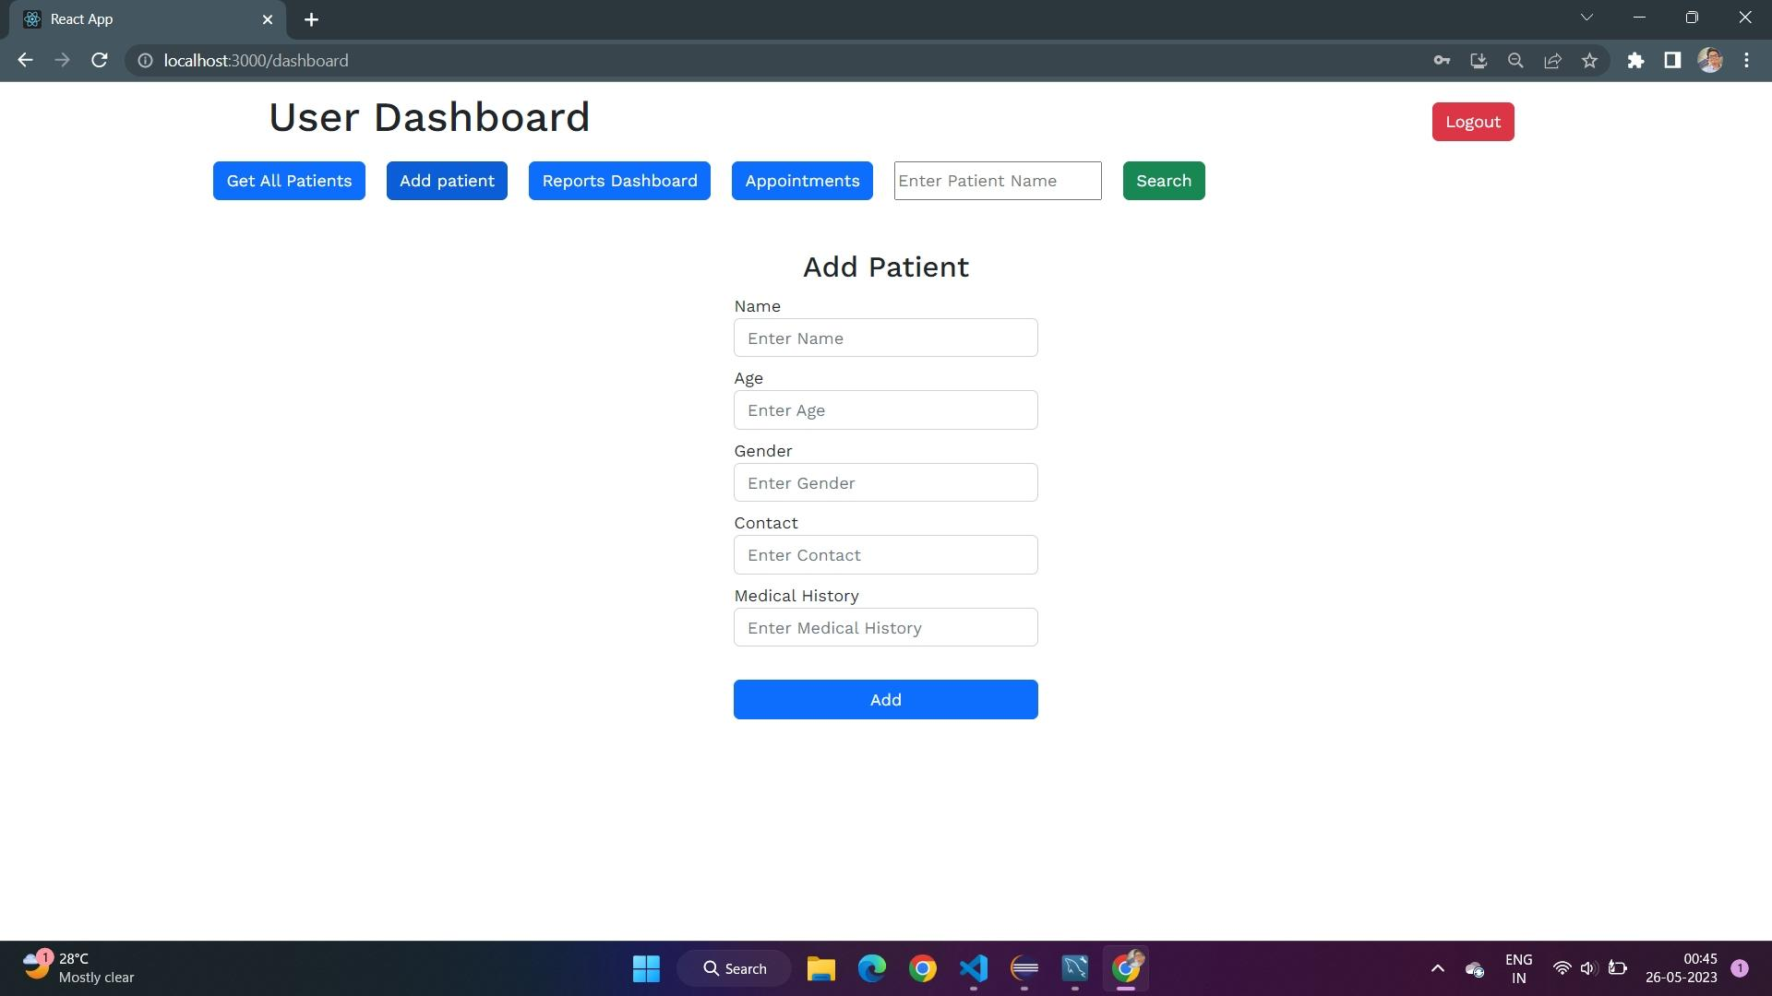
Appendices

Slide 25
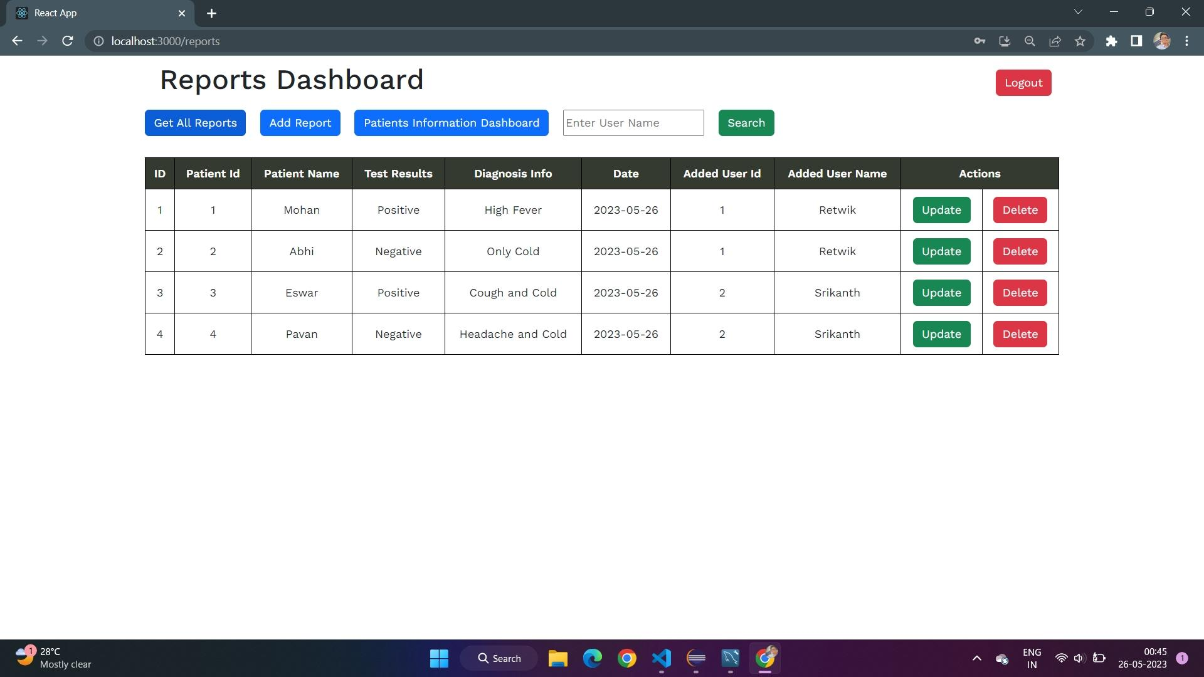
Appendices

Slide 26
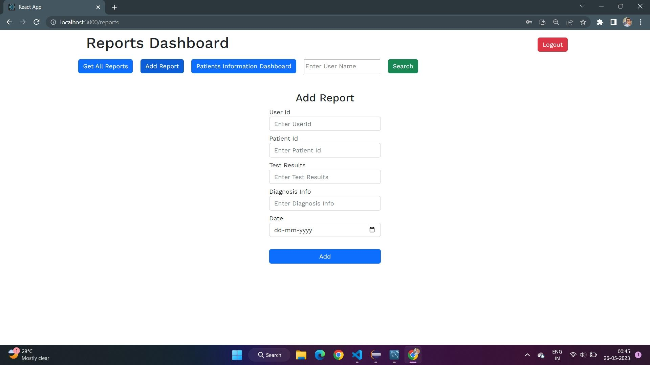
Appendices

Slide 27
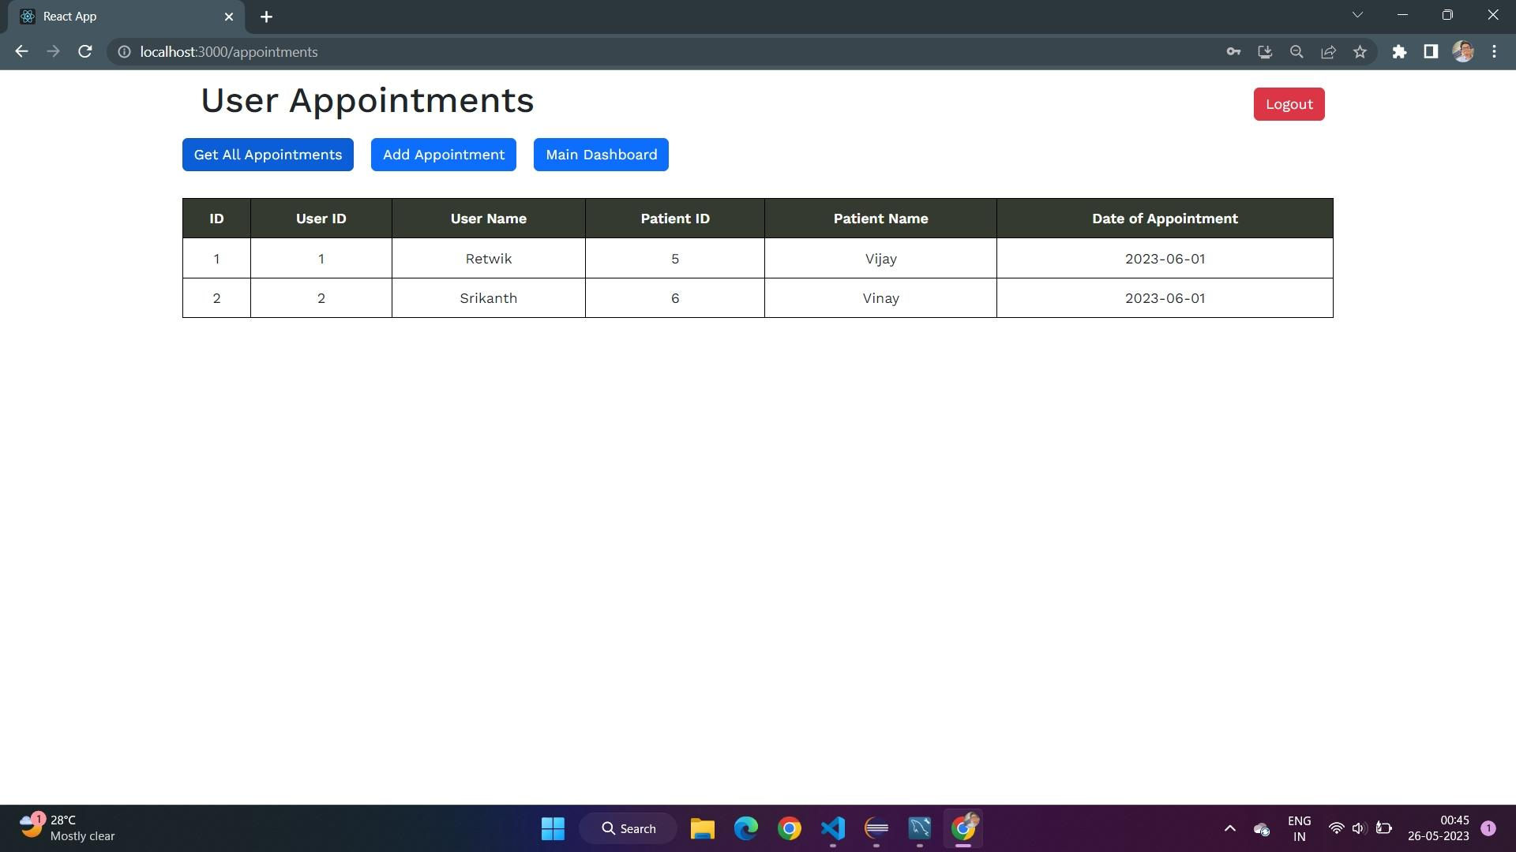
Appendices

Slide 28
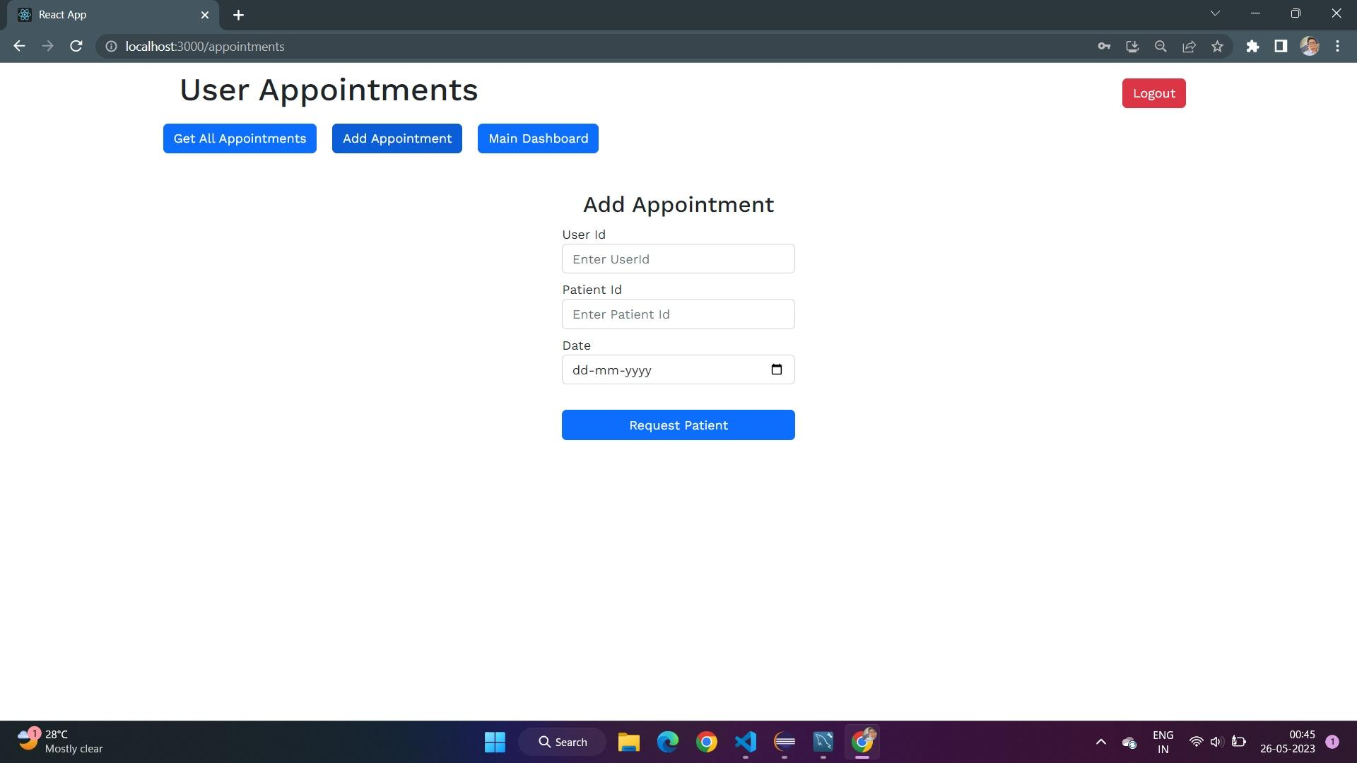
Appendices

Slide 29
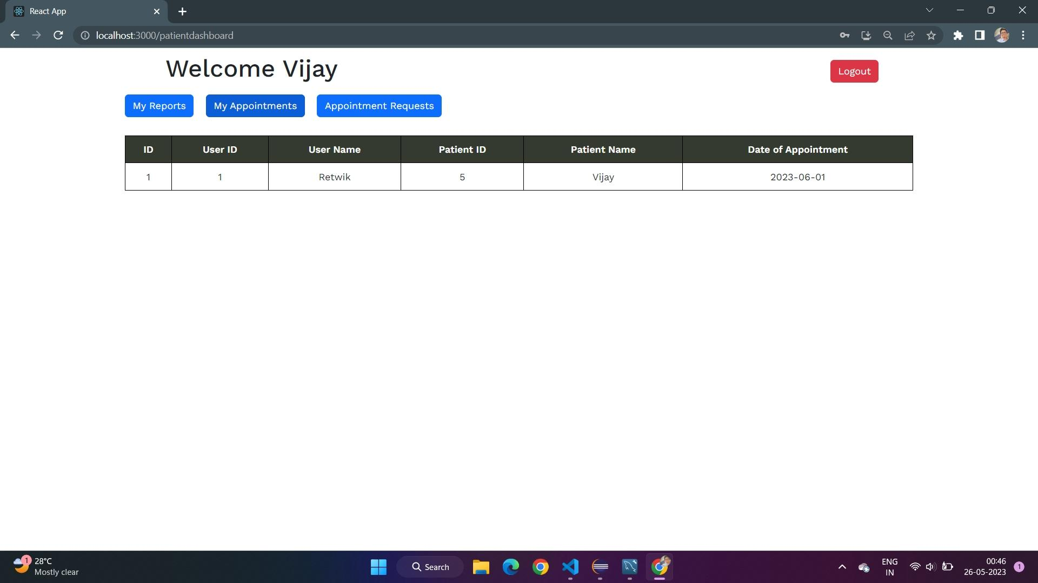
Appendices
PATIENT DASHBOARD:

Slide 30
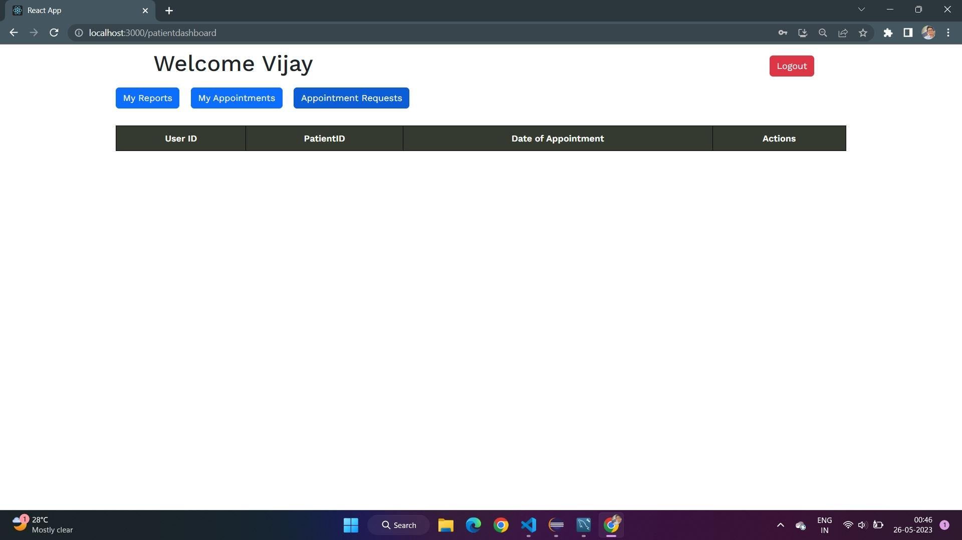
Appendices

