Slide 1

SMART INDIA HACKATHON 2026
Problem Statement ID - SIH26007
Problem Statement Title- MineSight - Safe and Efficient Operation of Mine Vehicles in Fog and Low-Visibility Conditions in Open Cast Iron Ore Mines.
Theme - Smart Automation
PS Category - Hardware
Team Name - WeBuildZ
Team ID -

Slide 2
MineSight
WeBuildZ
PROBLEM
Our Solutions
Sensors
Active Safety: Thermal-first vision (100m+ range) with in-cabin HUD road guidance and 3-stage collision auto-braking.
Zero Shutdowns: Restores safe 20–30 km/h haulage, recovering 50–60 lost monsoon days and ₹8–15+ Cr annually.
Offline V2V Mesh: Peer-to-peer LoRa network shares blind-spot obstacle data with zero reliance on cellular or internet.
ESP32-S3
Safety Crisis: 3–5m visibility vs 30m heavy vehicle braking distance leads to fatal rear-end collisions and steep bench roll-offs.
Economic Loss: 50–60 days of monsoon slowdowns per year, idling multimillion-dollar fleets and stalling ore evacuation.
Tech Gap: Optical cameras fail from backscatter glare; deep pit benches have zero cellular network for cloud alerts.
Connectivity Gap: Cameras blind from fog glare; deep mine pits lack cellular connectivity.
Raspberry Pi
ML Models
Innovations
Cooperative Fog-Vision: Peer-to-peer V2V mesh lets dumpers "see around" blind hairpin bends through other trucks' sensors.
Physics-Proof Sensor Fusion: Fuses Thermal IR (penetrates fog) + LiDAR (3D geometry) + Radar (speed/rain) for 100% weather resilience.
Low-Cost Retrofit: Plug-and-play modular unit costs under ₹35,000 vs. ₹16–30 Lakhs for proprietary OEM systems.
Safety & UI
MQTT
Fleet Dashboard

Slide 3
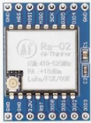


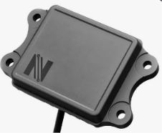

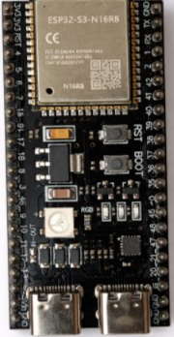
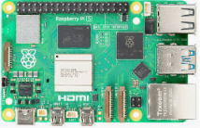




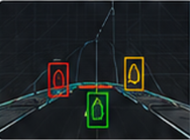
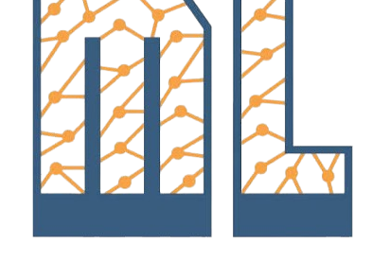

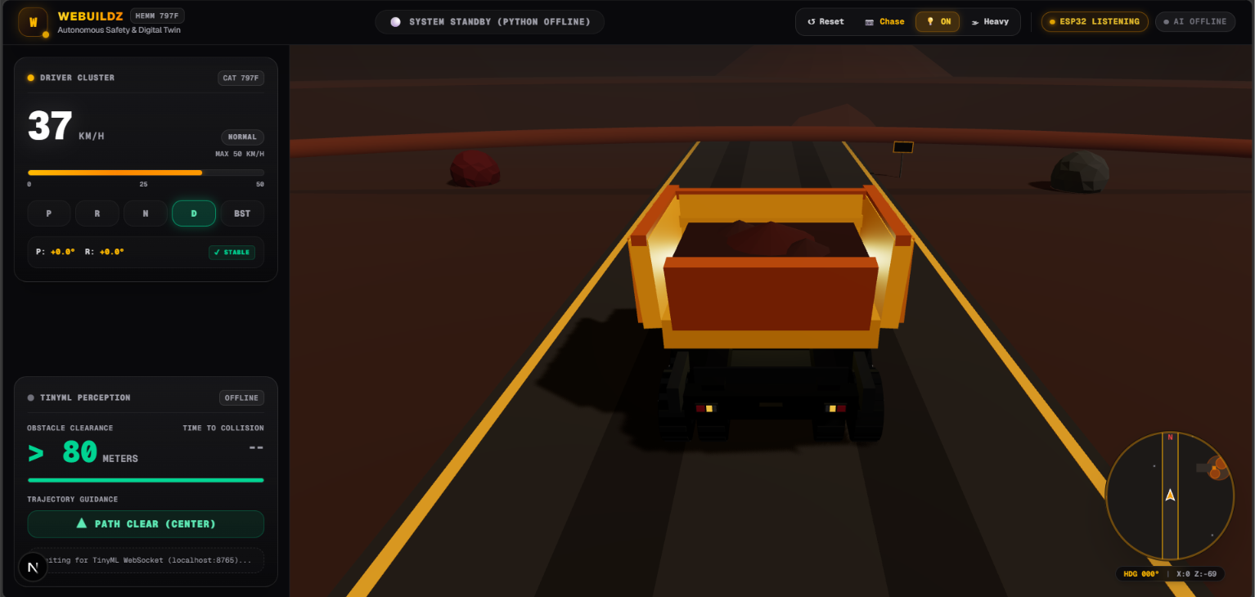



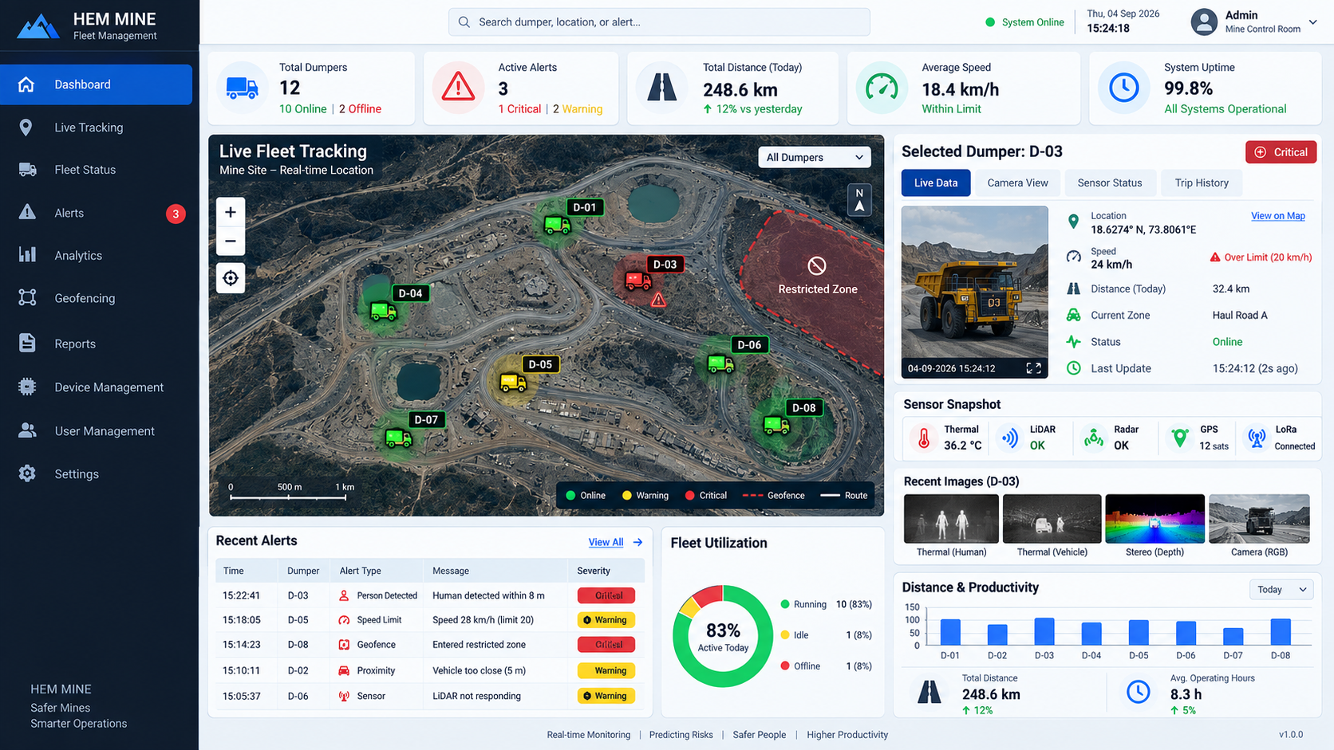
TECHNICAL APPROACH
WeBuildZ
L0
Hardware
Thermal Camera
LiDAR
mmWave Radar
RTK GPS
LoRa (V2V Mesh)
L1
Controller
ESP32-S3
Raspberry Pi
L2
ML Model
OpenCV
PyTorch
TensorFlow
NumPy
Sensor Fusion
TinyML
L3
Dashboard
In-Cabin Dashboard
Next.js
WebSocket
MQTT
Fleet Dashboard
Three.js
Tailwind CSS

Slide 4



FEASIBILITY AND VIABILITY
WeBuildZ
Technical Feasibility
Viability
Incremental deployment – Start with one vehicle, validate the system, then extend to multiple dumpers.
Existing infrastructure – Dashboard, V2V and sensor modules are designed as separate layers, making future upgrades easier.
Prototype cost – Target configuration is approximately ₹25,000–₹40,000 depending on available laboratory hardware.
Low-cost alternatives – Sensors can be replaced with MLX90640, YDLIDAR, ESP-NOW and other lower-cost options.
Modular hardware – Thermal, LiDAR, Radar, Stereo and GPS can be integrated as independent sensor modules.
Edge processing – Raspberry Pi 5 + Coral handles AI, sensor fusion and safety decisions.
Dedicated safety controller – ESP32-S3 manages sensor interfaces, alerts, V2V communication and watchdog functions.
Open-source software – YOLO, OpenCV, Kalman Filter, MQTT and Web technologies reduce development dependency.
Fallback architecture – Basic safety can continue through ESP32 + LiDAR/Radar if the main compute unit fails.
KEY RISKS → MITIGATION
V2V range limitations → Combine ESP-NOW + LoRa for short- and long-range communication.
Environmental Risk→ Develop AI, Web and IoT modules in parallel and integrate incrementally.

Slide 5
IMPACT AND BENEFITS
WeBuildZ
IMPACTS
BENEFITS
on Driver (Operator)
Economic Savings
Saves ₹8–15+ Crores annually per complex by eliminating idle multimillion-dollar fleet standbys and delayed ore evacuation.
Capital Efficiency
Retrofit BOM costs < ₹35,000 per truck vs. ₹16–30 Lakhs for proprietary Caterpillar/Hexagon systems.
Statutory DGMS Compliance
100% compliant with Directorate General of Mines Safety (DGMS) mandatory Collision Avoidance System norms.Statutory DGMS Compliance
Environmental Decarbonization
Eliminates thousands of hours of diesel engine idling during monsoon shutdowns, saving fuel and cutting CO₂ emissions.
Zero Fog Blindness: Restores 100m+ clear virtual vision in 3–5m fog via the in-cabin HUD, eliminating severe driver panic and visual stress.
Fatal Hazard Protection: 3-stage proactive alerts (HUD visual, seat vibration, auto-brake relay) prevent blind rear-end collisions and cliff-edge roll-offs.
on Fleet Management
Zero Weather Shutdowns: Recovers 50–60 lost or slowed monsoon operating days, maintaining safe 20–30 km/h haulage during heavy fog.
Real-Time Fleet Oversight: Central 3D Digital Twin gives control room operators live vehicle tracking, V2V mesh connectivity, and dynamic fog hazard heatmaps.

Slide 6


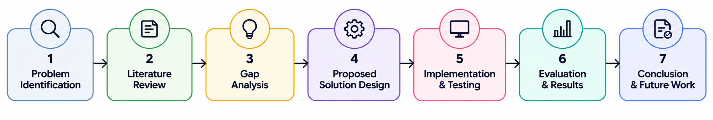

RESEARCH AND REFERENCES
WeBuildZ
References
COMPARISONS WITH EXISTING SYSTEMS
Dimension | Commercial | Chaulya | Our Proposal
Thermal Imaging
LiDAR
Radar
Sensor Fusion
V2V Cooperative Perception
Central Dashboard
Road Edge
Multi-Stage Safety
Deployable
Cost | $25-40k | $20-25k | $9-10K
GitHub - MineSight
Chaulya et al. (2025) – Research Paper
Hexagon — Vehicle Intervention System
Technical References
Ultralytics — YOLOv8
OpenCV — StereoSGBM
OASIS — MQTT v5.0 Standard
Research Workflow -
Live Demo – sih.webuildz.online

