Slide 1
CAPSTONE PROJECT · GROUP 2
Online Course
Recommendation System
A personalized course recommendation engine built with Content-Based and Collaborative Filtering
Final Presentation · Mentor: Diptarko

Slide 2

THE PEOPLE BEHIND THE PROJECT
Mentor & Team Members
MENTOR
RN
Raghavendra N
HV
Harsha Vardhan
VN
Varun N
Diptarko
HS
Harshitha S
AG
Ankita Gouda
VS
Vidya S
JR
Jagadish Ram
ONLINE COURSE RECOMMENDATION SYSTEM
02

Slide 3


WHY THIS PROJECT
Problem Statement
Online learning platforms provide thousands of courses across different domains. Selecting the right course according to a learner's interests, experience, and learning goals becomes challenging.
Traditional search methods often display generic results rather than personalized recommendations, causing learners to spend more time searching than learning.
Therefore, an intelligent recommendation system is required to provide personalized course suggestions.
ONLINE COURSE RECOMMENDATION SYSTEM
03

Slide 4

WHAT WE SET OUT TO DO
Objectives
Analyze learner–course interaction data.
Understand learner preferences through exploratory data analysis.
1
2
Develop a Content-Based Recommendation System.
Develop a Collaborative Filtering Recommendation System.
3
4
Improve recommendation accuracy using feature engineering.
Deploy the recommendation system using Streamlit.
5
6
ONLINE COURSE RECOMMENDATION SYSTEM
04

Slide 5

WHAT WE WORKED WITH
Dataset Overview
100,000
14
43,242
20
Total Records
Features
Users
Courses
Dataset Attributes
User ID
Course ID
Course Name
Instructor
Difficulty Level
Rating
Course Price
Enrollment Numbers
Feedback Score
Certification Offered
Study Material Available
Time Spent
Previous Courses Taken
ONLINE COURSE RECOMMENDATION SYSTEM
05

Slide 6


GETTING THE DATA READY
Data Preprocessing
The dataset was carefully examined before model building.
STEPS PERFORMED
Checked Missing Values
RESULT
Duplicate Detection
• No Missing Values
Data Type Verification
• No Duplicate Records
Statistical Summary
• Clean Dataset
Cardinality Analysis
• Ready for Machine Learning
ONLINE COURSE RECOMMENDATION SYSTEM
06

Slide 7

DATA QUALITY CHECK
Outlier Analysis
Boxplots were created for all numerical variables.
VARIABLES EXAMINED
Course Duration
Rating
Enrollment
Price
Feedback Score
Time Spent
Previous Courses
Observation: Although outliers were identified, they were retained because they represent genuine learner behavior and contain useful recommendation information.
ONLINE COURSE RECOMMENDATION SYSTEM
07

Slide 8

EXPLORATORY DATA ANALYSIS · 01
Course Enrollment Distribution
INFERENCE
Graphic Design with Canva has the highest enrollments among all courses.
Technical courses like Cybersecurity, DevOps, and Machine Learning also show strong demand.
The platform experiences balanced interest across both technical and professional domains.
ONLINE COURSE RECOMMENDATION SYSTEM
08

Slide 9
EXPLORATORY DATA ANALYSIS · 02
Difficulty Level Distribution
INFERENCE
Beginner courses dominate the platform, followed by Intermediate.
Advanced courses are comparatively fewer in number.
The platform mainly targets new learners — Beginner courses help boost engagement.
ONLINE COURSE RECOMMENDATION SYSTEM
09

Slide 10
EXPLORATORY DATA ANALYSIS · 03
Certification Availability
INFERENCE
Most courses on the platform provide certifications.
Certified courses attract more learners and increase course credibility.
Certification availability is an important feature during recommendation.
ONLINE COURSE RECOMMENDATION SYSTEM
10

Slide 11
EXPLORATORY DATA ANALYSIS · 04
Rating Distribution
INFERENCE
The majority of ratings lie between 3.5 and 5.
Very few courses receive poor ratings.
Overall learner satisfaction is high — the platform maintains quality course content.
ONLINE COURSE RECOMMENDATION SYSTEM
11

Slide 12
EXPLORATORY DATA ANALYSIS · 05
Course Price Distribution
INFERENCE
Course prices are evenly distributed across the catalogue.
Multiple pricing options are available to learners.
Learners have flexible budget choices — price alone does not determine popularity.
ONLINE COURSE RECOMMENDATION SYSTEM
12

Slide 13
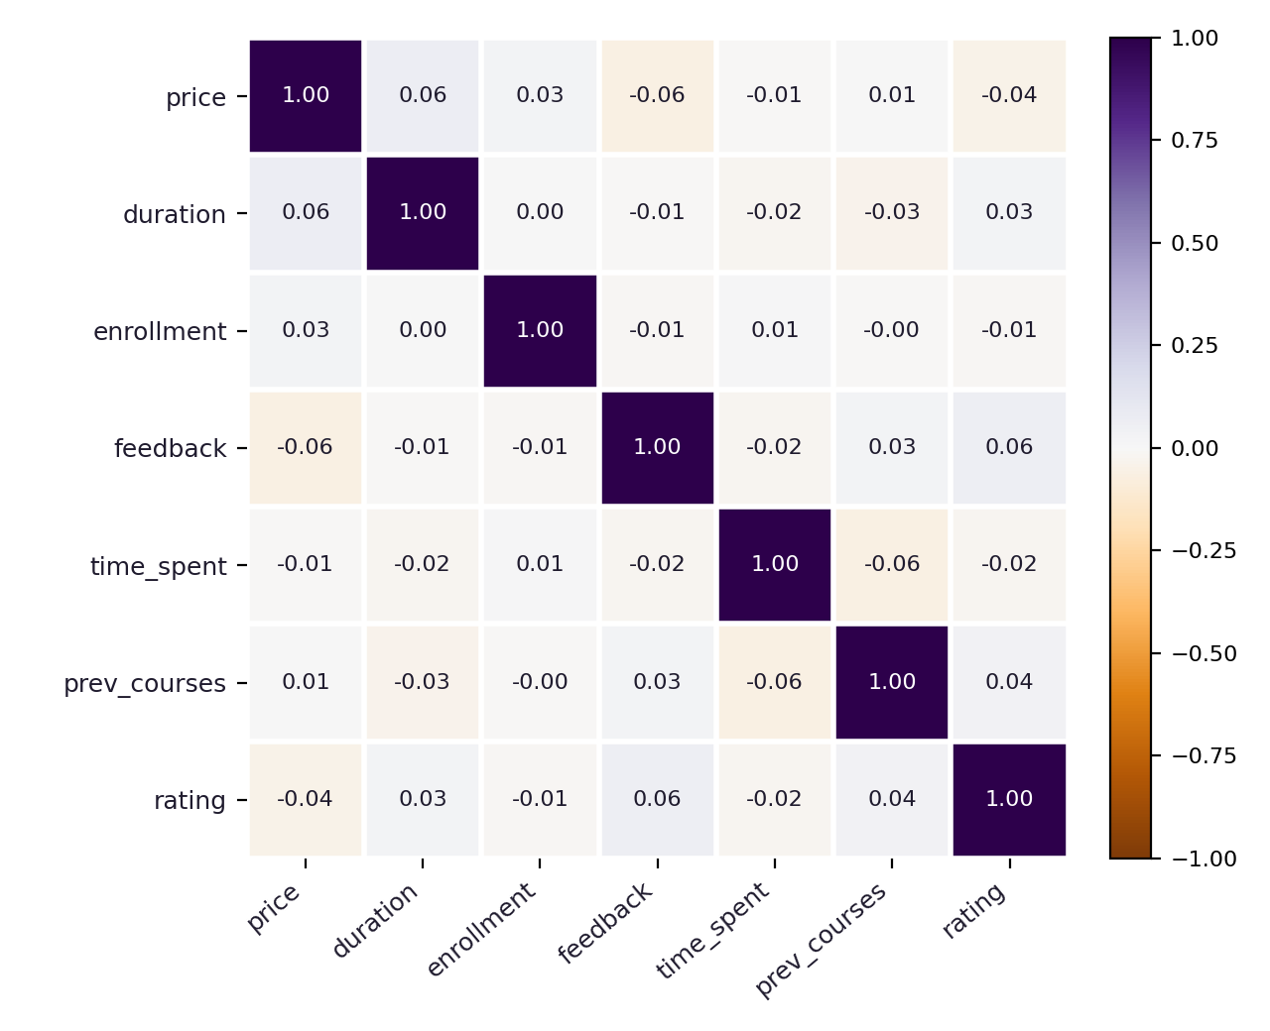
EXPLORATORY DATA ANALYSIS · 06
Correlation Heatmap
INFERENCE
A weak correlation exists between most numerical variables.
No single feature dominates the recommendation outcome.
Multiple features combined together improve prediction quality.
ONLINE COURSE RECOMMENDATION SYSTEM
13

Slide 14
EXPLORATORY DATA ANALYSIS · 07
Rating vs. Feedback Score
INFERENCE
A weak positive relationship was observed between rating and feedback score.
Feedback score alone cannot reliably predict ratings.
Different learners rate courses differently — additional features improve accuracy.
ONLINE COURSE RECOMMENDATION SYSTEM
14

Slide 15

PREPARING FOR MODELLING
Feature Engineering
1
Converted binary features (Yes/No → 1/0).
2
Encoded course difficulty using Label Encoding.
3
Created an Engagement Score to measure learner activity.
4
Created a Popularity Score using ratings, feedback, and enrollments.
5
Built a final feature dataset for training the recommendation models.
ONLINE COURSE RECOMMENDATION SYSTEM
15

Slide 16


MODELLING APPROACH
Recommendation Techniques
Two recommendation techniques were implemented for this project.
1
2
Content-Based Filtering
Collaborative Filtering
Recommends courses similar to the selected course, using course features such as name, instructor, and difficulty.
Recommends courses preferred by users with similar interests, based on the user–course rating matrix.
ONLINE COURSE RECOMMENDATION SYSTEM
16

Slide 17
MODEL · 01
Content-Based Recommendation
Recommends courses based on course features.
ADVANTAGES
Uses Course Name, Instructor, and Difficulty Level.
Fast recommendations
Converts text into numerical values using TF-IDF.
Measures similarity using Cosine Similarity.
Works for new users
Suggests the top similar courses.
Easy to implement
ONLINE COURSE RECOMMENDATION SYSTEM
17

Slide 18

MODEL · 02
Content-Based Results
EXAMPLE — INPUT COURSE
Python for Beginners
INFERENCE
RECOMMENDED COURSES
Recommendations are based on similar course features, helping learners discover related courses they may not have searched for directly.
Cybersecurity for Professionals
Networking and System Administration
Ethical Hacking Masterclass
DevOps and Continuous Deployment
ONLINE COURSE RECOMMENDATION SYSTEM
18

Slide 19
MODEL · 03
Collaborative Filtering
Uses user ratings for recommendations.
ADVANTAGES
Creates a User–Course Matrix.
Personalized recommendations
Finds similar users using Cosine Similarity.
Recommends courses liked by similar users.
Learns from user preferences
Improves user experience
ONLINE COURSE RECOMMENDATION SYSTEM
19

Slide 20
MODEL · 04
Collaborative Filtering Results
EXAMPLE — USER ID: 15796
RECOMMENDED COURSES
INFERENCE
Python for Beginners
Recommendations are based on users with similar interests, providing truly personalized course suggestions tailored to each learner's behaviour.
DevOps and Continuous Deployment
Networking and System Administration
ONLINE COURSE RECOMMENDATION SYSTEM
20

Slide 21

BRINGING IT TO LEARNERS
Streamlit Deployment
The recommendation model was deployed using Streamlit.
SAVED FILES
BENEFITS
course_df.pkl
Fast Loading
cosine_sim.pkl
Lightweight
course_indices.pkl
Interactive User Interface
Easy Course Recommendation
ONLINE COURSE RECOMMENDATION SYSTEM
21

Slide 22


DEPLOYMENT
Deployment — App Screenshot
Streamlit Web App
Learner selects a course from a dropdown and instantly sees the Top 5 recommended courses, computed live from the cosine similarity matrix.
Content-Based Filtering
TF-IDF Vectorization
Cosine Similarity
21

Slide 23

SIDE BY SIDE
Model Comparison
Basis
Content-Based
Collaborative
Uses
Course Features
User Ratings
Speed
Fast
Requires User History
New Users
Works for New Users
Needs History First
Implementation
Easy Implementation
More Complex
Personalization
Generic per Course
Personalized
Accuracy
Good
Better Accuracy
ONLINE COURSE RECOMMENDATION SYSTEM
22

Slide 24
WHAT THE DATA TOLD US
Key Insights
Dataset contains 100,000 learner–course interactions.
No missing values and no duplicate records.
Beginner courses dominate the platform.
Certification increases learner interest.
Ratings are generally high across courses.
Price has minimal impact on popularity.
The recommendation system performs effectively.
ONLINE COURSE RECOMMENDATION SYSTEM
23

Slide 25




WHERE THIS COULD GO NEXT
Future Scope
Hybrid Recommendation System
Deep Learning Models
Real-Time Recommendation
Personalized Learning Paths
Mobile Application
Cloud Deployment
AI Chatbot Integration
ONLINE COURSE RECOMMENDATION SYSTEM
24

Slide 26
WRAPPING UP
Conclusion
Successfully developed an Online Course Recommendation System using:
Exploratory Data Analysis
Feature Engineering
Content-Based Filtering
Collaborative Filtering
The system provides personalized course recommendations that improve learner experience and simplify course selection.
ONLINE COURSE RECOMMENDATION SYSTEM
25

Slide 27
THANK YOU
Questions & Discussion

