Slide 1
INTRO TO AI (FINAL PROJECT PROPOSAL)
Covid 19 Detection Using Symptoms
Presented By:
Harshavardhan Reddy Balla (00763407)
Sujith Kumar Gajarla (00766740)

Slide 2

GOAL
To train a model to predict Covid-19 positive or negative based on symptoms.
To minimize the chance of Positive person is being classified as Negative (i.e minimizing False positive < 5 )..
Implementing machine learning model for classifying the records in the dataset correctly, consistently and time efficiently.

Slide 3
OBJECTIVE
To design the best model such that it can predict the target accurately by comparing the results of individual model.
To implement various machine learning algorithms such as
Support Vector Machines.
Decision Trees
Voting classifier
To tune the hyperparameter and use voting classier for better accuracy.
Then to classify the test dataset using best model found.

Slide 4
Data Preprocessing
Data Acquisition (web
source)
(Data cleaning, normalisation and feature engineering)
1
2
4
3
Target Prediction (Model testing and accuracy prediction)
Model Fitting (Dataset splitting, Cross validation
and Model training )
Approach
TOOLS: Anaconda (Jupyter notebook)

Slide 5
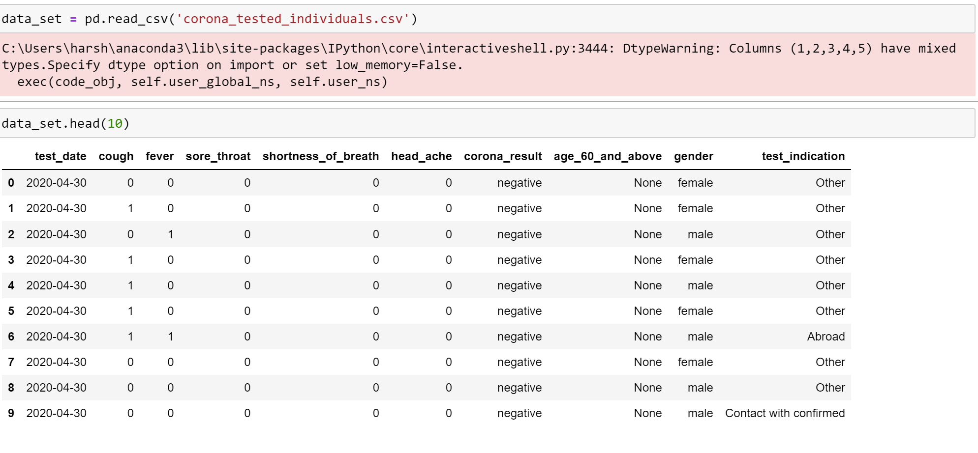
DATASET
https://data.gov.il/dataset/covid-19 (English) – Dataset Taken From
https://www.kaggle.com/datasets/imdevskp/corona-virus-report - For Futhur Research.

Slide 6
Evaluation Methodology
Confusion Matrix : for finding False Positive, True Positive, false Negative, True Negative
F1-score
Accuracy(>95)
Time Complexity
Correctness
Feature importance: You can measure the role of each feature in your final model using either built-in or external feature importance algorithms.
Decision boundary visualization

Slide 7
Deliverables
A user documentation manual with details of the working model.
A Python file containing machine learning algorithms developed for classification using the Python programming language.
GitHub repository link for project code and related files.
A YouTube video showing the project implementation and slides

