Slide 1
Honeywell Technology Challenge
Team name: Thinktank
Team members: Dheeraj R K
Harsha Vardhan M A
Nishanth M L
Srikanth E
College: PESIT, Bengaluru
Theme: Determine seating in an open
seating environment.

Slide 2
Approach to the problem
Creating cross platform applications, where a small background trail is left behind, to indicate the server regarding change in routers or access points(based on their physical addresses). The background thread runs every 10 minutes, checking for router changes.
A dynamic database is used to store changes, and the person querying the database can find out an approximate postion of the employee.

Slide 3
What we have used
Electron : a framework for creating native, desktop applications with web technologies.
Express JS : a node.js framework to create the server
MySql : An RDBMS , which holds our dynamic database
Variety of node packages are used in the computation tasks and the functionality of the application (like getmac, network, node-arp, auto-launch), and in the development process of the app (like electron-prebuilt, electron-packager) and many more …
Android studio (to develop only a simple database-querying app)

Slide 4
How does our app work?
A background thread has been created in the application, which works from the bootup of the computer till it shuts down (that is, even if the user closes the app)
The background thread runs for every 10 minutes and captures changes in the postion of the employee(based on changes in the router he/she has been connected to)

Slide 5
How does our app work?(cont.)
The changes in the router addresses of an employee are being reflected into the database.
Any user, searching for other users queries tables in the database to look out for their positions.

Slide 6
Special features
The desktop application is cross-platform (works on Windows, Linux and macOS) and architecture neutral (works on both 32 and 64 bit computers).
The background thread of the app is highly stable and it will keep running in the background even if the user closes the app.

Slide 7
Special features(cont.)
The number of background processes running at a time is always maintained one , by killing appropriate background processes based on their PIDs.
This can be explained like; At first, if the user launches the app and closes it, the background thread remains executing. If the user relaunches the app, instead of stacking up the new background process(of the relaunch) on the older background process, the older background process is terminated, which prevents unnecessary piling of background processes (which eventually consumes a lot of RAM)

Slide 8
Special features(cont.)
The application auto-launches on the start (bootup) of the computer.
The application can be updated automatically over the air (since this is not a full fledged project, this feature is not yet supported. But it can be easily done by adding small piece of code)

Slide 9
Special features(cont.)
Searches in the application, support the LIKE feature (that is, if a user searches for ‘anth’ , he/she will find results of srikanth, nishanth and others who have anth in their names, along with ‘anth’ )
The application supports desktop notifications (this had been used to show various error conditions like, no internet connection, employee not found …) . Balloons are used in windows for this purpose.

Slide 10
Half developed features
A simple android application has been developed which only queries the database in the server to figure out location of any employee.
Support for an administrator for the desktop app, has been created in both the server and the client side, who would have power to add employees into the database and remove them too.

Slide 11
Half developed features(cont.)
Support for macOS has not been tested, and since Electron works cross-platform, macOS support can be easily be given.
Electron creates easily maintainable, flexible applications where adding extra functionalities are easier than normal desktop applications.

Slide 12
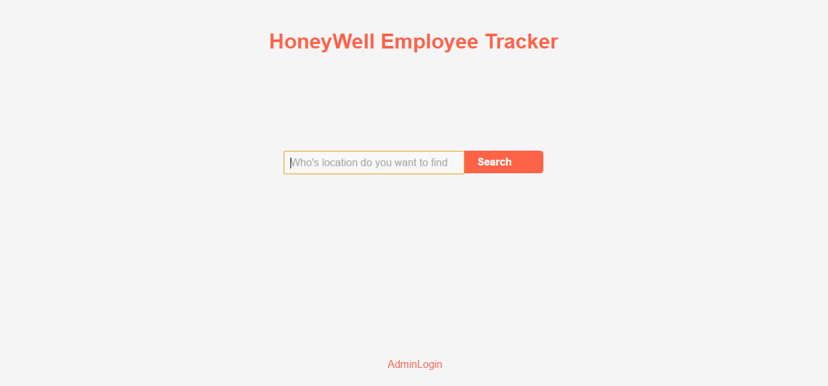
Screenshots

Slide 13
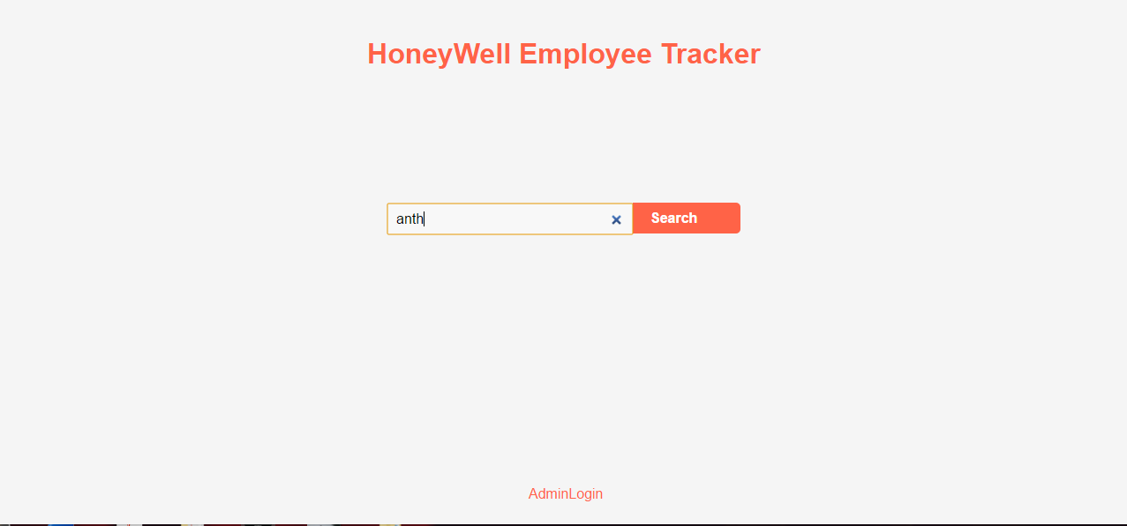
Screenshots

Slide 14
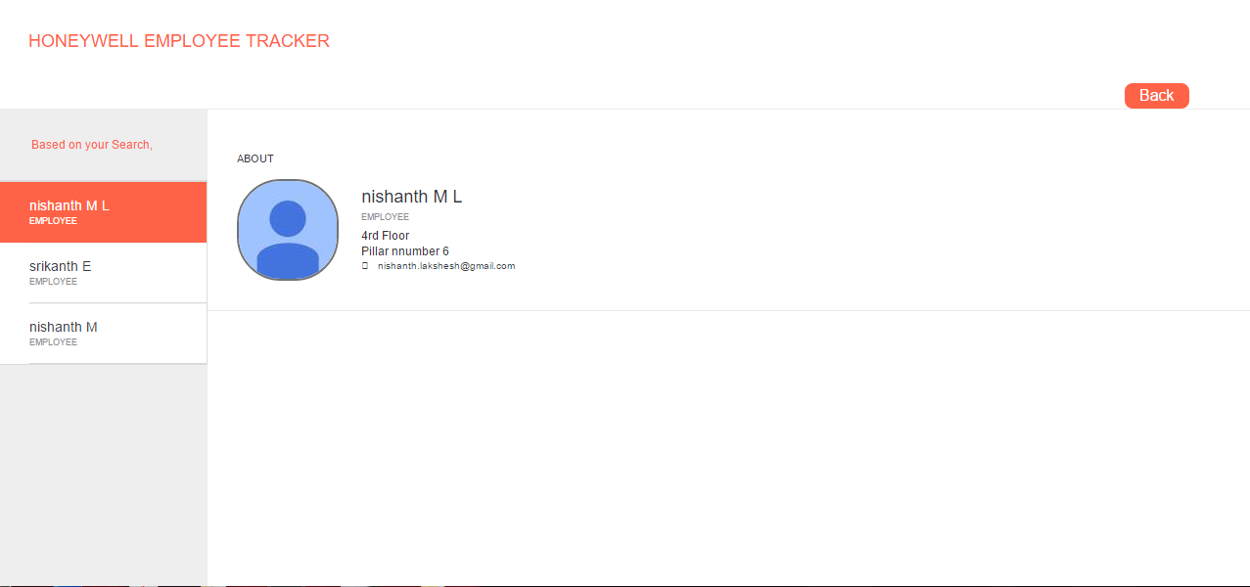
Screenshots

Slide 15
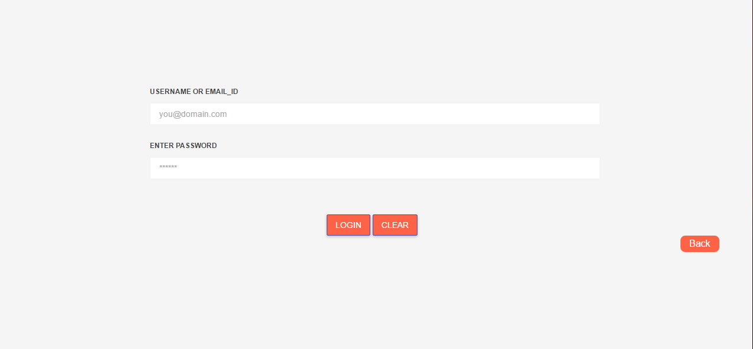
Screenshots

Slide 16
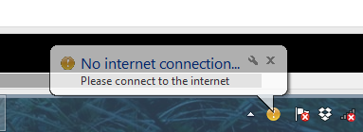
Screenshots

Slide 17
Kindly consider,
We are happy to fix all bugs , if they are encountered..

