Slide 1

PES Institute of Technology
Bangalore-560085.
Department of Information Science and Engineering
PROJECT
On
“ENCODING AND DECODING OF STRINGS USING MORSE-LIKE CODE ”
By
DHEERAJ RK
USN: 1PI14IS016
HARSHA VARDHAN MA
USN: 1PI14IS017
Guided by
Dr. Shylaja
and
Prof. Sindhu Pai

Slide 2
MOTIVATION
Inspired by the Enigma machine, invented by the Nazi Scientists during World War-2 , the famous computer scientist , Alan Turing was able to decrypt the messages encoded using the Enigma.
Hence , motivation was by Alan Turing and the Nazi Scientists in some sense.
Here , we try to make a similar model like the Enigma machine , with a little tweaking involved , i.e., adding our own encoding- decoding schemes and adding speech recognition as the input taking method.
HOW IS MORSE CODE USED TODAY?
Morse code was once widely used World over by almost everyone needing distant communication. Military, overseas shipping and the railroad relied on Morse code to provide reliable messages via wires. After the invention of radio during the first years of the 1900s, communication became more widespread and predictable. Industries relied on it to send simple and rapid messages to their distant clients and employees.

Slide 3
INTRODUCTION
MORSE CODE :
An alphabet or code in which letters are represented by combinations of long and short light or sound signals.
"it transmits a signal of continuous dashes in Morse”
Morse code is a method of transmitting text information as a series of on-off tones, lights, or clicks that can be directly understood by a skilled listener or observer without special equipment.

Slide 4
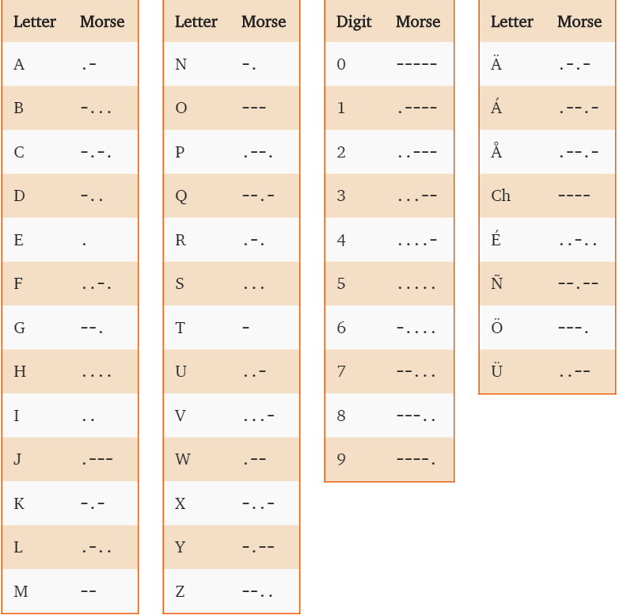
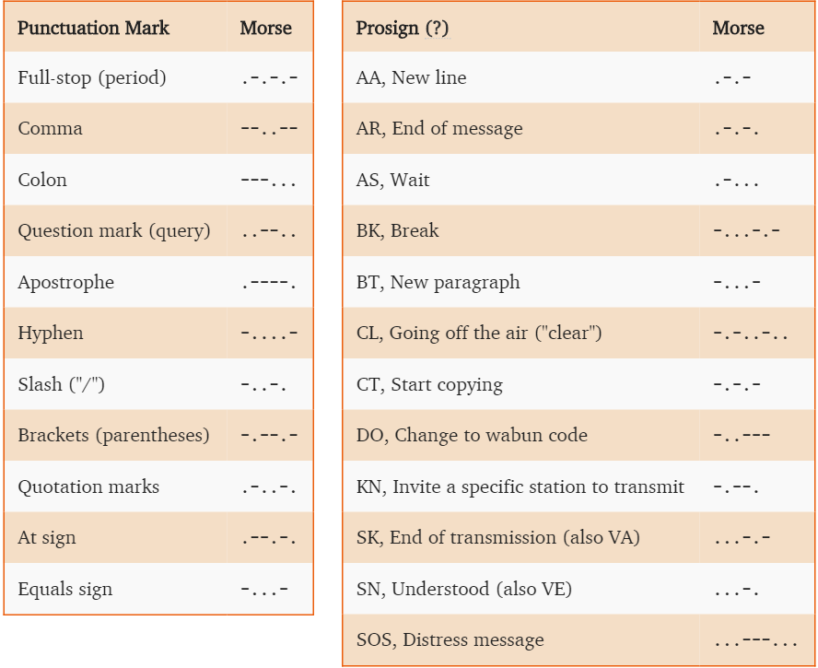
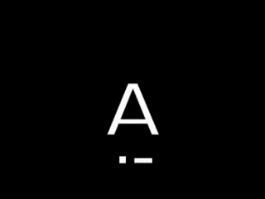
International Morse Code

Slide 5
ARCHITECTURE
TAKEN INPUT IS ENCODED INTO MORSE-LIKE CODE USING PREDEFINED FORMULAE
A BINARY TREE IS CREATED TO DECODE THE ENCODED STRING USING A PARTICULAR DECODING SCHEME
INPUT THROUGH SPEECH RECOGNITION
DIFFERENT PERMUTATIONS AND NECESSARY FILES ARE PROVIDED

Slide 6
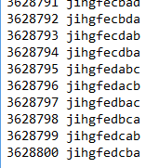
DESIGN
We are recording the English sentences. We are encoding it and converting the same to Morse Code which changes over a period of time.
We are recognizing the speech and by taking the recognized speech, we are writing it to the txt file, splitting each character, encoding it and finally converting it into Morse Code.

Slide 7
IMPLEMENTATION
We have written code in JAVA and used some packages .
We have used “SPHINX” which is a java package to recognize the speech and convert it to text .
We should store the words in a text file and when we input the speech it will recognize and search for the word in the text file and it will show the recognized output.
Later, the output obtained is encoded using a specific technique into morse-like code.
To decode the encoded morse-like code, we are using a binary tree with nodes as different alphabet, numbers and traversal of which can happen using the dits and dash sequences of the encoded morse-like code.
Encoding is done with the help of Cantor’s bijection formula,
(((x+y)*(x+y+1))/2)-1

Slide 8
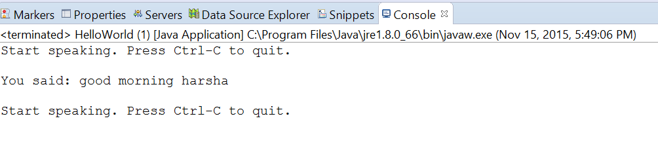
RESULTS
The recognized speech is given output as a string ,and that string is written to a text document.
This recognized speech is taken as input for the encoding process and it is converted to Morse code.

Slide 9

RESULTS
INPUT:
OUTPUT: Decoded output

Slide 10
DISCUSSIONS
We will let you play a game ,i.e you should just guess the output of the given speech.
Once the English Sentence is encoded , it can be given an open activity to decode it without using the decoding program.

Slide 11
CONCLUSION
This can be taken to recognize the (voice) speech and encode it.
It is very helpful for messaging without revealing the message for the intermediate person.
This cryptographical program works for nearly for pow(10,10) to pow(10,13) sentences .

Slide 12
FUTURE WORK
We will try to make the speech recognition more efficient.
We will try to get the input to the encoder by Speech recognition.
Try to convert the decoded text back to audio.
Encoding scheme can be made more efficient

