Slide 1
MORSE CODE
An alphabet or code in which letters are represented by combinations of long and short light or sound signals.
"it transmits a signal of continuous dashes in Morse”
Morse code is a method of transmitting text information as a series of on-off tones, lights, or clicks that can be directly understood by a skilled listener or observer without special equipment.

Slide 2
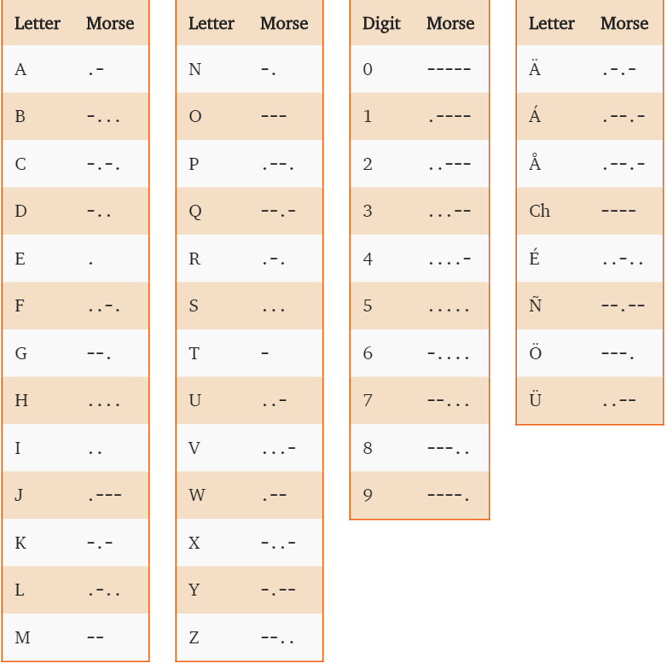
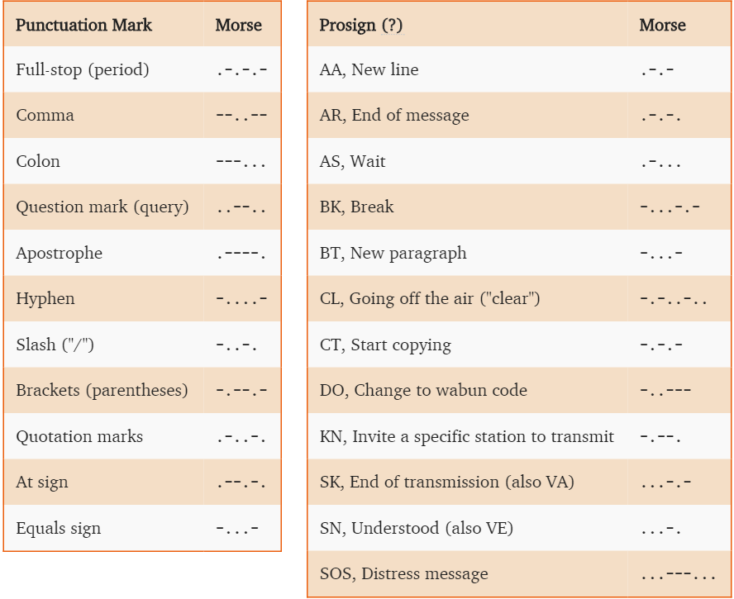
International Morse Code

Slide 3
MOTIVATION
HOW IS MORSE CODE USED TODAY?
Morse code was once widely used World over by almost everyone needing distant communication. Military, overseas shipping and the railroad relied on Morse code to provide reliable messages via wires. After the invention of radio during the first years of the 1900s, communication became more widespread and predictable. Industries relied on it to send simple and rapid messages to their distant clients and employees.
Communication today relies upon satellites, a complex grid and advanced technology to speed messages rapidly World-wide. The internet has increased information flow and ease of contact in almost unimaginable ways. However, old technology has a way of creeping back, since it is simple, relatively inexpensive and does not depend on the fragile grid systems of modern technology. Morse code operators stand ready to help in dire emergencies, grid failures, or war!
At Code Quick, we have always used an analogy to the old farm "out house." The technology might not be up to date, but it is certainly comforting to know there is one to fall back on if advanced plumbing fails.
Consider the following:
Amateur radio operators use Morse code extensively for contests, during which rapid connections are imperative. Morse code know as continuous wave transmissions or CW, requires a small footprint and therefore is readable when pileups occur on radio bands. The larger the amount of data to be transferred, the larger the amount of bandwidth required. Radios can be constructed cheaply without modulation and run much less power than with more sophisticated equipment.
Navigation beacons help airline pilots find and maintain proper headings even today.
Flashing light Morse even from a flashlight may be read several miles away for a lost sailor or hunter. Countless snowstorm rescues have been recorded by stranded drivers flashing an SOS signal on a flashing light. Mirrors accomplish the same thing during the day. The user directs a mirrored sun reflection and then blocks it with his other hand or piece of cardboard flashing out the Morse code signal.
Medical uses allow the severely handicapped person to tap or blink out a message that can now be ready by computers, giving new hope and meaning to life for sufferers.
A new method for using Morse code involves cell phones and text messages entered from an iambic keyer on the cell phone face. It seems that experienced Morse code operators can enter the text much faster than a QUERTY keyboard operator and can do it without looking at the keyboard. See Here
Who knows how brilliant minds will conceive of ways to use this simple technology in the future. In the mean time, knowing code might just allow you to survive, especially in times of catastrophe or national emergency.

Slide 4
LITERATURE SURVEY

Slide 5
APPROCH
We are recording the English sentences and we are converting it to Morse Code which change over a period of time.
We are recording the sentences using the “Sphinx” which is a speech recognizer in Java.
We are taking the recognized speech and we are splitting each character and we are converting it into Morse Code.

