Slide 1
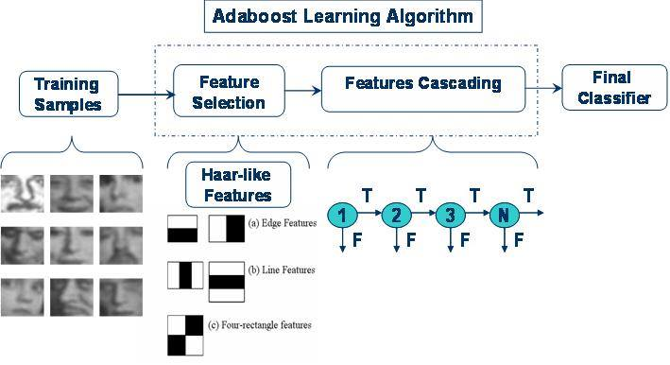
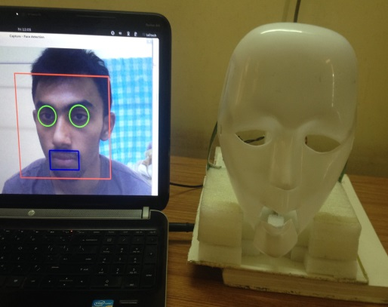
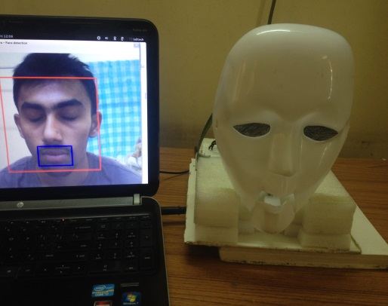
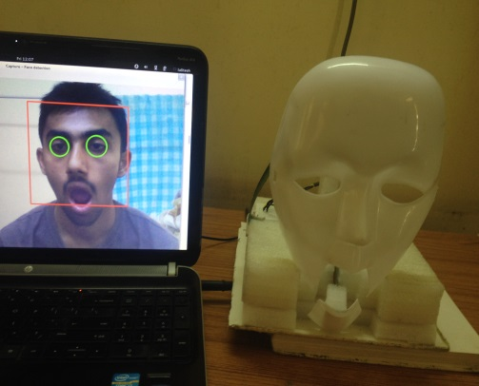
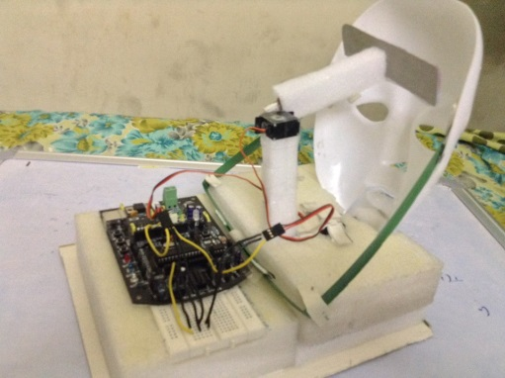
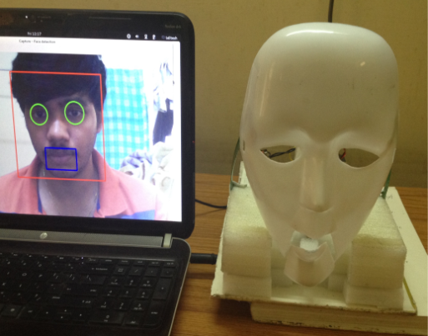
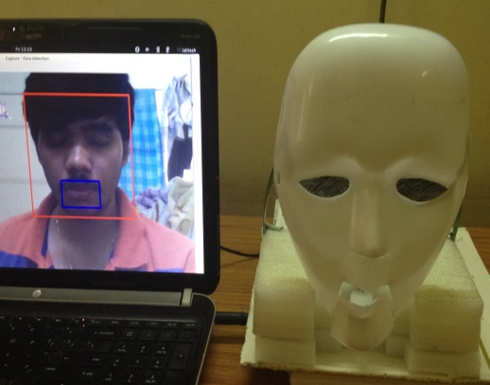
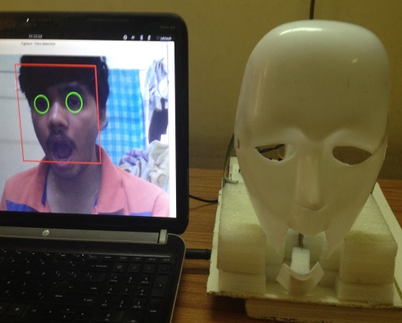
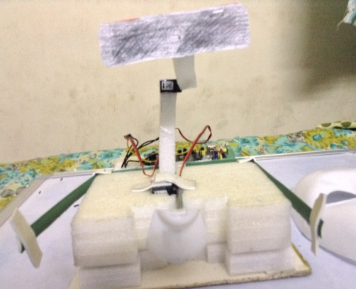
HUMANOID FACE PROTOTYPE
Mimics facial-gestures of the user in real-time
INTRODUCTION
Gesture recognition is an approach for an efficient human-computer interaction which is assumed to be very important in our daily lives. Gestures are meaningful body motions involving physical movements of hands, face etc., In this project, we considered face gestures as our approach to create human-computer interaction. To make the interaction possible, we are designing a humanoid face-prototype to mimic the gestures that are recognized on User’s face. By considering the complexities involved in Hardware & Software, we are limiting to detect only two facial gestures i.e., Eye-Blink and Jaw movement.
Input
Webcam is used to record the user’s face to recognize the gestures
Output
Recognized gestures are mimicked.
Motors controls the actions
Processing
OpenCV for gesture recognition
Arduino for decision making
BLOCK DIAGRAM
Arduino Processing:
Serial Communication between Arduino and Laptop is established through USB connection. File of Arduino ‘ttyUSB0’ can be accessed from the laptop. Status of flags related to mouth and eyes of face detected are continuously written in this file. Arduino reads this serial data to control the motors.
Number of eyes in the face detected are sent serially to Arduino. Eyes are considered as closed when number of eyes detected are 0 and opened when they are 1 or 2.
DESCRIPTION
Similarly, m/f ratio (area of mouth/area of face) is calculated in every frame. A limit to this ratio is statistically calculated. When this ratio crosses this limit then it is considered as mouth opened otherwise closed. These values are sent to Arduino serially which controls the respective servo motor to control the actions of face prototype.
Face Gesture Recognition:
OpenCV uses Viola-Jones method to detect the objects in the image. Viola Jones method has four basic key concepts.
Haar features
An Internal Image for rapid feature detection
Adaboost Machine learning technique
Cascade classifiers
REFERENCES
1. Paul Viola, Michael Jones. Rapid Object Detection using a Boosted Cascade of Simple Features in ACCEPTED CONFERENCE ON COMPUTER VISION AND PATTERN RECOGNITION 2001
RESULTS
Images showing detected gestures on user’s face and face prototype mimicking them
Hardware design
Mouth closed, Eyes open
Mouth closed, Eyes closed
Mouth open, Eyes closed
Arduino. Servo motors, Mask
Team: Harsha Vardhan , Lalitesh
Supervisor : Dr. Prithwijit Guha
EE 304 Design Project , IIT Guwahati

