Slide 1

Shrimp Disease Detection
Using Python and OpenCV — Camera-Based System
DEPT. OF CSE, JAIN (DEEMED-TO-BE UNIVERSITY), 2025–26
Submitted by: Harsha Varshan Reddy, Yokshith D, Sushmanth V, Devi Sri Praneeth B Under the Guidance of Prof. Lanke Ravi Kumar, Assistant Professor, CSE

Slide 2

The Problem: Disease in Shrimp Aquaculture
Rapid Spread
Traditional Methods
Bacterial and viral diseases like White Spot Syndrome (WSSV) and Vibrio parahaemolyticus cause mass mortality if untreated.
Manual visual inspection is time-consuming, subjective, and detects disease only at late stages.
Laboratory Limitations
Tests by institutions like ICAR-CIBA are accurate but costly, slow, and inaccessible for real-time farm decisions.

Slide 3
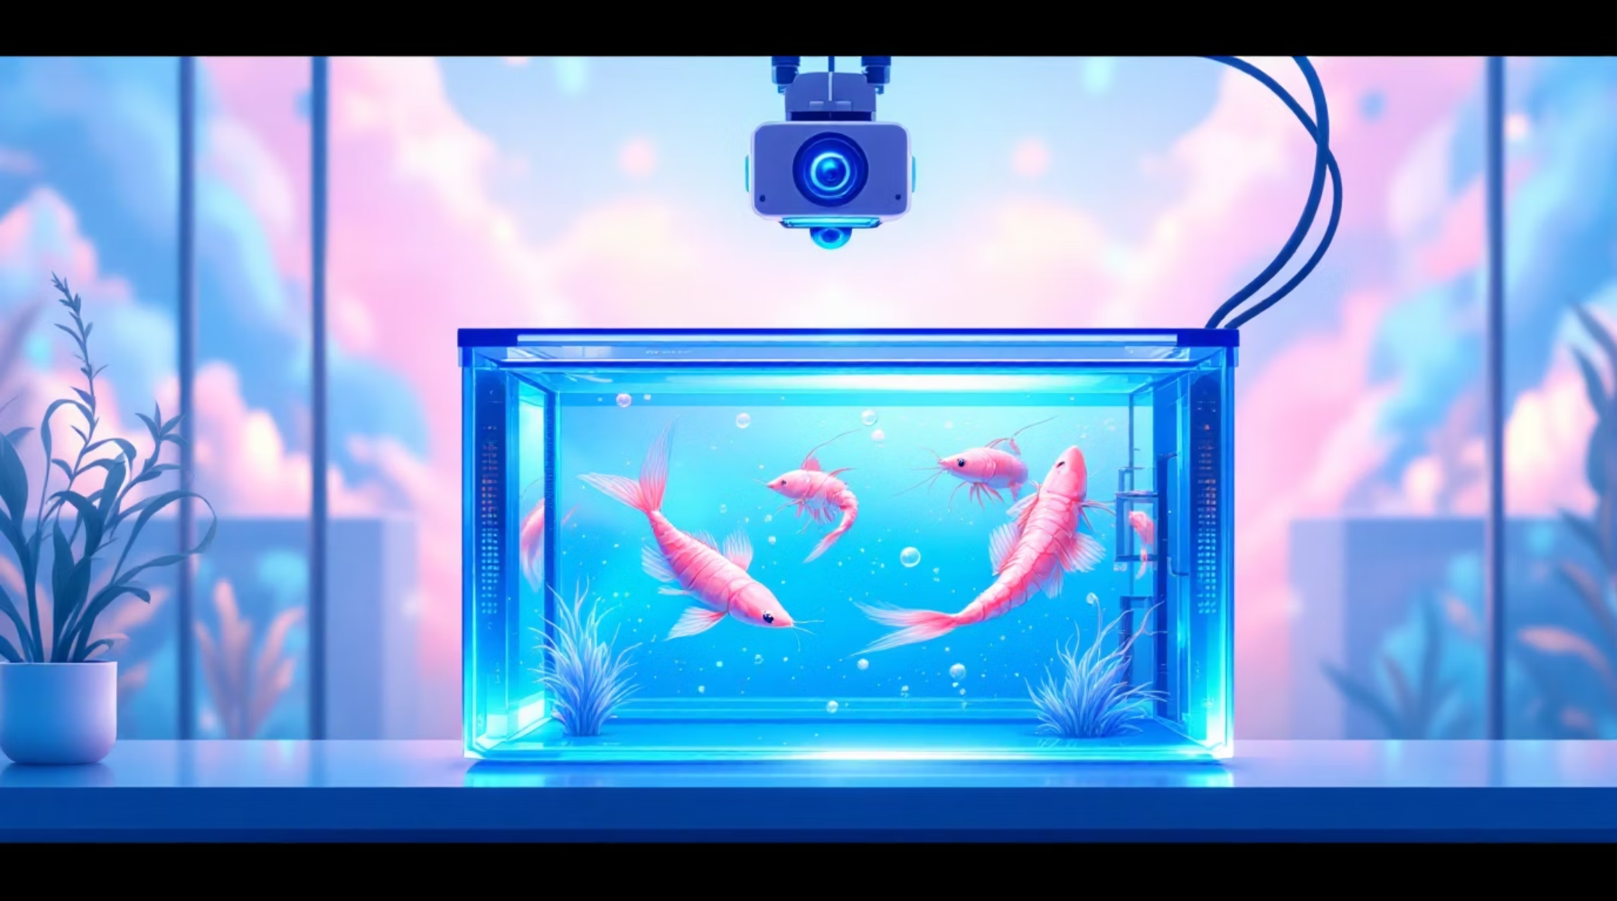
Our Solution: Camera-Based AI Detection
A camera placed above or near the tank captures live images of shrimps. These are processed using Python and OpenCV to:
Enhance image quality
Segment shrimp regions
Extract visual features — color changes, lesions, abnormal patterns
Predict healthy vs. diseased using a trained classifier (CNN)

Slide 4
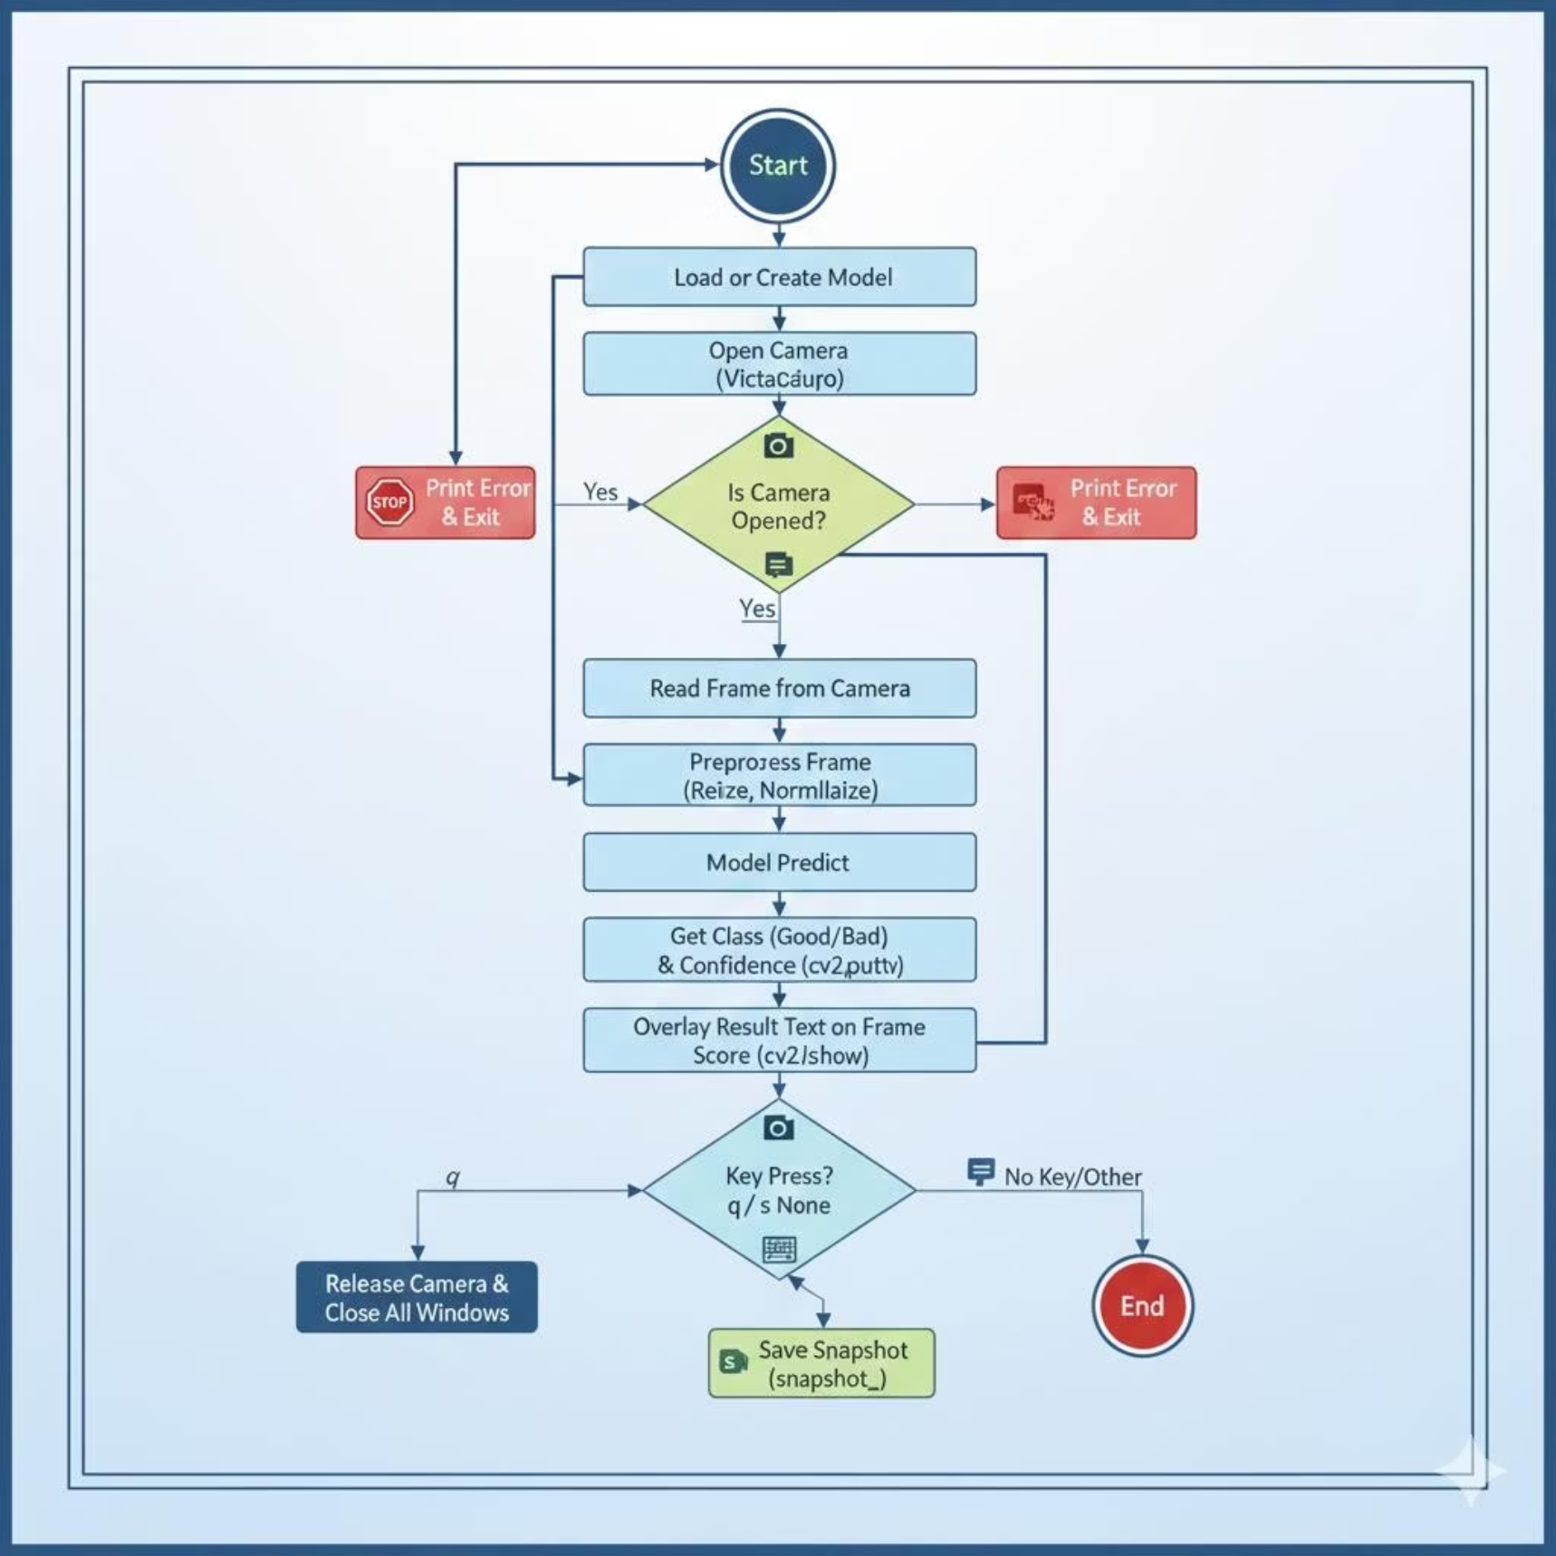
System Architecture
Three-Layer Pipeline
Hardware Layer
Laptop/PC + webcam via OpenCV VideoCapture(0)
Model & Processing Layer
Loads shrimp_model.h5; preprocesses frames to 224×224 RGB
User Interaction Layer
Real-time overlay, snapshot logging (s key), graceful exit (q key)

Slide 5
Implementation: Key Steps
01
02
03
Environment Setup
Camera & ROI
Color Masking
Import cv2, numpy, and TensorFlow Keras modules.
Capture frame, crop center region where shrimp is held.
Convert BGR → HSV; create white-pixel mask using brightness range.
04
05
Classification Rule
Display & Log
If white-pixel ratio > 15% → "Possibly Diseased"; else "Likely Healthy".
Overlay result on frame; save snapshots or quit via keyboard.

Slide 6
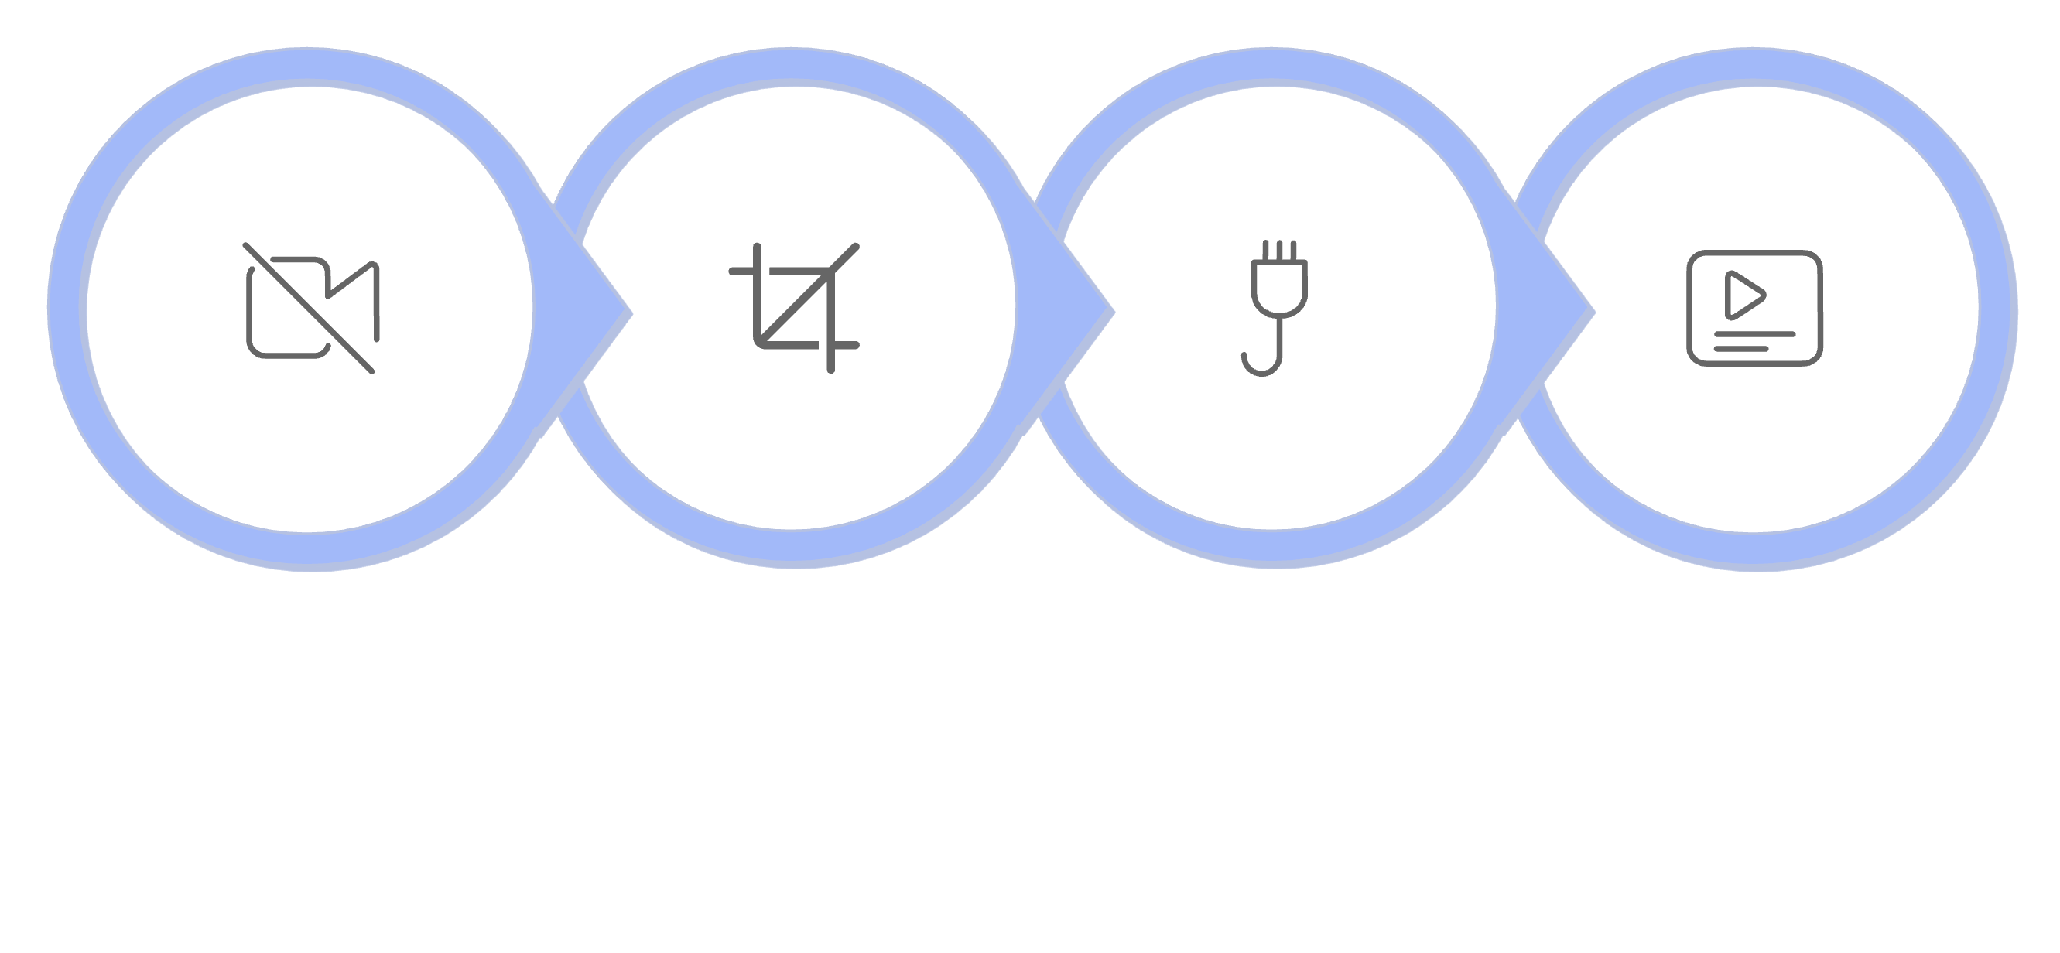
Model & Preprocessing Pipeline
Capture
Preprocess
Predict
Display
The dummy Keras model uses a Flatten → Dense(64, ReLU) → Dense(2, softmax) architecture, outputting probabilities for "Good Condition" (class 0) and "Bad Condition" (class 1). If shrimp_model.h5 is missing, it is auto-generated on first run.

Slide 7
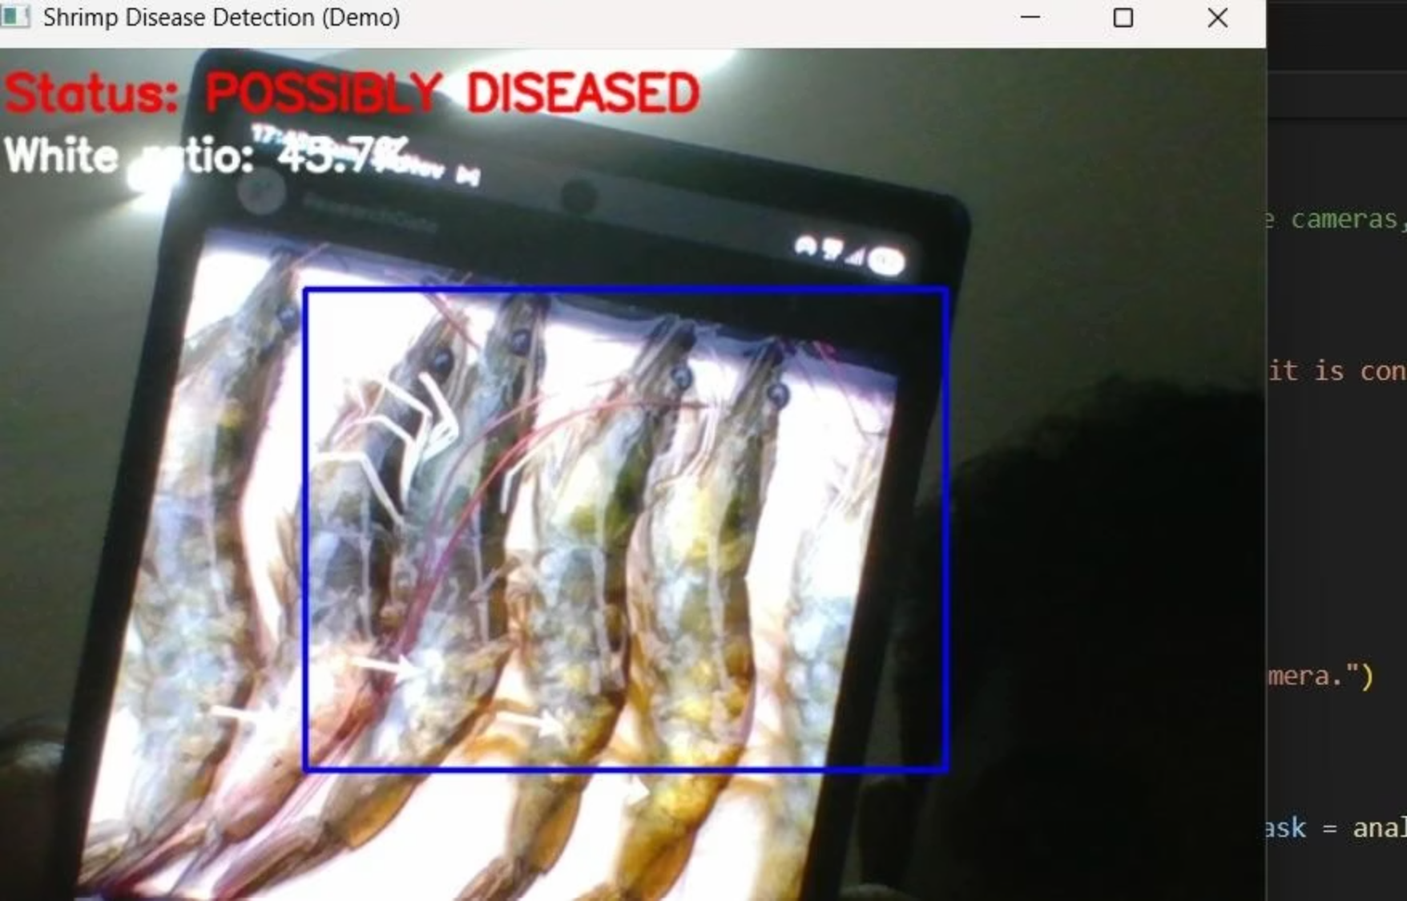

Results
Prototype Validation
The system ran end-to-end without lag on a standard laptop webcam:
✅ Frame Capture
Webcam feed opened successfully with proper hardware access.
✅ Real-Time Inference
Labels like "Good Condition (0.XX)" overlaid on every frame.
✅ Snapshot Logging
s key saved frames as snapshot_0.jpg, etc.
Note: The model used was a dummy placeholder — accuracy testing requires a real trained disease dataset.

Slide 8
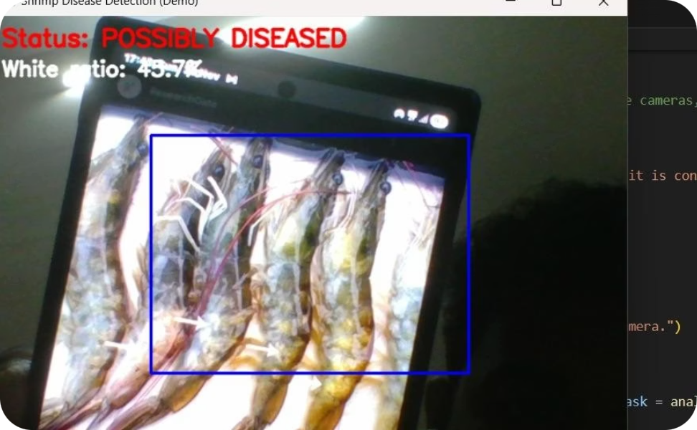
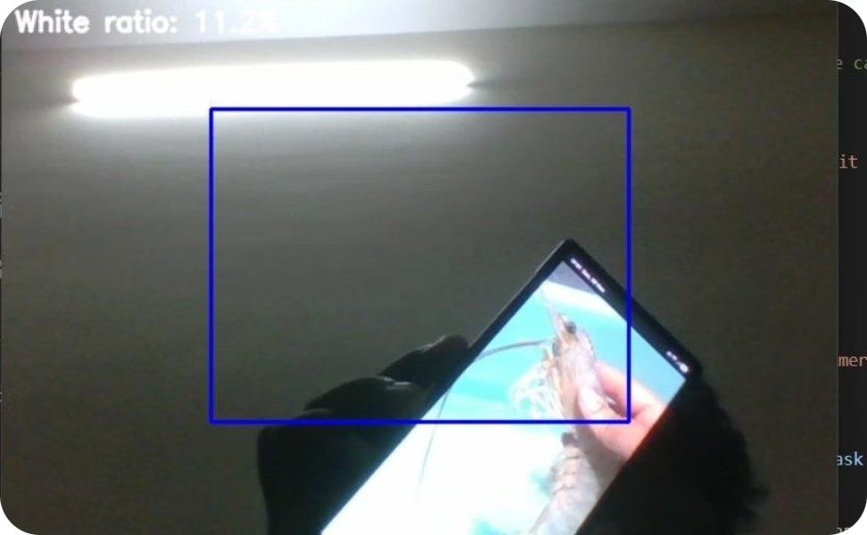
Visual Disease Indicators
Diseased Shrimp
White Spot Syndrome (WSSV)
Uniform shell color, no visible spots or lesions, active movement.
Characteristic white spots on shell — a key visual cue the system targets for classification.

Slide 9

Conclusion & Future Scope
Proven Feasibility
Next Steps
The prototype confirms that automated shrimp health screening using live camera feeds, OpenCV, and Keras is technically viable and runs in real time.
Train with real diseased shrimp datasets, add multi-disease classification, integrate YOLO for object detection, and connect to IoT/cloud dashboards for remote monitoring.
Impact
Enables faster farmer response — isolation, water treatment, oxygen correction — reducing mortality and economic losses substantially.

Slide 10
Thank You

