Slide 1

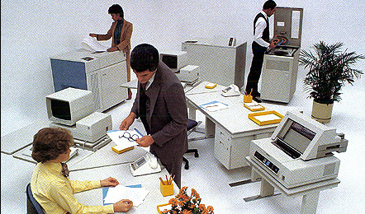
Mentor :- Mr.Pritish Varadwaj
Project Members :-
G.Varun Kumar Reddy (RIT2007019)
P.S.Raghu Chandra (RIT2007022)

Slide 2


Attendance of employee was kept on papers so was very difficult to maintain.
There was no proper tracking about visitors, just daily visitor information was kept and also was very difficult for retrieval.
Employee had to travel for office. So there were travel expenses and other expenses which should be reimbursed, but there was no proper management.

Slide 3

Now our proposed system will make the office
paperless, it will give a common platform that will maintain
attendance information,
visitors information,
reimbursement and
all letters tracking and we can retrieve any information any time in different format.

Slide 4

By building following features in old system
S: Keeping records of any visits to the office from an outside visitor thus making office secure.
M: Maintaining a record of inter-communication by hard mails (sending and receiving) like to whom it is forwarded and to whom it is sent.
A: Storing and maintaining information about each employee and their daily attendance.
R: Maintaining all the information about reimbursement.
T: Tracking

Slide 5

Jdk 1.6 with jdbc driver
Net Beans 6.5
MySql

Slide 6
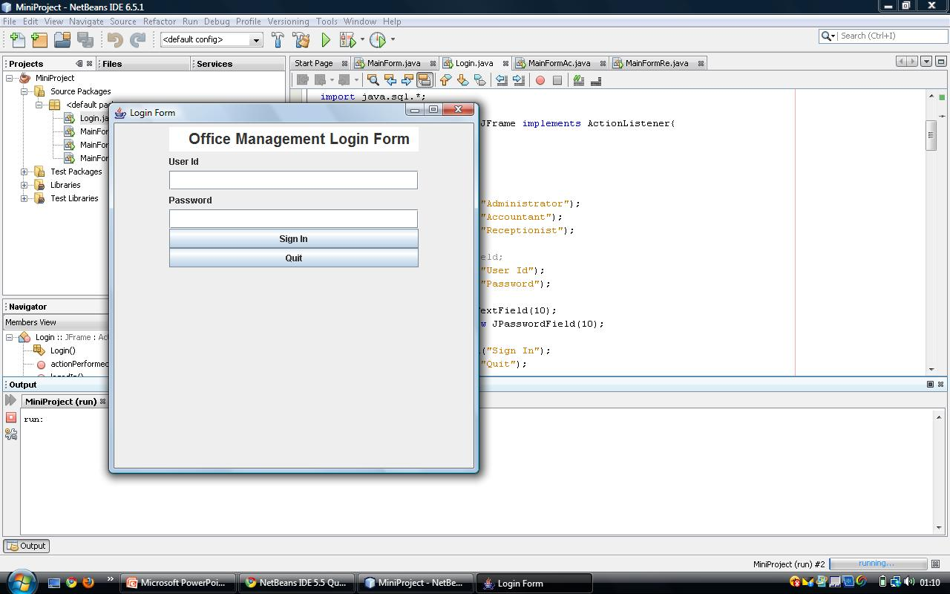

Slide 7
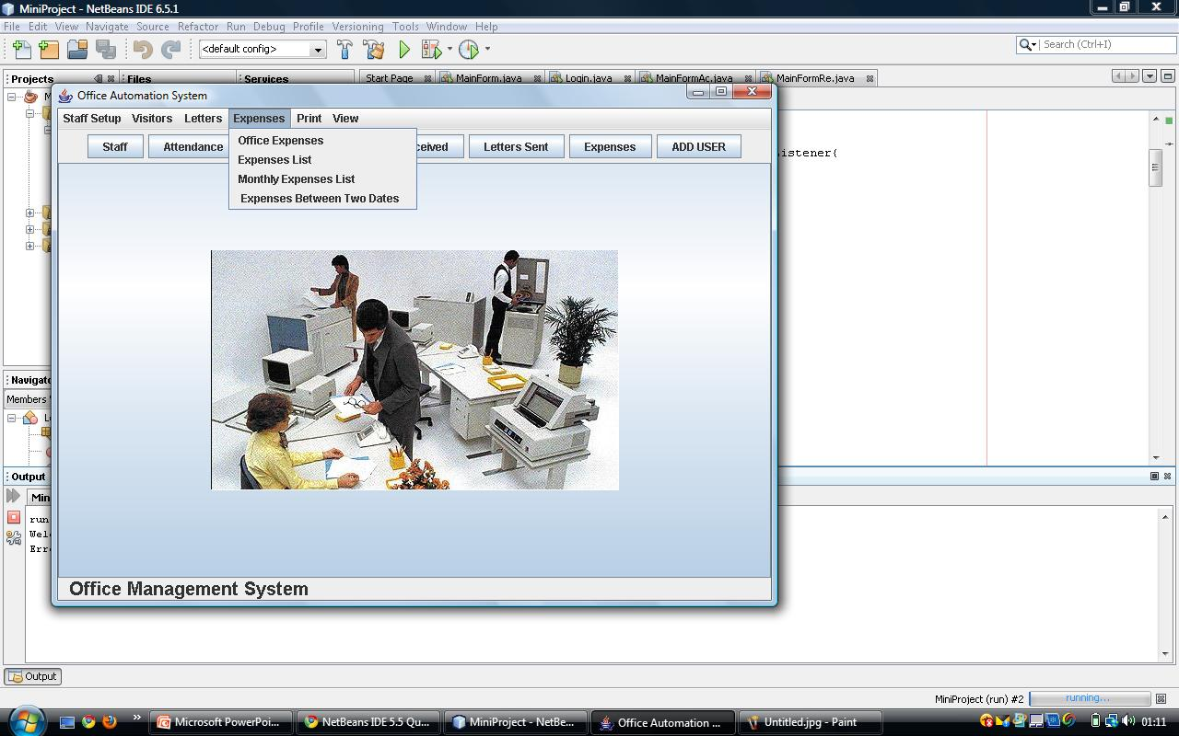

Slide 8

Swipe card system for attendance and authentication.
Maintain information about salary of employee.
This can be extended to an online system which can link different branches of a company.

Slide 9

Java 1.6 api
Complete reference java by Herbert Schildt
Netbeans tutorial - http://www.netbeans.org/kb/55/quickstart.html
Case study on “The Paperless Office: Facts and Fictions”, by Karl L. Smart ,Brigham Young University, Department of Management Communication.

Slide 10
THANK YOU

