Slide 1
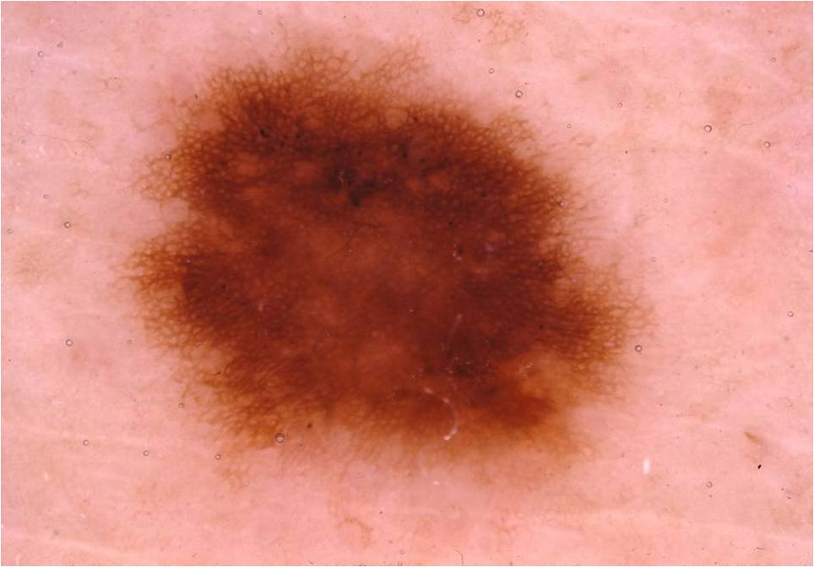
Feature Extraction
SVM-Classifier
Output:
Skin Lesion
Class
Input: Image

Slide 2
Convolutional Neural Network
Output:
Skin Lesion
Class
Input: Image

