Slide 1
Preventing phishing using visual cryptography
A.Harsha vardhan
imt2016101

Slide 2
Content
Phishing
Visual Cryptography
Online voting

Slide 3
Phishing
What is phishing ?
Phishing is a cybercrime in which a target or targets are contacted by email, telephone or text message by someone posing as a legitimate institution to lure individuals into providing sensitive data such as personally identifiable information, banking and credit card details, and passwords.
Phreaking + Fishing = Phishing
Phreaking = hack into telecommunications systems, especially to obtain free calls
Fishing = Attract the fish to bite
Phishing is a form of social engineering attack
Not all social engineering attacks are phishing attacks !
The first fishing incident appeared in 1995

Slide 4
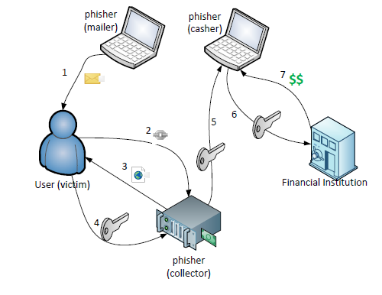
Phishing
Three components
Mail sender: sends large volume of fraudulent emails
Collector: collect sensitive information from users
Casher: use the collected sensitive information to en-cash

Slide 5
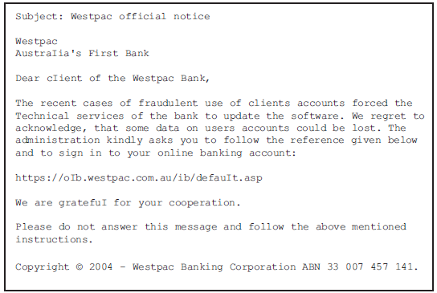
Standard email phishing case

Slide 6
Some examples of how phishing attacks are done
The email says you’ve won a contest you haven’t entered
The hyperlinked URL is different from the one shown
The email urges you to take immediate action
The email asks you to make a donation
The email includes suspicious attachments
Trojan Hosts

Slide 7
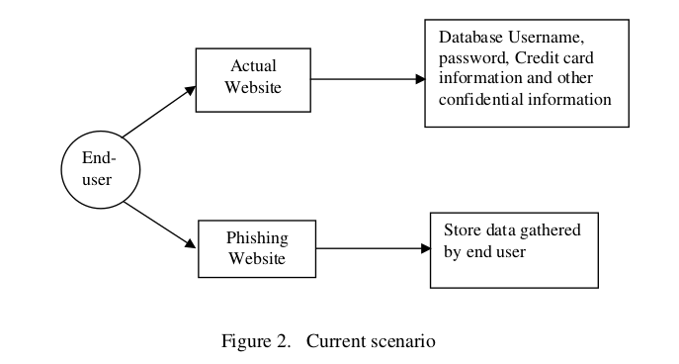
Phishing scenario

Slide 8
Some of the damages caused by phishing
India lost around $53 million (about Rs 328 crore) due to phishing scams with the country facing over 3,750 attacks in July-September last year
India ranked third in the list of countries where the highest number of cyber threats were detected, and second in terms of targeted attacks in 2017
7% of global phishing attacks are targeted in India
According to 2017 statistics, there are over 130 large-scale, targeted breaches in the U.S. per year, and that number is growing by 27 percent per year.
In 2016, 3 billion Yahoo accounts were hacked in one of the biggest breaches of all time
In 2016, Uber reported that hackers stole the information of over 57 million riders and drivers.

Slide 9
How to prevent phishing attacks ?
Visual cryptography
Visual cryptograpghy is one of the promising solutions to prevent cryptography
What is cryptography
Cryptography is associated with the process of converting ordinary plain text into unintelligible text and vice versa

Slide 10
Visual cryptography
Visual Cryptography is a special encryption technique to hide information in images in such a way that it can be decrypted by the human vision if the correct key image is used
Thus used to defend and security purposes.

Slide 11
How visual cryptography works?
Here plaintext is as an image
Encryption involves creating “shares” of the image which in a sense will be a piece of the image.
Give the shares to the respective holders.
Decryption – involving bringing together the an appropriate combination and the human visual system.

Slide 12


Example how visual cryptography works share 1 share 2 shares1+2

Slide 13
Visual cryptography
So basically it involves dividing the image into two parts:
Key : a transparency
Cipher : a printed page
Separately, they are just like random noise one is useless with out other share thus used for security purposes
Combination reveals an image

Slide 14
Advantages of visual cryptography
Simple to implement
Decryption algorithm not required (Use a human Visual System). So a person unknown to cryptography can decrypt the message.
We can send cipher text through FAX or E-MAIL
Infinite Computation Power can’t predict the message.

Slide 15
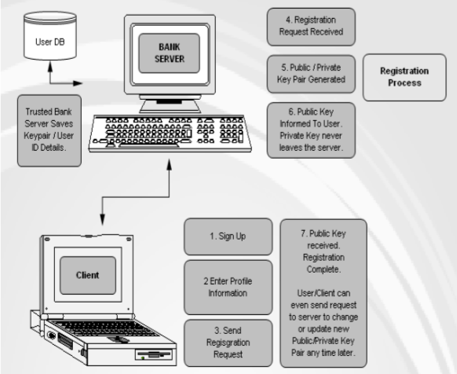
Preventing phishing using visual cryptograpghy
First step registration of user.

Slide 16
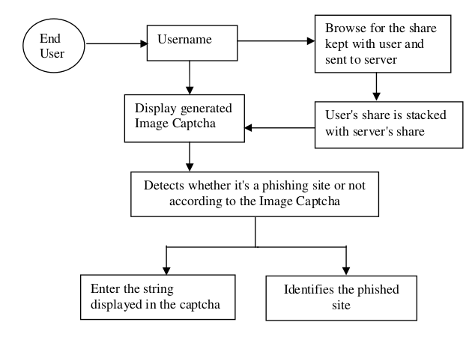
Preventing phishing using visual cryptograpghy
When user want to log in

Slide 17
Preventing phishing using visual cryptograpghy –CASE STUDY
ONLINE VOTING :-
Online voting system is the latest electronic voting system introduced in which the voted ballot is transmitted over the public Internet through web browser. The voter can directly vote online from anywhere in the world. Security is the major drawback in using this system .
Most of the applications are giving high protection towards the Password Security and they are not concentrating on phishing attacks. By phishing, attackers are directly getting the passwords from the user and they can enter into the relevant web sites with correct password.

Slide 18
Online voting
Generate user share and password for every voter – Mail them to voter using secure mails
Voter knows for sure that he is logging into legitimate website.
Once voter did his polling, he should not be allowed to vote again. This can be accomplished by making his password to be expired.
Whenever the voter did his polling, the corresponding voting count of that candidate has to be increased.

Slide 19
Online voting
Proper authentication should be provided so that the voters should not have unambiguous regarding the security of polling using online voting system. This can be achieved by the combined usage of visual cryptography and anti-phishing process.
Every voter should be provided with a share i.e. one of the image shares, of his password through any of the electronic transfer system such as email

Slide 20
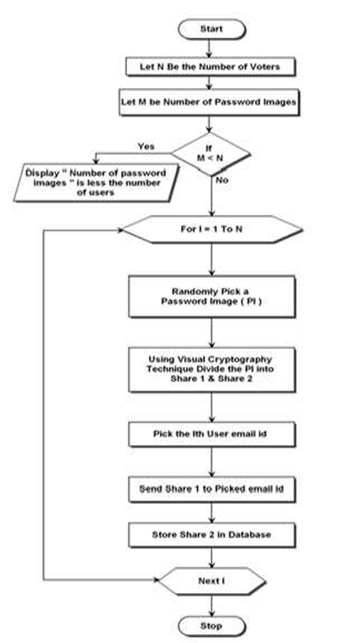
Online voting
In the Login phase first the user is prompted for the username (user id).Then the user is asked to enter his share which is kept with him. This share is sent to the server where the user's share and share which is stored in the database of the website, for each user, is stacked together to produce the image captcha. The image captcha is displayed to the user. The end user is required to enter the text displayed in the image captcha

Slide 21
Online voting -implementation
There are two sessions involved in the proposed system. They are Admin session and Voter session
Admin session
Login Details: Using this process, admin will login to the entire system.
Voters Details: The list of the voters who are eligible for the voting process can be viewed.
Election Details: The entire details of the elections (if any) present on any particular day can be viewed.
Image Details (Text Images): Here we present the password text images that the admin can provide for different voters that keep changing frequently.

Slide 22
Online voting -implementation
Nominees Details: Here the complete details of each nominee are presented clearly to make the work of admin simpler.
Setting Voters Password: The following steps to be taken for setting voters password:
-> Random Number Generator to pick the Image
-> Divide the Image into two shares using Visual Cryptography
Sending the First Share through Email using Visual Cryptography • Storing the second share in database .
Election Counting Details: Here the admin can actually view the number of votes gained by each candidate contested for elections and declare the results accordingly.
Change Password: Here the admin can change the passwords of all the candidates more frequently as per the requirement.

Slide 23
Online voting - implementation
Voter Session: Voter session involves user login with phishing protection, providing User ID and getting share from server, producing captcha image, and user home page whereas the user can select election, display the nominees, and cast the vote.
In the Voters Session, the following processes were involved:
A. Login Module with Phishing Protection
B. Providing User ID and getting Share from Server
C. Producing Captcha Image
D. Home Page
-> Selecting Election
-> Nominees Display
-> Voting Process

Slide 24
Advantages of Online voting
After user cast his vote, his password will be expired it will prevent same user from voting multiple times
Voter can vote from anywhere in the world with the internet access
Only user with a given ID can able to vote
counting becomes easier
Proposed online voting system is very effective and it will useful for voters and organization in many ways and it will reduce the cost and time.

