Slide 1
Human Activity Recognition Project proposal
Harshad Pardeshi Prof Srikanth Krishnamurthy
Rahul Chandra Spring 2018
Pratik patre Northeastern University

Slide 2
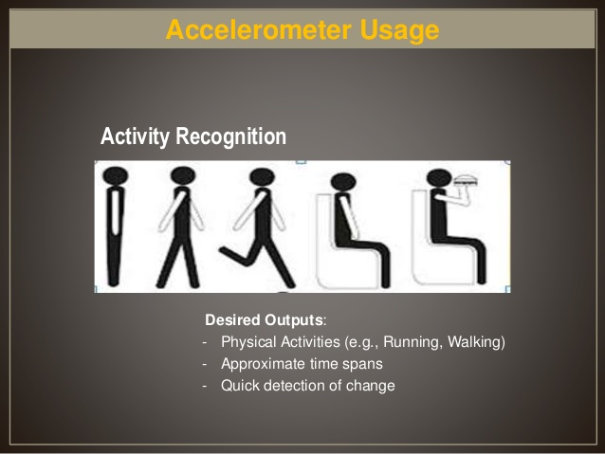
Introduction
Action Recognition is the process of identifying actions that occurs when an object moves(in this case, by humans)
Goal of activity recognition is an automated analysis or interpretation of ongoing events and their context from sensor data.
https://www.youtube.com/watch?feature=player_embedded&v=XOEN9W05_4A

Slide 3
Dataset
Body_accerlation
body_acc_x
body_acc_y
body_acc_z
6 activities WALKING, WALKING_UPSTAIRS, WALKING_DOWNSTAIRS, SITTING, STANDING, LAYING for 21 users
128 data points recorded in 2.56 seconds with 50% values carry forwarded
https://archive.ics.uci.edu/ml/datasets/human+activity+recognition+using+smartphones
Body_Gyroscope
body_gyro_x
body_gyro_y
body_gyro_z
Total_Acc
total_acc_x
total_acc_y
total_acc_z

Slide 4
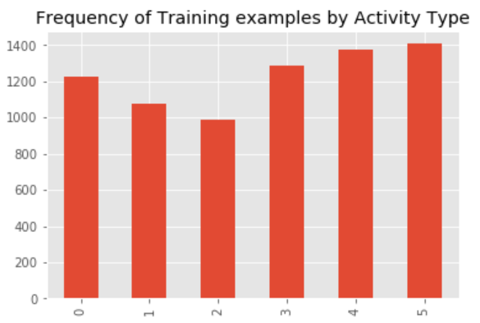
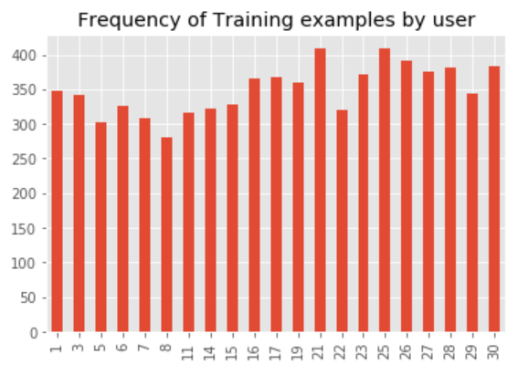
data Distribution

Slide 5
Proposed Work
Creating RNN and use of different activation functions for creating a base model
Implementation of LSTM and performance comparison between the two
Create REST API to call the model
Develop an Android App to predict the human activity with GPS data integration to measure distance and velocity

Slide 6
Thank You

