Slide 1
Local Train Ticket Generation
Presented by:
Varsha Bhanushali
Harshad Pardeshi
Bharat Verma
Guided by :
Rajashree Shedge

Slide 2
Agenda
Abstract
Present Scenario
Our ticket generation System
Ticket Generation process
Non Android Phones
Android Phones
Technologies used
Design
Business Opportunity
Results and Conclusion
References

Slide 3
Abstract
Now-a- days there are many options available for generating the Local train ticket. These options include through ATVM, printed ticket and CVM coupons.
Each of these have their own limitations viz. waiting in long queues, misuse of tickets. Also overhead of handling tickets, Smart cards or CVM coupons.
For the android phones, users can request their ticket through an android application. Users having non-android phones can generate their ticket using SMS.

Slide 4
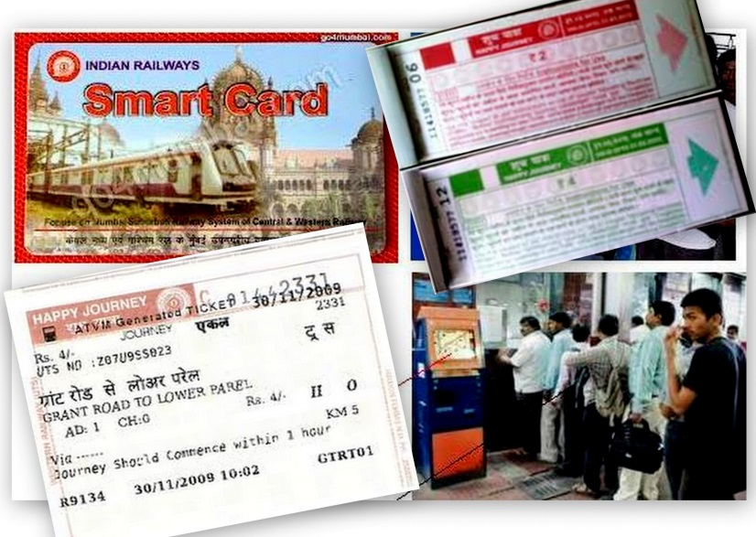
Present Scenario
Printed Ticket.
ATVM.
CVM coupons.
Existing System fot ticket generation:
Problems with these systems:
Passengers wait in long queue.
Time consuming process.
Large labor work required.
Unnecessary investment in ticket printing and specialized devices.
Handling of ticket, coupons, smart cards.

Slide 5


Our ticket generation System
Passenger can generate his ticket using mobile phone in two ways:
Using a simple Unified SMS.
Using a mobile application
Non-Android phone:
Android phone:

Slide 6
Ticket Generation Process
Steps :
Create Account.
Recharge account.
Request to generate ticket.
Validate the ticket.

Slide 7
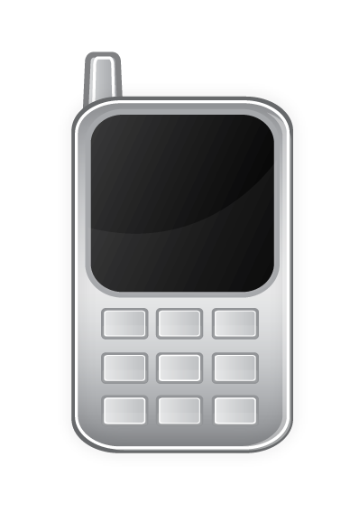
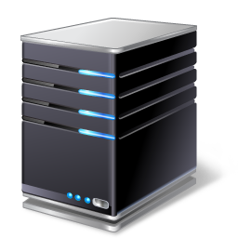

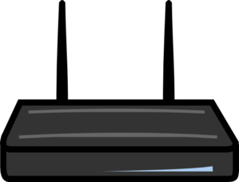
Generation process: Non-Android Phones
GSM Modem
Mobile Phone
Application Server
USSD gateway

Slide 8
Unstructured Supplementary Service Data(USSD)
USSD is a communication protocol used by GSM network to send text messages between mobile phone and application on the network.
No store and forward facility.
Menu-based application.
Phone and network independent.
Cost Effective.
Faster Communication.
Features:

Slide 9
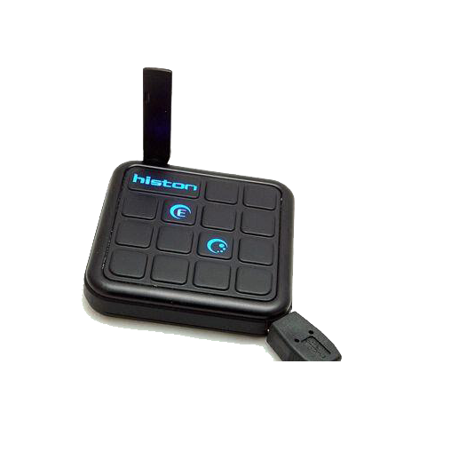
GSM Modem
Features :
Read, write and delete SMS.
Send and Receive SMS.
GPRS Support .
Quad Band GSM/GPRS 850/900/1800/1900 MHz
Connect via AT commands

Slide 10
Services provided
Book ticket - TKT BOOK from to no_of_passenger
Get help – TKT HELP
Get balance – TKT BALANCE
Get last booked ticket – TKT LBT

Slide 11
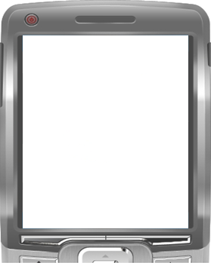
Ticket Generation
To:Gateway Number
TKT BOOK FROM TO No_of_passenger.
Options Send Exit
Rail_TKT
Your Ticket has been generated.
Ticket No : 00012
Options Reply Back
Ticket Request
Ticket Response

Slide 12
USSD Communication
*123*00012#
Options Call Exit
Tct no.00012
06/01/2009. 3:15.PM
From Kalyan to Nerul.
1 Adult, 0 Child
Single
Cost = 13 Rs.
Journey should commence in one hour.
Options Reply Back
USSD Request
USSD responce

Slide 13
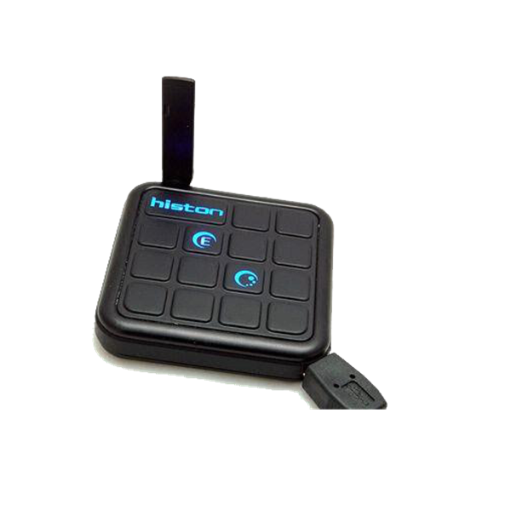
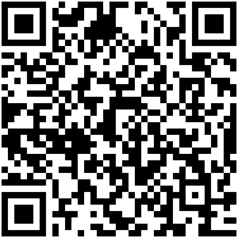
Generation process: Android Phones
Application Server
Android Phone
Gsm modem

Slide 14
Android SDK
Why Android?
Comprehensive.
Open source platform.
Secure.
Easy to Develop an app.

Slide 15
Quick Response Code (QRC)
Why QR Code ?
Easy to generate.
Secure way to encrypt
Capable of storing large data.
Scans quickly.

Slide 16
Technologies used

Slide 17
Enterprise JavaBeans
Enterprise JavaBeans (EJB) is a managed, server-side component architecture for modular construction of applications.
EJB is a server-side model that encapsulates the business logic of an application.
As the application complexity grows or the number of concurrent users increases, the use of EJBs makes it much easier to partition and scale the application

Slide 18
Hibernate
Hibernate is an object-relational mapping (ORM) library for the Java language.
It saves the development time.
Hibernate allows to map the Java objects to the relational database.
Hibernate can be used with JPA.
It makes application development easy.
Notes:
providing a framework for mapping an object-oriented domain model to a traditional relational database.

Slide 19
Maven
Apache Maven is a software project management and comprehension tool.
Maven can manage a project's build, reporting and documentation from a central piece of information.
Maven encourages the use of a central repository of JARs and other dependencies.
Superior dependency management including automatic updating, dependency closures.

Slide 20
SMSLib
SMSLib is a Java library which allows you to send/receive SMS messages via a compatible GSM modem.
Supports Inbound & Outbound big (multipart) messages.
Flash messaging.
Supports a few bulk operators, using http/https protocols.
SMSLib can handle multiple gateways at the same time.

Slide 21
Apache Tomcat
Apache Tomcat is an open source software implementation of the Java Servlet and Java Server Pages technologies.
Implements the Servlet 2.4 and JSP 2.0 specifications
Reduced garbage collection, improved performance and scalability
Native Windows and Unix wrappers for platform integration
Faster JSP parsing

Slide 22
Design

Slide 23
Block diagram
Non Android phone
USSD Server/gateway
GSM
Modem
Android phone
B
Application Sever
EJB Application
Centralized Database
Servlets
JAVA Beans
Rail Employee

Slide 24
RESULTS

Slide 25
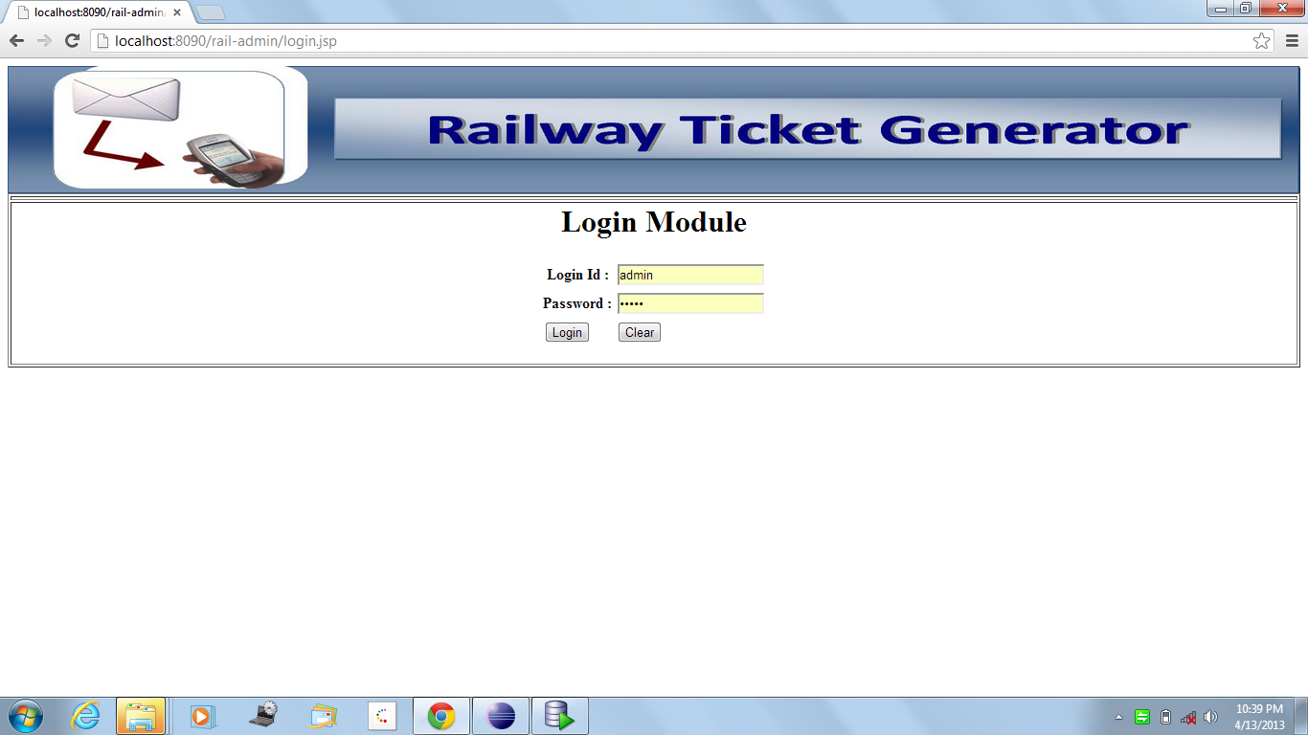
Login form :

Slide 26
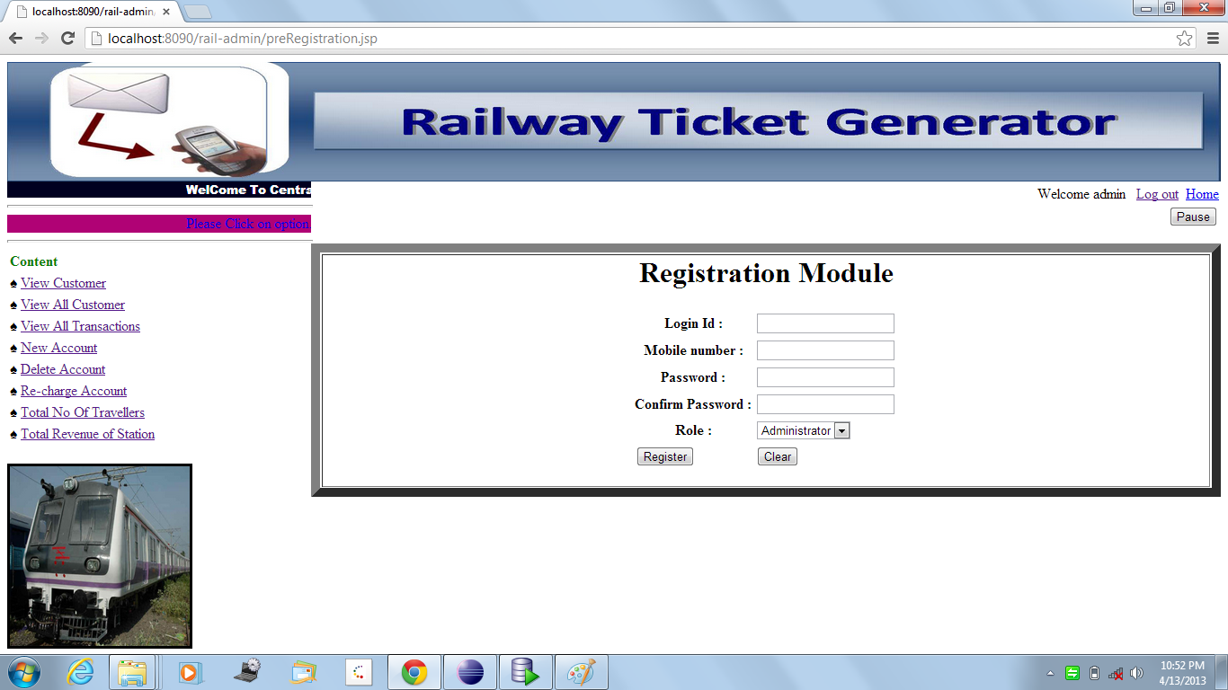
Create new account :

Slide 27
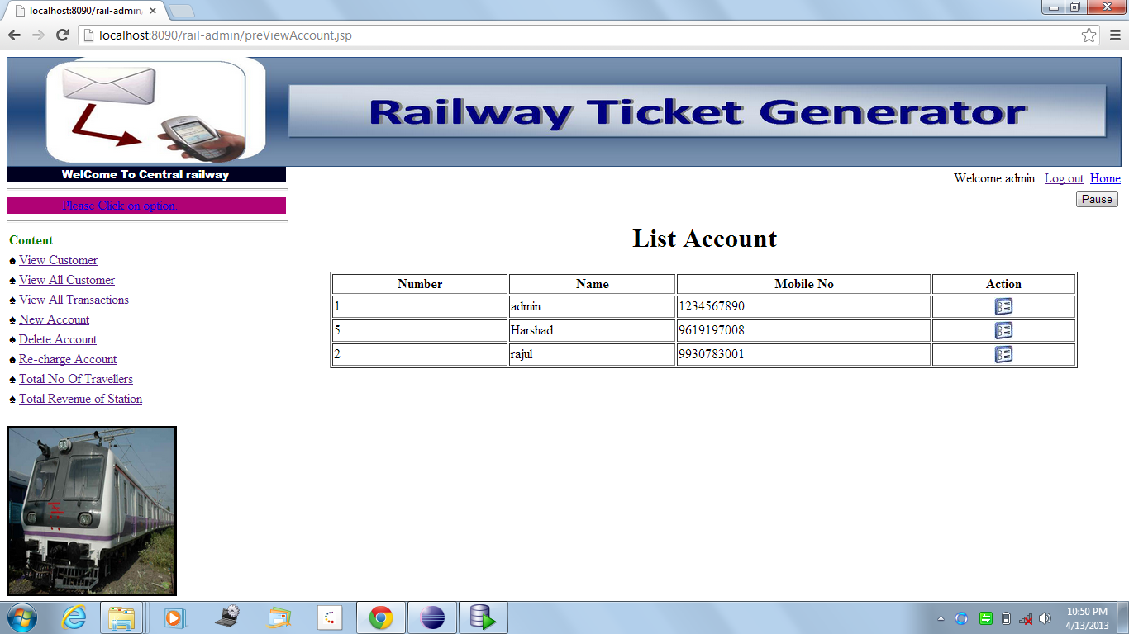
View all customers :

Slide 28
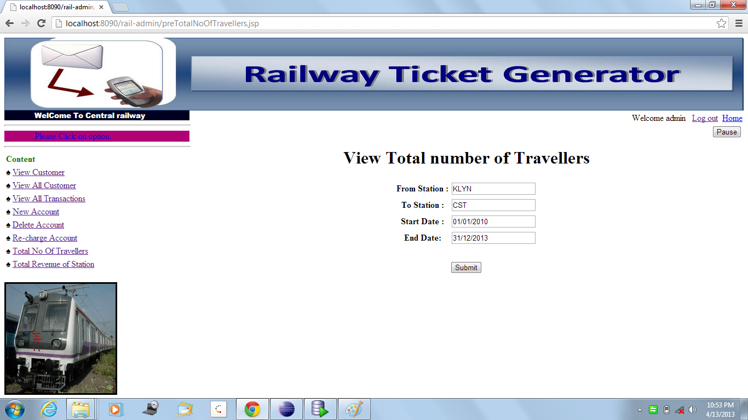
View all transactions :

Slide 29
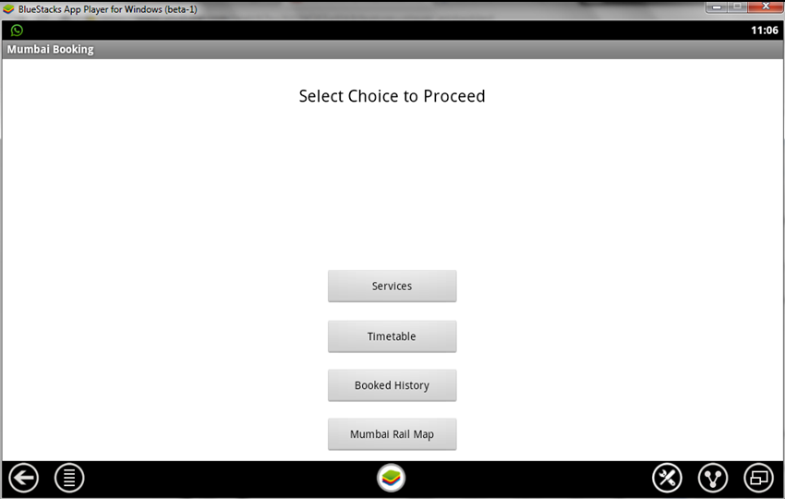
Home screen (mobile app) :

Slide 30
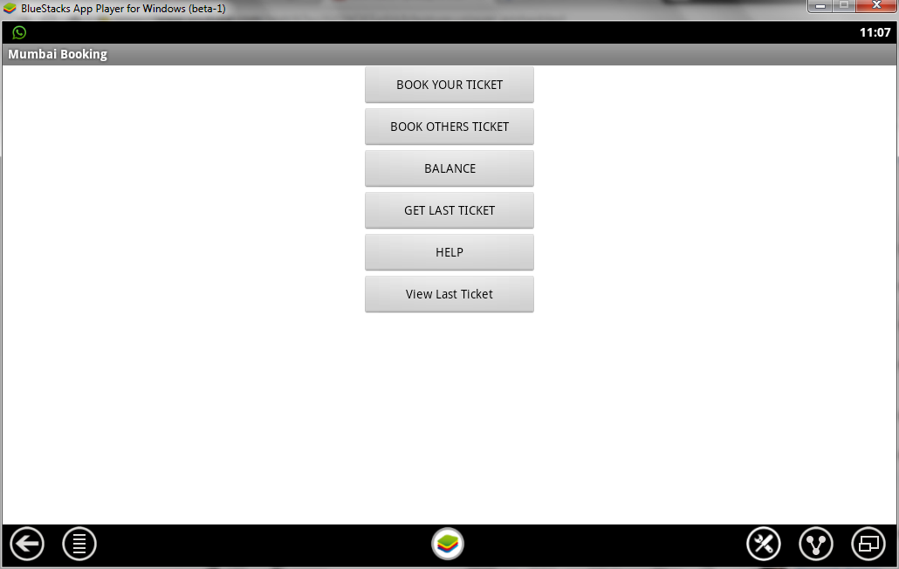
Services provided :

Slide 31
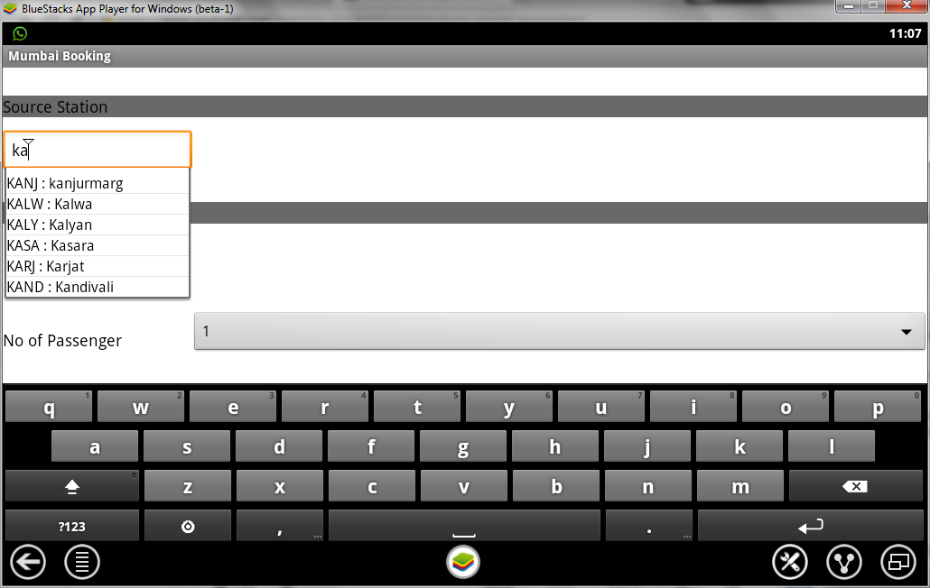
Book ticket :

Slide 32
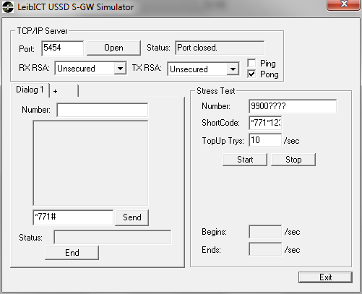
USSD Simulator

Slide 33
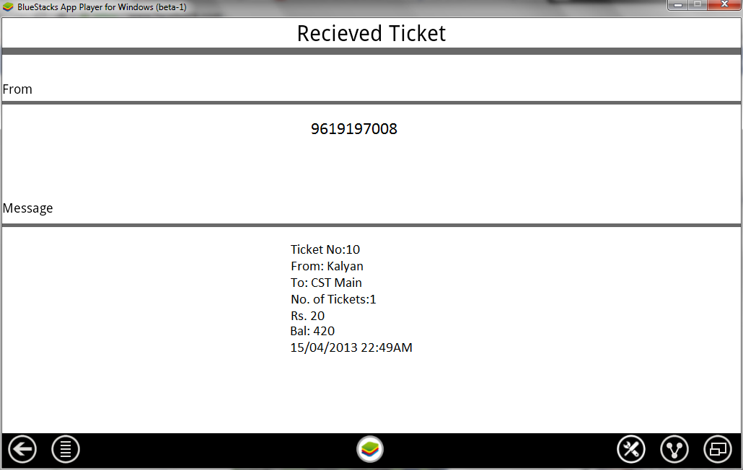
Last booked ticket :

Slide 34
Conclusion
Ease the ticket generation process by avoiding long queues, overhead of handling printed tickets,cvm and ATVM coupons
The cost required for our system is comparatively less to existing system.
Less time required for generating a report of resolved errors.
Error finding, resolving and updating will take less time than the existing system.
Benefits the customer as well as the railways.

Slide 35
Future scope
The presented system successfully generates a local train ticket through mobile app and SMS.
In spite of that the system can further improvised.
Location of the passenger can be tracked using GPS while he/she generating the ticket.
Information of live running train status.

Slide 36
References
http://en.wikipedia.org/wiki/USSD
http://en.wikipedia.org/wiki/Android_software_development
http://en.wikipedia.org/wiki/QR_code
Ching-yin Law, Simon So, “QR Codes in Education”, Hong Kong Institute of Education, Journal of Educational Technology Development and Exchange, 3(1), 85-100.. 2010.
Dialogic Corporation, ”USSD Services for Interactive Mobile Users”, 2010

Slide 37
Thank You!!! Any Questions ???

