Slide 1





Technovation’ 20 Project Title: Smart Stick for Blind and Partially sighted people

Slide 2
Abstract
Independence is the important methodology in achieving objectives, dreams and goals in life. Visually impaired/blind persons find themselves challenging the dangerous paths to go out independently. There are millions of visually impaired or blind people in this world who are always need the help from others. For many years the normal walking stick became a well-known attribute to blind person's navigation and later efforts have been made to improve the walking stick by adding remote sensor. Blind people have big problem when they walk on the street or stairs using normal walking stick, but they have sharp haptic sensitivity. The electronic walking stick will help the blind person by providing more efficient and convenient means of life.

Slide 3









Principle Used:
Ultrasonic Sensor
NRF Communication
LDR
Water/Fluid Detection
IR Sensor
LM35 Temperature Sensing

Slide 4

Hardware and Software Used
Hardware:
Arduino UNO
HC-SR04-ultrasonic sensor module
NRF24L01 wireless module
IR sensor
BC547 transistor
LM35-temperature sensor
9V Batteries, vibration motor, buzzer,LDR, LED, breadboard, few resistors, push-buttons, etc.
Software:
Arduino Software(IDE).

Slide 5
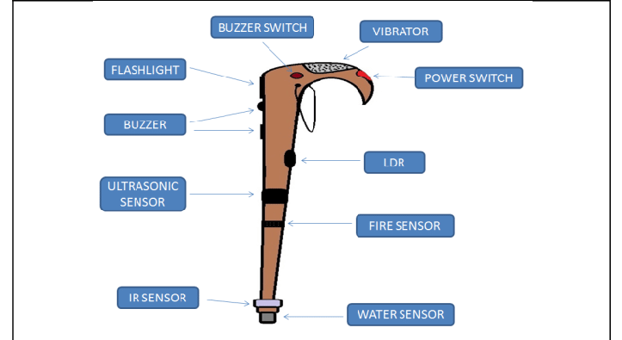
W rking:
Obstacle avoiding system using ultrasonic sensor
Quick access to the stick
Light monitoring system
Fluid/water surface detection
Fire detection
Pit/staircase detection

Slide 6


Manufacturing and pricing: Wooden stick manufacturing factors: weight,dimensions,etc. Electronic circuit: current market value for stick :ranging from around 2000/- onwards our estimated price for whole stick:Rs.1000/-

Slide 7
Future Work: 1)GPS Interfacing 2)VLSI Technology 3)Audio Instructions Through Speakers/Earpods 4)Emergency Button Project timeline Around next 1-1.5 month.

Slide 8

Thanks!
Any questions?

