Slide 1
Introduction to Computer Networking Concepts

Slide 2
Networking Devices
Network devices include all the devices that connect the end-user devices together to allow them to communicate.
End-user devices include computers, printers, scanners, and other devices that provide services directly to the user.
Host devices are physically connected to the network media using a network interface card (NIC).

Slide 3
Networking Devices
Network devices provide transport for the data that needs to be transferred between end-user devices.
Network devices provide extension of cable connections, concentration of connections, conversion of data formats, and management of data transfers.
Examples of devices that perform these functions are repeaters, hubs, bridges, switches, and routers.

Slide 4
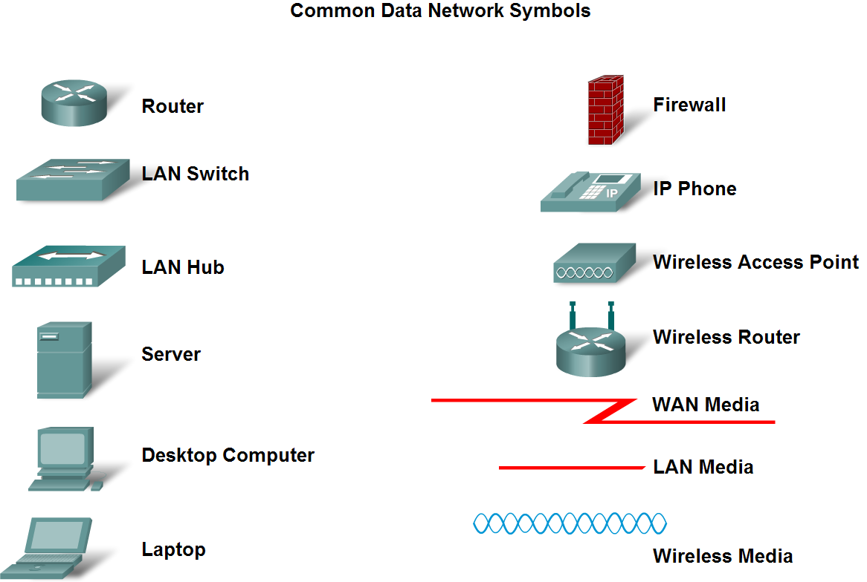
Networking Devices

Slide 5
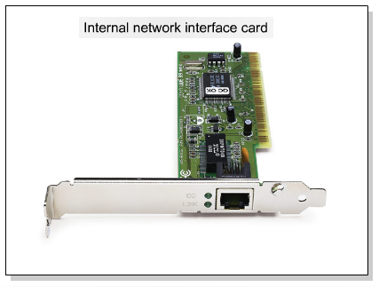
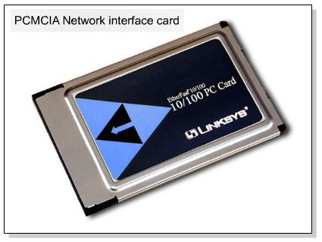
Network Interface Card
A network interface card (NIC) is a printed circuit board that provides network communication capabilities to and from a personal computer.
Also called a LAN adapter.

Slide 6
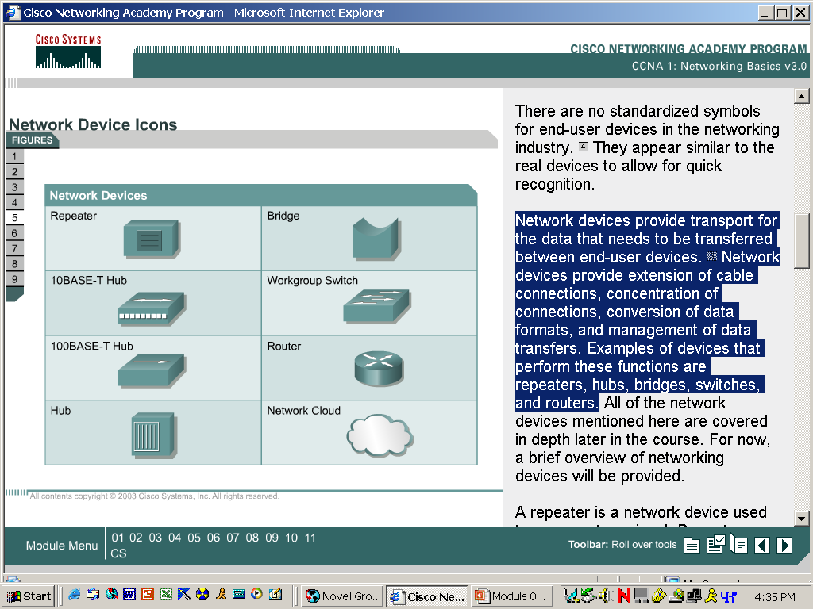
Networking Devices
Repeaters
A repeater is a network device used to regenerate a signal.
A repeater operates at the physical layer. Its job is to regenerate the signal over the same network before the signal becomes too weak or corrupted .so as to extend the length to which the signal can be transmitted over the same network. A repeater does not perform intelligent routing.
When the signal becomes weak, they copy the signal bit by bit and regenerate it at the original strength.
It is a 2 port device.

Slide 7
Networking Devices
Hubs
A hub is basically a multiport repeater. A hub connects multiple wires coming from different branches,
for example, the connector in star topology which connects different stations.
Hubs cannot filter data, so data packets are sent to all connected devices. In other words, collision domain of all hosts connected through Hub remains one.
Also, they do not have intelligence to find out best path for data packets which leads to inefficiencies and wastage.

Slide 8
Networking Devices
Bridges
A bridge operates at data link layer. A bridge is a repeater, with add on the functionality of filtering content by reading the MAC addresses of source and destination.
It is also used for interconnecting two LANs working on the same protocol.
It has a single input and single output port, thus making it a 2 port device.
Bridges provide connections between LANs.

Slide 9
Networking Devices
Switches
A switch is a multiport bridge with a buffer and a design that can boost its efficiency(a large number of ports imply less traffic) and performance.
A switch is a data link layer device.
switch can perform error checking before broadcasting data, that makes it very efficient as it does not forward packets that have errors and forward good packets selectively to correct port only.
In other words, switch divides collision domain of hosts, but broadcast domain remains same.

Slide 10
Networking Devices
Routers
A router is a device like a switch that routes data packets based on their IP addresses.
Routing is a process of moving/forwarding packets from one n/w to another n/w.
Router is mainly a Network Layer device.
Routers normally connect LANs and WANs together and have a dynamically updating routing table based on which they make decisions on routing the data packets.

Slide 11
Network Topologies
Types of Topology-
There are six types of topology in computer networks:
1. Mesh Topology
2. Star Topology
3. Bus Topology
4. Ring Topology
5. Hybrid Topology and 6.Tree Topology
1.Mesh Topology
In mesh topology each device is connected to every other device on the network through a dedicated point-to-point link. When we say dedicated it means that the link only carries data for the two connected devices only.
Lets say we have n devices in the network then each device must be connected with (n-1) devices of the network. Number of links in a mesh topology of n devices would be n(n-1)/2.

Slide 12
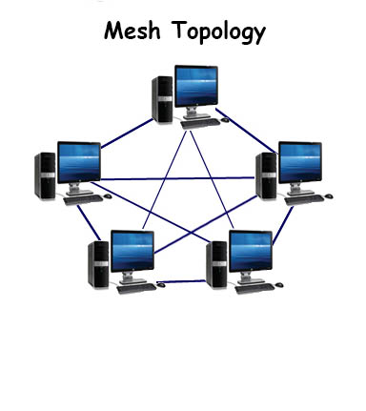

Slide 13
Advantages of Mesh topology
No data traffic issues as there is a dedicated link between two devices which means the link is only available for those two devices.
Mesh topology is reliable and robust.
Mesh topology is secure because there is a point to point link thus unauthorized access is not possible.
Fault detection is easy.
Disadvantages of Mesh topology
Amount of wires required to connected each system .
Since each device needs to be connected with other devices, number of I/O ports required must be huge.
Scalability issues because a device cannot be connected with large number of devices with a dedicated point to point link.

Slide 14
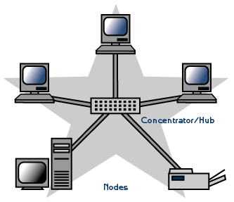
2. Star Topology

Slide 15
In star topology each device in the network is connected to a central device called hub.
Unlike Mesh topology, star topology doesn’t allow direct communication between devices, a device must have to communicate through hub.
If one device wants to send data to other device, it has to first send the data to hub and then the hub transmit that data to the designated device.
Advantages of Star topology
Less expensive because each device only need one I/O port and needs to be connected with hub with one link.
Easier to install
Less amount of cables required because each device needs to be connected with the hub only.
Robust, if one link fails, other links will work .

Slide 16
Disadvantages of Star topology
If hub goes down everything goes down, none of the devices can work without hub.
Hub requires more resources and regular maintenance because it is the central system of star topology.
Number of cables in a star topology is n .
Number of ports is 1*n=n.

Slide 17
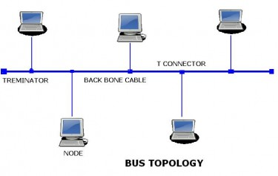
3.Bus Topology

Slide 18
In bus topology there is a main cable and all the devices are connected to this main cable through drop lines.
There is a device called tap that connects the drop line to the main cable. Since all the data is transmitted over the main cable, there is a limit of drop lines.
Advantages of bus topology
Easy installation, each cable needs to be connected with backbone cable.
Less cables required than Mesh and star topology
Disadvantages of bus topology
Difficultly in fault detection.
Not scalable as there is a limit of how many nodes you can connect with backbone cable.
Number of cables=n+1 and Number of ports=1*n

Slide 19
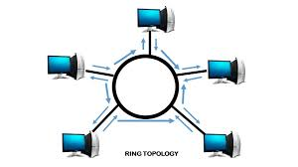
4.Ring Topology

Slide 20
In ring topology each device is connected with the two devices on either side of it.
There are two dedicated point to point links a device has with the devices on the either side of it.
This structure forms a ring thus it is known as ring topology.
If a device wants to send data to another device then it sends the data in one direction, each device in ring topology has a repeater.

Slide 21
Advantages of Ring Topology
Easy to install.
Managing is easier as to add or remove a device from the topology only two links are required to be changed.
Disadvantages of Ring Topology
A link failure can fail the entire network as the signal will not travel forward due to failure.
Data traffic issues, since all the data is circulating in a ring.

Slide 22
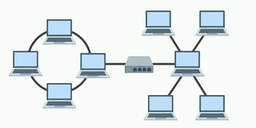
5. Hybrid topology

Slide 23
A combination of two or more topology is known as hybrid topology. For example a combination of star and ring topology is known as hybrid topology.
Advantages of Hybrid topology
We can choose the topology based on the requirement. For example, scalability is our concern then we can use star topology instead of bus topology.
Scalable as we can further connect other computer networks with the existing networks with different topologies.
Disadvantages of Hybrid topology
Fault detection is difficult.
Installation is difficult.
Designing is complex so maintenance is high expensive.

Slide 24
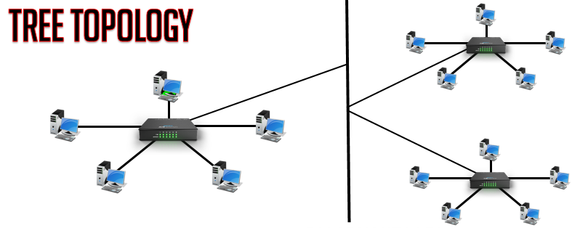
6.Tree Topology

Slide 25
A tree topology is a combination of a star network topology and a bus topology.
In tree topology, nodes of the underlying bus network topology are replaced with a complete star topology.
Advantages of tree topology:
A point to point wiring to the central hub at each intermediate node of a tree topology represents a node in the bus topology
Expansion of Network is possible and easy.
Error detection and correction is easy.
Disadvantages of tree topology:
Huge cabling is needed
A lot of maintenance is needed
Backbone forms the point of failure.

Slide 26
Scale: Local-area Networks (LANs)
A Local Area Network (LAN) is a private network that connects computers and devices within a limited area like a residence, an office, a building or a campus.
On a small scale, LANs are used to connect personal computers to printers.
Network size is limited to a small geographical area, presently to a few kilometers.
Data transfer rate is generally high. The range from 100 Mbps to 1000 Mbps
LANs are designed to:
Operate within a limited geographical area
All multi-access to high-bandwidth media
Control the network privately under local administration
Provide full-time connectivity to local services

Slide 27
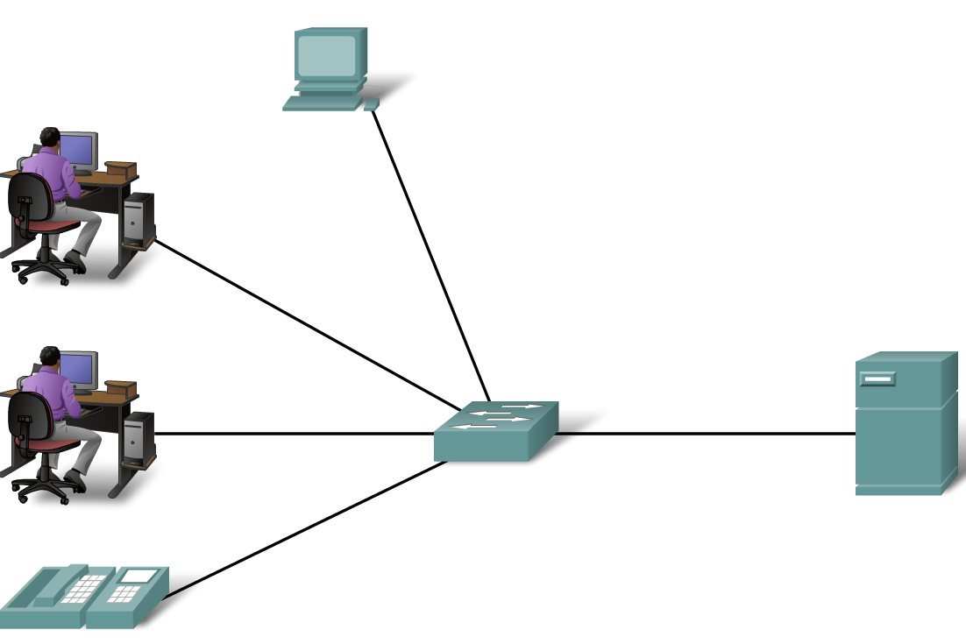
LANs

Slide 28
LANs consist of the following components:
Computers
Network interface cards
Networking media
Network devices
Some common LAN technologies are:
Ethernet
Token Ring
FDDI (Fiber Distributed Data Interface)

Slide 29
Wide-area Networks (WANs)
WANs interconnect LANs, which they provide access to computers or file servers in other locations.
A wide area network (WAN) is a computer network that covers a large geographical area comprising a region, a country or even the whole world.
WAN includes the technologies to transmit data, image, audio and video information over long distances and among different LANs and MANs.
WANs are designed to:
1.Operate over a large geographical area
2.Provide full-time and part-time connectivity
3.Connect devices separated over wide, even global areas

Slide 30
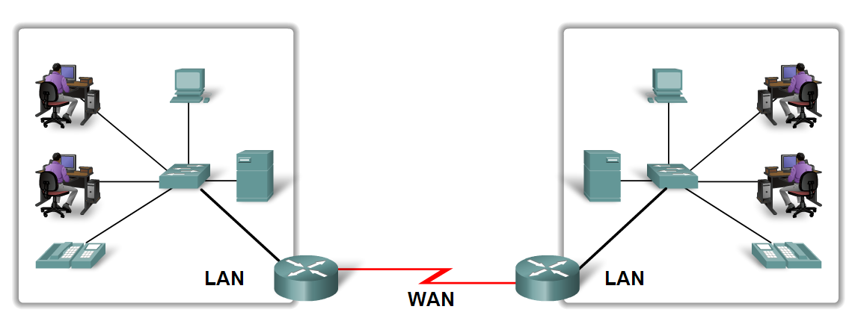
WANs

Slide 31
Some common WAN technologies are:
Modems
Integrated Services Digital Network (ISDN)
Digital Subscriber Line (DSL)
Frame Relay
Synchronous Optical Network (SONET)

Slide 32
Metropolitan-area Networks (MANs)
A MAN is a network that spans a metropolitan area such as a city .
A metropolitan area network (MAN) is a network with a size greater than LAN but smaller than a WAN.
A MAN usually consists of two or more LANs in a common geographic area.
Network size generally ranges from 5km to 50 km.
It may be as small as a group of buildings in a campus to as large as covering the whole city.
For example, a bank with multiple branches may utilize a MAN.
Cable TV network

Slide 33
Storage-area Networks (SANs)
A SAN is a dedicated, high-performance network used to move data between servers and storage resources.
Because it is a separate dedicated network, it avoids any traffic conflict between clients and servers.
The main functions of a storage area network (SAN) includes a high-speed network of storage devices.
SANs offer the following features:
Performance
Availability
Scalability

Slide 34
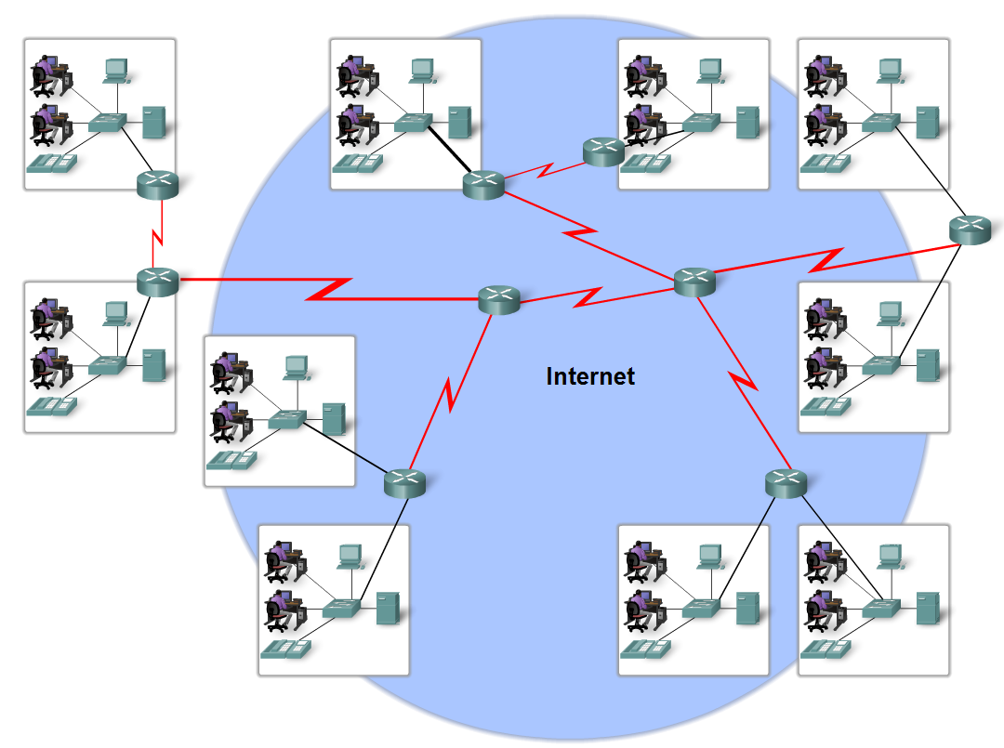
The Internet
The internet is defined as a global mesh of interconnected networks

