Slide 1

CMPE 257 Machine Learning Semester Project Presentation SMS Spam Detection
Bhide-Apte Harshada
Geete Bhushan
Borashan Ryan
November 28, 2017
Department of Computer Engineering

Slide 2
Project Goal
Background
In the mobile communication era, SMS are widely used, 200,000 SMS text messages every second.
Phone numbers are openly available – more vulnerable.
It is annoying to receive lots of spam SMS on your personal number.
More importantly it could be dangerous
A security risk to your financial and/or personal safety, identification theft.
Problem statement
Design a SPAM SMS detection system which can segregate spam sms from authentic sms based on the text content of the message. There are many existing approaches to solve this problem. Our aim is to analyze them to find out the most befitting model.
Concerns
Only one original feature, namely SMS text.
Informal short forms of words used in texts.
Variety of words used which indicate the same meaning which complicate processing.

Slide 3
Technical Approach
Model
Deciding which algorithms
Applying algorithms
Get output for spam detection
Data
Acquiring Dataset
Preprocessing data
Training + Testing data
Results
Evaluate results of each model
Compare results
Which is the Best?

Slide 4
Algorithms/Models Adopted
Naive Bayes classifier
Simple probabilistic classifier based on applying Bayes' theorem
Strengths:
Offers good performance despite simplicity
Scales well with large datasets
Weaknesses:
Dataset must be conditionally independent
Usually performance is beaten by more complex algorithms if they are properly tuned.
Support Vector Machine (SVM)
Non-probabilistic binary linear classifier
Strengths:
It can model non-linear decision boundaries
Many kernels available to choose from
Robust against overfitting
Weaknesses:
Memory intensive
Doesn’t scale well for larger datasets
Need to choose the right kernel
Decision Tree
A predictive model which goes from observations about an item to conclusions about the item's target value.
Strengths: Weaknesses:
It can learn non-linear relationships Prone to overfitting: as tree complexity increases, more
Deals well with outlying data training data is memorized.

Slide 5
Technical Flow
Loading Data
Data analyzing
Data preprocessing
Split the data 80:20 = training and testing
10 Fold Cross validation – 10 subparts of training data
Repeat 10 times each time use different subpart for scoring Accuracy
Convert Data to Vectors
9 subparts
Train model
9 subparts
Score Accuracy on remaining subpart
Testing on 20% test data
Production

Slide 6
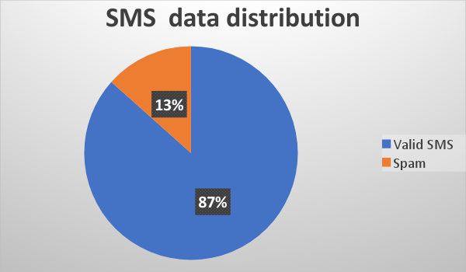
Data Source and Description
Corpus - Collection of texts
5,574 English SMS messages
Tagged as ham (valid) or spam
One text file with SMS texts and labels
Only one feature
Each line consists of 1 sms text and corresponding label.
ham What you doing?how are you?
ham dun say so early hor... U c already then ..
spam FreeMsg: Txt: CALL to No: 86888 & claim your reward
ham Siva is in hostel aha:-.
spam Sunshine Quiz! Win a super Sony DVD recorder Name..
spam URGENT! Your Mobile No was awarded a L2,000 Bonus
ham MY NO. IN LUTON 0125698789 RING ME IF UR AROUND
Data Collected by,
University of Economics in Prague
Grumbletext Web site – 425 SMS
Caroline Tag's PhD Theses – 450 SMS
NUS SMS Corpus (NSC) – 3,375 SMS
SMS Spam Corpus v.0.1 Big – 1,324 SMS

Slide 7
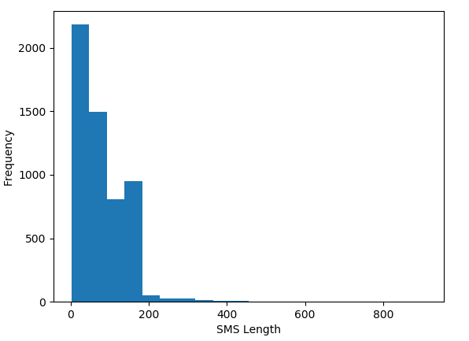
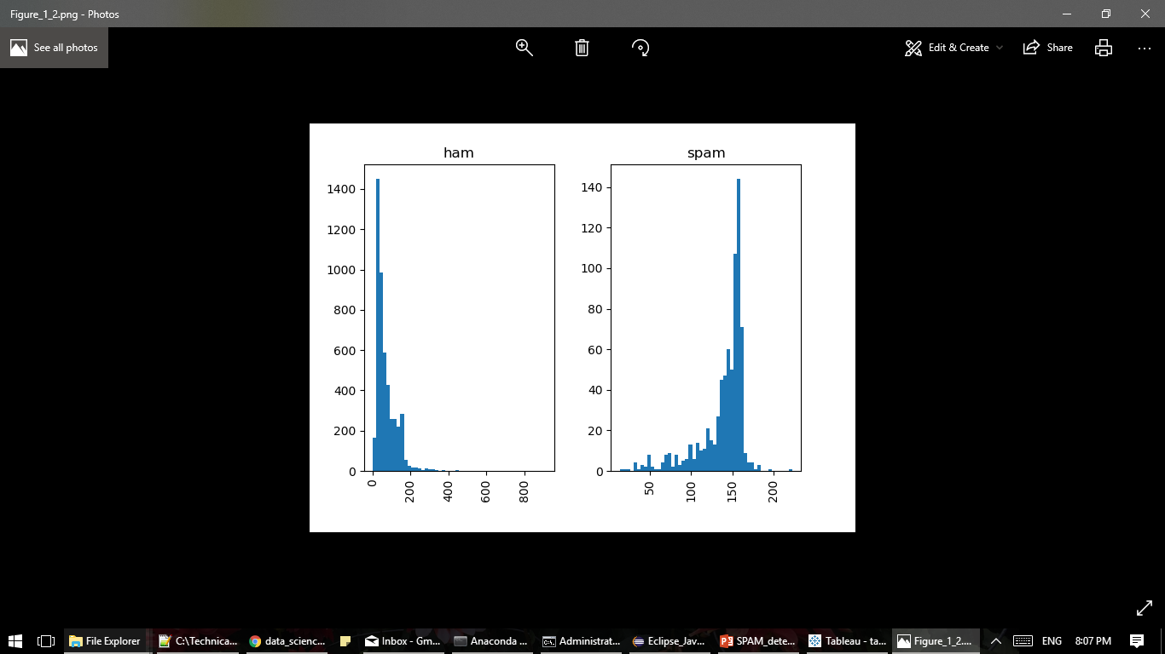
Data Analysis
Parameter | Valid SMS | Spam SMS
Count | 4827 | 747
Unique | 4518 | 653
Top | Sorry, I'll call later | Please call our customer service representative
Frequency | 30 | 4
Message Length analysis –
mean 80.478292
std 59.848302
min 2.000000
25% 36.000000
50% 62.000000
75% 122.000000
max 910.000000

Slide 8
Data Preprocessing
Split text into words
Bag-of-Words model
Simplifying representation used in natural language processing
Used in document classification
Text is represented as the multiset or bag of the words it contains
Grammar and order of words in message is disregarded
Multiplicity is taken into consideration
Frequency of occurrence of a word is used as a calculated feature for training out model
POS tagging – Textblob
Normalize words into lemmas
Part-of-Speech tags
POS tagging/ grammatical tagging / word-category disambiguation
Marking a word from corpus as a particular part of speech
Based on definition of word and context
Relationship with other words
Lemmatization
Grouping together the inflected forms of a word
They are analyzed as a single item
Word’s lemma = dictionary form
algorithmic process of determining the lemma of a word based on its intended meaning.

Slide 9
Data Vectorization
Convert each message, represented as a list of lemmas into a vector
Each vector has as many dimensions as there are unique words in the SMS corpus = 8874
The bag-of-words counts for the entire SMS corpus are a large, sparse matrix.
weighting the counts
how many times does a word occur in each message
To abstract from the original text length
TF-IDF
Frequent tokens get lower weight
TF-IDF
counting term frequency
normalizing the vectors to unit length
Term frequency–inverse document frequency
Importance of a word
Value increases proportionally to the no. of times word appears in SMS
Value decreases by the frequency of word in entire corpus
scikit-learn library’s `TfidfTransformer`
Time consuming

Slide 10
Results
We are training on 72% of all data at a time.
20% is set aside for testing purpose
10-Fold Cross validation reserves 10% of training data for scoring.
Accuracy – We are using Accuracy as main metric for evaluating and comparing models
We have evaluated Precision, Recall, f1-score and support of algorithms and made comparisons based on them.
We tried different combinations of kernels and penalty parameter values for SVM to see which combination is optimal for our purpose. Linear kernel with c=1 is the best parameter combination.
Naive bayes gave the best accuracy while SVM model proved to be the most stable model.

Slide 11
Effect of lemmas and IDF weighting
Accuracy (mean) | Standard Deviation | TF-IDF | Lemmas
0. 94573 | 0.00344 | √ | √
0.93048 | 0.00244 |  | √
0.94461 | 0.00251 | √
0.92936 | 0.00254
Effect of using lemmas Vs normal words was analyzed using Naive Bayes. Lemmas give better performance.
Effect of using inverse document frequency weighting was evaluated using Naive Bayes. It showed improved accuracy.
The combination of both gives the most optimal results.

Slide 12
SVM Parameter Combinations
Accuracy (mean) | Standard Deviation | Penalty parameter C of the error term | Kernel
0.98497 | 0.00423 | 1 | linear
0.98632 | 0.00542 | 10 | linear
0.98654 | 0.00535 | 100 | linear
0.98654 | 0.00535 | 1000 | linear
0.86544 | 0.00006 | 1 | rbf
0.86544 | 0.00006 | 10 | rbf
0.95717 | 0.00559 | 100 | rbf
0.95717 | 0.00559 | 1000 | rbf

Slide 13
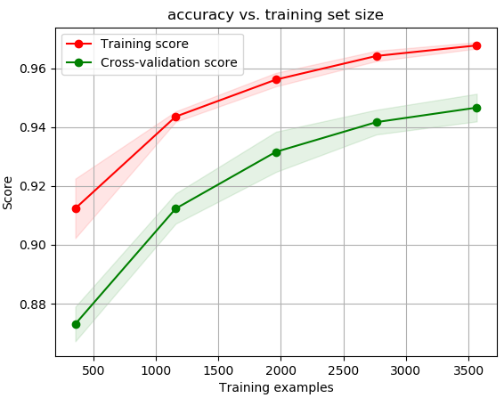
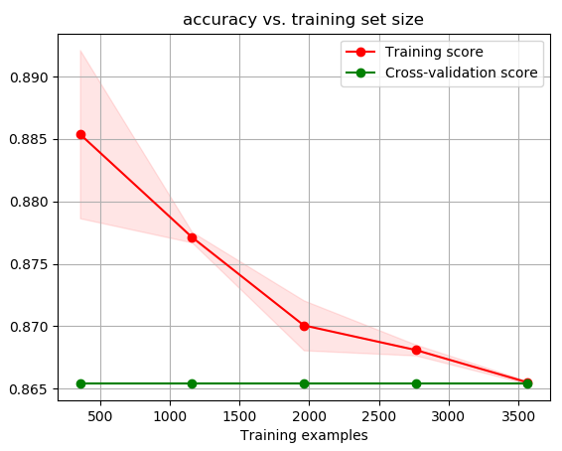
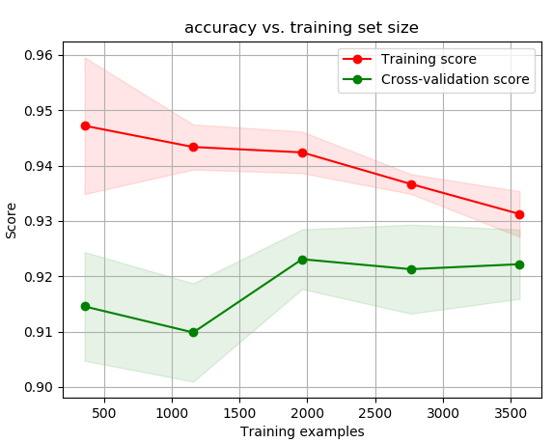
Learning Curves
Naïve Bayes
SVM
Decision Tree

Slide 14
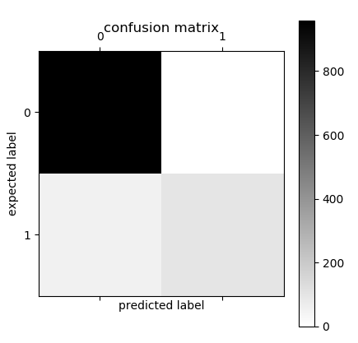

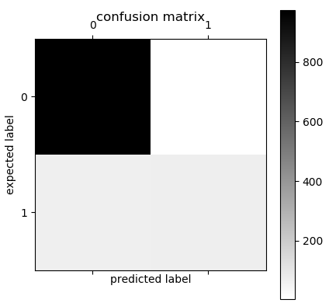
Confusion Matrix
SVM
Decision Tree
Naïve Bayes
959
0
965
3
975
4
12
135
67
69
56
100

Slide 15
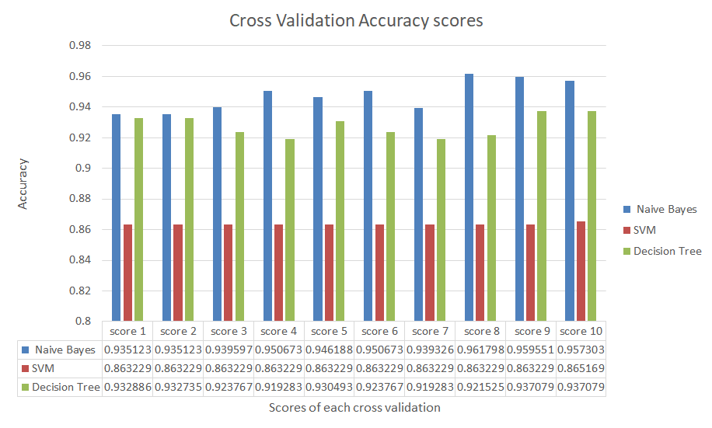
Naive Bayes
Mean | 0.947535456082
Std deviation | 0.009503865102
SVM
Mean | 0.863422683529
Standard deviation | 0. 00058195193
Decision Tree
Mean | 0.92689064633
Standard deviation | 0. 00593628658
Accuracy of Decision tree is good.
The values are slightly different each time.
Accuracy of Naive Bayes is higher in every subpart.
The values are slightly different each time.
Most accurate model.
Accuracy of SVM is lower in each cycle.
Values are exactly same for 9/10 subparts of data.
Most stable model.

Slide 16
Classification Reports
Naive Bayes
 | Precision | Recall | F1-score | Support
Ham | 0.95 | 1.00 | 0.97 | 961
Spam | 1.00 | 0.66 | 0.80 | 154
Avg/total | 0.96 | 0.95 | 0.95 | 1115
Precision = tp / (tp + fp) = the ability of the classifier not to label as positive a sample that is negative.
Recall = tp / (tp + fn) = the ability of the classifier to find all the positive samples.
F1-score = weighted harmonic mean of the precision and recall It reaches its best value at 1 and worst score at 0.
Support = no. of samples of the true response in that class
SVM
 | Precision | Recall | F1-score | Support
Ham | 0.99 | 1.00 | 0.99 | 977
Spam | 0.98 | 0.93 | 0.96 | 138
Avg/total | 0.99 | 0.99 | 0.99 | 1115
Decision Tree
 | Precision | Recall | F1-score | Support
Ham | 0.94 | 1.00 | 0.96 | 979
Spam | 0.95 | 0.51 | 0.66 | 136
Avg/total | 0.94 | 0.94 | 0.93 | 1115

Slide 17
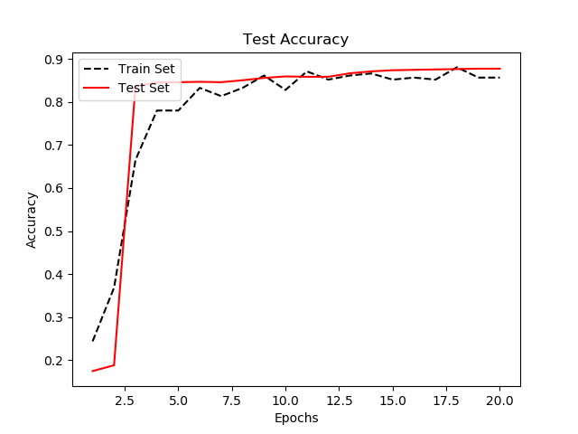
Recurrent neural network using Tensor Flow
Tensor flow and RNN
Tensorflow keeps track of the computations in the model and automatically computes the gradients for every variable.
Recurrent neural network - Neural networks that store
outputs from prior iterations.
SMS spam detectation using RNN
Using same set of sms data, the RNN is performed.
The RNN output is used for prediction of spam or ham
(1 or 0).
The results show initial time period of epochs, shows low test accuracy. But after certain threshold the Test accuracy is reach to 86% percent and it remains almost constant after that.
Test Accuracy

Slide 18
Tools Utilized
TextBlob
Python library
For processing textual data
API for natural language processing (NLP) tasks
part-of-speech tagging, noun phrase extraction, sentiment analysis, classification, translation…..
Need to pip install
Scikit-learn(sklearn)
Python library
Used for the term weighting and normalization
Used for Naïve Bayes classifier
SVM
Decision Tree
Tensorflow
Software library for machine learning
Open source
Neural networks
Google - research , production
Numerical computations using dataflow graphs
Nodes in the graph represent operations
Edges represent multidimensional data arrays(tensors)
Tableau
Data validation and visualization tool
Null check - null value removal
Data cleaning - removing non utf characters
Duplicate data - no. of times same message was received
Data completeness - check every text has a label
Notes:
tableau

Slide 19
Conclusion
Various methods for SMS spam classification are available.
They all have pros and cons.
Use of machine learning techniques to filter out spam messages will help unaware users from security thefts and will avoid annoyance for all the users in general.
Performance keeps growing, for both training and cross validation as no. data examples increases - Naive Bayes
There is still scope for improving the training models and aim for better accuracy.
Natural language processing techniques such as finding base words or lemmas for the words in text and weighting the words according to their importance in the context, help to improve classification results.

Slide 20
Lessons Learned
Getting hold of SMS datasets for research is not easy.
Less number of original features in the data increases the difficulty of processing by posing restrictions.
Using Data validation tools before pre-processing data proved useful.
Splitting data into training and test data and further 10-fold cross validation; reduce the actual training data significantly.
Good to have large datasets.
Cross validation helps in evaluating the stability of the model early on.
Studied the algorithms in detail.
Lots of libraries and tools
Used Textblob, sci-learn, pandas, numpy, matplotlib etc……
Explored and used TensorFlow

Slide 21
Other Path Could Have Been Taken
Using more training data, to overcome low model complexity
Using a more complex (lower bias) model to start with, to get more out of the existing data
We used Python through out. Can try others like R and matlab.
Applying same models on different datasets to verify the results and evaluate the effects.
Using modelling tools like IBM’s SPSS Modeller

Slide 22
Potential Scope Expansion for Future
Main scope to improve is in data preprocessing.
The pre-processing can be improved in many ways.
We used bag-of-words method and converted to lemmas. That greatly improved performance.
Other things to try :
Detecting HTML elements from text
Generating more calculated features
Detecting uppercase words
Frequency of numbers in message
Processing word phrases/combinations
Text length
Support for other languages than English such as Spanish.

Slide 23
Demo

Slide 24
References
https://radimrehurek.com/data_science_python/
http://www.grumbletext.co.uk/
http://etheses.bham.ac.uk/253/1/Tagg09PhD.pdf
http://www.comp.nus.edu.sg/~rpnlpir/downloads/corpora/smsCorpus/
http://www.esp.uem.es/jmgomez/smsspamcorpus/
http://www.dt.fee.unicamp.br/~tiago/smsspamcollection/
https://en.wikipedia.org/wiki/Bag-of-words_model
https://en.wikipedia.org/wiki/Part-of-speech_tagging
https://textblob.readthedocs.io/en/dev/
https://en.wikipedia.org/wiki/Lemmatisation
http://www.ling.upenn.edu/courses/Fall_2007/ling001/penn_treebank_pos.html
http://scikit-learn.org/stable/modules/generated/sklearn.metrics.precision_recall_fscore_support.html
https://www.cloudmark.com/en/s/resources/whitepapers/sms-spam-overview
Book - TensorFlow Machine Learning Cookbook - Nick McClure

Slide 25
Thank You

