Slide 1


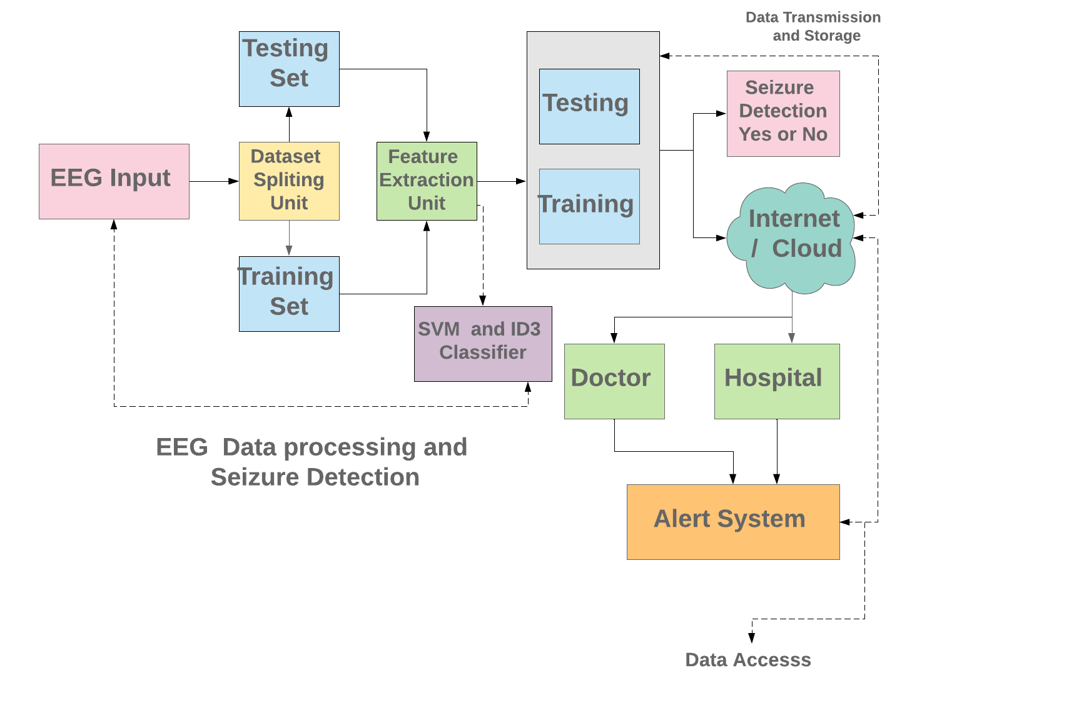
Title of Project: Epileptic Seizure Detection From EEG Signals Using Machine Learning.
Abstract :
Epilepsy is nothing but neurological disorders aﬀecting a signiﬁcant portion of the world’s population and approximately 2.5 million people in the United States. We propose a software based automated seizure detection system which will detect a seizure from electroencephalography (EEG) signals using machine learning algorithm. The propose system validate or test the values or signals given by user (Doctor) and then it predicate whether the epilepsy is detected or not.
We are using Support Vector Machine algorithm for classiﬁcation .It will predict whether the epilepsy is detected or not . After prediction of epilepsy message will be send to patient’s relatives .
Origin of Research Problem:
Objectives of Work:
Overcome: To Overcome the problem of Epilepsy.
Detection: To detect the Seizure at earlier stage.
Awareness : Creating People Awareness about Health.
Name | System Details | Characteristics
L. S. Vidyaratne and K.M. Iftekharuddin, “Real-Time Epileptic Seizure Detection Using EEG” [8] | This paper proposes a novel algorithm for epileptic seizure detection with scalp EEG that utilizes a wavelet decomposition method, known as HWPT, and FD estimation. The procedure of feature extraction and the formation of feature vector are designed such that spectral, fractal, spatial, and temporal information of seizure EEG are captured in the feature vectors. | The proposed algorithm a sensitivity of 96% with a median false positive rate of 0.1 h-1and an average detection delay of 1.89 s for the long term EEG Dataset A. Analysis of short-term scalp and intracranial EEG in Dataset B yields a 99.8% seizure detection accuracy.
M. A. Sayeed, S. P. Mohanty, E. Kougianos, and H. Zaveri, “ An Energy Eﬃcient Epileptic Seizure Detector” [6] | The proposed approach detects seizure onset based on the number of hypersynchronous pulses. The signal detection circuit provides the data for the hypersynchronous pulses. | The proposed implantable seizure onset detector monitors the brain activity in the seizure onset area.
M. A. Sayeed, S. P. Mohanty, E. Kougianos, V. P. Yanambakha, and H. Zaveri, “ A Robust and Fast Seizure Detection in IoT Edge ” [7] | The proposed seizure detection method utilizes the DWT, statistical features, and a naive Bayes classiﬁer. DWT provides time frequency (TF) localization of the EEG signal. The statistical features show considerable potential to distinguish seizure and non-seizure behavior and the use of the naive Bayes classiﬁer leads to an improved classiﬁcation accuracy. | In this smart seizure detection system in the edge- IoT framework which utilizes statistical feature extraction and naive Bayes classiﬁcation. The prototype of the system was implemented using Simulink R and ThingSpeak.
Md Abu Sayeed, Student Member, IEEE, Saraju P. Mohanty, Senior Member, IEEE,Elias Kougianos, Senior Member, IEEE, Hitten P. Zaveri ”eSeiz: An Edge-Device for Accurate Seizure Detection for Smart Healthcare ”[1] | Support vector machine algorithm is used for classiﬁcation. | It gives more accurate results.It requires more time for computation but it is more accurate.
Motivation of Work:
Population: Seizures, aﬀects approximately 1 percent of the world population.
Control: 30 to 40 percent of patient, antiepileptic drugs cannot eﬀectively control seizures.
Depression: Uncontrolled epilepsy can lead to depression.
Cost: Uncontrolled epilepsy can lead to Higher cost.
Algorithams:
Support Vector Machine.
Iterative Dichotomiser 3.
Architecture:
Conclusions:
We have proposed an epilepsy seizure detection software, which predict seizure at earlier stage. This system take input which are the signals or parameters of patients, and then Predict whether Epilepsy is detected or not.
This system uses Support vector machine algorithm for classiﬁcation. We are going to use Support vector machine and ID3 algorithms for classiﬁcation. We can compare them
and determine which algorithm gives better result.
References:
Md Abu Sayeed,“eSeiz: An Edge-Device for Accurate Seizure Detection for Smart Healthcare”.
M. A. Sayeed, S. P. Mohanty, E. Kougianos, and H. Zaveri, “ An Energy Eﬃcient Epileptic Seizure Detector”.
M. A. Sayeed, S. P. Mohanty, E. Kougianos, V. P. Yanambakha, and H. Zaveri, “ A Robust and Fast Seizure Detection in IoT Edge ”.

