Slide 1
Web Analysis
The web analytics team of www.datadb.com is interested to understand the web activities of the site, which are the sources used to access the website. They have a database that states the keywords of time in the page, source group, bounces, exits, unique page views, and visits.

Slide 2
Objectives
The team wants to analyze each variable of the data collected through data summarization to get a basic understanding of the dataset and to prepare for further analysis.
As mentioned earlier, a unique page view represents the number of sessions during which that page was viewed one or more times. A visit counts all instances, no matter how many times the same visitor may have been to your site. So the team needs to know whether the unique page view value depends on visits.
Find out the probable factors from the dataset, which could affect the exits. Exit Page Analysis is usually required to get an idea about why a user leaves the website for a session and moves on to another one. Please keep in mind that exits should not be confused with bounces.
Every site wants to increase the time on page for a visitor. This increases the chances of the visitor understanding the site content better and hence there are more chances of a transaction taking place. Find the variables which possibly have an effect on the time on page.
A high bounce rate is a cause of alarm for websites which depend on visitor engagement. Help the team in determining the factors that are impacting the bounce.

Slide 3
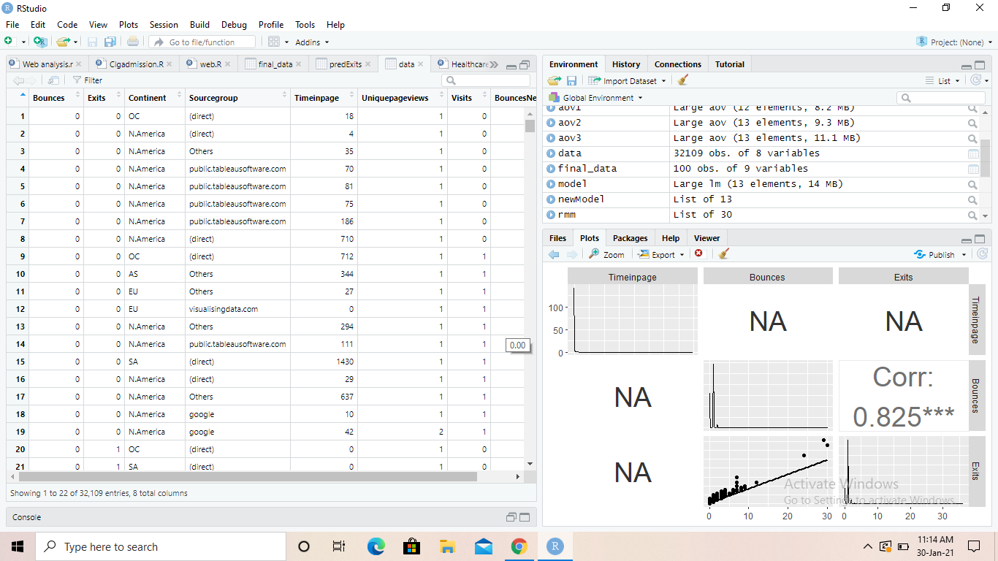
Dataset

Slide 4
Data Summary
Bounces Exits Continent Sourcegroup Timeinpage.V1
Min. :0.00000 Min. : 0.000 0: 321 1 :11542 Min. : -0.18554
1st Qu.:0.00000 1st Qu.: 1.000 1: 3171 0 : 7532 1st Qu.: -0.18554
Median :0.01000 Median : 1.000 2: 6470 6 : 5360 Median : -0.18554
Mean :0.00713 Mean : 0.906 3:20043 8 : 2388 Mean : 0.00000
3rd Qu.:0.01000 3rd Qu.: 1.000 4: 1356 3 : 2249 3rd Qu.: -0.16019
Max. :0.30000 Max. :36.000 5: 748 2 : 1354 Max. :118.32391
(Other): 1684
Uniquepageviews Visits BouncesNew
Min. : 1.000 Min. : 0.000 Min. :0.00000
1st Qu.: 1.000 1st Qu.: 1.000 1st Qu.:0.00000
Median : 1.000 Median : 1.000 Median :0.01000
Mean : 1.114 Mean : 0.906 Mean :0.00713
3rd Qu.: 1.000 3rd Qu.: 1.000 3rd Qu.:0.01000
Max. :45.000 Max. :45.000 Max. :0.30000

Slide 5
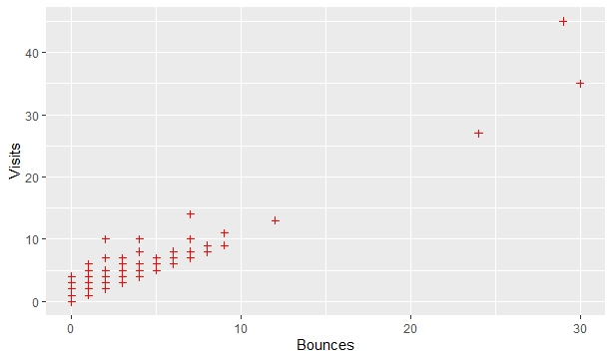
Correlation

Slide 6
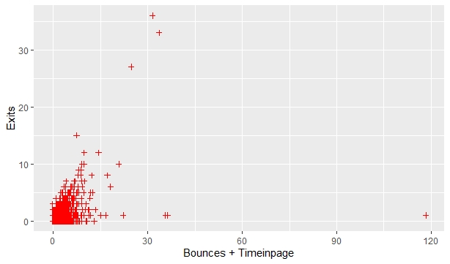
Exits VS Bounces+Timeinpage

Slide 7
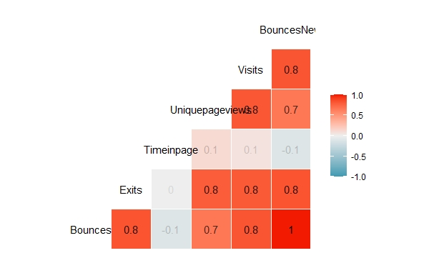

Slide 8
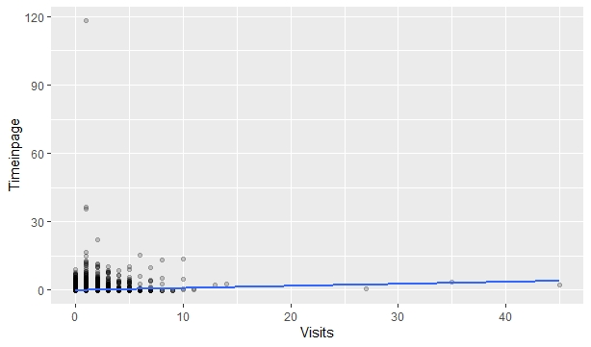
Strong Correlation

Slide 9
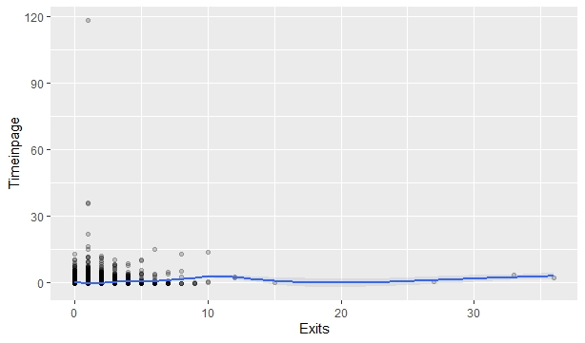
Weak Correlation

Slide 10
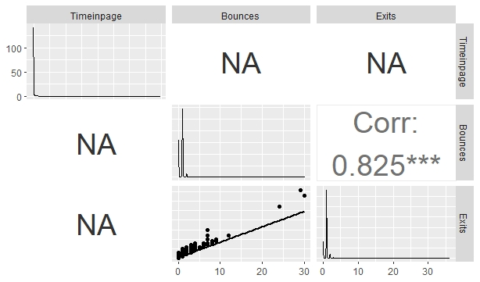
Correlation with all variables

