Slide 1
Forecasting Accidents and Classifying
Accident Severity
Group 6
CMPE 256
Team Members:
Harshada Jivane
Manasa Hari
Pragati Sharma

Slide 2
Motivation

Slide 3
Objectives
Basic data mining tasks for data preprocessing, data analysis and feature engineering
Time series forecasting using Facebook’s Prophet and ARIMA (Autoregressive Integrated Moving Average) to predict number of accidents
Classification model to classify the severity of accidents given the data of circumstances such as vehicle type, weather, road conditions

Slide 4
Dataset
The dataset consists of accident, casualties and vehicle information for the years 2017 to 2019
It contains a variable lookup excel sheet which provides information about various features in the three CSVs
This dataset is available on UK government’s website:
https://data.gov.uk/dataset/cb7ae6f0-4be6-4935-9277-47e5ce24a11f/road-safety-data

Slide 5
Time Series Forecasting
Prophet - Open-source library published by Facebook
Needs dataframe with ‘ds' and ‘y’
Sort by date
Split by date
Feature selection for regression
ARIMA - Autoregressive Integrated Moving Average
Needs Date columns as index and second column is the measurement we wish to forecast
AIC(Akaike Information Criterion) for grid search

Slide 6
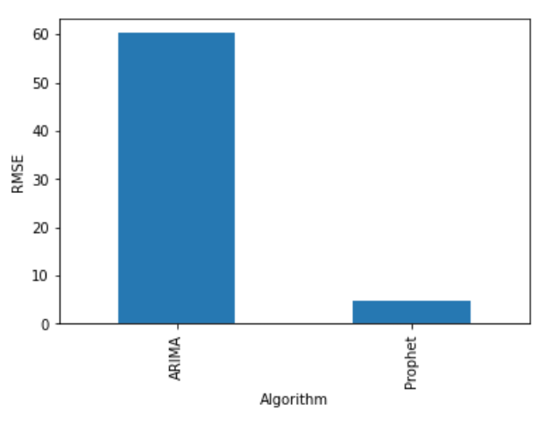
Results - Time Series Forecasting

Slide 7
Classification

Slide 8
Results - Classification

Slide 9
Conclusion (What went good/difficulties)
Prophet was easier to implement than ARIMA because of more available documentation

Slide 10
Thank You

