Slide 1

INSTITUTE FOR ADVANCED COMPUTING AND
SOFTWARE DEVELOPMENT AKURDI,PUNE
Presentation On
“Online Bus Ticket Booking”
PG-DAC Feb 2020
Created By: Group No:41
Ms.Anjali Roopchandani 1118
Ms.Harshada Pimpalkar 1138
Mr.Prashant Karhale Mr. Kashinath Patil
Center Coordinator Project Guide

Slide 2
Contents
01
Introduction
07
Use Case Diagrams
02
08
ER Diagram
Scope
03
Aim and Objective
09
Benefits of System
04
Activity Diagram
9
Conclusion
05
Features
10
Future Scope
06
02
11
ScreenShots
Scope
Reference

Slide 3
INTRODUCTION
➤ The Online Bus Ticket Booking website is developed for the Travellers to reserve seats online and to save them from hassles.
➤ It will allow the users to enjoy the booking of bus tickets from the current position via internet.
➤ The Travel Agency can also use this application for managing there ticket booking service.

Slide 4
SCOPE
➤This application can be used by any Travel Agent,Travel Agency to issue the tickets to the customers.
➤It also helps the customer to enquire the availability of seats in a particular bus for the specific date from desired location.
➤It will also provide the facility to check the timings and schedule of the buses along with the ticket price.

Slide 5
AIM AND OBJECTIVE
➤This system project is made as user friendly as possible .
➤Up To Date information is provided that is not possible manually.
➤The objective of my project is to make the Ticket Booking system of an Agency,simple,reliable,user friendly, and corrective. Moreover less time consuming as compared to manual work.
➤To Increase The Ticket Booking efficiency.

Slide 6
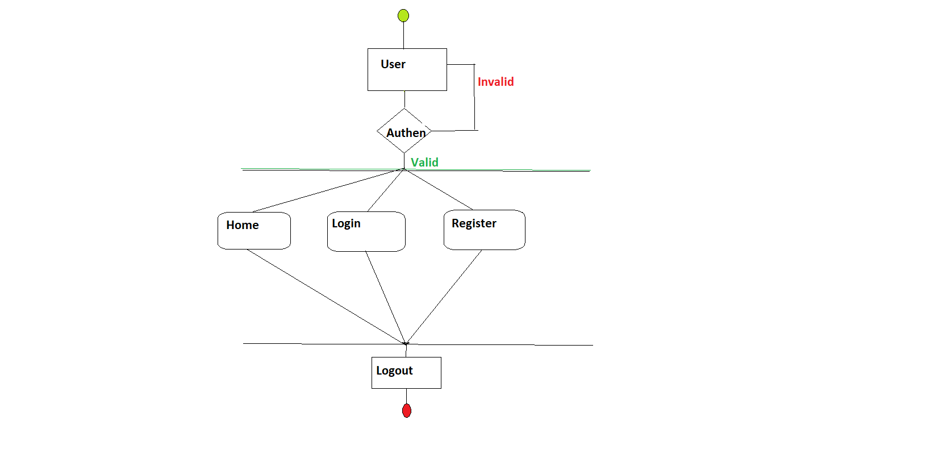
Activity Diagram for User

Slide 7
Features Provided to User
The User can enter the sources and destination to view the buses on the specific route.
The User can register himself and then re-login to book the tickets.
Can check the seats available.
Can see all the bus information
Can book no. of tickets after registration.
Can check number of Seats already booked.
Can view the bus information like arrival time,destination time etc.

Slide 8
ScreenShots for User Performed Operation

Slide 9
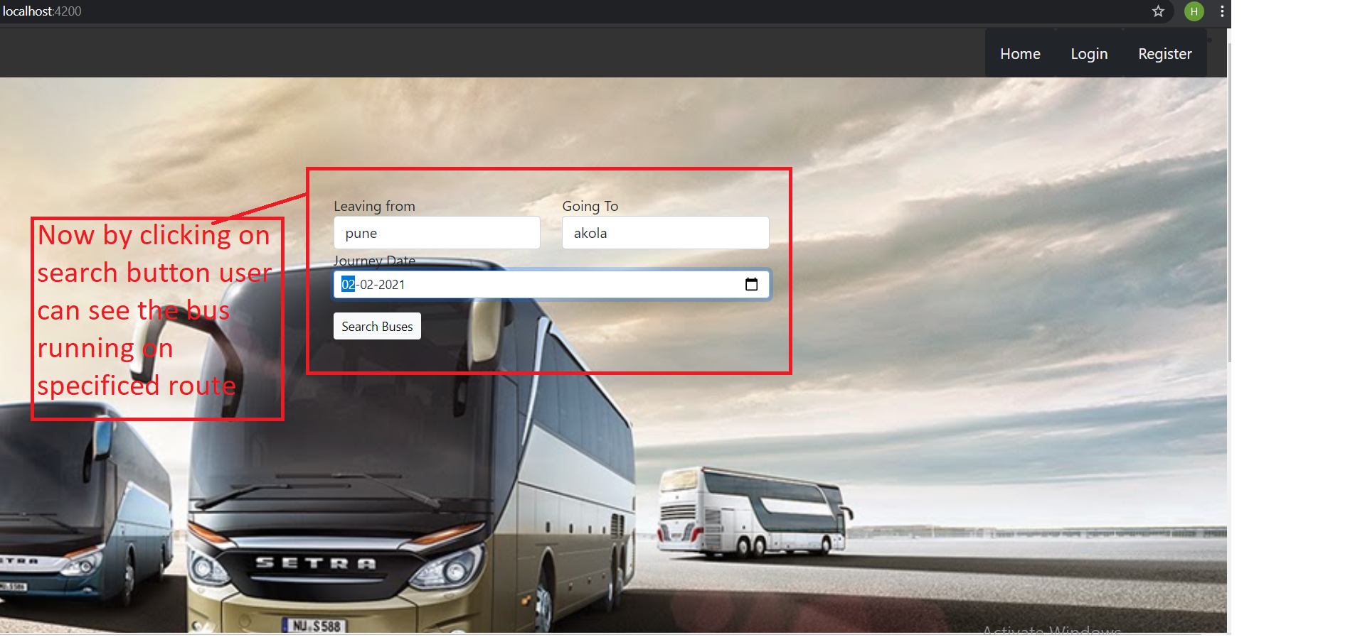

Slide 10
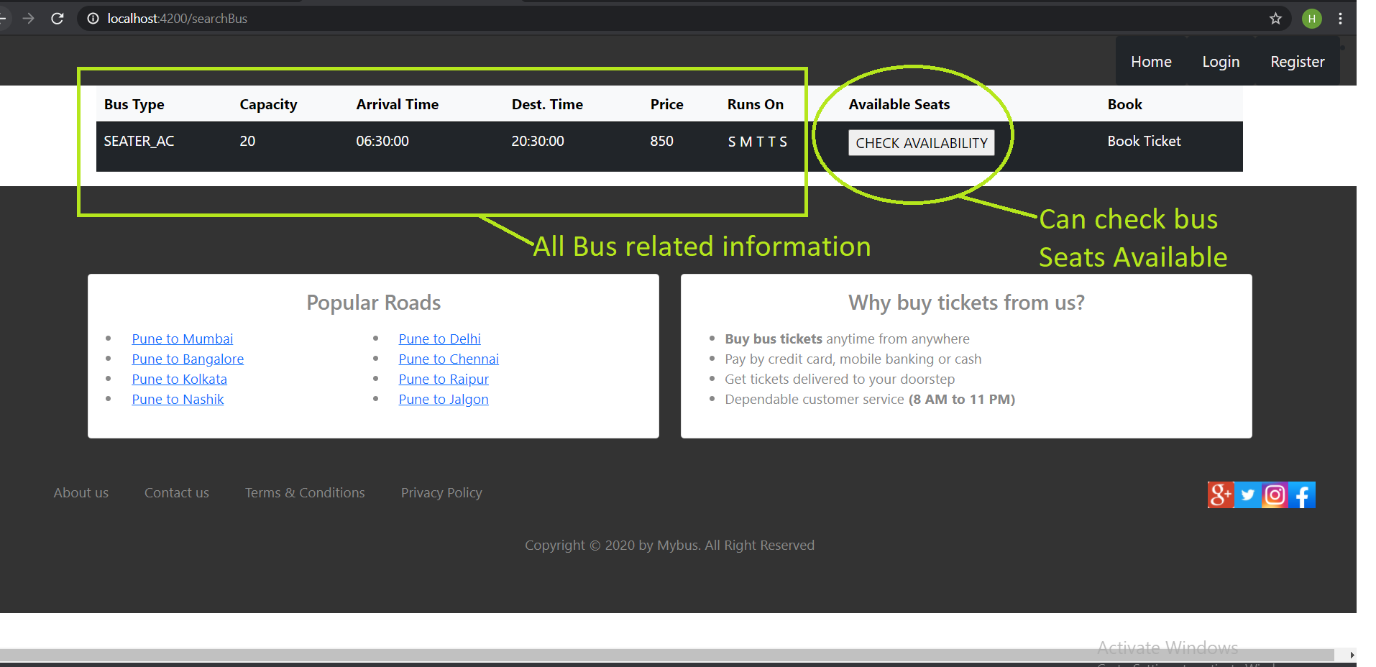

Slide 11
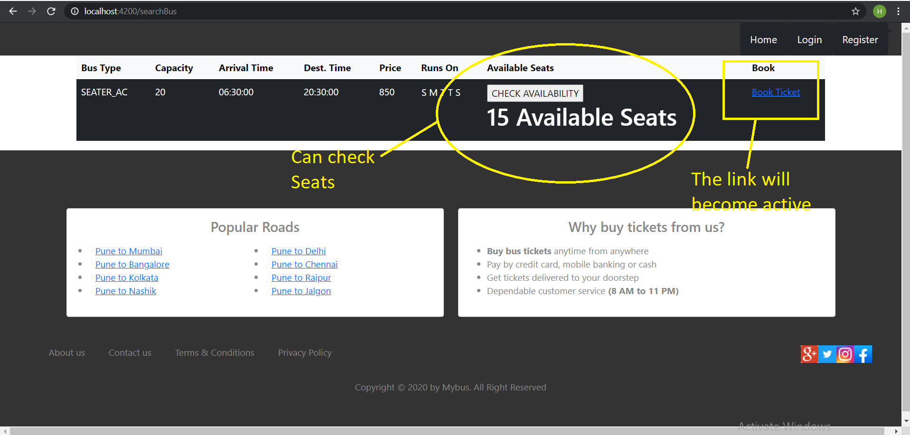

Slide 12
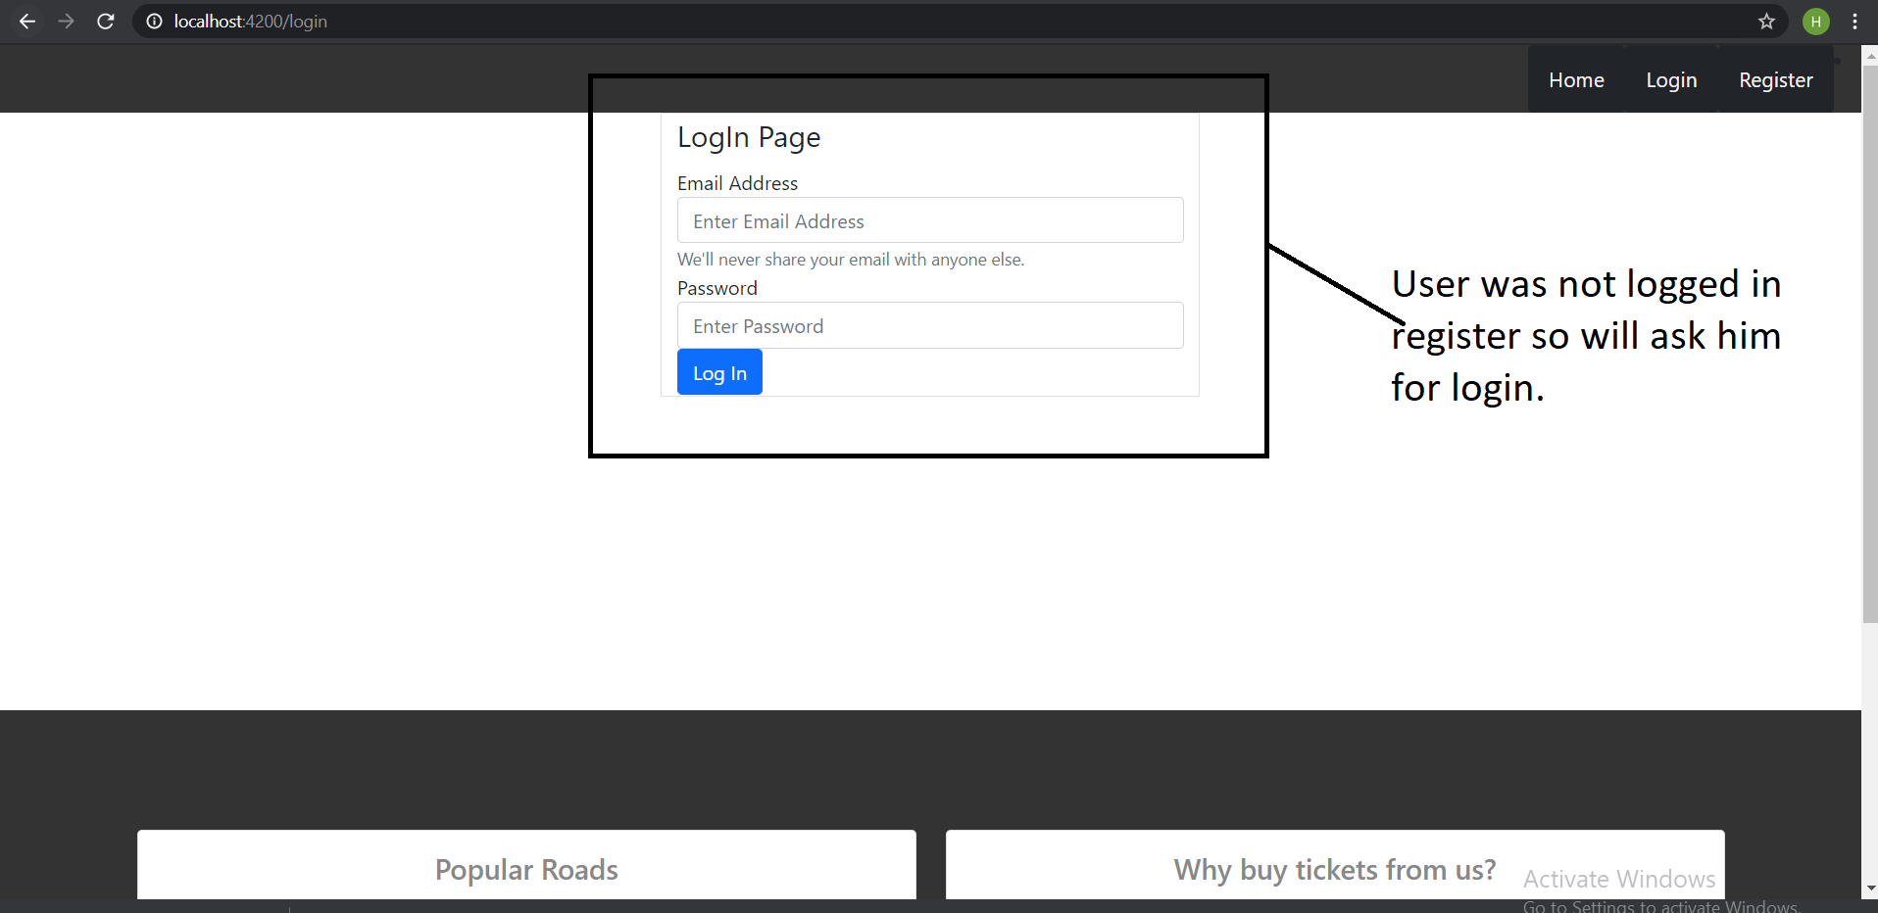
User was not logged in, so it will ask User to Login

Slide 13
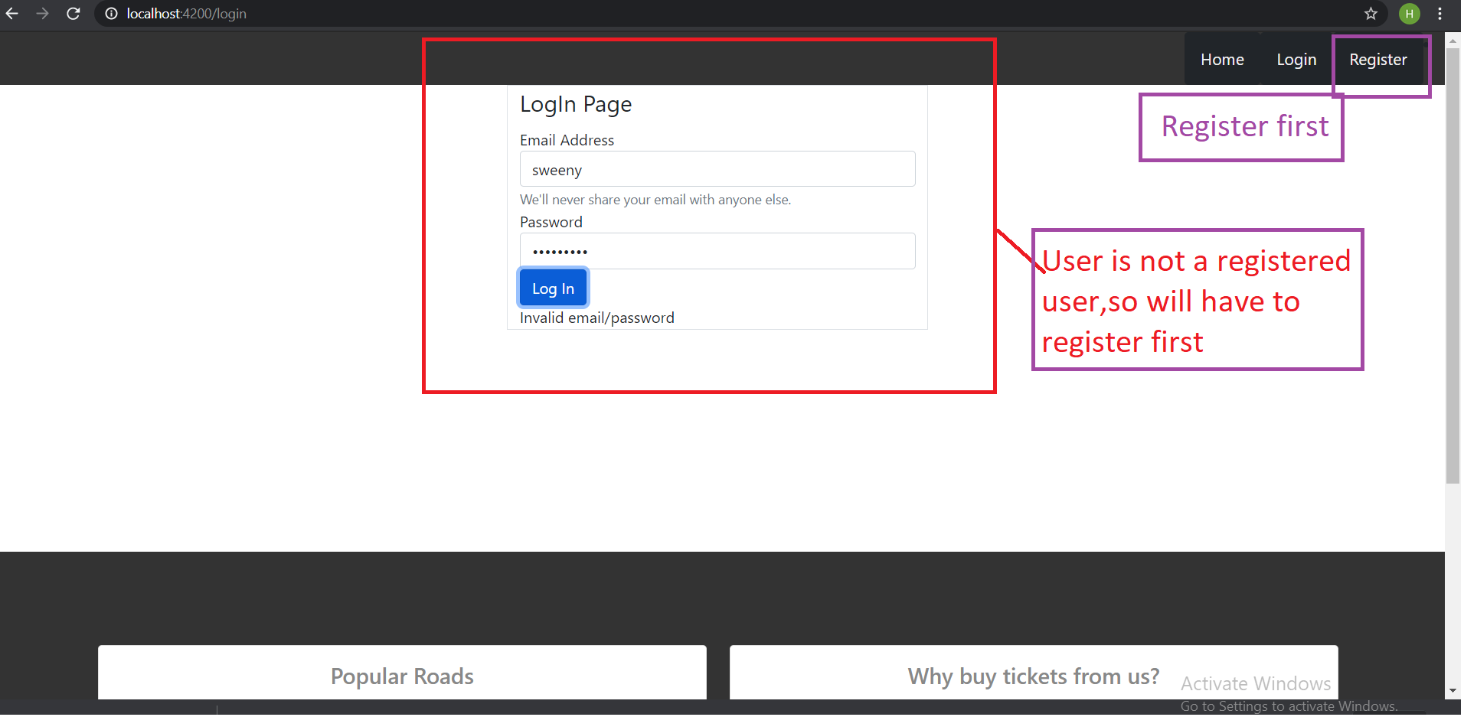

Slide 14
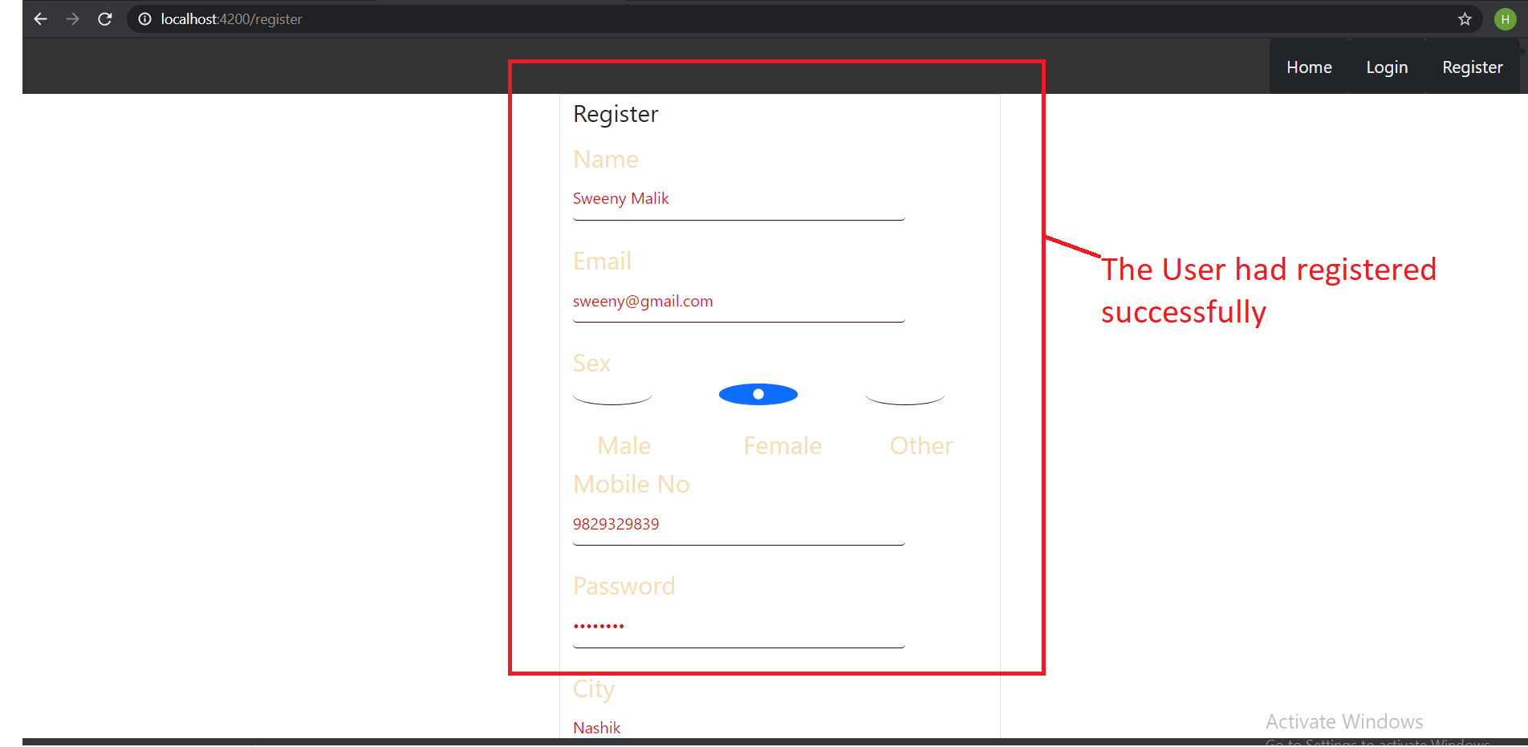

Slide 15
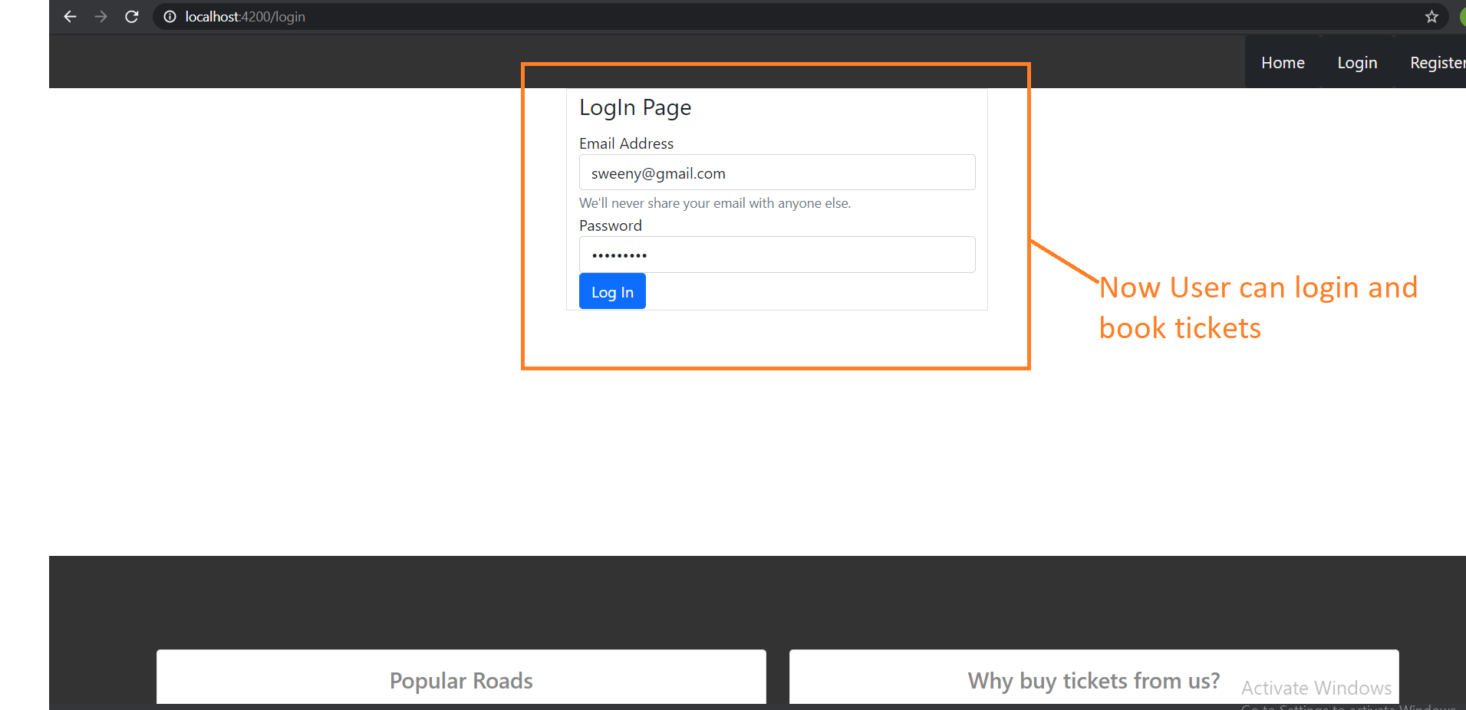

Slide 16
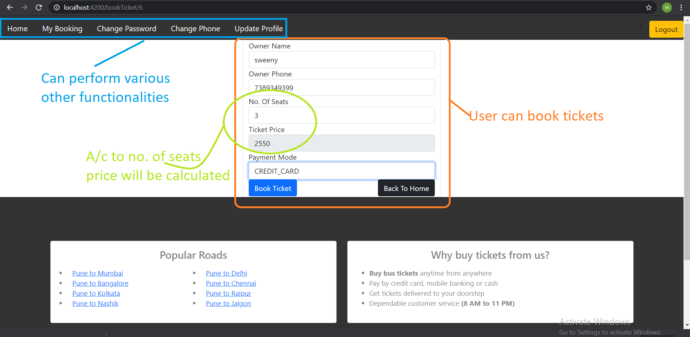

Slide 17
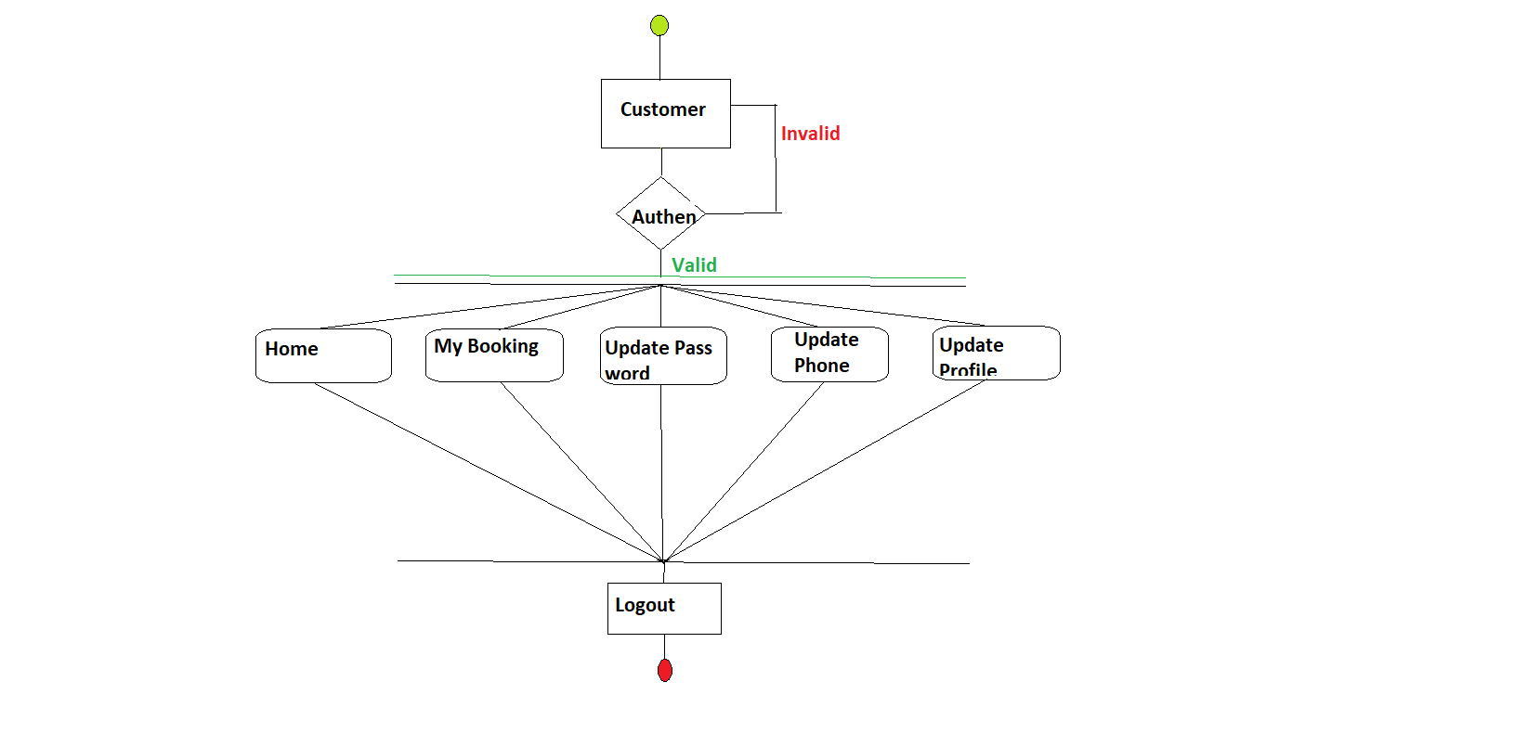
Activity Diagram for Customer

Slide 18
Features provided to Customer
The Customer can Update his profile.
Can see his Booking.
Can change password.
Can Book tickets.

Slide 19
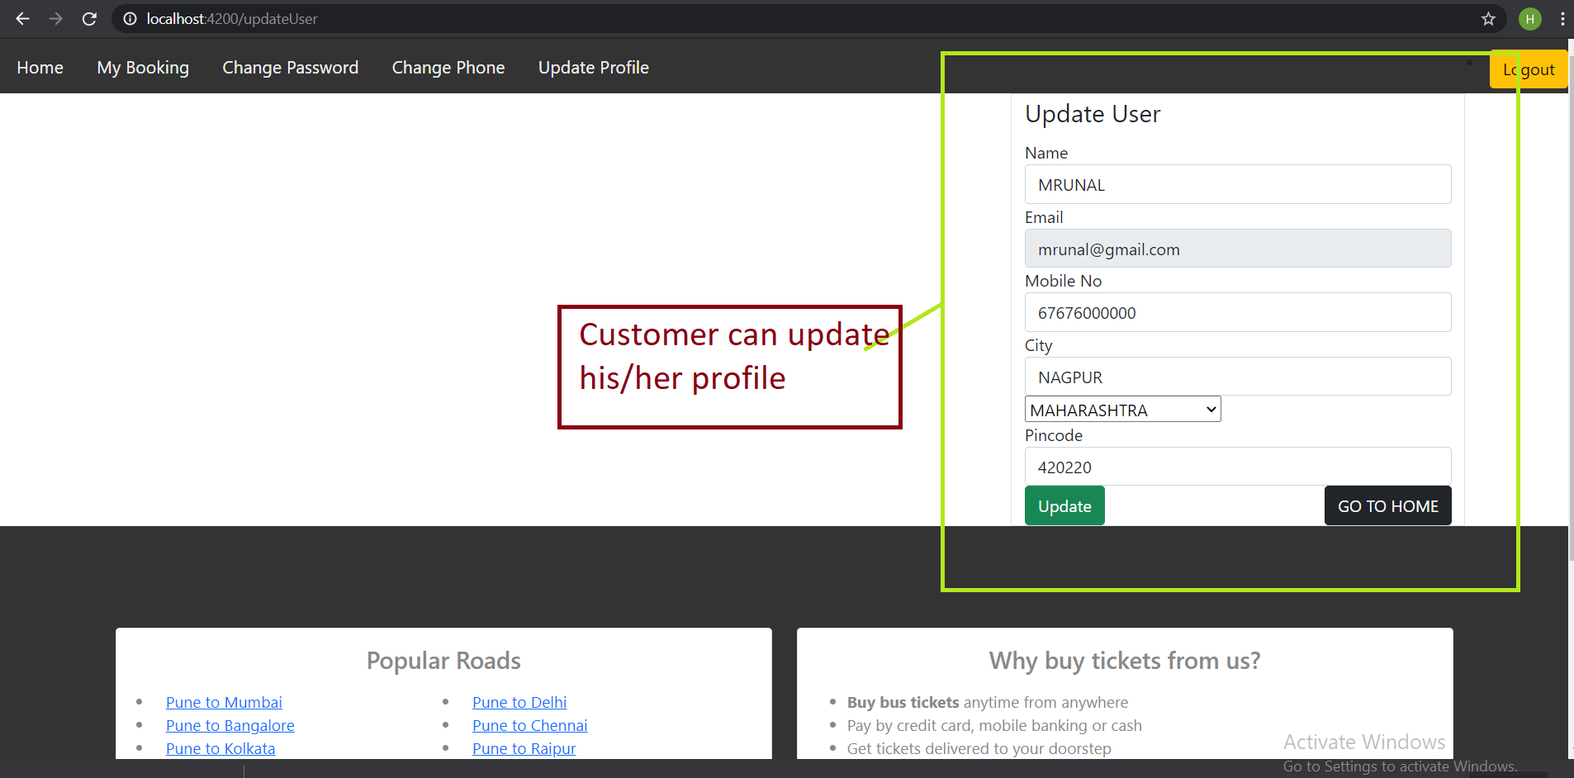

Slide 20
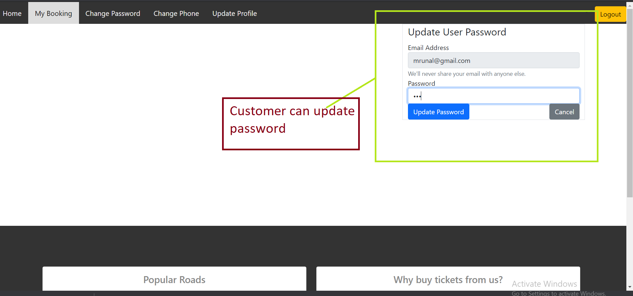

Slide 21
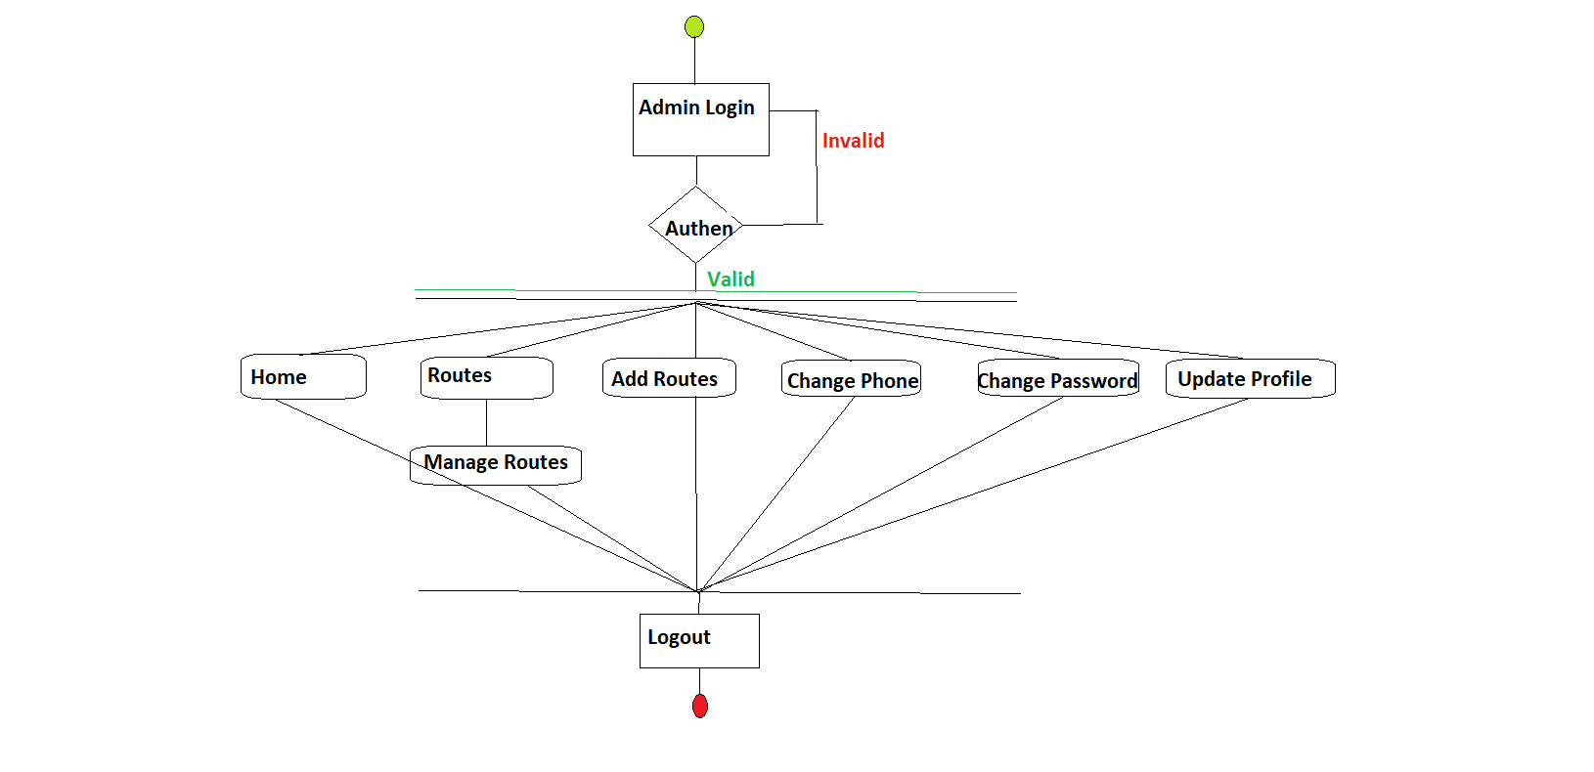
Activity Diagram of Admin

Slide 22
Features Provided to Admin
Add the route.
Delete the route.
Remove the bus from the route.
Update the bus details.
Update the route details.
Add the bus to specified route.
View the Total tickets booked,seats booked, etc.

Slide 23
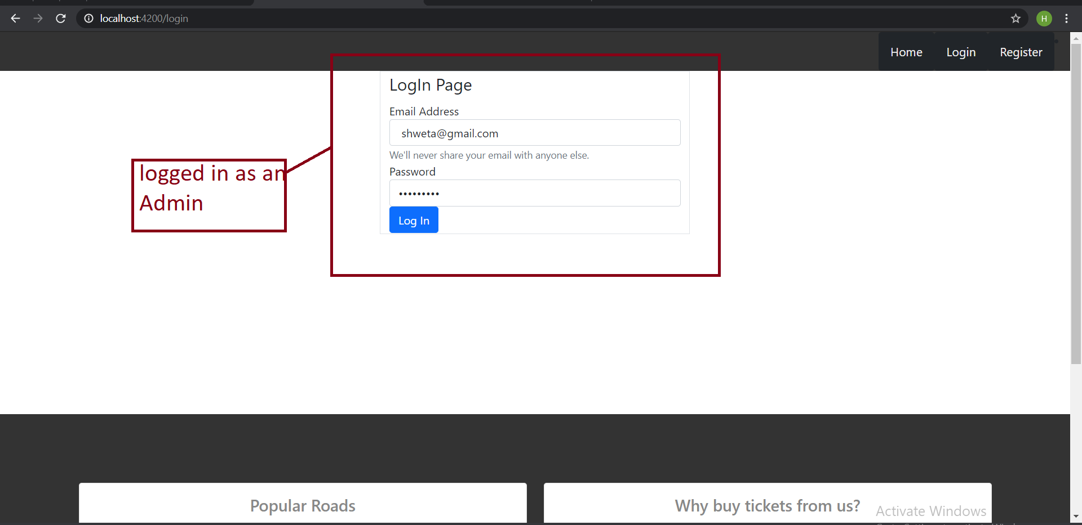

Slide 24
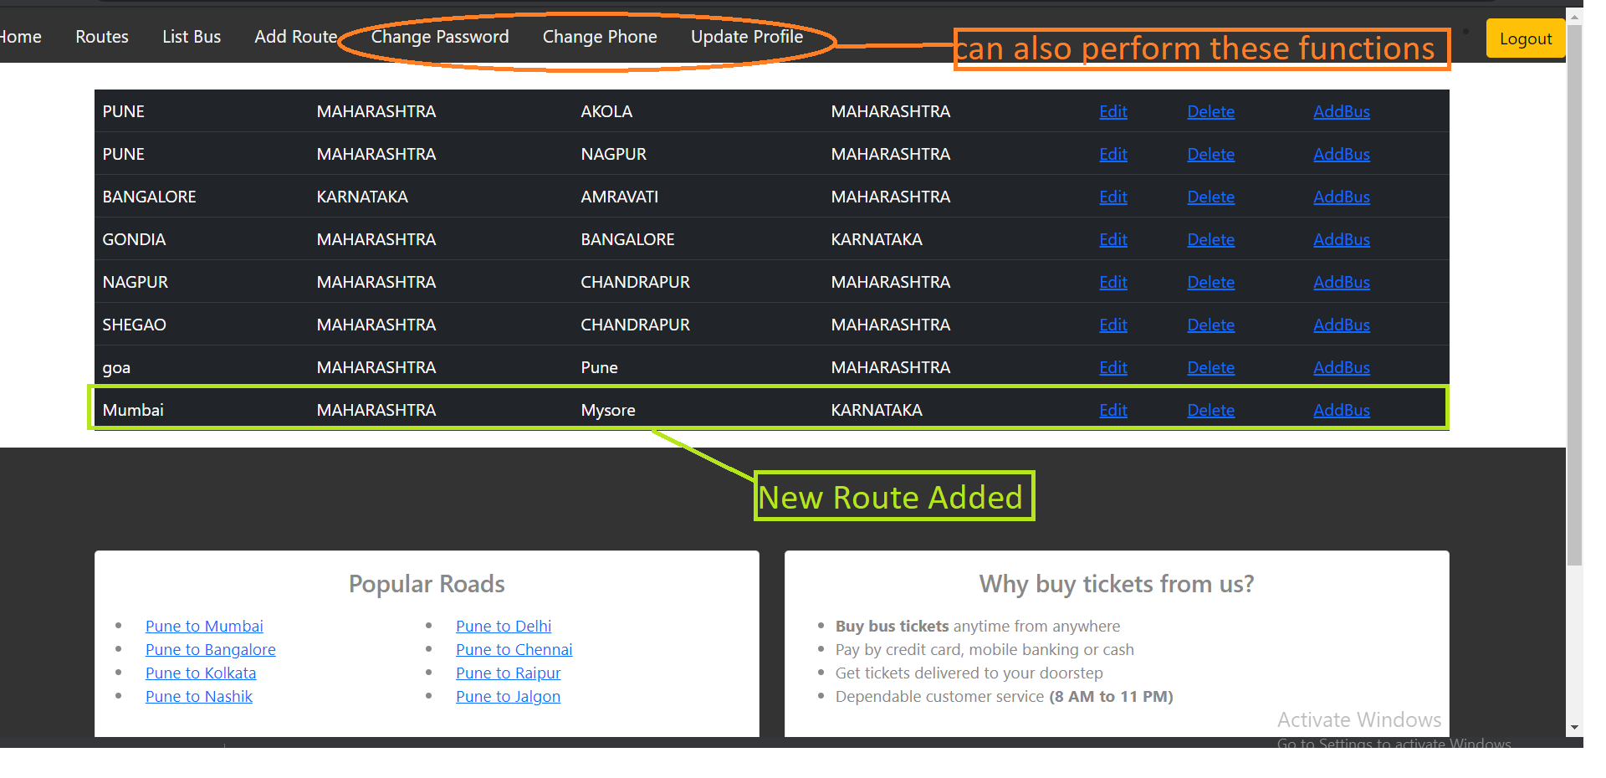

Slide 25
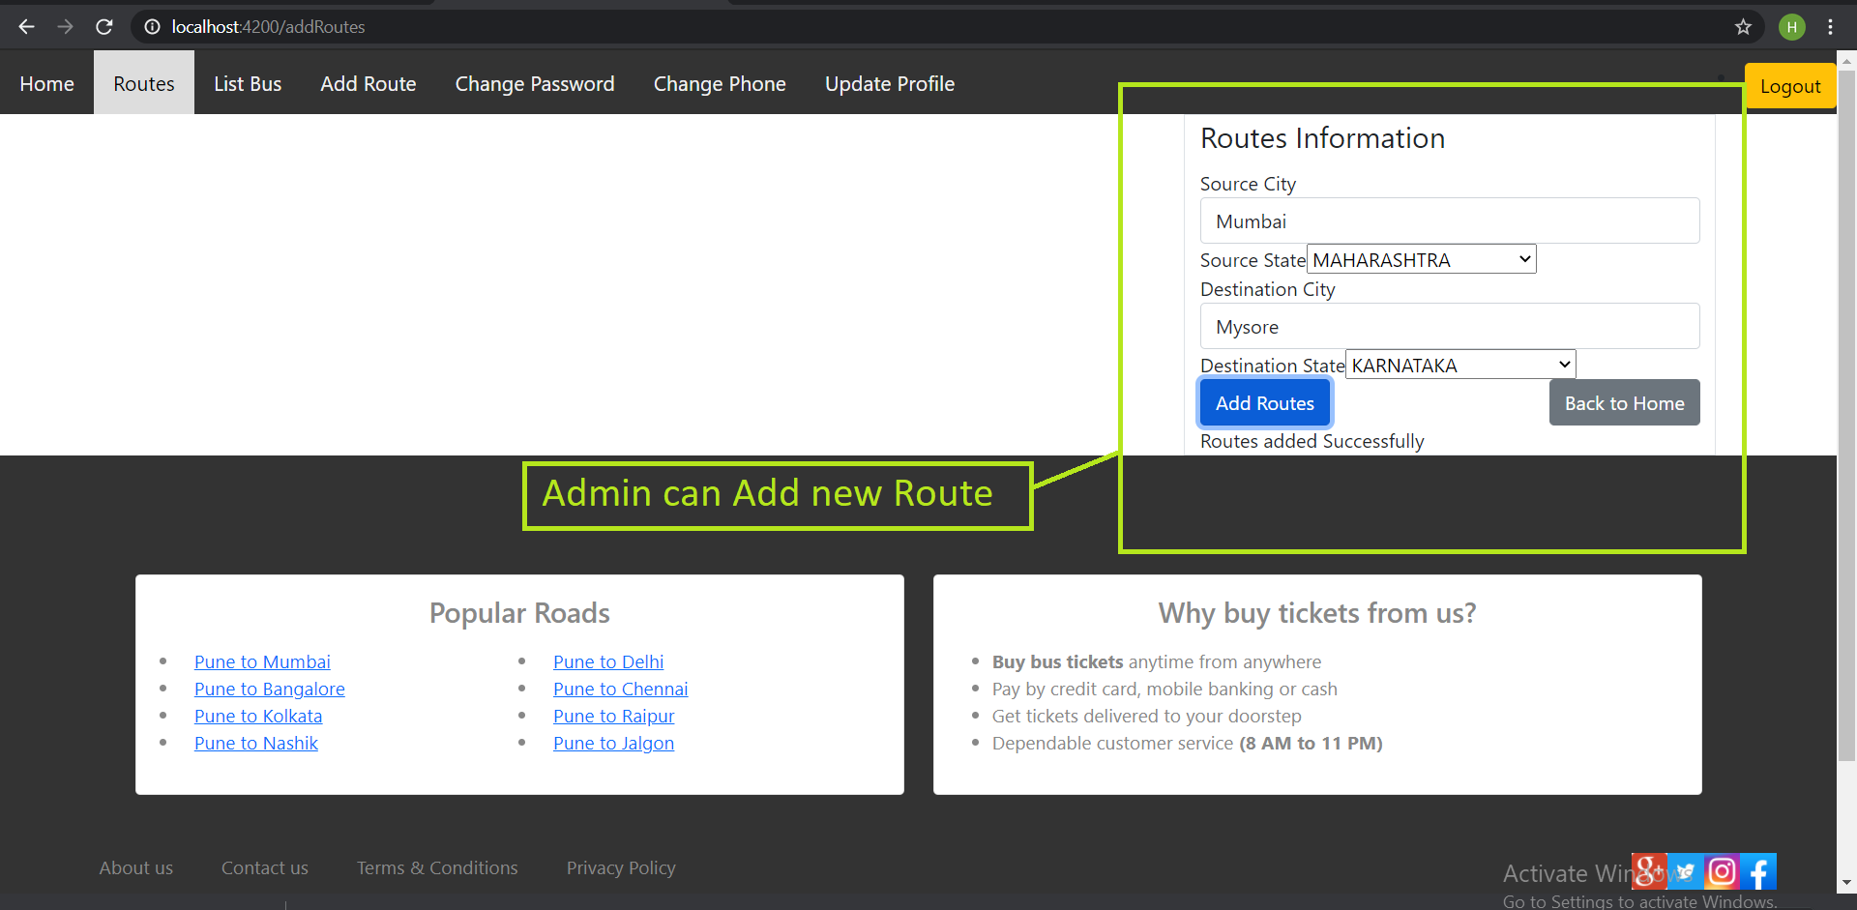

Slide 26
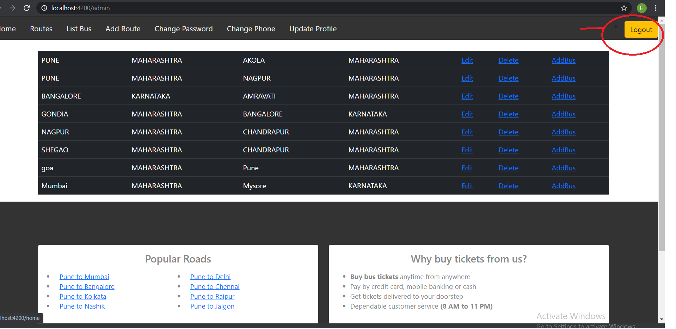

Slide 27
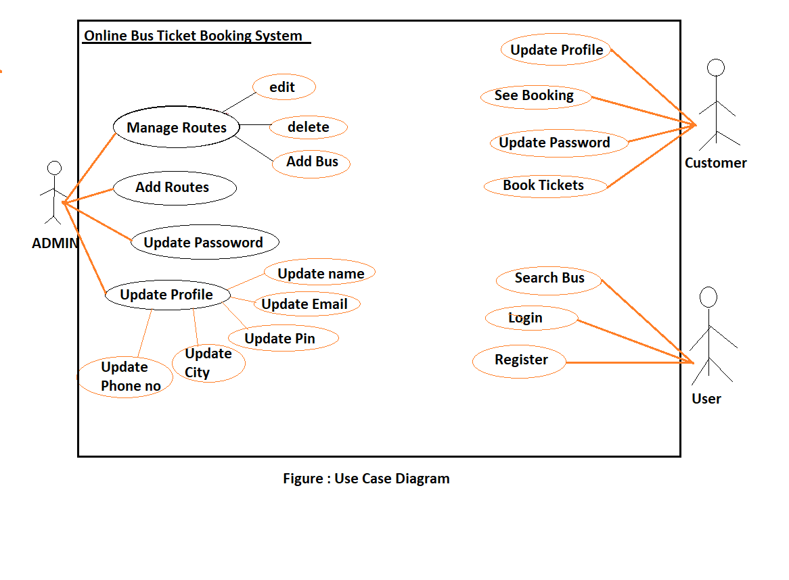
Use Case Diagram

Slide 28
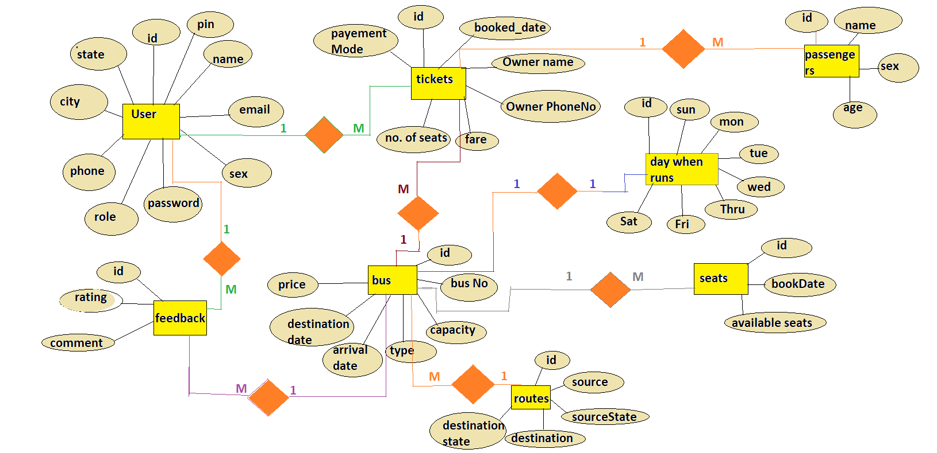
ER Diagram

Slide 29
Benefits of Online Ticket booking System
This system will help to maximize the number of Reservations.
Easy to Manage the calender.
Easy to Manage all the records.
This System is fully functional and flexible.
Easy to use.
Saves lot of time,money and Labour.
This Application acts as an office that is open 24/7.

Slide 30
CONCLUSION
In Online Bus Ticket Booking system ,we have developed a secure, user-friendly Website where user or visitors, can view and search the buses for specific route and can check seats available in the buses.
To access this system you only need a web browser, internet connection. Here we have maintained records of passenger details, seat availability, price per seat, bill generation and other things, we have developed computerized reservation system successfully.

Slide 31
Future Scope
➤This project can be enhanced further by adding the Agent Module to perform the agent related functionalities,The generated ticket can be sent on the email id of the customer.
➤The website is flexible enough to be modified and implemented as per future requirements.
➤We have tried our best to present this website.Messages and Email alerts for various things can be sent to the Users so that they cannot miss anything.
➤The offers information for various festival seasons can be send to the User.The payment related things can be upgraded .

Slide 32
REFERENCES
https://stackoverflow.com
https://www.javatpoint.com
https:docs//oracle.com
Geeksforgeeks
https://angular.io/api

Slide 33
Thank you

