Slide 1


Course Registration System
(using Core JAVA, Rest, Angular & SQL)
GROUP - 4

Slide 2
Framework for 6 Weeks
6 weeks plan (10th May 2022 – 20th June 2022)
Day to Day Discussion about cool industry Tools / Technologies and Doubt clearance.
Discussion of Project progress & transformation based on UML & Technologies happened every day with Professor.
- Started every morning session with review of progress report of project along with debugging and error solving if there’s any.
- Every session ends with a crystal clear description of the tasks that needs to be performed for project development.

Slide 3

WELCOME TO CRS
Notes:
Time – 1 min
Swati

Slide 4

Agenda
01
Our Journey
02
Agenda of Sessions
03
Project Goals
04
Tech Stack
05
Development
06
Challenges & Learnings
07
Demo
08
Questions
Notes:
Time – 1 min

Slide 5

OUR Journey
1)Understanding project goals
2)Decide the Technology
3)Design thinking
4)Development adaption
5)Project demo
Notes:
Time - 2 mins

Slide 6

Our team
SHALINI P S
HARSHADA BORSE
KIRTISH AJMERA
DUDEKULA SHAMSHAD
BASIREDDY SRAVANTHI
HARISH

Slide 7

Project Goals
Notes:
Time – 3 mins

Slide 8




Our Vision
To create a Course Registration System using Java development tools and technologies, REST and Visual. Couple it with MySQL where a user can have one of the 3 roles - Admin, Professor or Student and perform actions according to role.
All the functionalities like viewing courses, grades, recording grades, adding, deleting, viewing users and course by ADMIN needs to be implemented.
1
2
Quality
Security
3
4
Interactivity
Speed
Notes:
User satisfaction and brand value

Slide 9
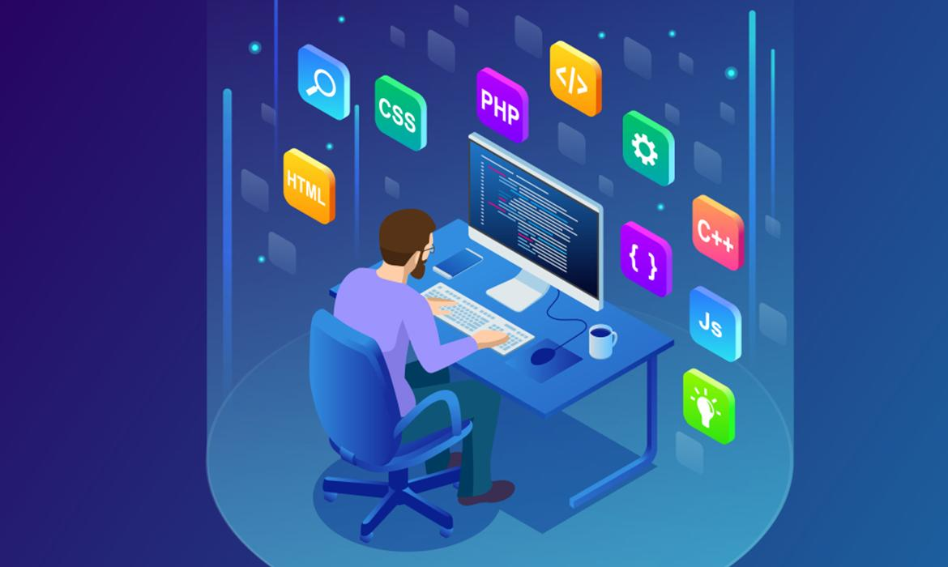
Tech Stack
Notes:
Time – 2 mins

Slide 10


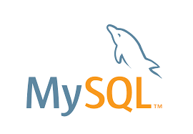






Backend
Data
Tools
FrontEnd
Core Language
VCS
HTML
SQL Database
Framework
CSS
JavaScript
Modelling
Notes:
Time – 1 min

Slide 11
The Eclipse IDE is rich features IDE that supports various programming features for the developers and ease their work for development of advanced application in eclipse platform. It is mostly preferred for the java-based application development. It supports various programming languages that make the platform favorable for the programmers to use for application development.

Slide 12
Spring Boot is an open source Java-based framework used to create a micro Service. It is developed by Pivotal Team and is used to build stand-alone and production ready spring applications. Spring Boot provides a good platform for Java developers to develop a stand-alone and production-grade spring application that you can just run. It increases productivity and reduces the development time

Slide 13
Angular is a development platform, built on TypeScript. As a platform, Angular includes
A component-based framework for building scalable web applications
A collection of well-integrated libraries that cover a wide variety of features, including routing, forms management, client-server communication, and more
A suite of developer tools to help you develop, build, test, and update your code

Slide 14

Development
Notes:
Time – 1 min

Slide 15
Design the flow of application with UML Artifacts
Understanding Problem Statement
Requirement understanding
Research
d Estimation
Project Planning
Project Grooming
Delivery
Project Implementation
Development
Apply the appropriate Design Pattern
Review
VC using GIT
Integrate
Deploy
Test
Notes:
Time – 1 min

Slide 16
UML DIAGRAMS

Slide 17
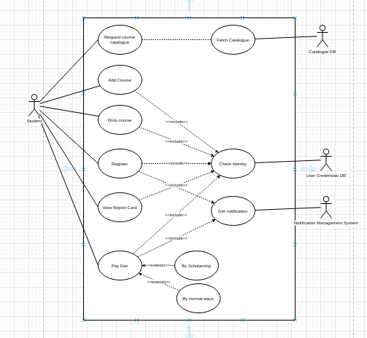
Use Case Diagram - Student

Slide 18
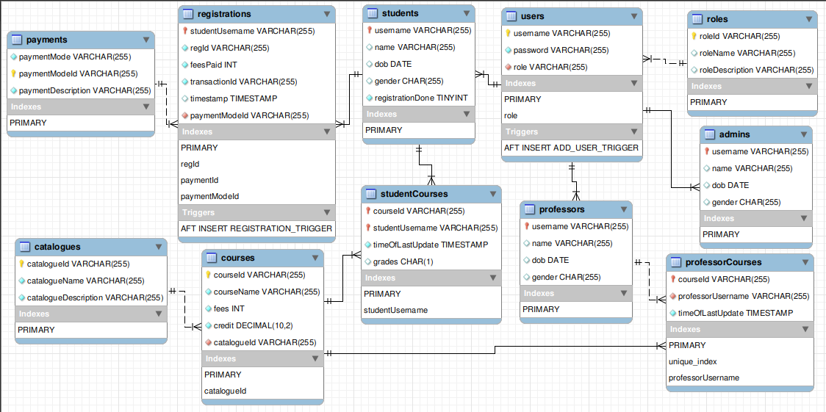
Database Schema

Slide 19
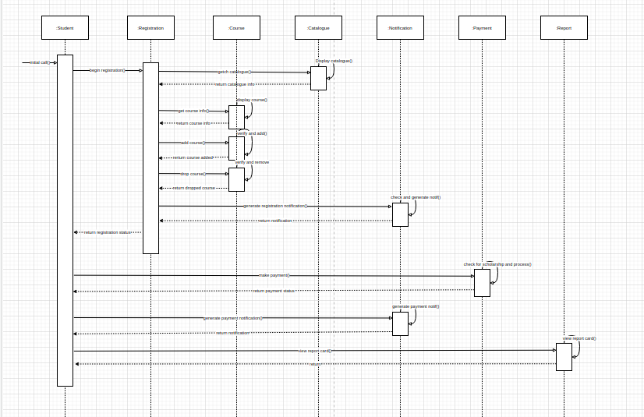
Sequence Diagram - Student

Slide 20
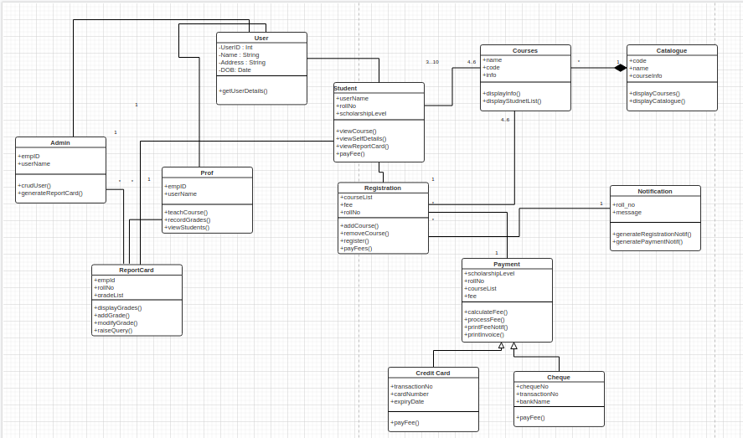
Class Diagram

Slide 21
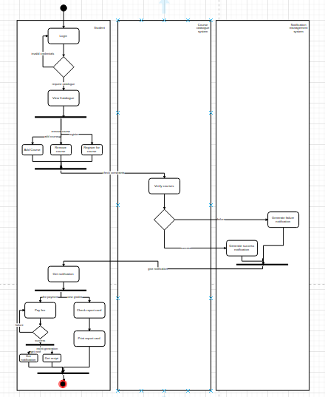
Activity Diagram - Student

Slide 22

Challenges & Learnings
Notes:
Time – 2 mins

Slide 23
LEARNING
Learning can happen virtually too.
Crystal clear thought process in designing UML diagrams.
Setting up the environment.
Better at writing clean and readable codes
Learn to use production technologies
CHALLENGES
Virtual Learning Experience
Setting the environment.
Initially had trouble in designing UML diagrams

Slide 24

Demo

Slide 25

Questions
Notes:
Time - ?

Slide 26

Thank you
Notes:
Time – After this show the testimonial video. 1 min

